Slide 1
Concluding Remarks P-OOK
Date: 2018-03-06
Authors:

Slide 2
Abstract
The idea of shortening the “on” period was initially proposed in [1], and we refer to it as P-OOK [2, 3]
It was verified by others in [4, 5]
Using P-OOK for the 62.5 kbit/s mode with a non-zero duration of 2 us provides a gain of 0.8-1.2 dB depending on receiver design. This comes without any additional complexity, i.e., “for free”

Slide 3
Simulation Setup
0
0
P-OOK
ON
OFF
ON
OFF
$$T_{b}$$
$$T_{Z}$$
$$T_{NZ}$$
1
1
P-OOK
OFF
ON
OFF
ON
$$T_{b}$$
$$T_{Z}$$
$$T_{NZ}$$
We use $T_{Z}=T_{NZ}=2us$, $T_{b}=4us$
4 MHz receiver

Slide 4
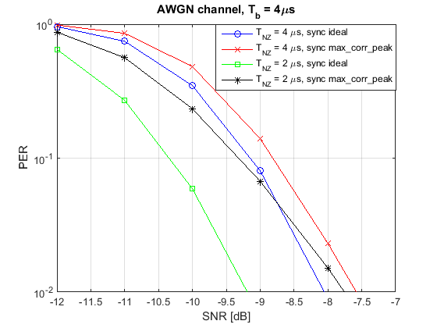
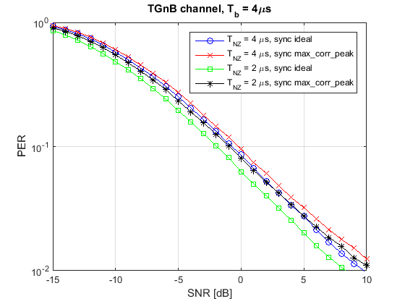
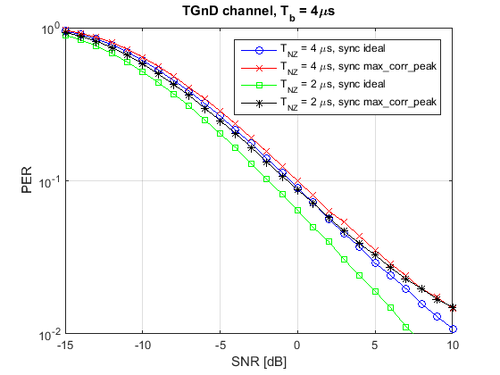
Performance for non-PA limited case
 | AWGN @ 10% PER | TGnB @ 10% PER | TGnD @ 10% PER
Correlation peak sync | +0.6 dB | +0.8 dB | +0.7 dB
Ideal sync | +1.2 dB | +1.7 dB | +1.5 dB

Slide 5
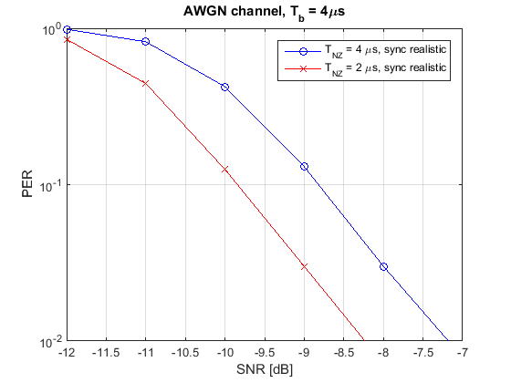
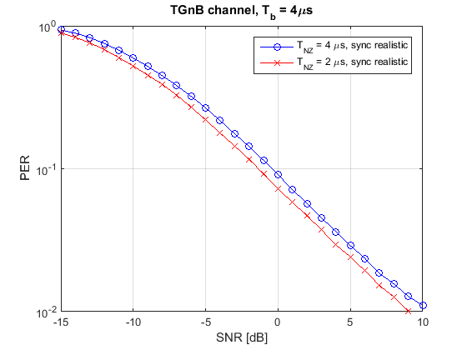
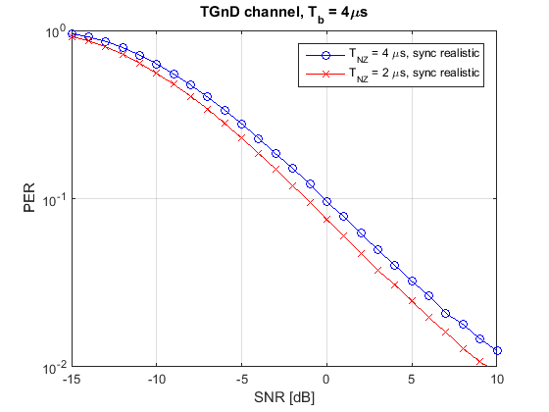
Performance for non-PA limited case with practical synchronization
 | AWGN @ 10% PER | TGnB @ 10% PER | TGnD @ 10% PER
Practical sync | +1.0 dB | +1.0 dB | +1.0 dB

Slide 6
Receiver window
0
0
$$T_{rec}$$
$$T_{rec}$$
1
1
$$T_{rec}$$
$$T_{rec}$$
What happens if we have a receiver window that is too wide?

Slide 7
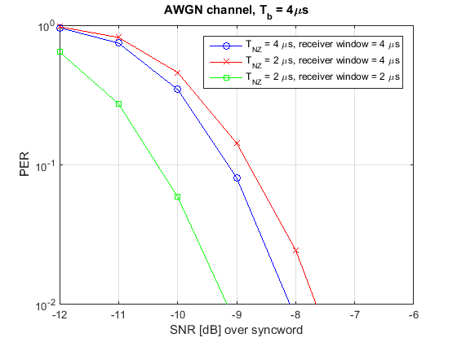
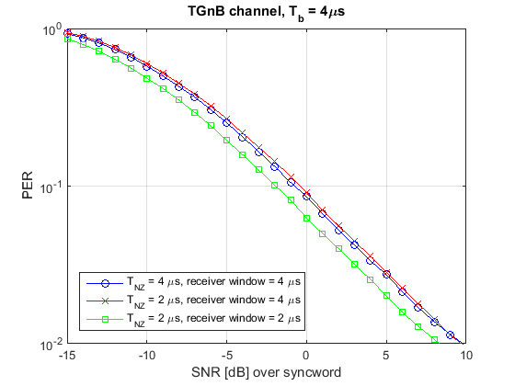
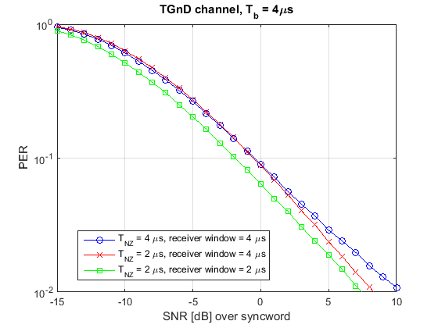
Performance for non-PA limited case including wider receiver window
A wider receiver window very slightly degrades the performance of the system

Slide 8
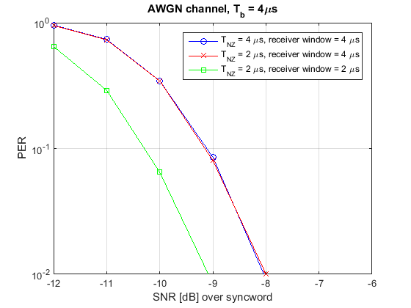
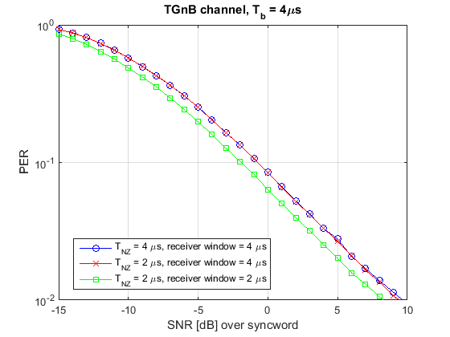
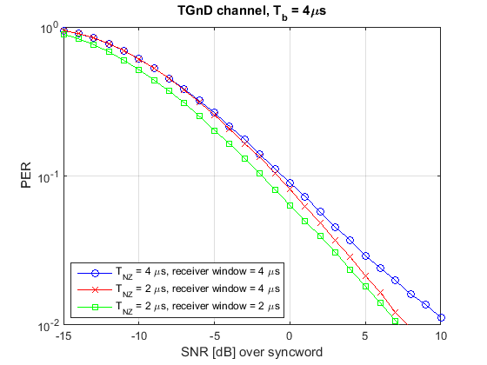
Performance for non-PA limited case including wider receiver window using a power detector
By using a power detector instead of envelope detector, a wider receiver window can be used without loss of performance

Slide 9
Observations using P-OOK with 2us symbols for the 62.5 kbit/s case
By tuning the receiver, it is expected that performance gains of 1 dB can be attained
This tuning of the receiver does not require any additional complexity (e.g. choosing good receiver parameters)
Even without any tuning in the receiver, P-OOK does not degrade performance noticeably

Slide 10
References
[1] 0696r0 – Blank GI for the Waveform Coding
[2] 1673r1 – Partial OOK - Generalizing the Blank GI Idea
[3] 0142r3 – Additional Results for 62.5 kb/s: Symbol Structure and P-OOK
[4] 0071r0 – Performance Investigation on Partial OOK
[5] 0124r0 – Shorter ‘On’ Time Duration Study

