Slide 1
Concluding Remarks P-OOK
Date: 2018-03-DD
Authors:

Slide 2
Abstract
The idea of shortening the “on” period was initially proposed in [1], and we refer to it as P-OOK [2, 3]
It was verified by others in [4, 5]
Using P-OOK for the 62.5 kbit/s mode with a non-zero duration of 2 us provides a gain of 0.8-1.2 dB depending on receiver design. This comes without any additional complexity, i.e., “for free”

Slide 3
Simulation Setup
0
0
P-OOK
ON
OFF
ON
OFF
$$T_{b}$$
$$T_{Z}$$
$$T_{NZ}$$
1
1
P-OOK
OFF
ON
OFF
ON
$$T_{b}$$
$$T_{Z}$$
$$T_{NZ}$$
We use $T_{Z}=T_{NZ}=2us$, $T_{b}=4us$

Slide 4
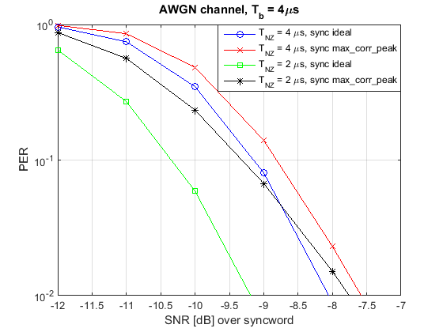
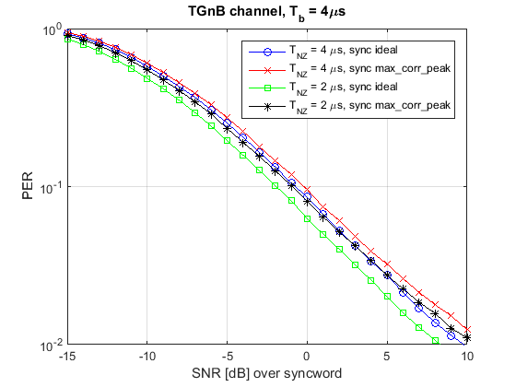
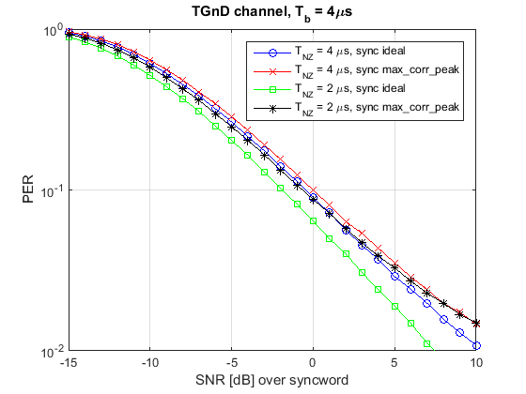
Performance for non-PA limited case
 | AWGN @ 10% PER | TGnB @ 10% PER | TGnD @ 10% PER
Practical sync | +0.6 dB | +0.8 dB | +0.7 dB
Ideal sync | +1.2 dB | +1.7 dB | +1.5 dB

Slide 5
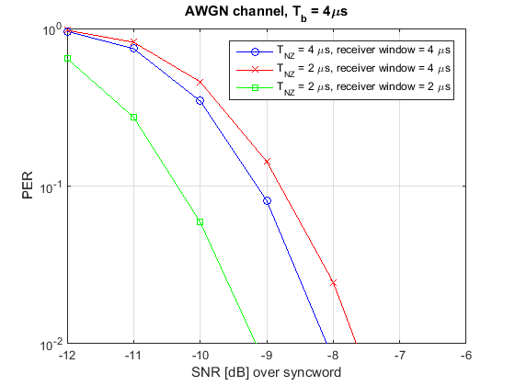
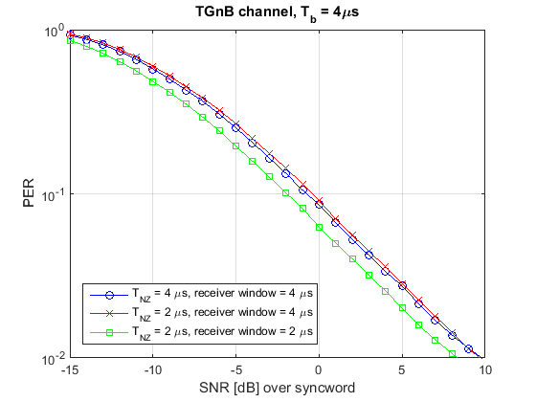
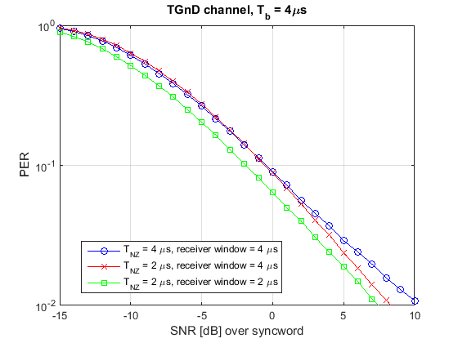
Performance for non-PA limited case including wider receiver window
A wider receiver window slightly degrades the performance of the system

Slide 6
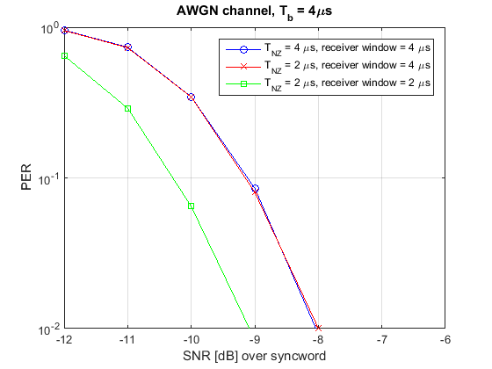
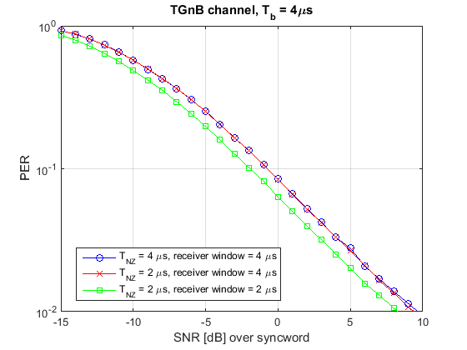
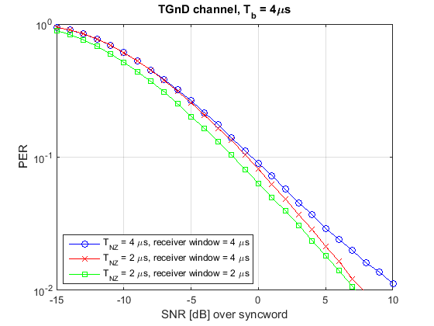
Performance for non-PA limited case including wider receiver window using a power detector
By using a power detector instead of envelope detector, a wider receiver window can be used without loss of performance

Slide 7
Observations using P-OOK with 2us symbols for the 62.5 kbit/s case
By tuning the receiver, it is expected that a performance gains exceeding 1 dB can be attained
This tuning of the receiver is does not require any additional complexity (e.g. choosing good receiver parameters)
Furthermore, using power detection can in some cases further improve the performance when using P-OOK

Slide 8
References
[1] 0696r0 – Blank GI for the Waveform Coding
[2] 1673r1 – Partial OOK - Generalizing the Blank GI Idea
[3] 0142r3 – Additional Results for 62.5 kb/s: Symbol Structure and P-OOK
[4] 0071r0 – Performance Investigation on Partial OOK
[5] 0124r0 – Shorter ‘On’ Time Duration Study

