Slide 1
Efficient Signaling for TDD MU BF
Date: 2018-03-02
Authors:

Slide 2
Introduction
A TDD MU Beamforming for distributed network was proposed in order to improve the time efficiency.
In the TDD MU BF, the information of multiple responders should be included into a TDD SSW frame.
  However, the overhead tends to be increased for the more number of responders.
So, we investigate the overhead and propose the method to reduce overhead.

Slide 3
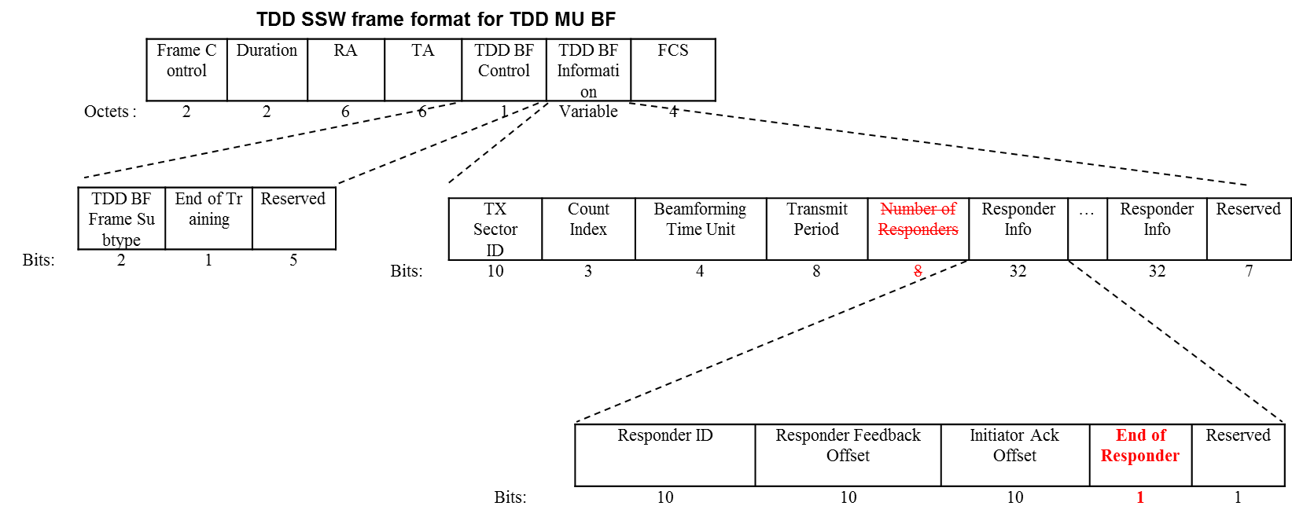
Proposed TDD SSW for MU
The number of Responders field does not be needed if the Responder Info field can indicate whether this is the end of the Responder Info field by adding End of Responder field.
  We can save 1 octet compared to previous TDD SSW frame.

Slide 4
Overhead analysis
Due to LDPC encoding process(block-wise encoding), even 1 octet can increase PPDU duration significantly.
  Considering 32 spreading of control PHY and the number of training sectors, overhead becomes more severe.
There are factors which affect the overhead.
  The number of responders
  The number of training sectors
So, we investigate the overhead depending on the factors above.

Slide 5
Overhead analysis
(TDD slot duration)
When the number of responders is 11, 32, 53, 74, 95, 116, 137, 158, 179, 200, 221, and 242, proposed TDD SSW frame needs one less LDPC codeword for encoding compared to existing TDD SSW frame.
When the number of responders is 11.
  TXTIME[TDD SSW for MU] of existing frame = 30.56us
  TXTIME[TDD SSW for MU] of proposed frame = 27.35us
  We can save about 3us TDD slot duration per each TDD SSW frame.
When the TDD slot duration is longer than 113us and less shorter than 125us,
  The maximum number of transmission of exiting TDD SSW frame is 3.
  The maximum number of transmission of proposed TDD SSW frame is 4.
  We can transmit one more TDD SSW frame.

Slide 6
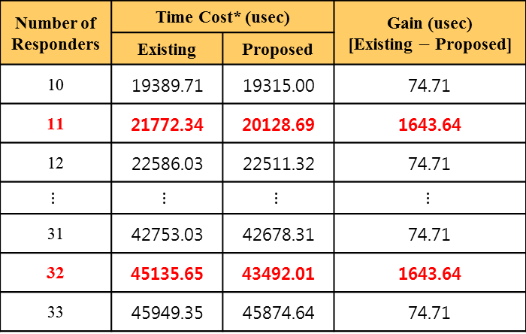
Overhead analysis
(Number of responders)
The time cost of proposed frame is decreased when the number of responders is 11, 32, 53, 74, 95, 116, 137, 158, 179, 200, 221, and 242.
Number of Responders | Time Cost* (usec) |  | Gain (usec) [Existing $−$ Proposed]
 | Existing | Proposed
10 | 19389.71 | 19315.00 | 74.71
11 | 21772.34 | 20128.69 | 1643.64
12 | 22586.03 | 22511.32 | 74.71
$$⋮$$ | $$⋮$$ | $$⋮$$ | $$⋮$$
31 | 42753.03 | 42678.31 | 74.71
32 | 45135.65 | 43492.01 | 1643.64
33 | 45949.35 | 45874.64 | 74.71
*Assumption and configuration [1]
: 16 TX Beams, and repeat TDD SSW frame 32 times for each TX Beam
*Time Cost
= {TXTIME[TDD SSW for MU]*32 + SBIFS*(32-1) + TXTIME[TDD SSW Feedback]*N_Responders + TXTIME[TDD SSW ACK]*N_Responders + SBIFS*(N_Responders-1) + SBIFS*(N_Responders-1)} * 16

Slide 7
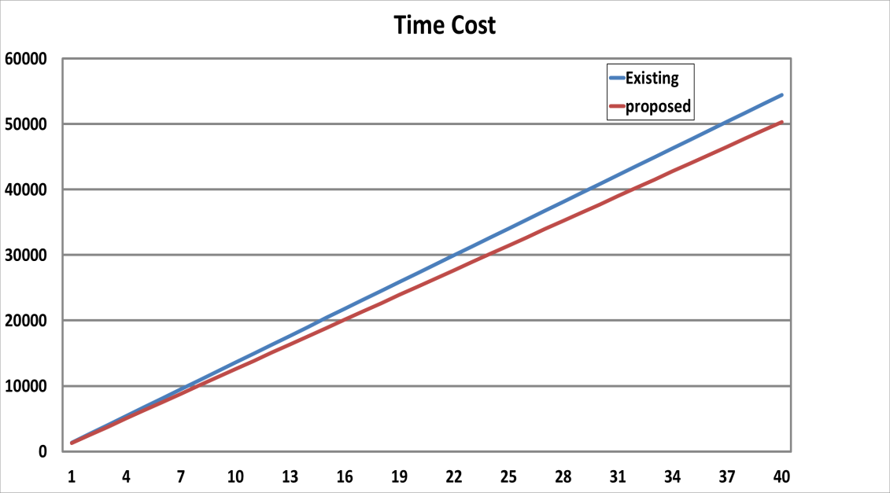
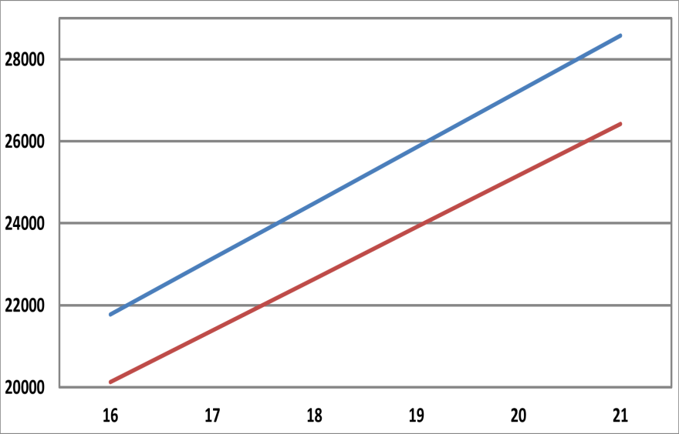

Overhead analysis
(Number of training sectors)
The time cost of proposed frame is decreased as the number of training sectors is increased.
(usec)
$≈$2 ms
(sectors)
*Assumption and configuration:
- Repeat TDD SSW Frame 32 times for each TX Beam
- The number of responders is 11.

Slide 8
Conclusion
A TDD SSW frame for MU improves time efficiency for a case in which the initiator perform BF training with multiple responders.
In terms of time efficiency, the existing TDD SSW frame for MU needs to be modified.
The proposed TDD SSW frame for MU can make the time cost reduced.

Slide 9
Reference
[1] 11-18-0175-01-00ay-bf-training-enhancement-for-mmwave-distribution-networks

Slide 10
Appendix
TXTIME[TDD SSW for MU]
= 𝑇_(𝑆𝑇𝐹−𝐶𝑃)+𝑇_(𝐶𝐸−𝐶𝑃)+(11×8+(𝐿𝑒𝑛𝑔𝑡ℎ−6)×8+𝑁_𝐶𝑊×168)×𝑇_𝐶×32+𝑁_𝑇𝑅𝑁×𝑁_(𝑇𝑅𝑁−𝑈𝑛𝑖𝑡)
TXTIME[TDD SSW for MU] when the number of responders is 11,
  Using existing TDD SSW frame:
  = 3.636us + 0.655us+(11×8+(70-6)×8+5×168)×0.57ns×32 = 30.56us
  Using proposed TDD SSW frame:
  = 3.636us + 0.655us+(11×8+(69-6)×8+4×168)×0.57ns×32 = 27.35us

Slide 11
SP
Do you agree that the End of Responder field(1bit) is used for indicating the end of Responder Info fields in the TDD SSW frame instead of using the Number of Responders field?

