Slide 1
Channel Measurement for TDD Slots
Date: 2018-03-02
Authors:

Slide 2
Introduction
Channel measurement request and response between DN and CN can be useful to enhance the scheduling of TDD slots.
In this contribution, we propose an channel measurement method suited to the scheduling of TDD slots.

Slide 3
Channel measurement of TDD slot units
The TDD SP structure is composed of multiple TDD slots.
A DN schedules TDD slots to each DN/CN and then the each DN/CN can transmit/receive within the assigned slot.
If the DN knows CN’s channel quality as a unit of TDD slot, the scheduling of TDD slots can be enhanced.
Therefore, the channel measurement as a unit of TDD slot is suitable to the TDD slot structure.

Slide 4
Existing channel measurement frame
The duration of an individual measurement unit has even duration within Measurement Duration.
Not suitable to the TDD SP.

Slide 5
Issues for existing channel measurement frame
If we want to perform channel measurement for TDD slot structure, measurement duration or measurement unit should be aligned with the slot duration for accurate measurement.
However, it can be hard to align with the each slot duration by using existing channel measurement frame.
Following next 3 slides show why the existing channel measurement frame is not suitable to the TDD slot structure.

Slide 6
Issue of reusing existing frame (Case 1)
Case 1: When the measurement unit is same duration as TDD slot 1.
TDD slot 2 cannot be measured properly since Measurement unit 2 includes the part of duration of TDD slot 3.
TDD slot 3 cannot be measured accurately since Measurement unit 3 is shorter than the duration of TDD slot 3.

Slide 7
Issue of reusing existing frame (Case 2)
Case 2: When measurement unit is same duration with the shortest TDD slot(=TDD slot 2) or greatest common denominator(G.C.D.).
All TDD slots cannot be measured properly since each Measurement unit is not aligned with TDD slots.
If many TDD slots exist in TDD SP, feedback overhead can be large.
E.g.) - TDD slot 1 duration: 66us, TDD slot 2 duration: 10us, TDD slot 3 duration: 100us,
- measurement duration: 176us
- G.C.D: 2us
→ the number of measurement unit : 176/2=88 (it requires too much feedback information)

Slide 8
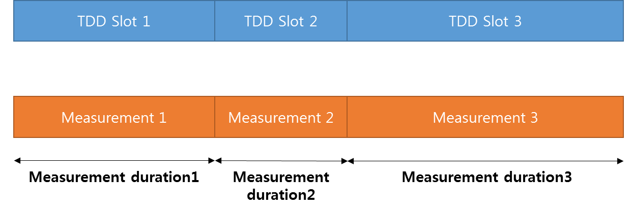
Issue of reusing existing frame (Case 3)
Case 3: When channel measurement frame is transmitted individually for each TDD slot.
If many TDD slots exist in TDD SP, many measurement request frame should be transmitted. It is not efficient.
E.g.) - TDD SP duration: 6ms
- each TDD slot duration: 60us
→ the number of required measurement request frame: 6000/60=100 (too many transmissions)

Slide 9
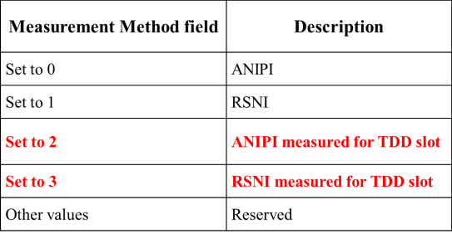
Proposed channel measurement for TDD slots
Measurement Method field: If this field is set to 2, it indicates ANIPI during the duration of the requested measurement, in units of 1 µs. If this field is set to 3, it indicates RSNI during the duration of the requested measurement, in units of 1 µs
Measurement Duration field: If the Measurement Method field is set to 2 or 3, The Measurement Duration field is set to the duration of the requested measurement, in units of 1 µs (TU/1024).
Number of Time Blocks field: If the Measurement Method field is set to 2 or 3, the Number of Time Blocks field indicates the number of TDD slots within the Measurement Duration.

Slide 10
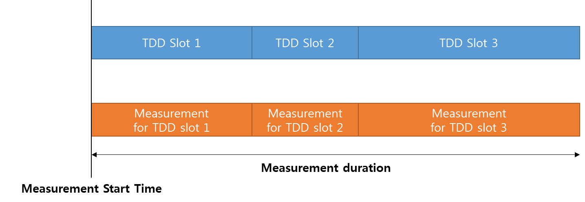
Example of channel measurement for TDD slots
Measurement Method field: sets to 2 or 3, it indicates channel measurement for TDD slots.
Measurement Start Time field: indicates the beginning of the TDD slot 1.
Measurement Duration field: from the beginning of TDD slot 1 to the end of TDD slot 3, in units of 1 µs (TU/1024).
Number of Time Blocks field: sets to 3, it indicates the number of TDD slots during measurement duration.

Slide 11
Conclusion
The channel measurement as a unit of TDD slot can make the mmWave distribution networks enhanced.
However, the existing channel measurement frame is not suitable to the TDD slot structure.
In this contribution, we proposed the channel measurement method for TDD slots by using modified channel measurement frame.

Slide 12
SP
Do you agree to add the proposed channel measurement method for TDD slots described in “11-18-0451-00-00ay-Channel measurement for TDD slots” into the draft?

