Slide 1
Differential feedback for compressed beamforming in OFDM mode
Date: 2018-03-06
Authors:

Slide 2
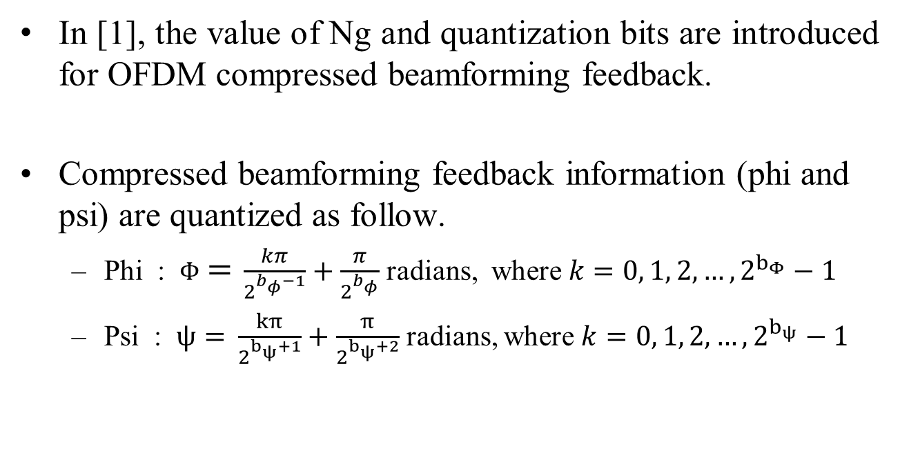
Introduction(1/2)
In [1], the value of Ng and quantization bits are introduced for OFDM compressed beamforming feedback.
Compressed beamforming feedback information (phi and psi) are quantized as follow.
  Phi : $Φ=$ $\frac{kπ}{2^{b_{φ}−1}}+\frac{π}{2^{b_{φ}}}$ radians, where $k=0, 1, 2, …, 2^{b_{Φ}}−1$
  Psi : $ψ=$ $\frac{kπ}{2^{b_{ψ}+1}}+\frac{π}{2^{b_{ψ}+2}}$ radians, where $k=0, 1, 2, …, 2^{b_{ψ}}−1$

Slide 3
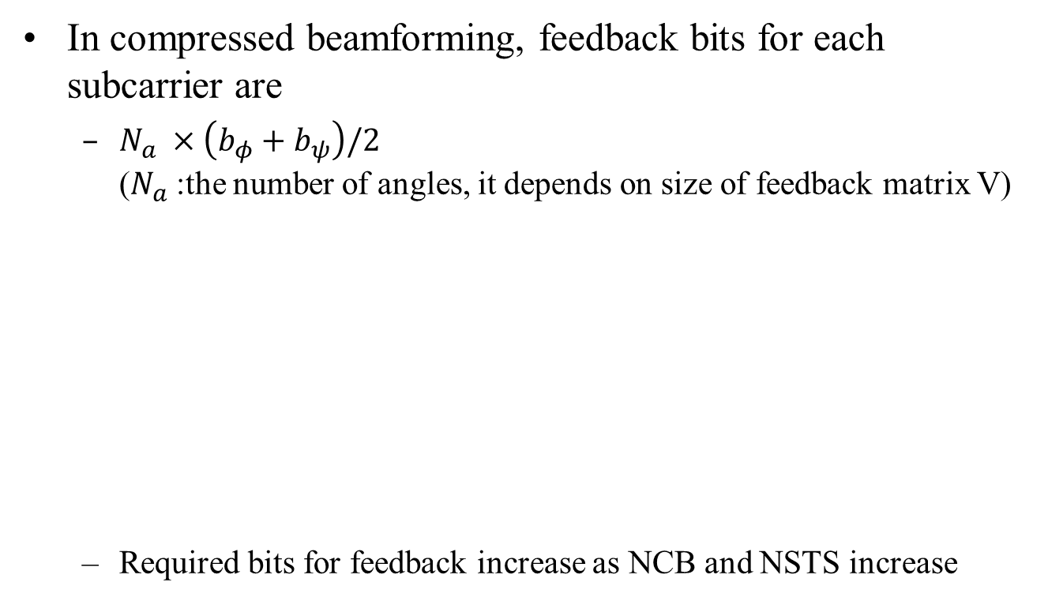
Introduction(2/2)
In compressed beamforming, feedback bits for each subcarrier are
  $N_{a} ×\left(b_{φ}+b_{ψ}\right)/2$
  ($N_{a}$:the number of angles, it depends on size of feedback matrix V)
  Required bits for feedback increase as NCB and NSTS increase
2x2 MIMO Ng=2 | Phi (bits) | Psi (bits) | Total (bits)
NCB=1 | 178*6 = 1068 | 178*4 = 712 | 1780
NCB=2 | 388*6 = 2328 | 388*4 = 1552 | 3880
NCB=3 | 598*6 = 3588 | 598*4 = 2392 | 5980
NCB=4 | 808*6 = 4848 | 808*4 = 3232 | 8080

Slide 4
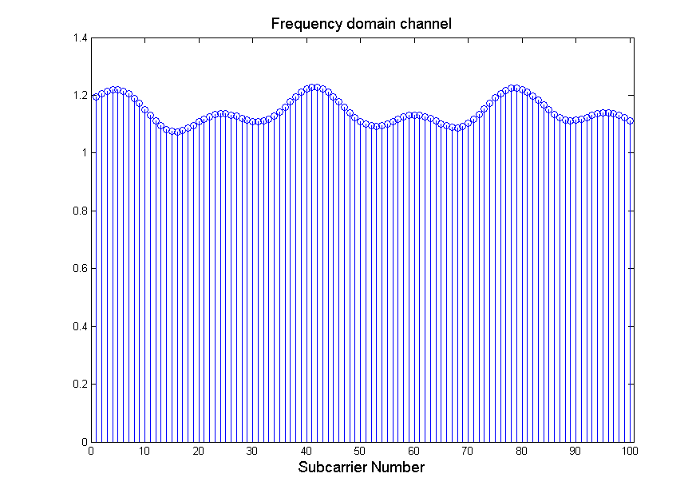
Observation Points(1/2)
  There exist 11ay CR channels that have relatively lower frequency selectivity as can be seen below
  For this reason, we investigate quantized phi and psi

Slide 5
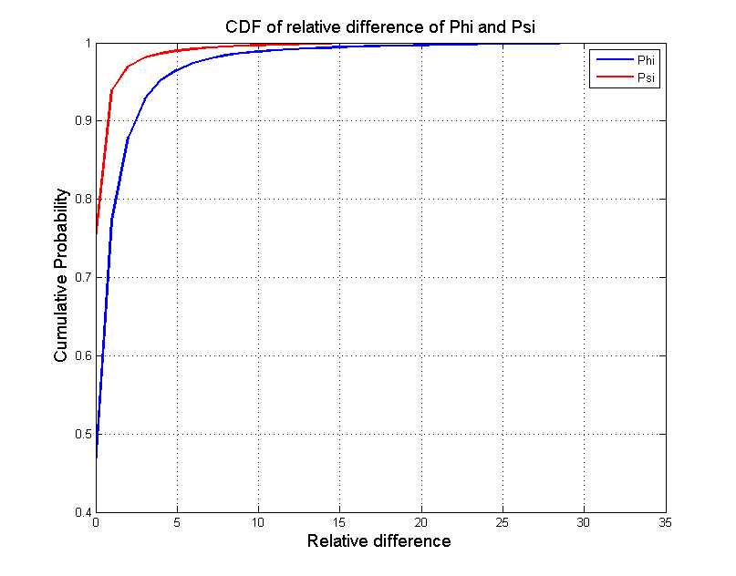
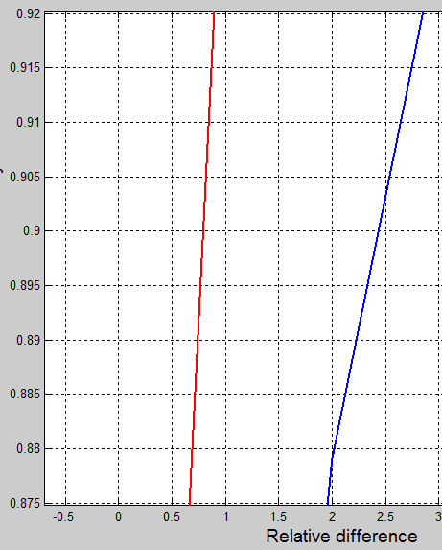
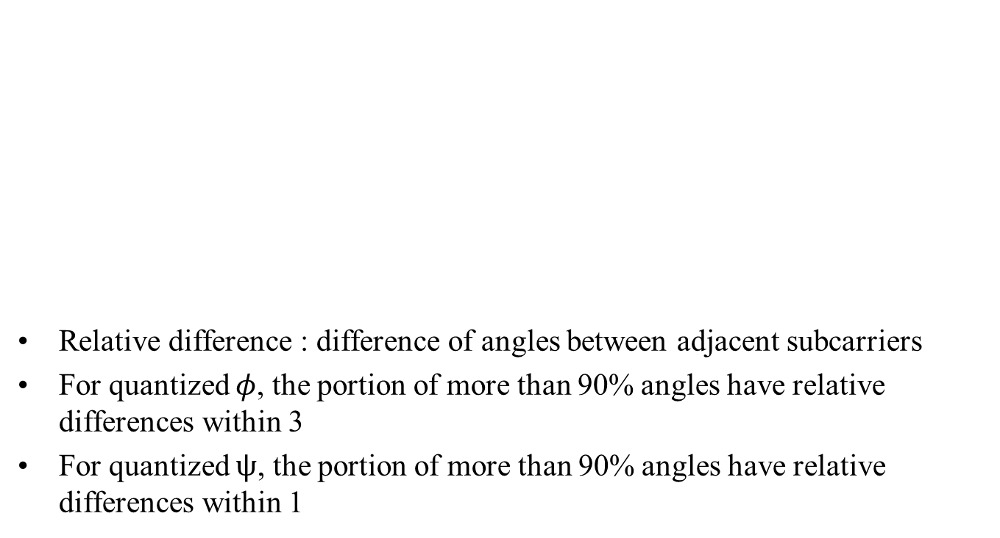
Observation Points(2/2)
Relative difference : difference of angles between adjacent subcarriers
For quantized $φ$, the portion of more than 90% angles have relative differences within 3
For quantized $ψ$, the portion of more than 90% angles have relative differences within 1
1,000,000 channels are used

Slide 6
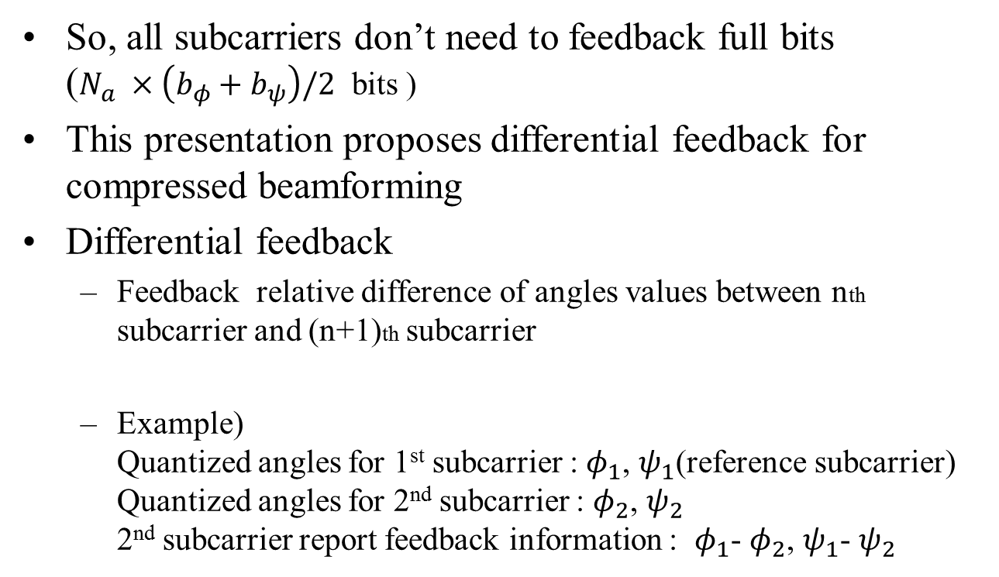
Proposed Method
: Differential Feedback(1/2)
  So, all subcarriers don’t need to feedback full bits ($N_{a} ×\left(b_{φ}+b_{ψ}\right)/2$ bits )
This presentation proposes differential feedback for compressed beamforming
Differential feedback
  Feedback relative difference of angles values between nth subcarrier and (n+1)th subcarrier
  Example)
  Quantized angles for 1st subcarrier : $φ_{1}$, $ψ_{1}$(reference subcarrier)
  Quantized angles for 2nd subcarrier : $φ_{2}$, $ψ_{2}$
  2nd subcarrier report feedback information : $φ_{1}$- $φ_{2}$, $ψ_{1}$- $ψ_{2}$

Slide 7
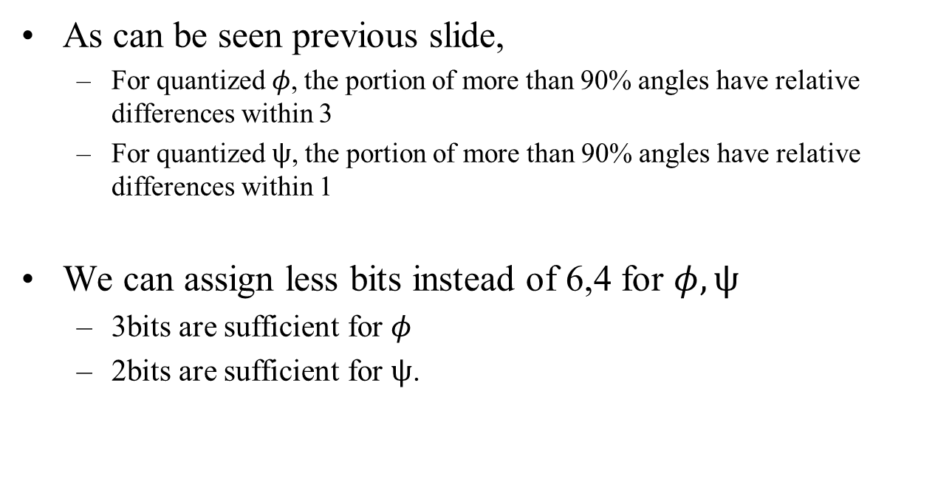
Proposed Method
: Differential Feedback(2/2)
As can be seen previous slide,
  For quantized $φ$, the portion of more than 90% angles have relative differences within 3
  For quantized $ψ$, the portion of more than 90% angles have relative differences within 1
We can assign less bits instead of 6,4 for $φ,ψ$
  3bits are sufficient for $φ$
  2bits are sufficient for $ψ$.

Slide 8
Overhead reduction
Example
We can reduce 50% using differential feedback
  Moreover, proposed method is more efficient in relatively lower frequency selectivity channel
2x2 MIMO Ng=2 | Conventional (Full feedback) | Proposed (Differential) | Reduction
NCB=1 | 1780 | 890 | 50%
NCB=2 | 3880 | 1940
NCB=3 | 5980 | 2990
NCB=4 | 8080 | 4040

Slide 9
Performance analysis
In relatively lower frequency selectivity channel, proposed method does not have any performance degradation
However, in relatively higher frequency selectivity channel, differential feedback may not be proper
So, we define 1 bit to indicate whether full feedback or differential feedback in MIMO Feedback Control Field
  Receiver can make a decision to apply or not based on channel measurement results

Slide 10
Conclusion
We investigate the characteristic of 11ay channel
In relatively lower frequency selectivity channel, we don’t need to feedback using full bits
We propose optional use of differential feedback for compressed beamforming in relatively lower frequency selectivity channel
In our proposed method, we can assign less bits with 50% overhead reduction.

Slide 11
Straw Poll #1
Do you agree to
  include the proposed differential feedback method for compressed beamforming in OFDM mode?

Slide 12
References
[1] 11-18-0382-00-00ay-Tone grouping size for hybrid beamforming feedback in OFDM mode

