Slide 1
WUR Preamble Sequence Design and Performance Evaluation
Date: 2018-03-08
Authors:
Name | Affiliation | Address | Phone | Email
Justin Jia Jia | Huawei Technologies |  |  | justin.jia@huawei.com
Ming Gan | Huawei Technologies
Wei Lin | Huawei Technologies
Chenchen Liu | Huawei Technologies
Jun Zhu | Huawei Technologies

Slide 2
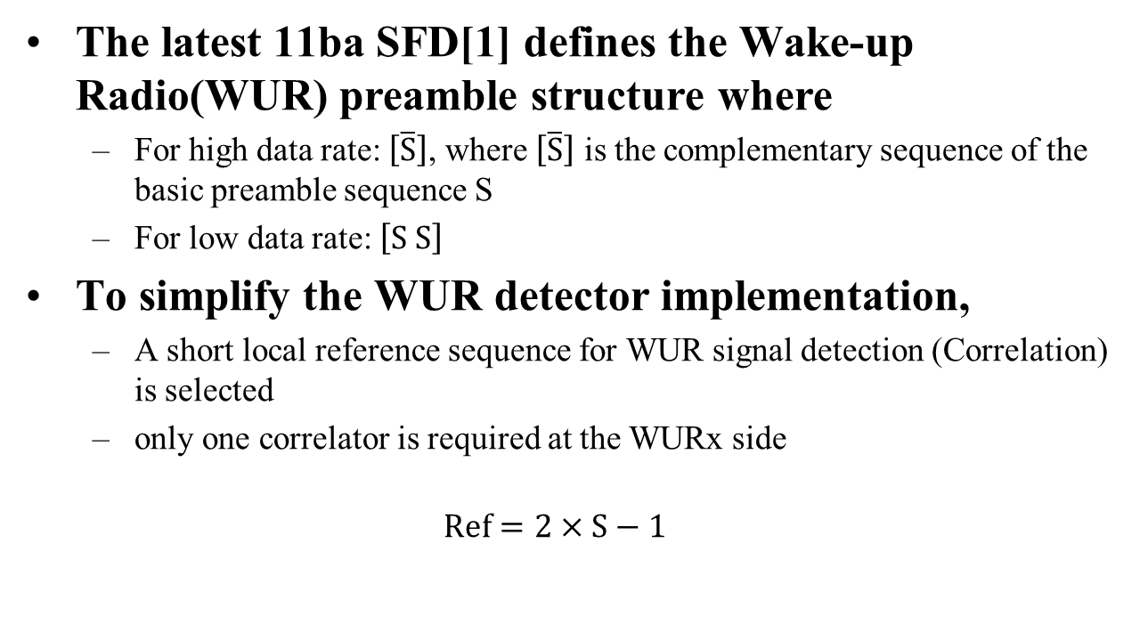
Introduction
The latest 11ba SFD[1] defines the Wake-up Radio(WUR) preamble structure where
  For high data rate: $\left[\overline{S}\right]$, where $\left[\overline{S}\right]$ is the complementary sequence of the basic preamble sequence S
  For low data rate: $\left[S S\right]$
  To simplify the WUR detector implementation,
  A short local reference sequence for WUR signal detection (Correlation) is selected
  only one correlator is required at the WURx side
    $$Ref=2×S−1$$

Slide 3

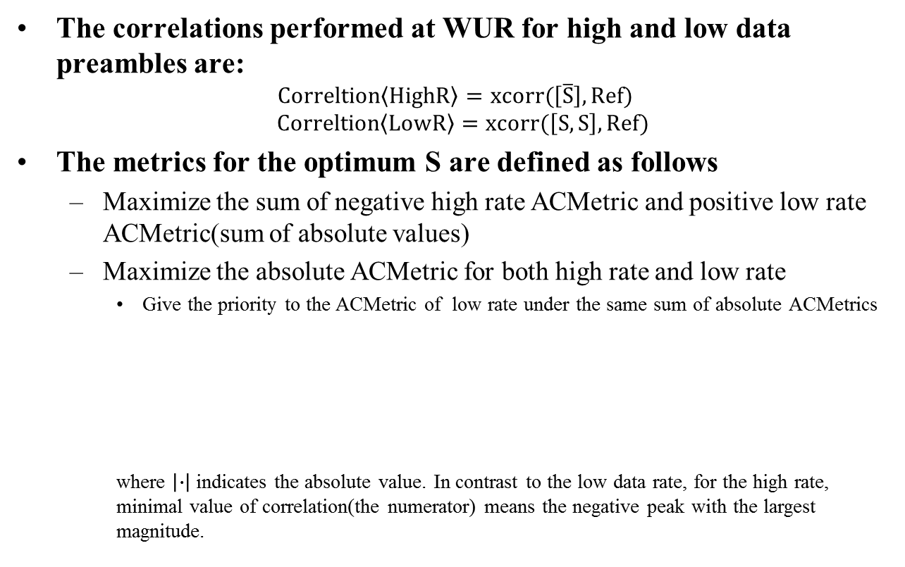

Metrics
The correlations performed at WUR for high and low data preambles are:
$$Correltion\left\langle HighR\right\rangle =xcorr(\left[\overline{S}\right], Ref)$$
$$Correltion\left\langle LowR\right\rangle =xcorr(\left[S,S\right], Ref)$$
The metrics for the optimum S are defined as follows
  Maximize the sum of negative high rate ACMetric and positive low rate ACMetric(sum of absolute values)
  Maximize the absolute ACMetric for both high rate and low rate
    Give the priority to the ACMetric of low rate under the same sum of absolute ACMetrics
    where $\left|∙\right|$ indicates the absolute value. In contrast to the low data rate, for the high rate, minimal value of correlation(the numerator) means the negative peak with the largest magnitude.
$$ACMetric\left\langle HighR\right\rangle =\frac{Min(Correltion\left\langle HighR\right\rangle ) }{2ndLargest|Correltion\left\langle HighR\right\rangle |}$$
$$ACMetric\left\langle LowR\right\rangle =\frac{Max(Correltion\left\langle LowR\right\rangle )⁡}{2ndLargest|Correltion\left\langle LowR\right\rangle |}$$

Slide 4
Metrics Analysis
  Multiple Auto/Cross-Correlation Metrics may be not necessary
  It is impossible to have two sets of local reference sequence Refs at the correlator of the receiver
  Data rates can be identified by the sign of output of correlator at the receiver side
    It could be further enhanced by the number of peaks
  Auto Correlation Metric can ensure the timing performance
  The output sign of correlator in the numberator can be used to distinguish the two data rates
  The absolute value of second largest peak in denominator is used for our metrics to avoid the timing error and false rate detection
    A huge second largest peak with the same sign as the largest peak may cause timing error
    A huge second largest peak with the opposite sign as the largest peak may cause false rate detection
  In this contribution, we pick up four candidates of 32-bit-based basic sequence S1[2], S2[3], S3[4], and S4[5] and evaluate their performance
  S1 = [1 0 1 0 0 0 1 1 0 1 1 0 1 1 1 1 0 0 0 0 1 0 0 1 1 1 0 0 0 1 0 1];
  S2 = [0 1 1 1 0 1 0 1 0 0 1 0 1 0 0 1 0 1 1 0 0 1 1 0 1 1 0 0 0 1 1 0];
  S3 = [1 0 1 0 0 1 0 0 1 0 1 1 1 0 1 1 0 0 0 1 0 1 1 1 0 0 1 1 1 0 0 0];
  S4 = [1 0 1 0 1 0 1 0 0 1 0 1 1 0 0 1 1 0 0 1 1 0 0 1 0 1 1 0 0 1 0 1];
Equal number of Ones and Zeros
Recommended
Sequence

Slide 5
Correlation Property of S1
Correlations at the receiver for S1:
Better performance for the high rate
ACMetric <HighR> | -8.0
ACMetric <LowR> | 4.0

Slide 6
Correlation Property of S2
Correlations at the receiver for S2:
ACMetric <HighR> | -3.2
ACMetric <LowR> | 4.0

Slide 7
Correlation Property of S3
Correlations at the receiver for S3:
ACMetric <HighR> | -5.3
ACMetric <LowR> | 8.0
Better performance for the low rate

Slide 8
Correlation Property of S4
Correlations at the receiver for S4:
ACMetric <HighR> | -2.7
ACMetric <LowR> | 2.3

Slide 9
Metrics for preamble sequence
Summary on Metrics comparison
  S3 has the best performance for data rate, however, S1 performs best on high data rate
 | S1 | S2 | S3 | S4
ACMetric <HighR> | -8 | -3.2 | -5.3 | -2.7
ACMetric <LowR> | 4 | 4 | 8 | 2.3

Slide 10
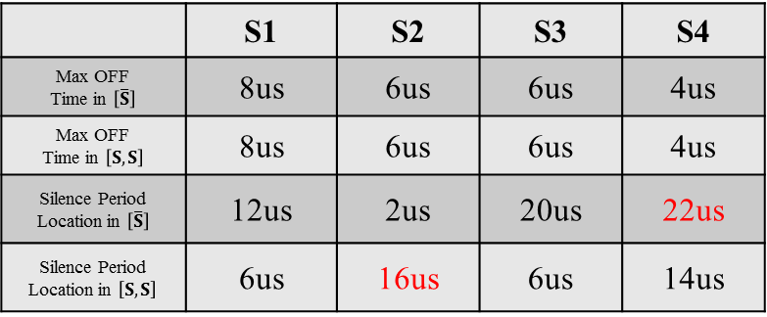
AGC Related
The concerns of AGC adjustment are listed as follows:
  The Max OFF time in high/low data rate preambles, respectively
  Silence Period Location[5]: The location of first 4us OFF period in high/low data rate preambles, respectively
 | S1 | S2 | S3 | S4
Max OFF Time in $\left[\overline{S}\right]$ | 8us | 6us | 6us | 4us
Max OFF Time in $\left[S,S\right]$ | 8us | 6us | 6us | 4us
Silence Period Location in $\left[\overline{S}\right]$ | 12us | 2us | 20us | 22us
Silence Period Location in $\left[S,S\right]$ | 6us | 16us | 6us | 14us

Slide 11
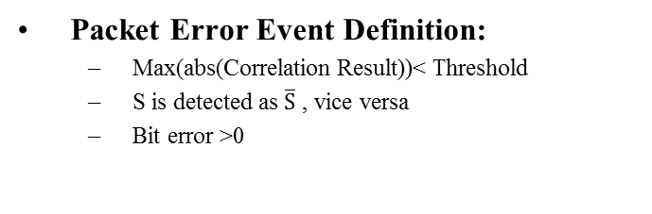
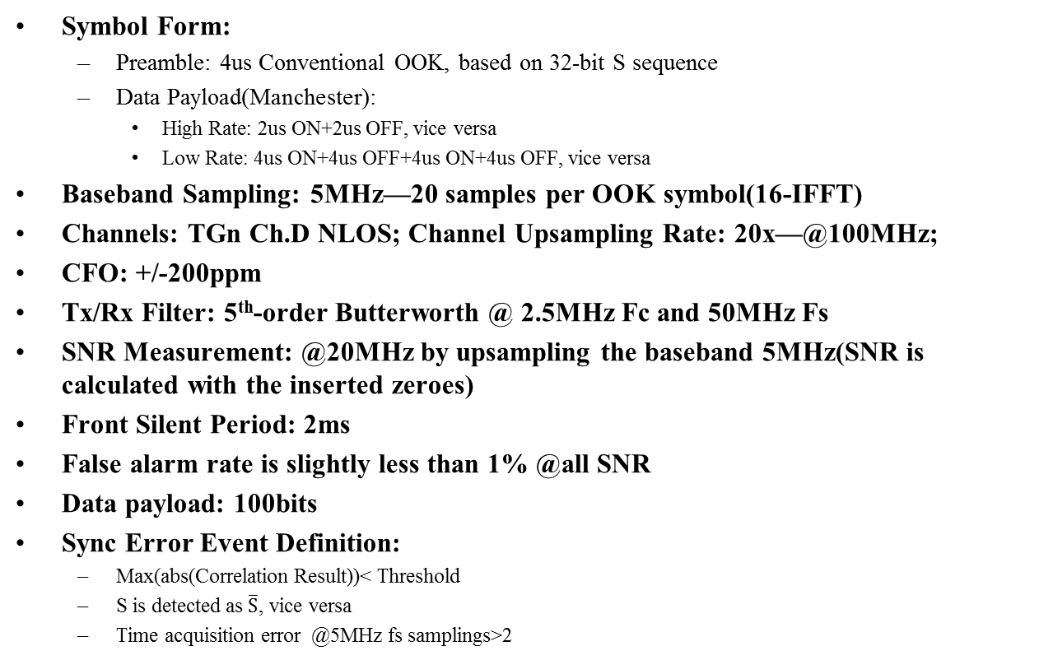
Simulation Settings[6]
Symbol Form:
  Preamble: 4us Conventional OOK, based on 32-bit S sequence
  Data Payload(Manchester):
    High Rate: 2us ON+2us OFF, vice versa
    Low Rate: 4us ON+4us OFF+4us ON+4us OFF, vice versa
Baseband Sampling: 5MHz—20 samples per OOK symbol(16-IFFT)
Channels: TGn Ch.D NLOS; Channel Upsampling Rate: 20x—@100MHz;
CFO: +/-200ppm
Tx/Rx Filter: 5th-order Butterworth @ 2.5MHz Fc and 50MHz Fs
SNR Measurement: @20MHz by upsampling the baseband 5MHz(SNR is calculated with the inserted zeroes)
Front Silent Period: 2ms
False alarm rate is slightly less than 1% @all SNR
Data payload: 100bits
Sync Error Event Definition:
  Max(abs(Correlation Result))< Threshold
  S is detected as $\overline{S}$, vice versa
  Time acquisition error @5MHz fs samplings>2
Packet Error Event Definition:
  Max(abs(Correlation Result))< Threshold
  S is detected as $\overline{S}$ , vice versa
  Bit error >0

Slide 12
Performance Comparison
PER of High Data Rate using the preamble $\left[\overline{S}\right]$
PER of Low Data Rate using the preamble $\left[S,S\right]$

Slide 13
Summary
  Through the simulation results and metrics analysis, we obtain
  Low rate case: S3 outperforms S1, S2 and S4 by about 0.28dB, 0.35dB and 0.54dB gain @1% PER, respectively, where S1 and S2 have similar overall PER performance
  High rate case: S1 outperforms S2, S3 and S4 by 0.55dB, 0.3dB and 0.59 dB gain @1% PER, respectively, where S2 and S4 have similar overall PER performance
It is recommended to choose S3 since the performance in low data rate environment is more concerned.
 | Low Rate |  | High Rate
 | SNR@ 1% PER | SNR@ 10% PER | SNR@ 1% PER | SNR@ 10% PER
S1 | 6.07dB | 0.64dB | 8.87dB | 4.07dB
S2 | 6.00dB | 0.66dB | 9.42dB | 4.15dB
S3 | 5.72dB | 0.61dB | 9.17dB | 4.20dB
S4 | 6.26dB | 0.73dB | 9.46dB | 4.16dB

Slide 14
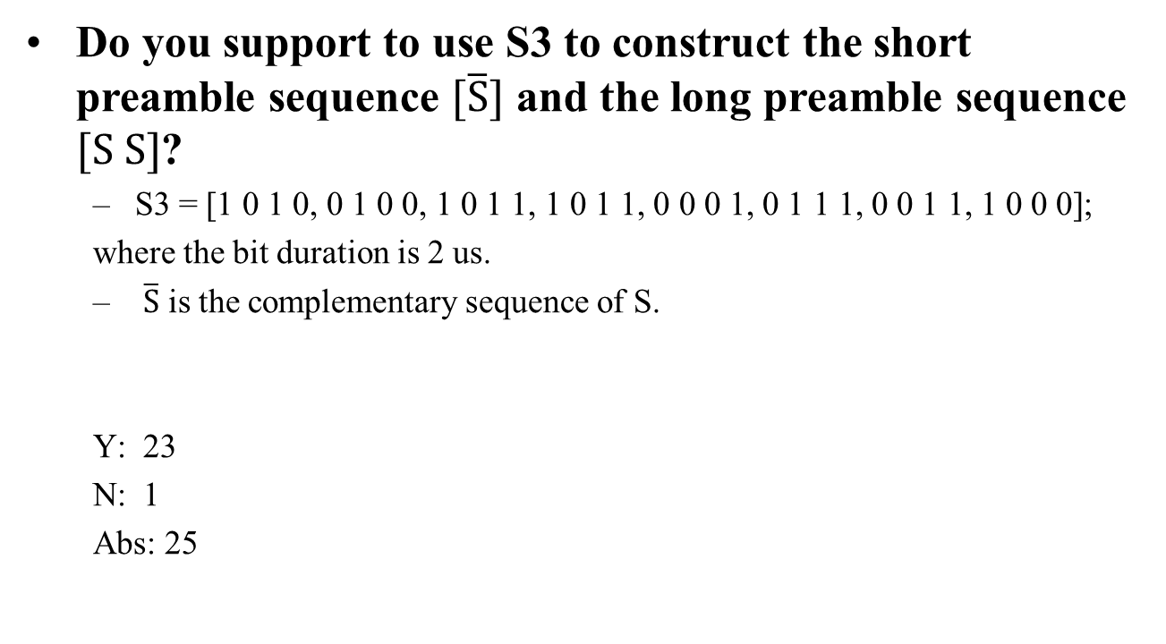
Straw Poll
Do you support to use S3 to construct the short preamble sequence $[\overline{S}]$ and the long preamble sequence $[S S]$?
  S3 = [1 0 1 0, 0 1 0 0, 1 0 1 1, 1 0 1 1, 0 0 0 1, 0 1 1 1, 0 0 1 1, 1 0 0 0];
  where the bit duration is 2 us.
  $\overline{S}$ is the complementary sequence of S.
  Y: 23
  N: 1
  Abs: 25

Slide 15
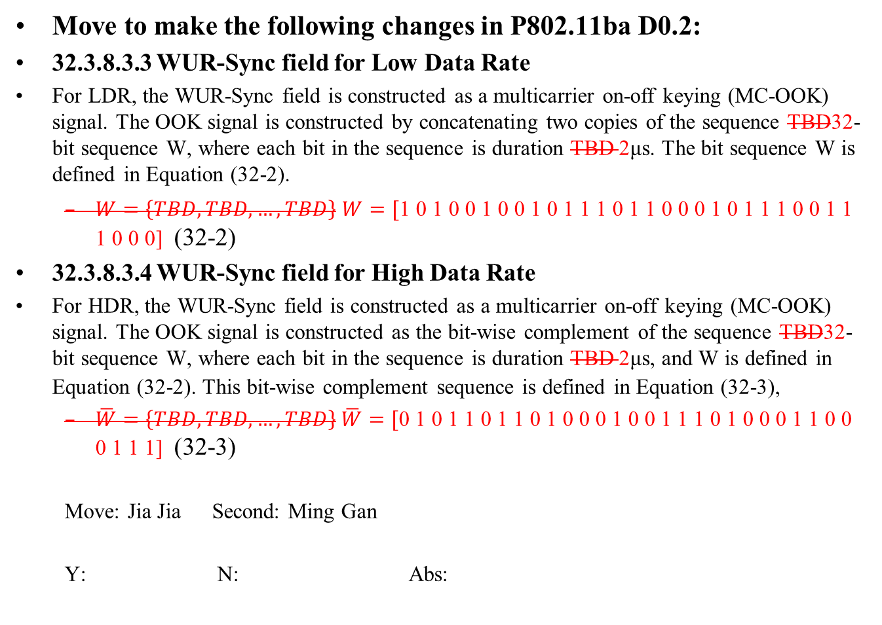
Motion 1
Move to make the following changes in P802.11ba D0.2:
32.3.8.3.3 WUR-Sync field for Low Data Rate
For LDR, the WUR-Sync field is constructed as a multicarrier on-off keying (MC-OOK) signal. The OOK signal is constructed by concatenating two copies of the sequence TBD32-bit sequence W, where each bit in the sequence is duration TBD 2μs. The bit sequence W is defined in Equation (32-2).
  $W=\left\{TBD,TBD,…,TBD\right\}$ $W=[\text{1 0 1 0 0 1 0 0 1 0 1 1 1 0 1 1 0 0 0 1 0 1 1 1 0 0 1 1 1 0 0}\text{ 0]}$ (32-2)
32.3.8.3.4 WUR-Sync field for High Data Rate
For HDR, the WUR-Sync field is constructed as a multicarrier on-off keying (MC-OOK) signal. The OOK signal is constructed as the bit-wise complement of the sequence TBD32-bit sequence W, where each bit in the sequence is duration TBD 2μs, and W is defined in Equation (32-2). This bit-wise complement sequence is defined in Equation (32-3),
  $\overline{W}=\left\{TBD,TBD,…,TBD\right\}$ $\overline{W}=[\text{0 1 0 1} \text{1 0 1 1} \text{0 1 0 0} \text{0 1 0 0} \text{1 1 1 0} \text{1 0 0 0} \text{1 1 0 0} \text{0 1 1 1]}$ (32-3)
  Move: Jia Jia Second: Ming Gan
  Y: N: Abs:

Slide 16
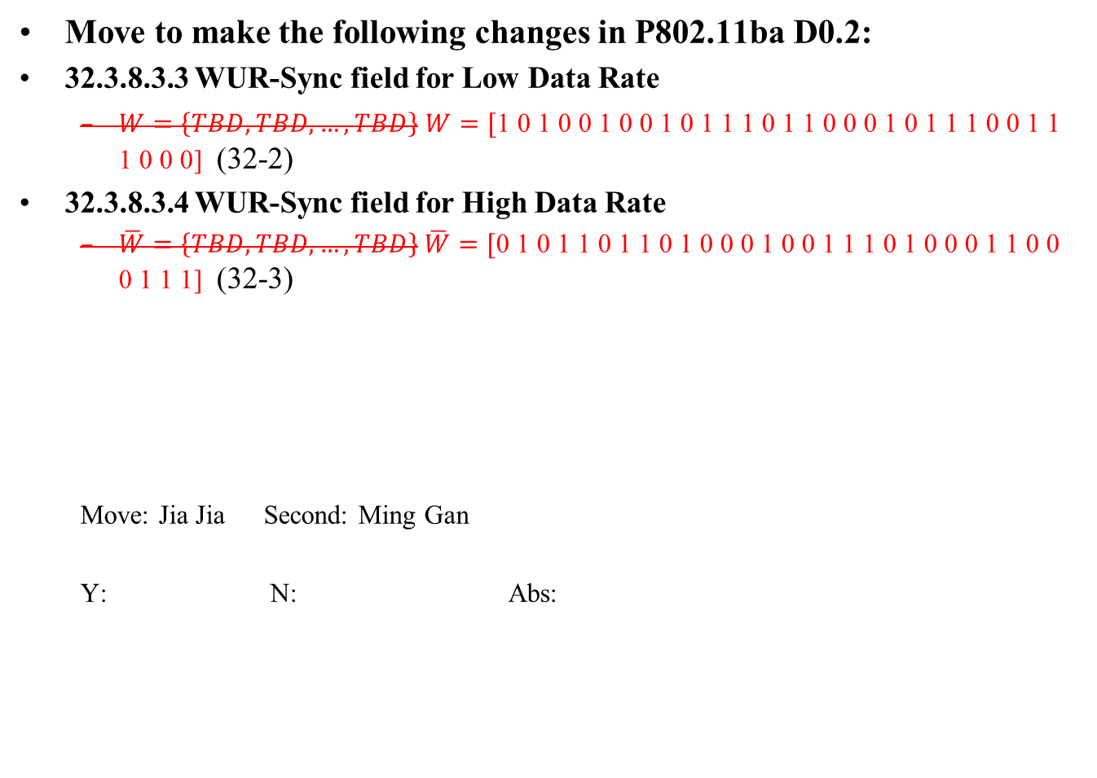
Motion 2
Move to make the following changes in P802.11ba D0.2:
32.3.8.3.3 WUR-Sync field for Low Data Rate
  $W=\left\{TBD,TBD,…,TBD\right\}$ $W=[\text{1 0 1 0 0 1 0 0 1 0 1 1 1 0 1 1 0 0 0 1 0 1 1 1 0 0 1 1 1 0 0}\text{ 0]}$ (32-2)
32.3.8.3.4 WUR-Sync field for High Data Rate
  $\overline{W}=\left\{TBD,TBD,…,TBD\right\}$ $\overline{W}=[\text{0 1 0 1} \text{1 0 1 1} \text{0 1 0 0} \text{0 1 0 0} \text{1 1 1 0} \text{1 0 0 0} \text{1 1 0 0} \text{0 1 1 1]}$ (32-3)
  Move: Jia Jia Second: Ming Gan
  Y: N: Abs:

Slide 17
Reference
[1] IEEE 802.11-17/0575r9,“Specification Framework for TGba”, Jan. 2018
[2] IEEE 802.11-17/1636r0, “A Simple WUR Preamble Design”, Nov. 2017
[3] IEEE 802.11-18/0123r0, “Options for Sync Field Bit Sequence”, Jan. 2018
[4] IEEE 802.11-18/0100r1, “WUR Preamble Sequence Performance Evaluation”, Jan. 2018
[5] IEEE 18/0096r3, “WUR Sync Design”, Jan. 2018
[6] IEEE 802.11-17/0188r9, “Simulation Scenario and Evaluation Methodology”, Jul. 2017
[7] IEEE 802.11-17/1617r1, “Dual Sync Designs”, Nov. 2017

Slide 18
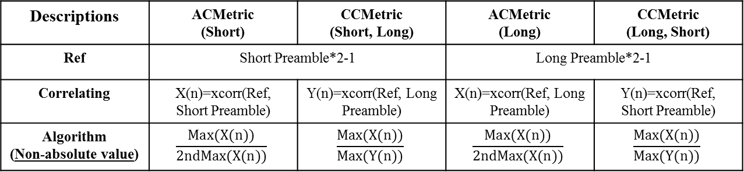
Appendix 1
Comparison based on other Metrics[7]
Descriptions | ACMetric (Short) | CCMetric (Short, Long) | ACMetric (Long) | CCMetric (Long, Short)
Ref | Short Preamble*2-1 |  | Long Preamble*2-1
Correlating | X(n)=xcorr(Ref, Short Preamble) | Y(n)=xcorr(Ref, Long Preamble) | X(n)=xcorr(Ref, Long Preamble) | Y(n)=xcorr(Ref, Short Preamble)
Algorithm (Non-absolute value) | $$\frac{Max(X(n))}{2ndMax(X(n))}$$ | $$\frac{Max(X(n))}{Max(Y(n))}$$ | $$\frac{Max(X(n))}{2ndMax(X(n))}$$ | $$\frac{Max(X(n))}{Max(Y(n))}$$
Sequence | ACMetric (Short) | CCMetric (Short, Long) | Sum (using Short Preamble) | ACMetric (Long) | CCMetric (Long, Short) | Sum (using Long Preamble) | Overall Sum
S1 | 8 | 4 | 12 | 2 | 8 | 10 | 22
S2 | 5.3 | 4 | 9.3 | 2 | 6.4 | 8.4 | 17.7
S3 | 8 | 8 | 16 | 2 | 10.7 | 12.7 | 28.7
S4 | 5.3 | 2.3 | 7.6 | 2 | 5.3 | 7.3 | 14.9

