Slide 1
Introduction to RPW- Experimental Study of a rotating polarization wave (RPW) system
Date: 2018-03-04
Authors:

Slide 2
Abstract
A wireless system that controls polarization to improve communication quality is proposed. A prototype of transceiver controlling polarization was manufactured and tested in various communication environment. Experiment data of these testing show that the proposed system successfully improved the quality especially in cluttered environment without any line-of-sight paths.

Slide 3

Polarization Dependable Wireless Communication Systems
Penetration comm.
Comm. in rich reflection
fixed
Comm. through narrow gap
fixed
Irregular Reflection waves
Regular (Snell’s) reflection waves

Slide 4
Problems of Wireless System for IoT
Quality of Information
Propagation paths through which data of sensor are transferred fluctuate and deteriorate information quality.
Quantity of Information
Conventional wireless system hardly communicates with a sensor not only in and through materials but also beyond narrow gaps and slits.
Challenges
By using both a digital signal processing device and physical characteristics of the electromagnetic wave, the special conditions of the wave that overcome unstable reception and not leachable paths are realized.

Slide 5
Solution with Polarization
  Motivation
  An Electromagnetic wave propagates through discontinuous boundaries, i.e., a material interface, a narrow gap, and a slit, when polarization satisfies special Condition on the boundary. The wireless system using precious polarization control improves both quality and quantity of information for IoT applications.
  Propose
  The transmitter sends information on the electromagnetic wave whose polarization rotated at a very lower frequency than that of the carrier. The receiver captures information at many different timings within the entire period of the polarization rotation. Both the transmitter and receiver use the optimum polarization that improves quality and quantity of information even though propagation paths are fluctuated.

Slide 6
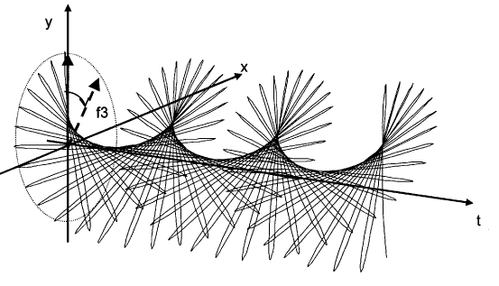
*RPW Transmitter
RPW transmitter
cosω_{p}t
polarization
fc
fc
ω_{p}/2π
sinω_{p}t
・RPW’s slowly rotating polarization let receiver measure the polarization with arbitrary two antennas by using digital signal processing technologies.
*Rotating Polarization Wave

Slide 7
RPW Receiver
LPF*
Polarization
Selection
Baseband
Data
fc
DEMOD
...
LPF*
ω_{p}/2π
Rearrange
0
1
1
0°
0
1
1
45°
Serial-Parallel
DEMOD
0
1
1
90°
...
...
...
...
0
1
1
315°
0° 180 ° 0° 180 ° 0° 180 ° 0° 180 °…

Slide 8
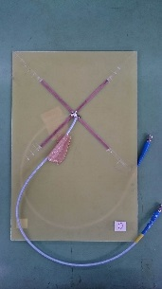
Prototype Radio
  Features
  ・Zynq7000 SoC (FPGA + ARM core)
  ・AR9361 (RF 2x2 transceiver with 12bits DACS and ADCs)
  ・2 HPA and 2 LNA
  ・*Cross dipoles
  ・TDD system
  ・Carrier frequency 920MHz (ISM 900 MHz bands)
  ・Polarization frequency 125kHz
  ・Data rate 64bps
  ・Output power <20dBm
  ・DBPSK modulation 8MHz
  ・Carrier sense operation
  ・Radio certifications (Japan, Singapore, Malaysia)
  ・30x20x5 cm size
*cross dipole

Slide 9
Field Test in Office (setup)
Experimental setup
Tx in closed shelf
Rx in closed shelf
２．５ｍ
Specifications
・Output power -20dBm
・Carrier frequency 920MHz
・Polarization rotation frequency 125kHz
・DBPSK Modulation frequency 8MHz
・Data Rate 64bps
５ｍ
８ｍ

Slide 10
Field Test in Office (results)
Receiving power [dBm]
Packet Error Rate
-70
10⁻⁰
-75
10⁻¹
：RPW
-80
：RPW
：*FPW
：*FPW
10⁻²
-85
-90
10⁻³
-95
10⁻⁴
Case 1
Case 2
Case 1
Case 2
*Fixed Polarization Wave

Slide 11
Field Test in Factory (setup)
Experimental setup
20m
30m
Tx
Rx3
Rx2
Rx1
280m
Specifications
・Output power for measuring receiving power 10dBm
・Output power for measuring PER 0dBm
・Carrier frequency 920MHz
・Polarization rotation frequency 125kHz
・DBPSK Modulation frequency 8MHz
・Data Rate 64bps

Slide 12
Field Test in Factory (results)
Receiving Power[dBm]
Packet Error Rate
-66
10⁻⁰
-68
10⁻¹
：RPW
-70
10⁻²
：FPW
：RPW
10⁻³
-72
：FPW
-74
10⁻⁴
-76
10⁻⁵
radio1
radio2
radio3
Rx1
Rx2
RX3

Slide 13
Summary
・Wireless system achieves to transfer signals to EM wave hardly reachable position by using an optimum polarization.
・RPW system slowly rotates transmitting polarization and receives many useful polarizations at different timings
・A signal transferred on the RPW arrived at the receiver trough a narrow gap of a closed office cabinet.
・The RPW system improved receiving power over 10 dB and PER performance at least one order than those of the average operation of the fixed polarized system.

Slide 14
References
・ K. Takei, “Polarization angle diversity for highly-reliable machine-to-machine radio,“ in Proc. 2013 IEEE ICCPCT., pp. 825-828.
・ M. Aono, K. Takei, “Polarization angle diversity and quick decodable block code for M2M wireless communication,“ in Proc. 2014 APMC.
・ M. Aono, “Polarization angle diversity and new digital software radio architecture,“ in Proc. 2015 IEEE ICCPCT, paper-ID 545.
・ H. Yamada and K. Takei, “Evaluation of communication coverage of the Rotating Polarization Wave wireless,“ in Proc. 2017 IEICE society meeting, paper-ID B-5-93.
・ News release 2017.9.11 “Hitachi successfully developed the rotating polarization wave radio device that achieves high quality wireless communication in a manufacturing place with many obstacles,”
URL: http://www.hitachi.co.jp/New/cnews/month/2017/09/0911.html

