Slide 1
Compressed SSID for WUR Discovery Frame
Date: 2018-02-27
Authors:
Name | Affiliation | Address | Phone | Email
Taewon Song | LG Electronics | 19, Yangjae-daero 11gil, Seocho-gu, Seoul 137-130, Korea |  | taewon.song@lge.com
Suhwook Kim |  |  |  | suhwook.kim@lge.com
Jeongki Kim |  |  |  | jeongki.kim@lge.com
Kiseon Ryu |  |  |  | kiseon.ryu@lge.com
Jinsoo Choi |  |  |  | js.choi@lge.com

Slide 2
Abstract
A type of WUR discovery frame has been supported in the current specification framework for 11ba [1]
  R.4.8.A: Define a type of WUR frame as WUR Discovery frame to assist the STAs to discover the BSS.
The current SFD mandates APID, Compressed SSID, and PCR Channel be included in WUR discovery frame [2]
  The size of SSID is too long to be squeezed into WUR frame
In this contribution…
  First, we examine a method to compress original SSID into shorter version of SSID
  Next, we suggest a proper size for compressed SSID

Slide 3
Compress methods
Truncation
  Use MSB or LSB from bitstream, which is the encoded SSID
CRC
  Use CRC-8, CRC-16 (CRC-CCITT), CRC-32 or anything
Per-byte sampling
  Pick some MSB or LSB from each octet
Original SSID | Encoded (e.g., UTF-8) | 1. Truncation (Using LSB) | 2. CRC (Using CRC32 and truncate) | 3. Per-byte sampling
Adam’s AP | 01000001 … 01000001 01010000 | 01000001 01100100 | 01111100 11001101 | 00010111 11000100

Slide 4
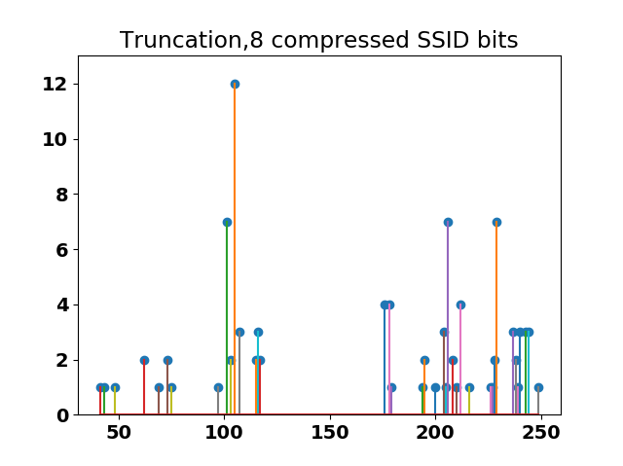
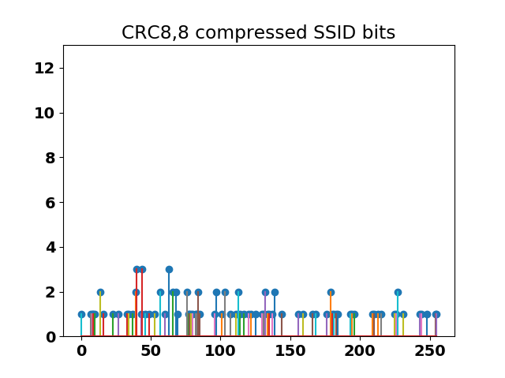
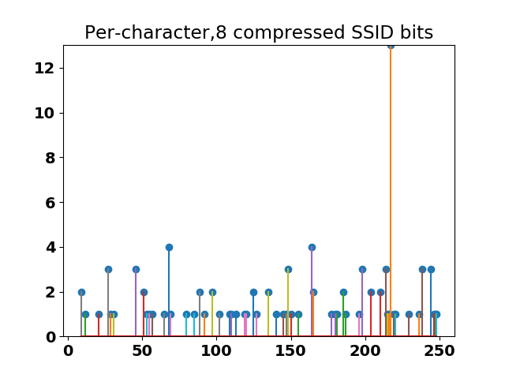
Comparison between compressing methods
The number of each hashed values
Hashed values
The number of SSIDs (from gathered list of common SSID names) = 100
The length of compressed SSID = 8
Since MSBs of UTF-8 encoded octets always begin with 0, we omit these zeros
<Max value of duplicated hashes>
Truncation: 12
CRC-8: 3
There is no difference in collision probability between CRC-8, CRC-16, and CRC-32 (See Appendix for other CRC hash values)
CRC has the least number of duplicated hashed compared to the other methods
Per-byte sampling: 13

Slide 5
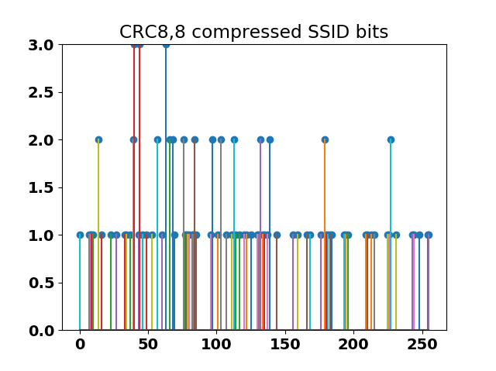
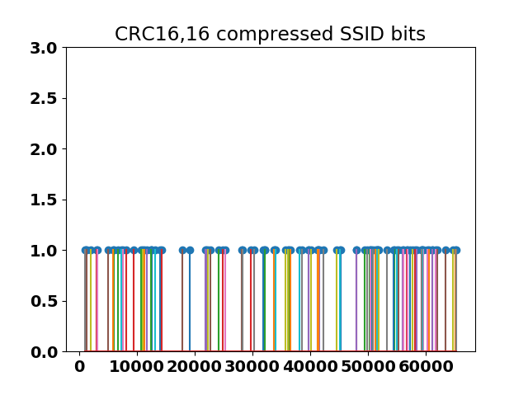
Comparison between the size of C-SSID
The number of each hashed values
Hashed values
The number of SSIDs (from gathered list of common SSID names) = 100
The length of compressed SSID = 8, 16
<Max value of duplicated hashes>
CRC-8: 3
CRC-16: 1
Uniformities of both cases are almost same (See Appendix for detailed polynomials)
Despite the fact that there would be some collision case for CRC-8, the case will be trivial when STAs use APID and C-SSID as an identifier

Slide 6
Conclusion
Among the compression methods, CRC has the least number of duplicated hashed values
  That means CRC has the least opportunity that a certain C-SSID collides with others
We could use CRC-based compression method on the length which is expected to be determined
In terms of the size of C-SSID, 8 bits would be further enough if STAs identifies AP using C-SSID and APID as well

Slide 7
Straw Poll 1
Which option do you prefer as a compression method for C-SSID?
  Option 1: CRC (A specific polynomial is TBD)
  Option 2: Truncation
  Option 3: Per-byte sampling
  A

Slide 8
Straw Poll 2
Which option do you prefer as a size for C-SSID?
  Option 1: 8 bits
  Option 2: 16 bits
  Option 3: More than 16 bits
  A

Slide 9
References
[1] 11-17/0575r9, “Spec framework”
[2] 11-18/0160r7, “WUR discovery frame content”

Slide 10
Appendix

Slide 11
List of common SSIDs
ssid
xfinitywifi
linksys
<no ssid>
BTWiFi-with-FON
NETGEAR
Ziggo
dlink
BTWifi-X
default
FreeWifi
hpsetup
UPC Wi-Free
optimumwifi
FreeWifi_secure
AndroidAP
eduroam
BTWIFI
TELENETHOMESPOT
cablewifi
…
Source of common SSIDs: https://wigle.net/stats#ssidstats

Slide 12
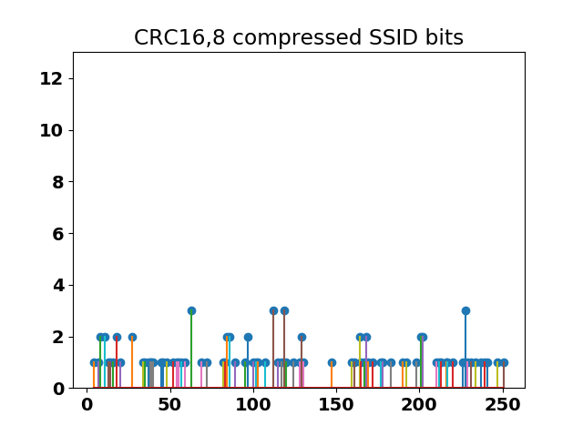
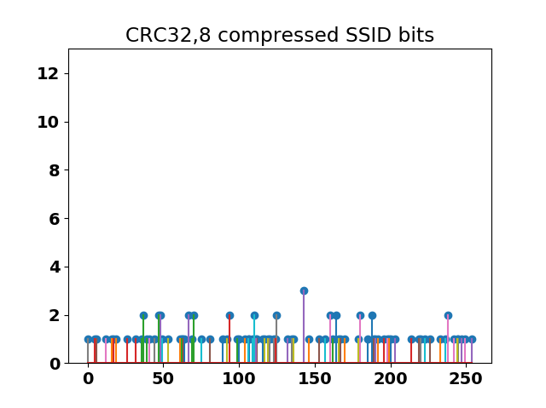
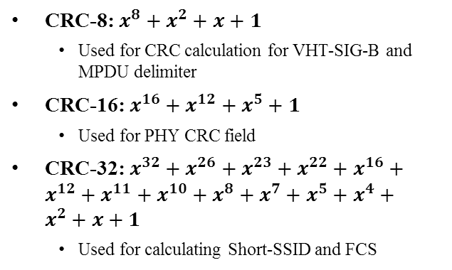
Analysis (C-SSID: 8 bits, only CRC)
The number of each hashed values
Hashed values
The number of SSIDs (from gathered list of common SSID names) = 100
The length of compressed SSID = 8
Only use CRC-8, CRC-16 (CRC-CCITT), and CRC-32
Collision probabilities of using CRCs are almost the same
CRC-8: $x^{8}+x^{2}+x+1$
  Used for CRC calculation for VHT-SIG-B and MPDU delimiter
CRC-16: $x^{16}+x^{12}+x^{5}+1$
  Used for PHY CRC field
CRC-32: $x^{32}+x^{26}+x^{23}+x^{22}+x^{16}+x^{12}+x^{11}+x^{10}+x^{8}+x^{7}+x^{5}+x^{4}+x^{2}+x+1$
  Used for calculating Short-SSID and FCS

