Slide 1
Introduction of Vice Chair Candidate Jon Rosdahl
Date: 2018-03-06
Authors:

Slide 2
Abstract
Candidate information presentation

Slide 3
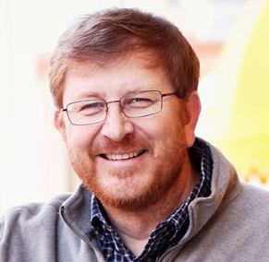
Jon Rosdahl
Candidate for IEEE 802.11 Chair

Slide 4
My Expectations
I would like to start by saying that regardless of who eventually wins the election this week, the new leadership team will need everyone’s support in order to be successful.
No one will be successful without the support of the working group as a whole.
I would hope that everyone would understand that my success does not depend on someone else’s failure.
The reason a person wins an election should be on the merits of the person being elected rather than any negative statement against an opponent.

Slide 5
IEEE Experience
25th Anniversary of participating in 802 sessions this month.
Over the course of the 25 years, I have served as
Vice-Chair of 802.11 for 12 years.
Treasurer for 10 years
Task Group leader (TGm – Secretary/Vice Chair)
PAR Review SC chair
Assisted Various Assignments – P&P, Counting, PAR etc.
Served on the IEEE-SA Standards Board and Standing Committees
IEEE-SA Standards Board (7 years)
NesCom (8 yrs); PatCom (3 yrs); ProCom (4 yrs); RevCom (3 yrs)
Computer Society Vice President Standards Activities
Senior Member of the IEEE

Slide 6
Why Run?
I enjoy working with you.
I believe that my contributions to the group has made an impact.
I believe my experience and skill set can be utilized to make a difference in the future of IEEE 802.11
Today’s challenges are going to be solved with cooperation of the committee members; You all just need the opportunity to engage in the process;
Notes:
I believe:
Working Group Officers serve the needs of the Working Group.
Diligence, integrity and stability are as important as capability and execution.
The IEEE 802.11WG members should choose officers that are able to facilitate the Working Group process in order to provide standards that fulfill the requirements of the consumers in marketplace.

Slide 7
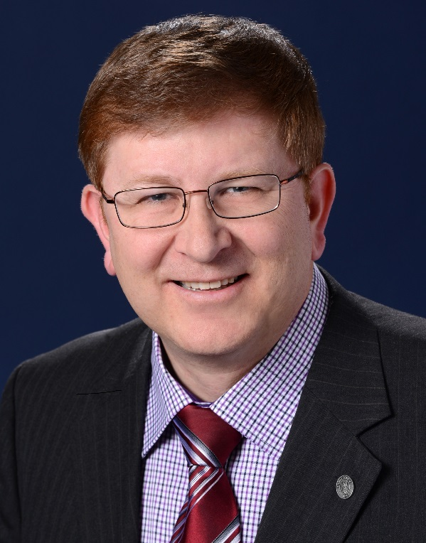
Thanks and Request for your Support
I thank you for your confidence in me over the years, and hope that I have earned your trust and confidence to re-elect me as your Vice-Chair.
Jon Rosdahl

