Slide 1
60GHz Passive Location
Date: 2018-10-15
Authors:

Slide 2
Introduction
This presentation presents the concepts of passive location in 60GHz.

Slide 3
Is 60GHz passive location different
Passive means – the STAs have not peformed beamforming training with APs/Location Servers
STAs receive in qasi-Omni.
In order to enable receive by many STAs – APs transmit in many directions.

Slide 4
How can we perform passive location in 60GHz
AOD of APs
  Using the AOD of two or more APs, location can be determined (assuming the location of the APs is known)
  Each AP performs a sector sweep. Each sector contains the AOD (earth coordinates).
  A device selects the sector received with highest accuracy.
  Angular resolution – 2-3 degrees in azimuth.
  It is possible to improve resolution by adding a TRN field to each sector.
    Transmitting each TRN subfield in a different direction
    Using the TRN subfield to perform actual angular search (see backup slides)

Slide 5
How Does it work
APs transmit a sector sweep, possibly with LCI and earth direction for each sector.
  Possibly each AP indicates other APs schedule for sector sweeps. Including their location
  Also APs may schedule their sectors sweeps at close times.
  May be coordinated with beacons – not necessarily efficient.
LCI and scheduling of sector sweeps may be carried OOB
  A <6GHz AP may publish the existence of the APs/Location server, their location and the schedule and frequencies in which they will transmit sector sweeps.

Slide 6
Second Method: AOA at STA
APs transmit sector sweep. To each sector sweep packet TRN field is appended enabling performance of AOA estimation.
Each STA performs AOA estimation on each sector it receives and keeps the results from the best received sector.
Using the difference angle between each pair of APs (at least two pairs), the STA may determine its location.
  If the STA can convert direction to earth direction the calculation can be more robust.

Slide 7
AOA’s on STA
Angular Accuracy in STA may be lower – due to smaller arrays and non-optimal placement of array in space.
Results may be combined with the AOD results from 3 APs.

Slide 8
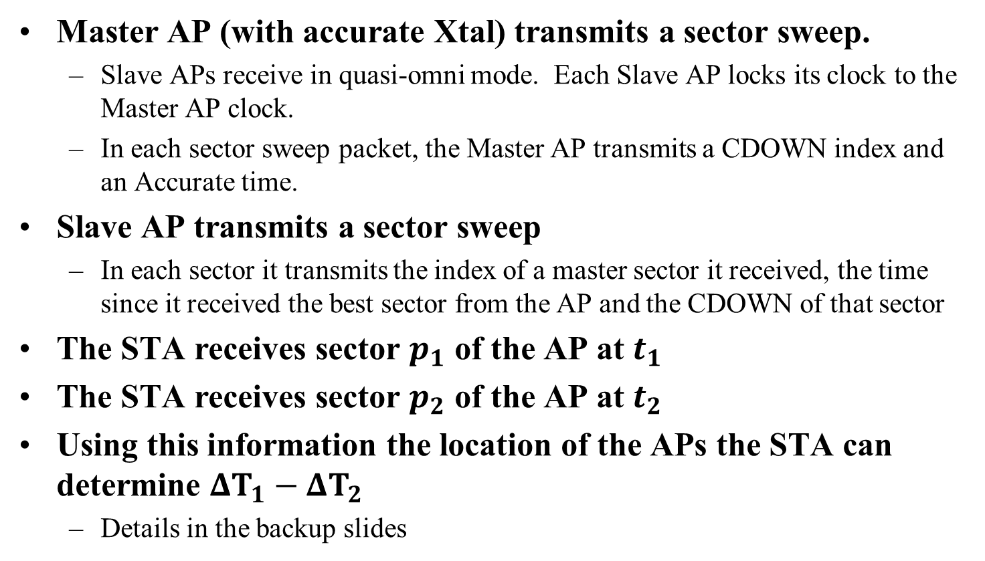
Third Method: Pseudo DTOA
Master AP (with accurate Xtal) transmits a sector sweep.
  Slave APs receive in quasi-omni mode. Each Slave AP locks its clock to the Master AP clock.
  In each sector sweep packet, the Master AP transmits a CDOWN index and an Accurate time.
Slave AP transmits a sector sweep
  In each sector it transmits the index of a master sector it received, the time since it received the best sector from the AP and the CDOWN of that sector
The STA receives sector $p_{1}$ of the AP at $t_{1}$
The STA receives sector $p_{2}$ of the AP at $t_{2}$
Using this information the location of the APs the STA can determine $ΔT_{1}−ΔT_{2}$
  Details in the backup slides

Slide 9
Backup

Slide 10
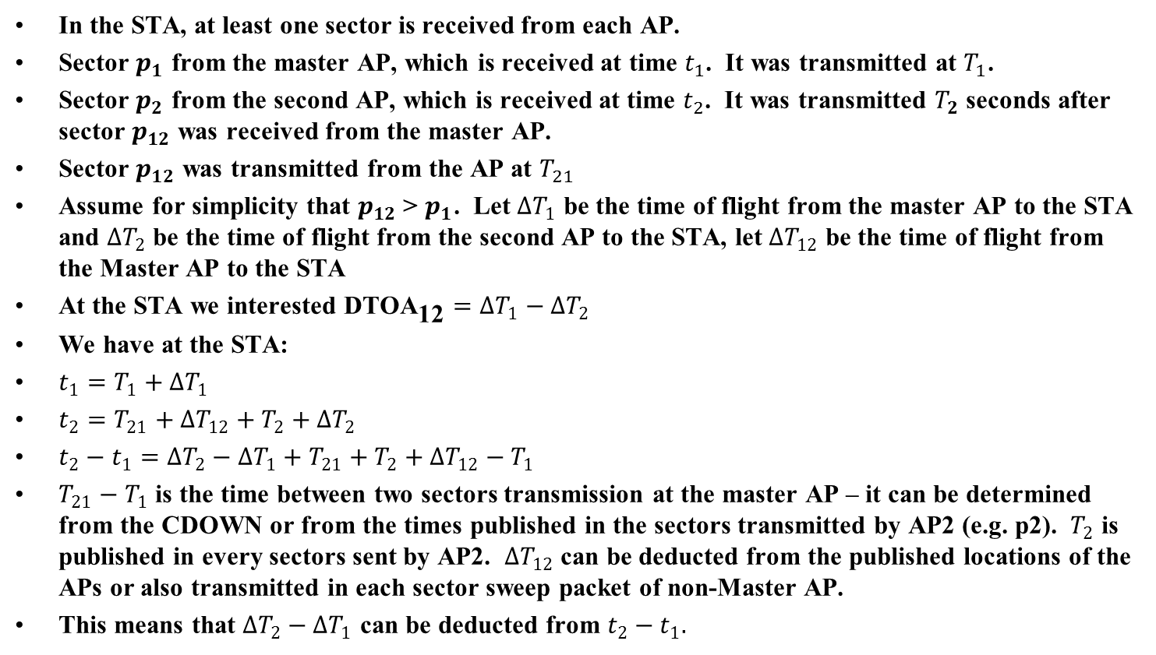
Details of DTOA
In the STA, at least one sector is received from each AP.
Sector $p_{1}$ from the master AP, which is received at time $t_{1}$. It was transmitted at $T_{1}$.
Sector $p_{2}$ from the second AP, which is received at time $t_{2}$. It was transmitted $T_{2}$ seconds after sector $p_{12}$ was received from the master AP.
Sector $p_{12}$ was transmitted from the AP at $T_{21}$
Assume for simplicity that $p_{12}$> $p_{1}$. Let $ΔT_{1}$ be the time of flight from the master AP to the STA and $ΔT_{2}$ be the time of flight from the second AP to the STA, let $ΔT_{12}$ be the time of flight from the Master AP to the STA
At the STA we interested $\text{DTO}{\text{A}}_{\text{12}}=ΔT_{1}−ΔT_{2}$
We have at the STA:
$$t_{1}=T_{1}+ΔT_{1}$$
$$t_{2}={T_{21}+ΔT_{12}+T}_{2}+ΔT_{2}$$
$$t_{2}−t_{1}=ΔT_{2}−ΔT_{1}+T_{21}+T_{2}+ΔT_{12}−T_{1}$$
$T_{21}−T_{1}$ is the time between two sectors transmission at the master AP – it can be determined from the CDOWN or from the times published in the sectors transmitted by AP2 (e.g. p2). $T_{2}$ is published in every sectors sent by AP2. $ΔT_{12}$ can be deducted from the published locations of the APs or also transmitted in each sector sweep packet of non-Master AP.
This means that $ΔT_{2}−ΔT_{1}$ can be deducted from $t_{2}−t_{1}.$

Slide 11
References

