Slide 1
Motivation for Vendor Specific Request Element
Date: 2018-01-17
Authors:

Slide 2
Abstract
Use case example for the Vendor Specific Element

Slide 3
Information Request Example (1)
PBSS containing PCP 2 and STA 3 and STA 4
STA 1 would like to determine if STA 3 in the PBSS with has Vendor Specific Capabilities A and B.
PCP 2
STA 3
STA 1
STA 4

Slide 4
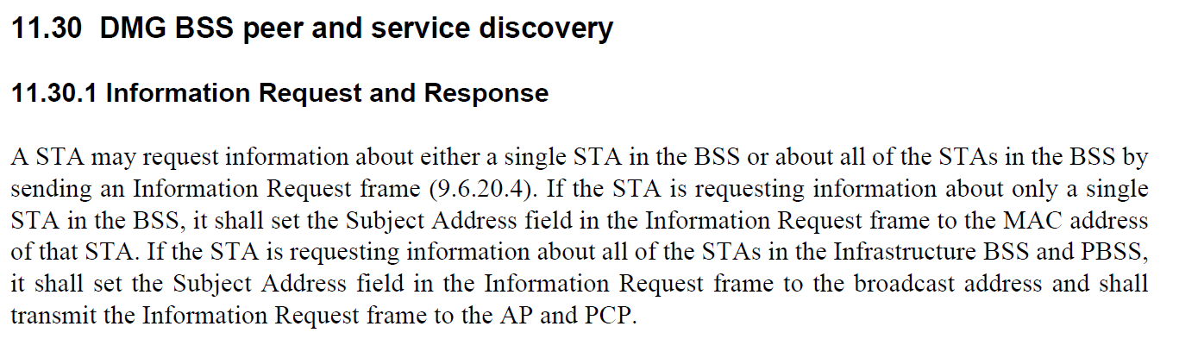
Information Request Example (2)

Slide 5
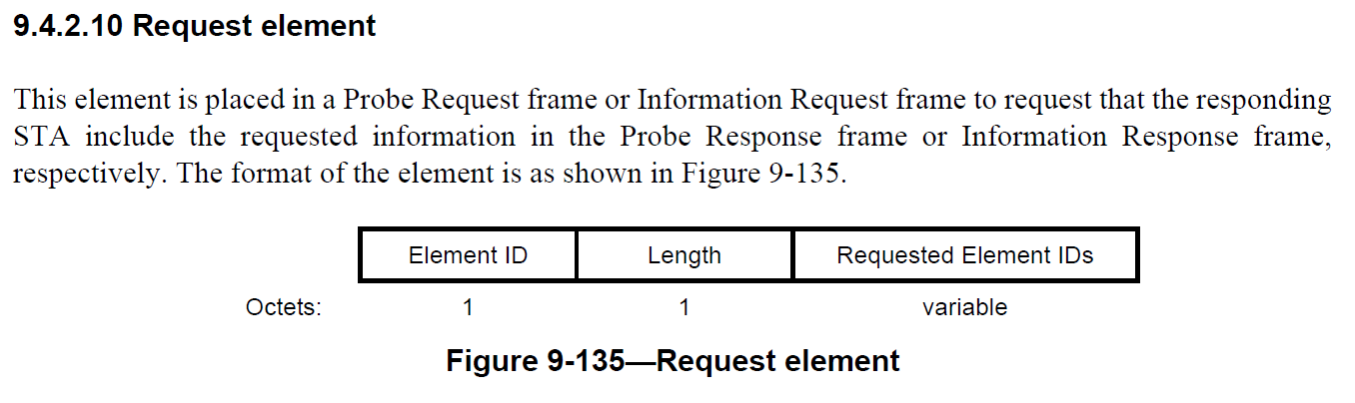
Information Request Example (3)
Also Extended Request because the Element IDs are limited

Slide 6
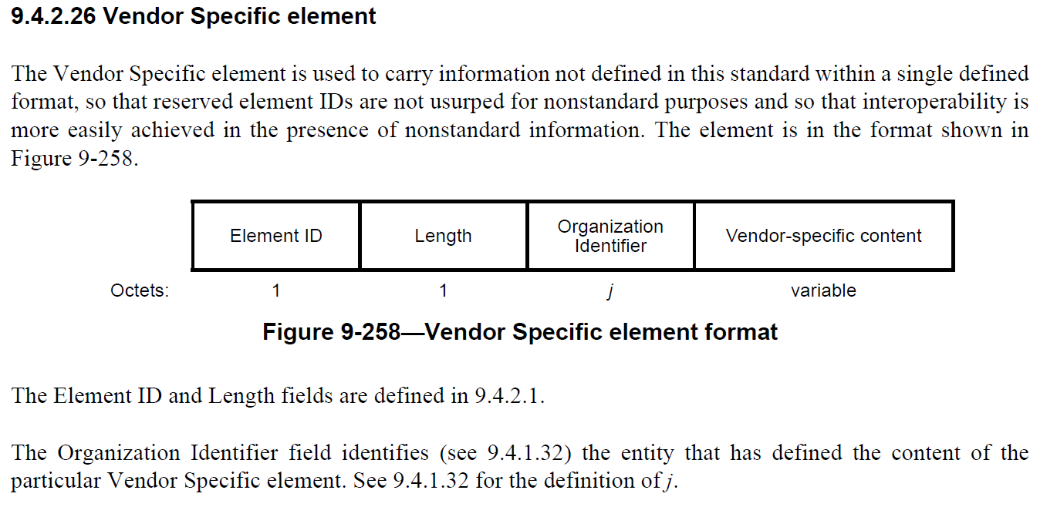
802.11-2016 Vendor Specific Element
The Vendor Specific Element field can be used for responses, but it is not suitable for requests. A STA may have several possible elements it could share.

Slide 7
Solution – New Vendor Specific Request (2)
Example:
  STA 1 makes a Vendor Specific Request for Vendor Specific Elements A and B from STA 3 using an Information Request to PCP 2.
  PCP 2 responds with the appropriate Vendor Specific Elements for STA 3.

Slide 8
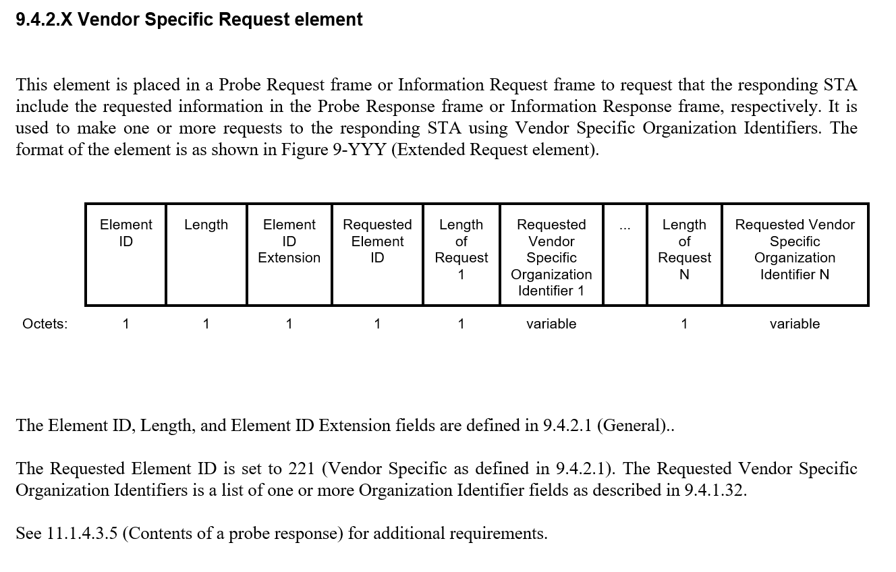
Solution – New Vendor Specific Request

Slide 9
References

