Slide 1
January 2018
802.11 Full Duplex
Date: 2018-01-15
Authors:
Slide <number>
James Gilb, Gilb Consulting
Notes:
doc.: IEEE 802.11-18/0191r0
January 2018
GenXComm, Inc.
Page <number>

Slide 2
January 2018
It is proposed that a TIG or a SG be formed to consider 802.11 Full Duplex standardization in 802.11 WG
The aim is to gauge the interest in starting a Topic Interest Group (TIG) or a Study Group (SG) for:
802.11 Full Duplex
This meeting will not:
  Fully explore the problem
  Debate strengths and weaknesses of different solutions
  Choose a solution
  Create a standard or specification
Slide <number>
James Gilb, Gilb Consulting
Notes:
doc.: IEEE 802.11-18/0191r0
January 2018
GenXComm, Inc.
Page <number>

Slide 3
January 2018
802.11 Full Duplex can enable IEEE 802.11 to keep pace with increased user demand
802.11 Full Duplex will allow simultaneous uplink and downlink on the same spectrum simultaneously
With increasing user demand, 802.11 is challenged with meeting throughput requirements in dense environments
  802.11 Full duplex with its self-interference cancellation can be a solution
    As number of users increase, self-interference cancellation can improve throughput by an order of magnitude
Wired standards like DOCSIS have already adopted Full Duplex as part of the standard to leverage its advantages
Slide <number>
James Gilb, Gilb Consulting
Notes:
doc.: IEEE 802.11-18/0191r0
January 2018
GenXComm, Inc.
Page <number>

Slide 4
January 2018
Agenda
What is Full Duplex?
How can 802.11 benefit from Full Duplex?
Technical considerations
Possible implementation options for Full Duplex
Adoption of full duplex to DOCSIS standard
Q&A
Straw Polls
Slide <number>
James Gilb, Gilb Consulting
Notes:
doc.: IEEE 802.11-18/0191r0
January 2018
GenXComm, Inc.
Page <number>

Slide 5
January 2018
What is Full Duplex (FDx)?
Full Duplex (FDx) is a bidirectional type of communication system where the two end nodes send and receive data signals at the same time.
Simplex
Half-Duplex
Full Duplex
Transmitter
Receiver
Transmitter
Receiver
Transmitter
Receiver
OR
AND
Transmitter
Receiver
Transmitter
Receiver
Slide <number>
James Gilb, Gilb Consulting
Notes:
doc.: IEEE 802.11-18/0191r0
January 2018
GenXComm, Inc.
Page <number>

Slide 6
January 2018
FDD, TDD and Full Duplex
Frequency
FDD
Frequency
TDD
Frequency
Full Duplex
DL
Guardband
Guardband
UL
UL
DL
UL
DL
UL & DL simultaneously
Time
Time
Time
Full Duplex doubles the capacity of the communication system
Slide <number>
James Gilb, Gilb Consulting

Slide 7
January 2018
Motivation for Full Duplex
Situation
  802.11 is one of the most common communications mediums used in home and enterprise environments
  Its success has led to widespread adoption
Problem Statement
  In dense environments (large number of users), 802.11 average throughput rates get substantially lower as the number of users grow.
  802.11 capacity is limited by the available unlicensed spectrum
Slide <number>
James Gilb, Gilb Consulting

Slide 8
January 2018
Motivation for Full Duplex
Possible Solutions
  Multiple solutions are possible
    Full duplex communication can double the spectrum efficiency and throughput/capacity
    802.11ad (WiGig)
Slide <number>
James Gilb, Gilb Consulting

Slide 9
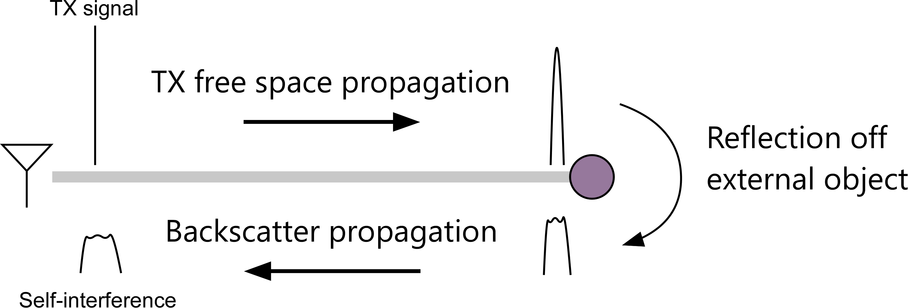
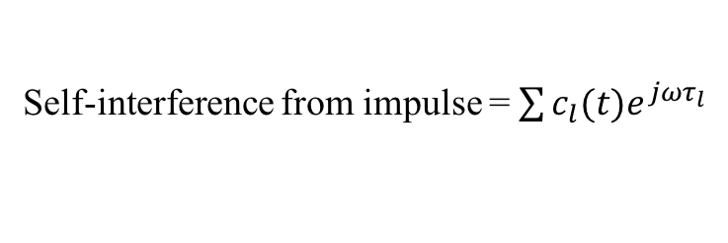
January 2018
Challenges with Full Duplex
Challenges
  Full Duplex means simultaneous Tx and Rx using the same carrier
    Reflections of Tx signals can be stronger than the desired Rx signal. These reflections must be cancelled to enable high fidelity reception of the Rx signal
Self-interference from impulse =
Slide <number>
James Gilb, Gilb Consulting

Slide 10
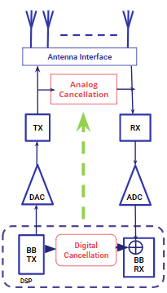
January 2018
Reflection/Echo Cancellation
Reflection/Echo signal must be cancelled to allow demodulation of desired Rx signal
  Analog cancellation is mandatory to prevent saturation of front-end LNA due to strong reflections/echoes
  Digital cancellation can augment analog cancellation to enhance interference rejection and improve SNR
30-50dB cancellation
40-50dB cancellation
Slide <number>
James Gilb, Gilb Consulting

Slide 11
January 2018
Reflection/Echo Cancellation
 | Approach 1 | Approach 2 | Approach 3 | Approach 4 | Approach 5 | Approach 6
Institutions Involved | RICE, Univ. of Waterloo | UT Austin, UCLA | GenXComm, Inc. | Stanford, Kumu Networks | Princeton, Photonics Systems Inc | Columbia, Yonsei
Approaches | Antenna Separation | Meta-materials based circulator | Hybrid | Delay and Subtract | Photonics | Antenna Polarization
MIMO Capability | Limited | Limited | Yes | Yes | Limited | Yes
Scatter Tolerance | No | No | Yes | No | No | No
Form Factor | Antenna-spacing based | small | small | small | small | small
Slide <number>
James Gilb, Gilb Consulting

Slide 12
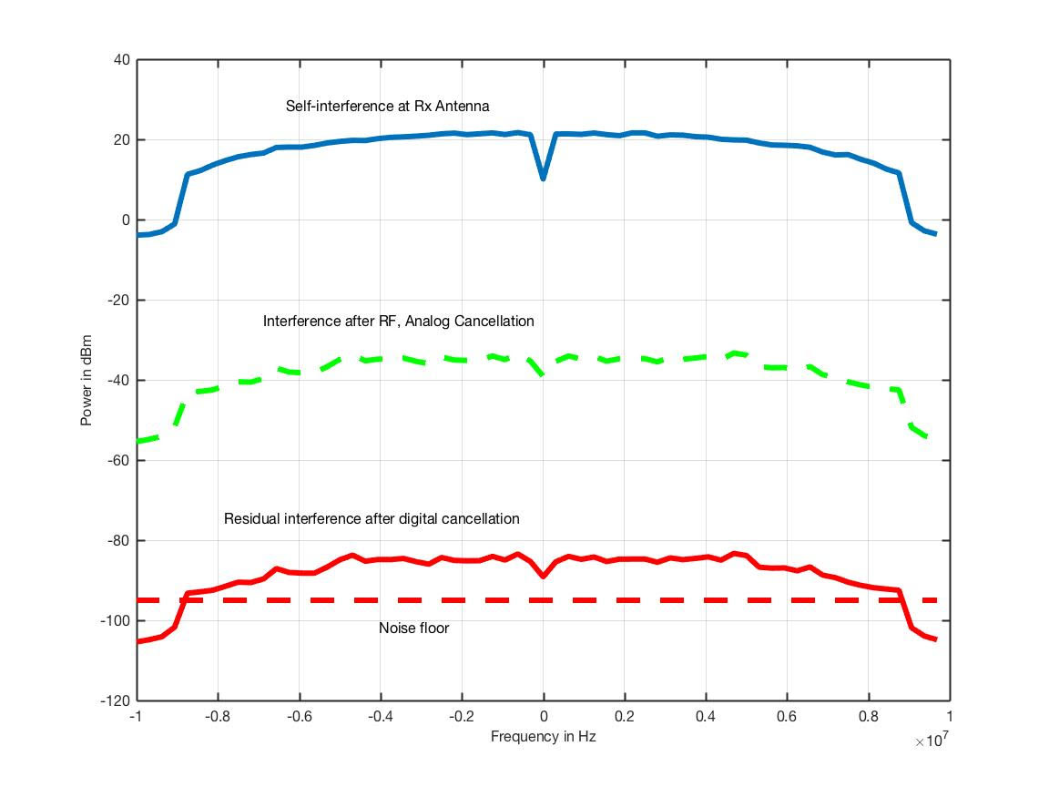
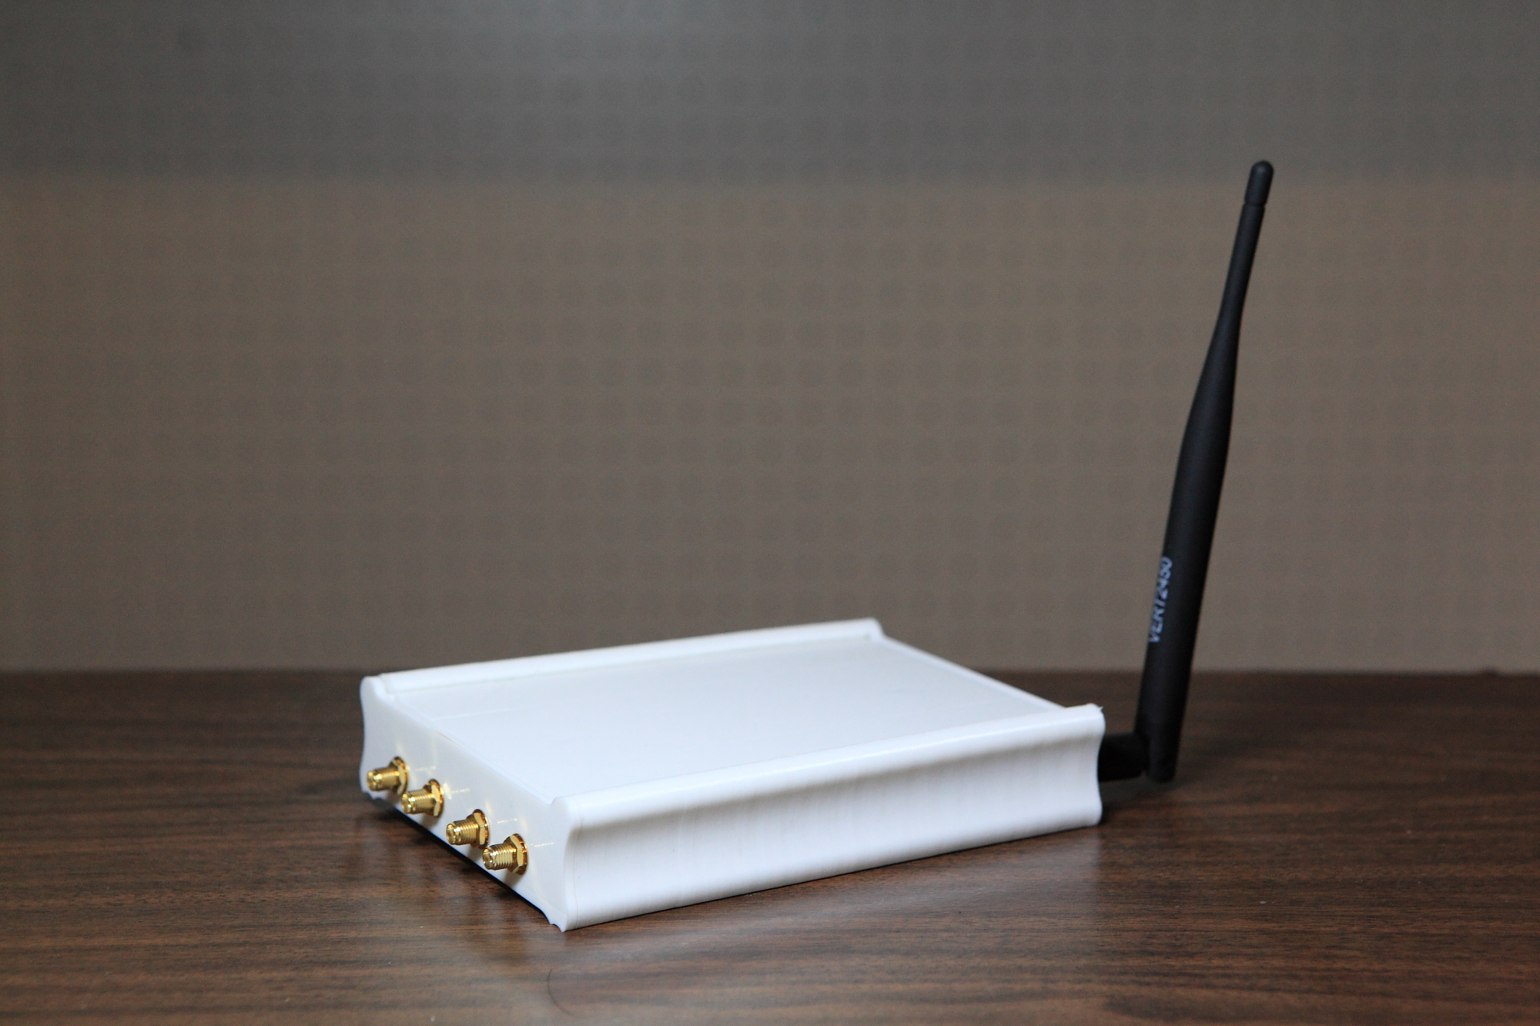
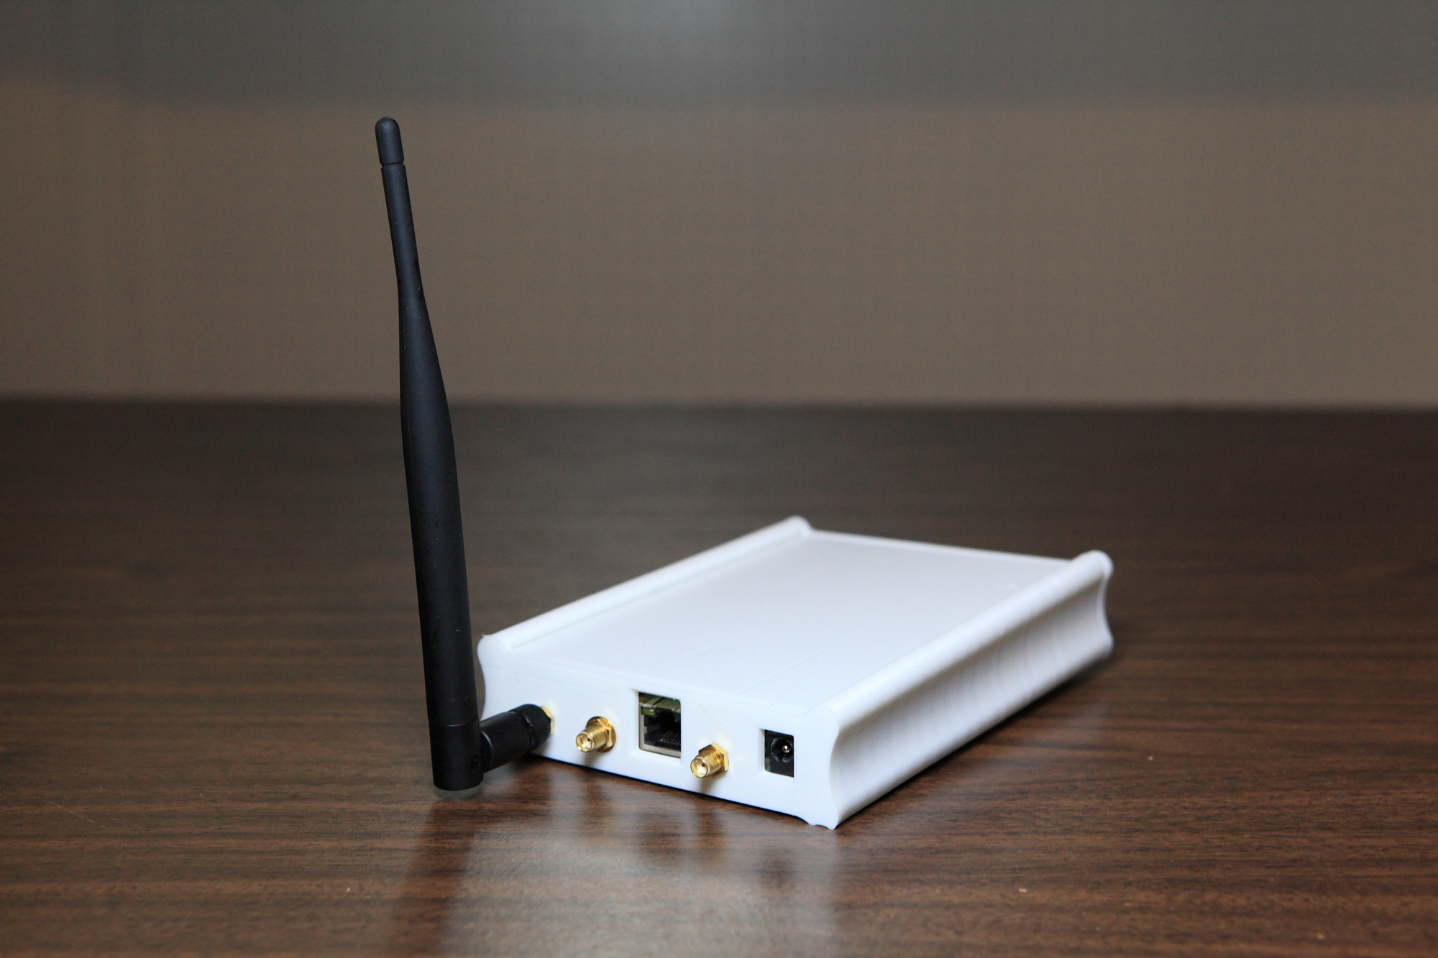
January 2018
Successful Full Duplex Lab Prototype
Full Duplex 2.4GHz, 20 MHz BW, 100 Mbps
Total cancellation of ~100dB
~50dB
~50dB
Timeframe: January 2016
Slide <number>
James Gilb, Gilb Consulting
Notes:
This is for 802.11ac MCS9
doc.: IEEE 802.11-18/0191r0
January 2018
GenXComm, Inc.
Page <number>

Slide 13
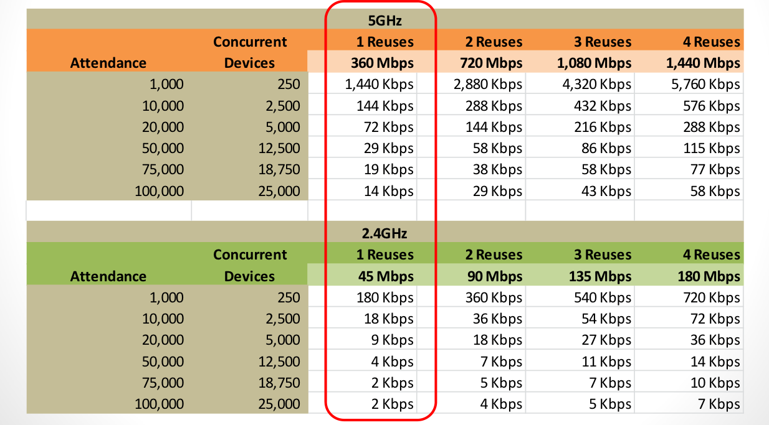
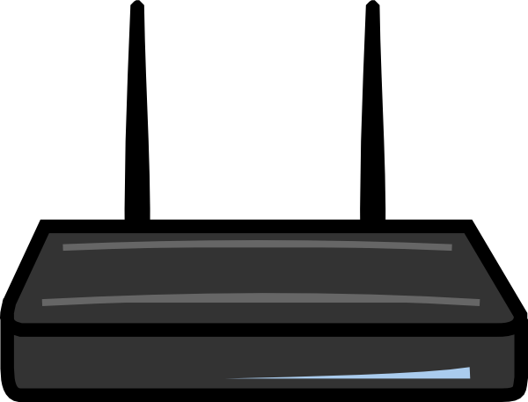
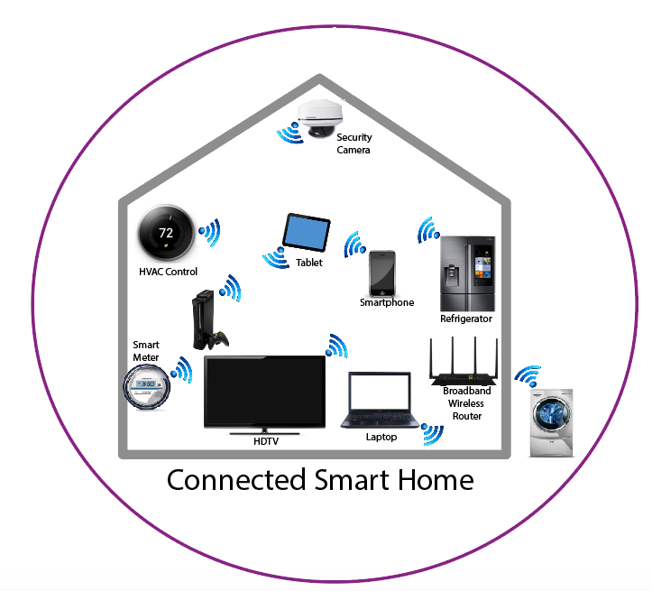
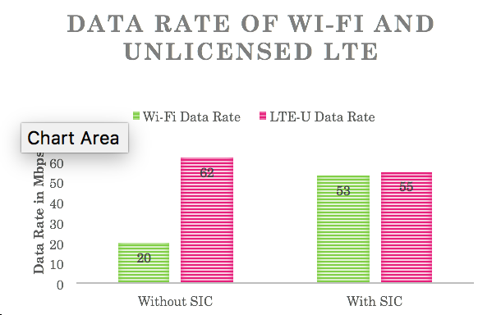
January 2018
Use case for Full Duplex in 802.11
Frequency
Multi-channel AP
Full Duplex
+
802.11
Frequency
Full Duplex Mesh
LAA
Wi-Fi
Frequency
Multi-RAT Platform
Slide <number>
James Gilb, Gilb Consulting

Slide 14
January 2018
Layer II Advantages
AP
Collision Detection with Collison Avoidance
  With Full Duplex, 802.11 radios can detect if there frame is colliding with another radio’s frame in real-time
  Reduction in the signaling overhead to communicate the collision
  AP can pre-emptively declare collision while it is receiving the energy from both STA
Multi-band transmission
  Full duplex enables radios to transmit in adjacent and overlapping frequency band to make better use of the spectrum
Sense Collison
STA
STA
AP
Indicate
Collision
Indicate
Collision
Sense Collison
STA
STA
Slide <number>
James Gilb, Gilb Consulting

Slide 15
January 2018
Layer II Advantages (cont.)
More optimal scheduling
  Flexible uplink and downlink scheduling with simultaneous transmit and receive capability at the access point
  Maintain fair use of spectrum while improving the spectral efficiency
  Full duplex is complimentary to OFDMA and MIMO
Wireless Self Backhaul
  Full duplex has capability of providing indoor and outdoor self backhaul to a 802.11 network
  This capability allows improved wireless coverage that has caused problem in scaling the network indoors and outdoors
Slide <number>
James Gilb, Gilb Consulting

Slide 16


January 2018
802.11 throughput enhancement with interference cancellation
Indoor dense environment: Walls and surroundings cause
Multi-path fading effects
UE
AP
With Full Duplex Echo Cancellation
802.11 network model of dense indoor venues like conferences, concerts, sporting events, offices
Without Full Duplex
Echo Cancellation
Assumptions: 5GHz UNI-I, 4x4 MU-MIMO capable AP, 80MHz Channel Bandwidth, ZFBF receiver
Slide <number>
James Gilb, Gilb Consulting

Slide 17
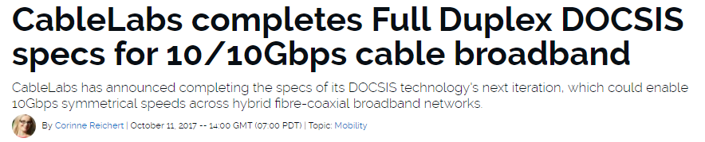
January 2018
DOCSIS Full Duplex
Slide <number>
James Gilb, Gilb Consulting

Slide 18
January 2018
Straw Poll
Do you support the formation of a study group for “Full Duplex for 802.11”?
Yes: 21
No: 23
Needs More Information: 57
Abstain: :0
Do you support the formation of a TIG for “Full Duplex for 802.11”
Yes: 51
No: 11
Needs more information: 29
Abstain: 2
Slide <number>
James Gilb, Gilb Consulting

Slide 19
January 2018
References
Bharadia, Dinesh, Emily McMilin, and Sachin Katti. "Full duplex radios." ACM SIGCOMM Computer Communication Review 43.4 (2013): 375-386.
Duarte, Melissa, and Ashutosh Sabharwal. "Full-duplex wireless communications using off-the-shelf radios: Feasibility and first results." Signals, Systems and Computers (ASILOMAR), 2010
Debaillie, Björn, et al. "Analog/RF solutions enabling compact full-duplex radios." IEEE Journal on Selected Areas in Communications 32.9 (2014): 1662-1673.
Chung, MinKeun, et al. "Prototyping real-time full duplex radios." IEEE Communications Magazine 53.9 (2015): 56-63.
Barghi, Sanaz, et al. "Characterizing the throughput gain of single cell MIMO wireless systems with full duplex radios." Modeling and Optimization in Mobile, Ad Hoc and Wireless Networks (WiOpt), 2012 10th International Symposium on. IEEE, 2012.
Korpi, Dani, et al. "Advanced self-interference cancellation and multiantenna techniques for full-duplex radios." Signals, Systems and Computers, 2013 Asilomar Conference on. IEEE, 2013.
Goyal, Sanjay, et al. "A distributed MAC protocol for full duplex radio." Signals, Systems and Computers, 2013 Asilomar Conference on. IEEE, 2013.
Tong, Zhen, and Martin Haenggi. "Throughput analysis for wireless networks with full-duplex radios." Wireless Communications and Networking Conference (WCNC), 2015 IEEE. IEEE, 2015.
Slide <number>
James Gilb, Gilb Consulting

