Slide 1
Interference Mitigation in mmWave Distribution Networks
Name | Affiliation | Address | Phone | Email
Djordje Tujkovic | Facebook | 1 Hacker Way Menlo Park, CA 94025 |  | djordjet@fb.com
Krishna Gomadam |  |  |  | kgomadam@fb.com
Alireza Mehrabani |  |  |  | tarighat@fb.com
Payam Torab |  |  |  | ptorab@fb.com

Slide 2
Overview
In this presentation we share a set of PHY and MAC features that we have found useful for interference mitigation and stable performance of mmWave distribution networks
Discussed features
  PHY level
    Continuous acquisition (signal RSSI)
    Link specific signature
      Different Golay codes
      Signal rotation
      I/Q swap
  MAC level
    Receive Abort

Slide 3
PHY-level Features

Slide 4
Need for PHY-level rejection (1)
𝜹1 + 𝜹2
With fixed wireless access and scheduled time slots the interference pattern is severe
  Transmission times on main (target) and interfering link highly correlated
Polarity concept in [2] mitigates self interference for collocated radios but aligns receive periods
Example
  Two Distribution Node (DN) radio sectors receiving from two Client Nodes (CNs) during the same TDD subframe
  CN1 and CN2 can start transmitting almost at the same time, with arrival times deterministically different due to propagation delays
  Conflicts cannot always be resolved through network scheduling (i.e., assigning CN1 and CN2 to different TDD subframes)
Transmission offset components
𝜹1 : Transmit slot boundary synchronized to within ±1 µs
𝜹2 : Time of flight difference (d1 – d2)/c typically within ±1 µs
(compare with DMG STF duration of 1.2364 µs)
CN1 → DN1
PPDU
CN2 → DN2
PPDU

Slide 5
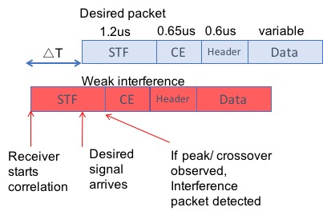
Need for PHY-level rejection (2)
Interfering packet can be fully contained within the receiver slot, i.e., receive abort on slot boundary does not help
Receiver locks onto early interference packet when △T ∈ [1.2 - 𝛼, 2.45] µs [1]
  Exact value of 𝛼 depends on AGC and preamble detection implementation
We discuss two mitigation mechanisms
  Continuous acquisition
  Link specific signature
Mechanisms can be used together

Slide 6
Need for PHY-level rejection (3)
𝜹1 + 𝜹2
Following measurement data shows a severe impact on throughput if no PHY-level rejection is deployed
CN1 → DN1
PPDU
 |  |  |  | Standard Golay Sequences
CN2 | Input | Input | Input | DN1-CN1 | DN1
Tx power | INR | SIR | SINR | throughput | PER
(dBm) | (dB) | (dB) | (dB) | (% of full rate) | (%)
31 | 9 | 10 | 9.5 | 4.60% | 92.00
29 | 8 | 11 | 10.4 | 3.70% | 93.00
27 | 7 | 12 | 11.2 | 4.60% | 92.00
25 | 5 | 14 | 12.8 | 4.60% | 92.00
23 | 3 | 16 | 14.2 | 4.60% | 92.00
21 | 2 | 17 | 14.9 | 3.70% | 92.00
19 | 0 | 19 | 16.0 | 3.70% | 92.00
17 | -2 | 21 | 16.9 | 3.70% | 92.00
15 | -4 | 23 | 17.5 | 4.60% | 90.00
13 | -6 | 25 | 18.0 | 18.70% | 69.00
11 | -8 | 27 | 18.4 | 65% | 27.00
9 | -10 | 29 | 18.6 | 93% | 5.00
7 | -12 | 31 | 18.7 | 99% | 0.70
CN2 → DN2
PPDU

Slide 7
PHY-level rejection: Achievable gain via mitigation (measurement data [1])
11ad modem is configured to use different Golay sequences (for STF and CEF) and packet acquisition’s sensitivity is intentionally degraded (higher threshold used for Golay peak detection).
Interfering link ~1 µs ahead of target link to emulate early-weak interference; low SNR operating region; MCS 9
 |  |  |  | Standard Golay Sequences | Different Golay Sequences *
CN2 | Input | Input | Input | DN1-CN1 | DN1-CN1
Tx power | INR | SIR | SINR | throughput | throughput
(dBm) | (dB) | (dB) | (dB) | (% of full rate) | (% of full rate)
31 | 9 | 10 | 9.5 | 4.60% | 99%
29 | 8 | 11 | 10.4 | 3.70% | 100%
27 | 7 | 12 | 11.2 | 4.60% | 100%
25 | 5 | 14 | 12.8 | 4.60% | 99%
23 | 3 | 16 | 14.2 | 4.60% | 99%
21 | 2 | 17 | 14.9 | 3.70% | 100%
19 | 0 | 19 | 16.0 | 3.70% | 100%
17 | -2 | 21 | 16.9 | 3.70% | 100%
15 | -4 | 23 | 17.5 | 4.60% | 100%
13 | -6 | 25 | 18.0 | 18.70% | 100%
11 | -8 | 27 | 18.4 | 65% | 100%
9 | -10 | 29 | 18.6 | 93% | 100%
7 | -12 | 31 | 18.7 | 99% | 100%

Slide 8
(1) Continuous acquisition
In-band digital RSSI is monitored after the AGC gain is frozen, to detect any large increase in RSSI.
  This RSSI is calculated off the post-ADC I/Q data, and at 1.7Gsps domain (energy received in the 1.7GHz channel)
Example RSSI calculation procedure
  Calculate pwr(n) by averaging the signal power over every 8 received samples
  Calculate RSSI(n) by applying an averaging window over the last 32 values of pwr(n); i.e., RSSI(n)=mean[pwr(n:n-31)]
  Whenever, RSSI(n) exceeds the value of RSSI(n) at the time of AGC freeze by e.g. 3dB (or 5dB), reset the acquisition hardware for re-acquisition.
  Effective bandwidth of RSSI calculation is 1.76GHz/(8*32)~7MHz or effective averaging over two Golay blocks
Rx[0]
Rx[8]
Rx[1]
Rx[9]
Time
Rx[7]
Rx[15]
pwr(0)=mean(|Rx(0:7)|²)
pwr(1)=mean(|Rx(8:15)|²)

Slide 9
Continuous acquisition
Baseline with no interference (simulation)
Suggested method
  Continue monitoring post-ADC RSSI, even after initial preamble acquisition.
  If the RSSI jumps by more than 5dB (configurable threshold), perform the following:
    Release AGC to re-adjust RX gain
    Enable Golay correlators
    Discard the current acquired time/frequency values
    Start a new preamble acquisition
Typical preamble acquisition algorithm is modeled in Matlab simulation
It included impairments like ppm, channel multipath, ADC saturation/quantization, AGC settlement time, phase noise, etc
With continuous acquisition feature, there is zero probability of “missed detection” at SNR down to -5dB (for SC preamble). This confirms no chance of miss-trigger to re-acquire.

Slide 10
Continuous acquisition
Early-interference same Golay (simulation)
As an example, with re-acquisition triggered at +5dB RSSI jump, ~100% correct detection at SIR > 5dB, with no degradation in baseline performance.
SIR>+5dB region covers most practical scenarios in Distribution Network use case.
Correct detection at lower SIRs (e.g., SIR>+3dB) still achievable by adjusting the trigger threshold in the implementation.
Re-Acquisition RSSI-Jump Trigger = 5dB

Slide 11
(2a) Link specific signature: Different Golay sequences
Link specific preamble: Use different Golay sequences in STF and CEF portions of preamble for interfering link.
In 11ad, the Ga and Gb are generated according to the following equations:
  A_{k}(n )=W_{k} A_{k −1}(n) + B_{k −1}(n − D_{k}); A₀(n)=δ(n)
  B_{k}(n )=W_{k} A_{k −1}(n) − B_{k −1}(n − D_{k}); B₀(n)=δ(n)
  Ga₁₂₈(n)=A₇(128-n), Gb₁₂₈(n)=B₇(128-n)
  D_{k} = [1 8 2 4 16 32 64] and W_{k} =[-1-1-1-1+1-1-1]
We propose to create additional Golay sequences by modifying W_{k}
  The correlator structure and the delays remain the same
  128 (2⁷) Golay sequences available with 7 elements in W
  Additional sequences possible with complex entries in W

Slide 12
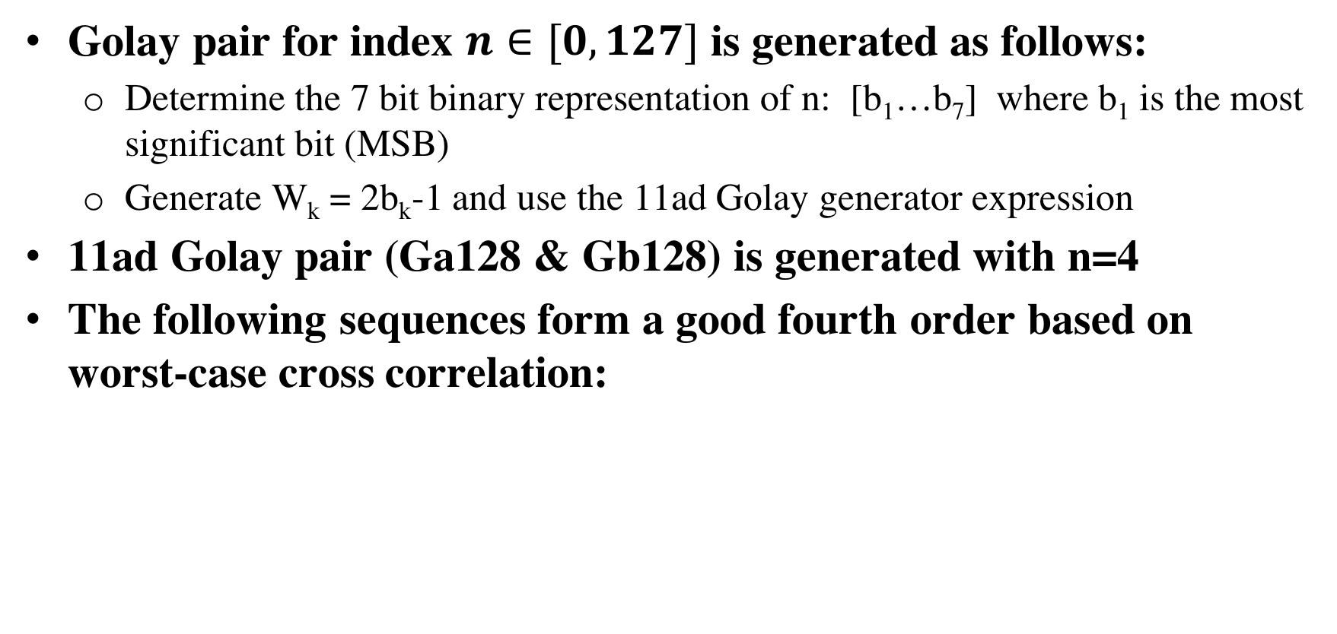
Golay sequence definition
Golay pair for index $n∈[0,127]$ is generated as follows:
  Determine the 7 bit binary representation of n: [b₁…b₇] where b₁ is the most significant bit (MSB)
  Generate W_{k} = 2b_{k}-1 and use the 11ad Golay generator expression
11ad Golay pair (Ga128 & Gb128) is generated with n=4
The following sequences form a good fourth order based on worst-case cross correlation:
Golay index | W
4 | [-1-1-1-1 1-1-1]
92 | [1 -1 1 1 1 -1 -1]
48 | [-1 1 1 -1 -1 -1 -1]
108 | [1 1 -1 1 1 -1 -1]

Slide 13
Worst case cross correlation of Golay (4, 92, 48, 108)
Worst case cross correlation in dBr | Index 4 | Index 92 | Index 48 | Index 108
Golay index 4 (11ad) | 0 | -11.5 | -8.5 | -11.1
Golay index 92 | -11.5 | 0 | -9.9 | -8.5
Golay index 48 | -8.5 | -9.9 | 0 | -10.1
Golay index 108 | -11.1 | -8.5 | -10.1 | 0
Notes:
Packet detection block should be based on cross correlation of the received signal with Golays
Autocorrelation based packet detection may not provide gains
Actual suppression gain can be enhanced with looking at the structure of the cross correlator output instead of just the peak
  Thresholding and AGC tuning can further help

Slide 14
Different Golay example (1)
Simulation scenario: only interfering packets are transmitted
Consider a receiver, receiving mismatching preambles (interfering signal with different preamble)
Full rejection of interference can be achieved (for high/low INR regions)
100% “missed detection” rate below means the receiver does not lock onto any interfering signals with different preamble

Slide 15
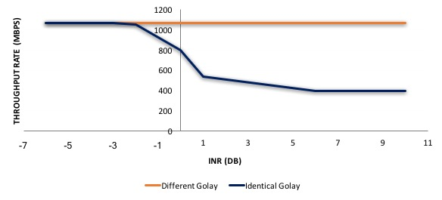
Different Golay example (2): Field data
MSC9 50% duty cycle (TDD) on both links transmitting simultaneously, max Tput per link 1.05Gbs
Interference advanced by 1us

Slide 16
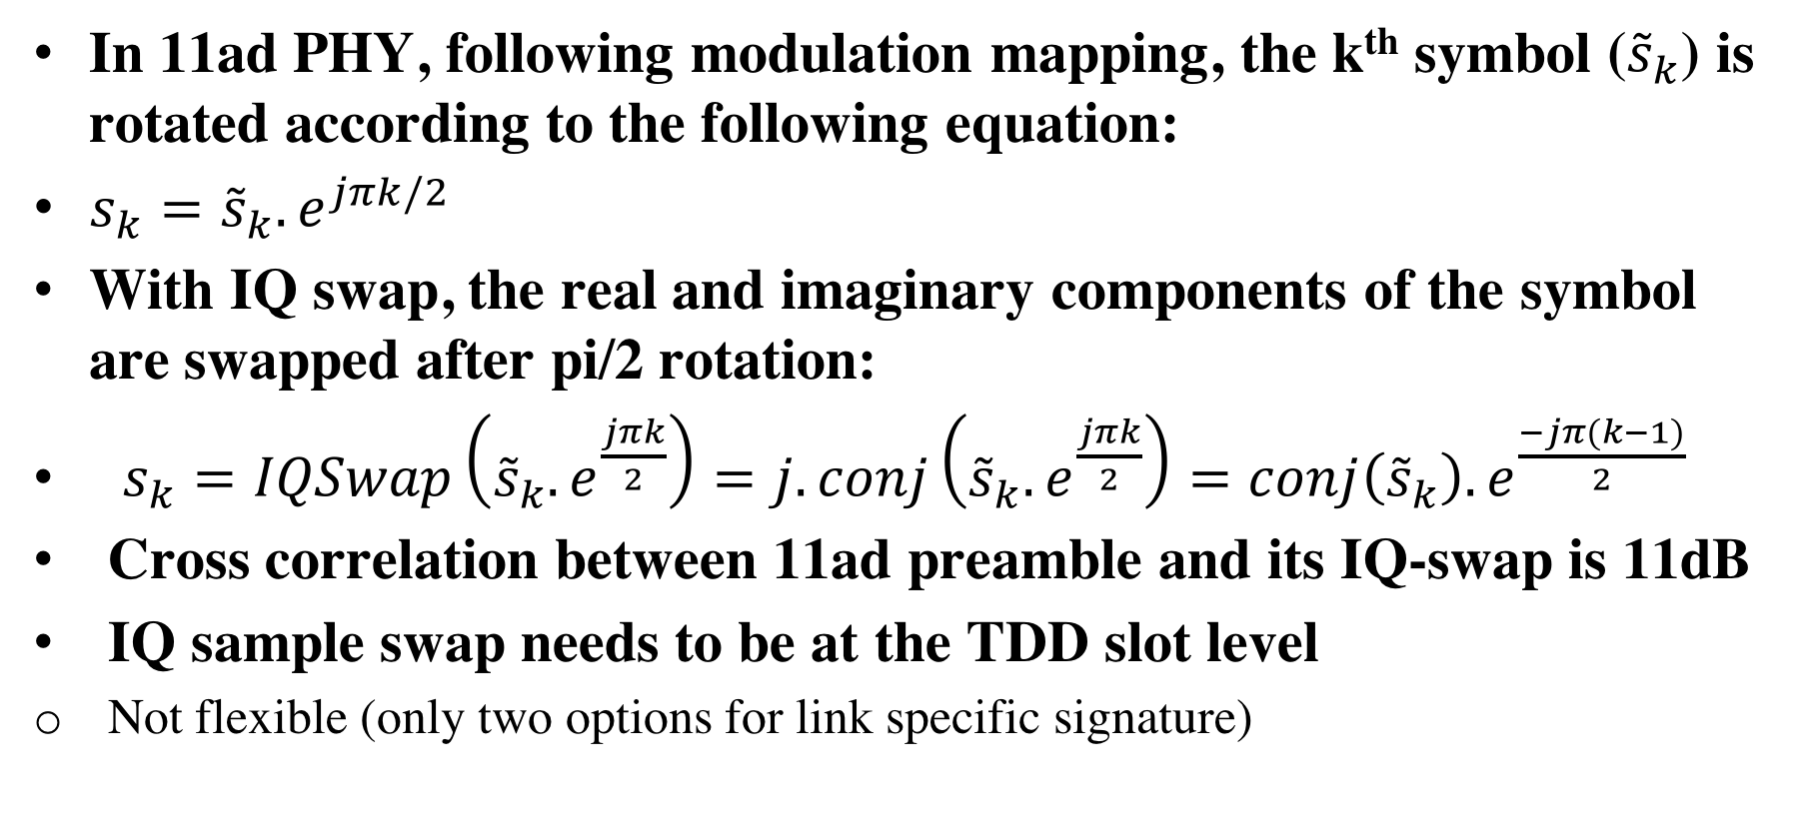
(2b) Link Specific Signature: IQ swap
In 11ad PHY, following modulation mapping, the k^{th} symbol (${\tilde{s}}_{k}$) is rotated according to the following equation:
$s_{k}={\tilde{s}}_{k}. e^{jπk/2}$
With IQ swap, the real and imaginary components of the symbol are swapped after pi/2 rotation:
$s_{k}=IQSwap\left({\tilde{s}}_{k}. e^{\frac{jπk}{2}}\right)=j.conj\left({\tilde{s}}_{k}. e^{\frac{jπk}{2}}\right)=conj\left({\tilde{s}}_{k}\right). e^{\frac{−jπ(k−1)}{2}}$
Cross correlation between 11ad preamble and its IQ-swap is 11dB
IQ sample swap needs to be at the TDD slot level
  Not flexible (only two options for link specific signature)

Slide 17
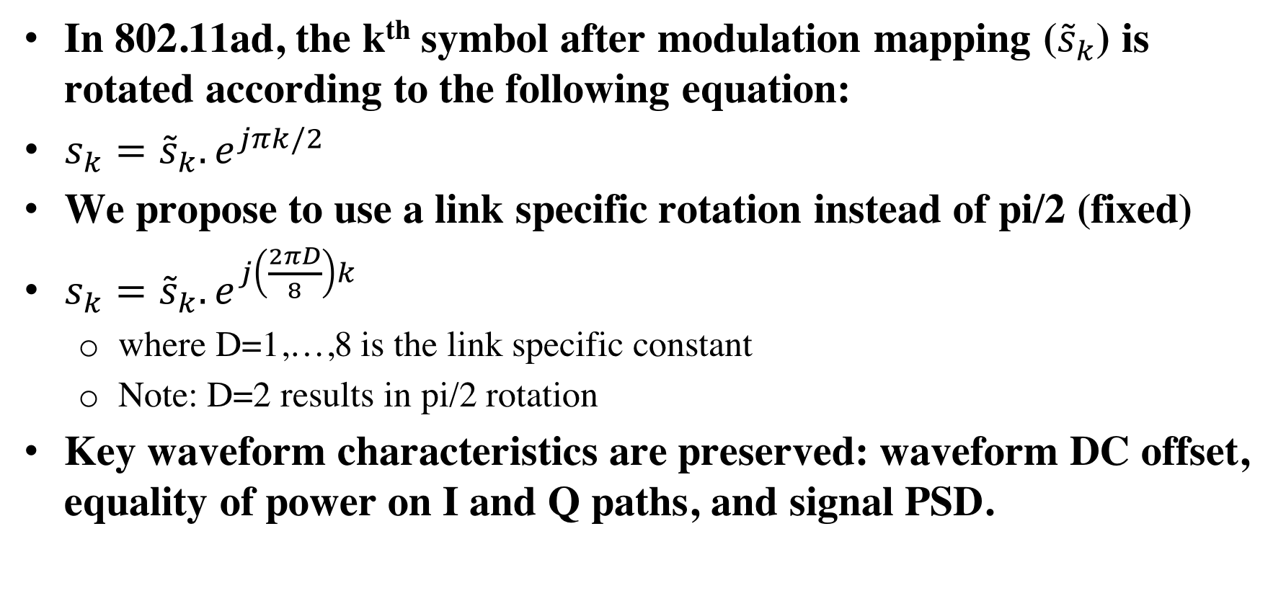
(2c) Link Specific Signature: Signal rotation
In 802.11ad, the k^{th} symbol after modulation mapping (${\tilde{s}}_{k}$) is rotated according to the following equation:
$s_{k}={\tilde{s}}_{k}. e^{jπk/2}$
We propose to use a link specific rotation instead of pi/2 (fixed)
$s_{k}={\tilde{s}}_{k}. e^{j\left(\frac{2πD}{8}\right)k}$
  where D=1,…,8 is the link specific constant
  Note: D=2 results in pi/2 rotation
Key waveform characteristics are preserved: waveform DC offset, equality of power on I and Q paths, and signal PSD.

Slide 18
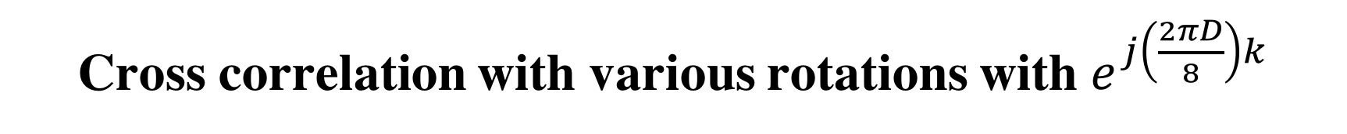
Cross correlation with various rotations with $e^{j\left(\frac{2πD}{8}\right)k}$
Cross correlation in dBr
D | 1 | 2 | 3 | 4 | 5 | 6 | 7 | 8
1 | 0.0 | -8.1 | -9.0 | -11.2 | -11.0 | -11.2 | -9.0 | -8.1
2 802.11ad | -8.1 | 0.0 | -8.1 | -9.0 | -11.2 | -11.0 | -11.2 | -9.0
3 | -9.0 | -8.1 | 0.0 | -8.1 | -9.0 | -11.2 | -11.0 | -11.2
4 | -11.2 | -9.0 | -8.1 | 0.0 | -8.1 | -9.0 | -11.2 | -11.0
5 | -11.0 | -11.2 | -9.0 | -8.1 | 0.0 | -8.1 | -9.0 | -11.2
6 IQ swap of 802.11ad | -11.2 | -11.0 | -11.2 | -9.0 | -8.1 | 0.0 | -8.1 | -9.0
7 | -9.0 | -11.2 | -11.0 | -11.2 | -9.0 | -8.1 | 0.0 | -8.1
8 | -8.1 | -9.0 | -11.2 | -11.0 | -11.2 | -9.0 | -8.1 | 0.0

Slide 19
Summary of rotation choices for D in $e^{j\left(\frac{2πD}{8}\right)k}$
D | Comments
1 (pi/4) | Degrades BPSK PAPR slightly Improves QPSK PAPR slightly
2 (pi/2) | 802.11ad
3 (3*pi/4) | Same as 1
4 (pi) | No constellation rotation for BPSK. PAPR is degraded for BPSK
5(5*pi/4) | Same as 1
6 (3*pi/2) | IQ swap of 2 (802.11ad)
7 (7*pi/4) | Same as 1
8 (2*pi) | No constellation rotation for BPSK PAPR for BPSK may be affected
Notes:
Autocorrelation based packet detection may not provide gains
Actual suppression gain can be enhanced with looking at the structure of the cross correlator output instead of just the peak
  Thresholding and AGC tuning can further help

Slide 20
MAC-level Features

Slide 21
Need for receive abort
Missed preamble detection even with sufficient SIR
Interfering PPDUs can keep the radio busy at the beginning of a TDD slot, resulting in the STA missing the intended packet, even with sufficient SIR
Interference sources
  DMG devices outside the distribution network
  Neighboring links from different distribution networks (unsynchronized) on the same channel
Distribution network devices need a mechanism to abort a pending receive operation on a timed basis
  Semantics can be in the form of a receive abort (RXABORT) request at the PHY SAP level
TDD slot allocated to
STA A (Rx) and STA B (Tx)
TDD slot allocated to
STA A (Rx) and STA C (Tx)
Without receive abort at the end of the slot:
the interfering PPDU will block the C→A PPDU even with sufficient SIR
B → A
PPDU
C → A
PPDU
Preamble
Interfering PPDU
With receive abort at the end of the slot:
C→A PPDUs can be correctly received assuming sufficient SIR
B → A
PPDU
C → A
PPDU
Interfering PPDU
Abort receive after a guard time based on largest time synchronization error
Notes:
☺☺☺☺☺☺

Slide 22
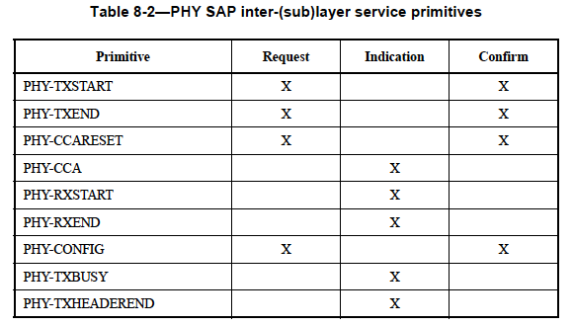
Receive abort operation: Time-based abort request
TDD slot allocated to
STA A (Rx) and STA B(Tx)
TDD slot allocated to
STA A (Rx) and STA C (Tx)
Relying on MAC decode (RA mismatch) is generally insufficient because PHY plus MAC decode latency could enter the next TDD slot
We recommend to add a PHY-RXABORT Request primitive in PHY SAP
Without receive abort at the end of the slot:
the interfering PPDU will block the C→A PPDU even with sufficient SIR
Interfering PPDU
aRxPHYDelay
MAC processing delay
(decode RA)

Slide 23
Summary

Slide 24
Summary
We discussed several interference mitigation techniques
  (PHY) Continuous acquisition
    No changes to preamble design
    Can reliably work for SIR>5dB
    Can improve network efficiency in access/consumer applications of DMG devices
  (PHY) Link specific signature (Different Golay sequences, I/Q swap, Signal Rotation)
    The strongest (best) mechanism in terms of rejection
    Can essentially work in any range of SIR
      Exact range of coverage will depend on details of preamble acquisition algorithm
    Co-existence with 11ad/11ay can be addressed through control plane
      11aj faced similar problems; fixed wireless can be more systematic
  MAC-level rejection
    Additional protection

Slide 25
Straw Poll (1)
Do you agree to recommend to re-acquire a DMG/EDMG packet upon detecting a jump in RSSI after AGC freeze (details to be defined) for TDD networks?
  Note: For example, +3-5 dB RSSI jump (TBD), detected through a measurement, with 3 dB bandwidth of ~ 7MHz (two Golay 128 sequences)
Y: N: A:

Slide 26
Straw Poll (2)
Do you agree to define a receive PHY abort (PHY-RXABORT) primitive in PHY SAP, with usage defined at least for Distribution Networks?
Y: N: A:

Slide 27
On the waveform transformations
We have found the following transformations important for Distribution Networks (and are not seeking more research or extensions)
At this meeting we are not running any straw poll until further discussion
  Use of different Golay complementary sequences; sequences limited to those that can be generated through weight, delay [W, D] formulation, with D same as in 11ad (fixed), and W variable
  I, Q swap
  Signal rotation (exp (2 * pi * j * k /8))

Slide 28
References
“Changes to IEEE 802.11ay in support of mmW Distribution Network Use Cases,” IEEE 802.11-17/1022r0
“Features for mmW Distribution Network Use Case,” IEEE 802.11-17/1321r0

Slide 29
Appendix:
Simulation packet manual

Slide 30
Simulation model: Features
MATLAB files attached in .zip format
Sample-level model for "AGC, packet acquisition, re-acquisition”
DMG waveform only
Included impairments
  ADC quantization/saturation, carrier frequency offset (ppm), gain command-line delays, channel multipath, fractionally-delayed channel taps

Slide 31
Simulation model: Algorithms
AGC
  Based on “clipping rate” and “average RSSI”
  Different gain settings for IF and RF
  Pause mechanism to accommodate latency of gain-change commands
Golay/STF Acquisition
  Averaging over multiple Golay blocks
  Dynamic detection threshold (not a fixed absolute level)
  Tracking multiple Golay peaks
  End of STF detection (+1 → -1 transition)
Continuous re-acquisition
  Monitor RSSI/clipping rate after first detected STF for possible triggering of re-aquisition

Slide 32
Matlab Structure: Running Single Packet
Modify all simulation configurations in the file “systemConfig.m”
  Nominal values for all configurations are given in the following slides.
Run “demoPacketAcq.m” to simulate a single packet acquisition instance and plots all key waveforms.

Slide 33
Configuration Parameters (1/3)
%% Channel Conditions for Interference/Target
cfg.noisePwr = -80; %dBm
cfg.sir = 10; %dB
cfg.snr = 15; %dB
cfg.intPpm = 10; % ppm: frequency offset @Int device
cfg.tarPpm = -10; % ppm: frequency offset @Tar device
cfg.intTxEvm = 20; % dB: TX EVM of Int device
cfg.tarTxEvm = 20; % dB: TX EVM of Tar device
cfg.toaInt = 1000 + round(rand*400); % Tc: time of arrival for interference signal
cfg.toaTar = 1*1800+2550 + round(rand*400); % Tc: time of arrival for target signal
cfg.orthGolay = 1; % 1: use different Golay for Interfering waveform
cfg.intChannelVal = [0 -30]; % dB: relative power levels of channel taps for interference signal
cfg.intChannelDel = [0 2]; % Tc: relative power levels of channel taps for interference signal
cfg.tarChannelVal = [0 -40 -40 -40]; % dB: relative power levels of channel taps for interference signal
cfg.tarChannelDel = [0 4 8 16]; % Tc: relative power levels of channel taps for interference signal

Slide 34
Configuration Parameters (2/3)
%% Waveform and RF/analog Chain Configurations
cfg.Fc = 1.76e9; % Hz: chip rate
cfg.Fcar = 60e9; % Hz: carrier frequency
cfg.nDataSamples = 512; % number of qpsk data samples added after preamble
cfg.rfGain0 = 20; % fixed front end RF gain
cfg.rfGain = (-7:7:50); % set of variable RF gain values
cfg.bbGain = (-7:1.5:30); % set of variable BB gain values
cfg.rfGainAct = 1.5+(-7:7:50); % actual RF gain values
cfg.bbGainAct = -.75+(-7:1.5:30); % actual BB gain values
cfg.adcBits = 6; % bits: number of logical ADC bits
cfg.adcBackoff = 10; % dB: target backoff for ADC output
cfg.adcFullSwing = -10; % dBm: ADC input power level corresponding to full swing sine wave
cfg.agcBlk = 8; % number of data sample per block of ADC data
cfg.rfLatency = 4; % cfg.agcBlk * Tc: latency for propagation of effect of RF gain change
cfg.bbLatency = 2; % cfg.agcBlk * Tc: latency for propagation of effect of BB gain change

Slide 35
Configuration Parameters (3/3)
%% Algorithm Configurations
cfg.rssiAvgLen = 8; % Number of partial rssi values being averaged
cfg.rssiAvgForThresh = 32; % Number of partial rssi values averaged to derive threshold for golay outout
cfg.clipAvgLen = 2; % Number of partial clipping rate values being averaged
cfg.golayAvgNum = 2; % supported values: 1, 2, 3, 4 :Number of Golay blocks to be averaged at output of Golay correlator before peak detection
cfg.rssiThreshFactor = 12; % dB: threshold set above running-rssi for detecting golay peaks
cfg.numPeaks = 7; % number of confirmed peaks to declare a detected STF
cfg.useClipRate = 1; % 1: utilize clipping rate as part of agc gain routine
cfg.ClipRateTh = .8; % threshold for clipping rate in order to take an action by agc routine
cfg.enableGainFreeze = 1; % 1: freeze RX gain after certain number of Golay peaks
cfg.cosEndofStf = -0.5; % threshold for cosine of phase rotation to declare end of STF
cfg.pwrDetEn = 0; % enable monitoring co-channel power increase to reset AGC/Acquisition
cfg.pwrDetdB = 5; % dB: pwer increase level to release AGC
cfg.golayWindowing = 1; % number of adjacent samples averaged at golay correlator output (to cover half-chip delay channel tap)
cfg.rfWait = 16; % cfg.agcBlk * Tc: wait time after RF gain change before another gain adjustment
cfg.bbWait = 16; % cfg.agcBlk * Tc: wait time after BB gain change before another gain adjustment

Slide 36
Running “demoPacketAcq.m” (1)

Slide 37
Running “demoPacketAcq.m” (2)

Slide 38
Matlab Structure: Running Large Number of Packets
Run “loopPacketAcq.m” to perform monte carlo simulations by running over nPackets acquisition instances and sweeping over a single configuration field
  You can modify the following three parameters in this file:
    nPackets = 100;
    loopField='snr';
    loopRange = 5:1:15;
  This scripts models and produces statistics for “correct detection”, “false detection”, “missed detection”
After running “loopPacketAcq.m” , a .math file is generated to store simulation results. Copy the .math file name to “plotLoopAcq.m”, run “plotLoopAcq.m” to plot the results.

Slide 39
Running “loopPacketAcq.m” (1)

