Slide 1
Waveform Design for SYNC Field
Date: 2018-01-15
Authors:

Slide 2
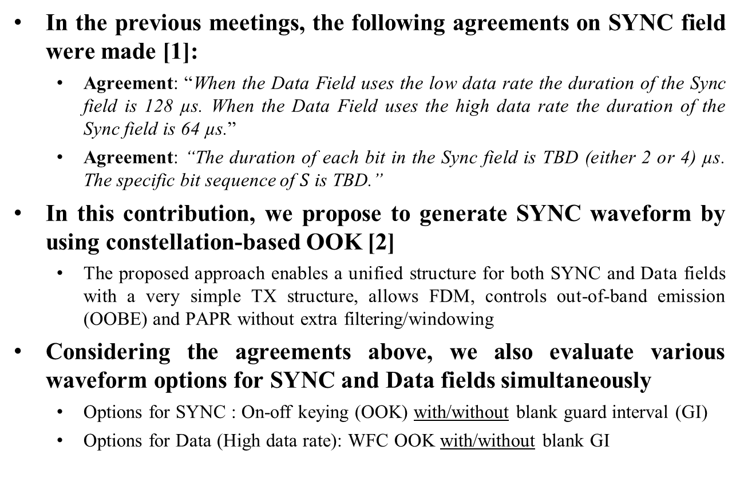
Introduction
In the previous meetings, the following agreements on SYNC field were made [1]:
  Agreement: “When the Data Field uses the low data rate the duration of the Sync field is 128 µs. When the Data Field uses the high data rate the duration of the Sync field is 64 µs.”
  Agreement: “The duration of each bit in the Sync field is TBD (either 2 or 4) µs. The specific bit sequence of $S$ is TBD.”
In this contribution, we propose to generate SYNC waveform by using constellation-based OOK [2]
  The proposed approach enables a unified structure for both SYNC and Data fields with a very simple TX structure, allows FDM, controls out-of-band emission (OOBE) and PAPR without extra filtering/windowing
Considering the agreements above, we also evaluate various waveform options for SYNC and Data fields simultaneously
  Options for SYNC : On-off keying (OOK) with/without blank guard interval (GI)
  Options for Data (High data rate): WFC OOK with/without blank GI

Slide 3
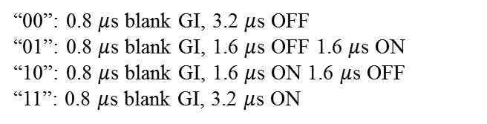

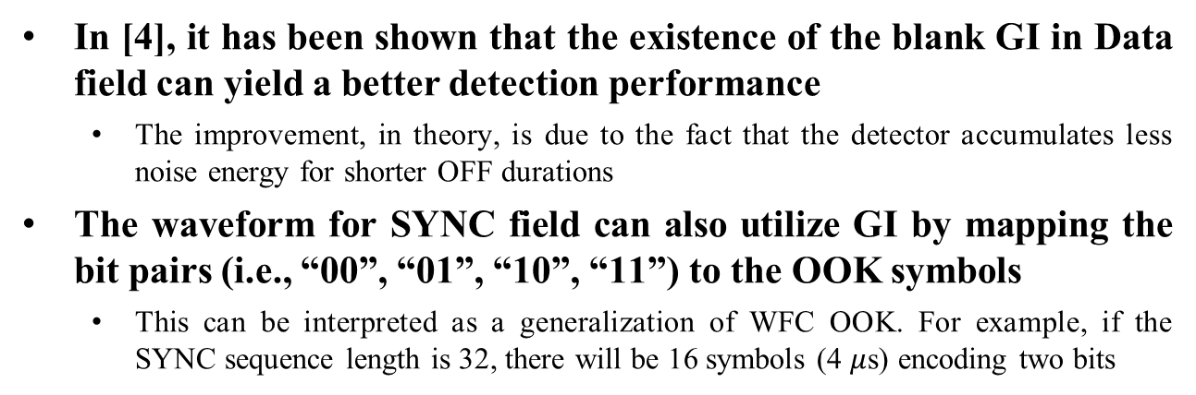



SYNC Field Waveform with GI
In [4], it has been shown that the existence of the blank GI in Data field can yield a better detection performance
  The improvement, in theory, is due to the fact that the detector accumulates less noise energy for shorter OFF durations
The waveform for SYNC field can also utilize GI by mapping the bit pairs (i.e., “00”, “01”, “10”, “11”) to the OOK symbols
  This can be interpreted as a generalization of WFC OOK. For example, if the SYNC sequence length is 32, there will be 16 symbols (4 $μ$s) encoding two bits
SYNC sequence (32)
10 01 …… 00 11
“10”
“01”
“00”
“11”
GI
“00”: 0.8 $μ$s blank GI, 3.2 $μ$s OFF
“01”: 0.8 $μ$s blank GI, 1.6 $μ$s OFF 1.6 $μ$s ON
“10”: 0.8 $μ$s blank GI, 1.6 $μ$s ON 1.6 $μ$s OFF
“11”: 0.8 $μ$s blank GI, 3.2 $μ$s ON
GI
GI
…
GI
4 $μ$s
4 $μ$s
4 $μ$s
4 $μ$s
SYNC (64 $μs$)

Slide 4
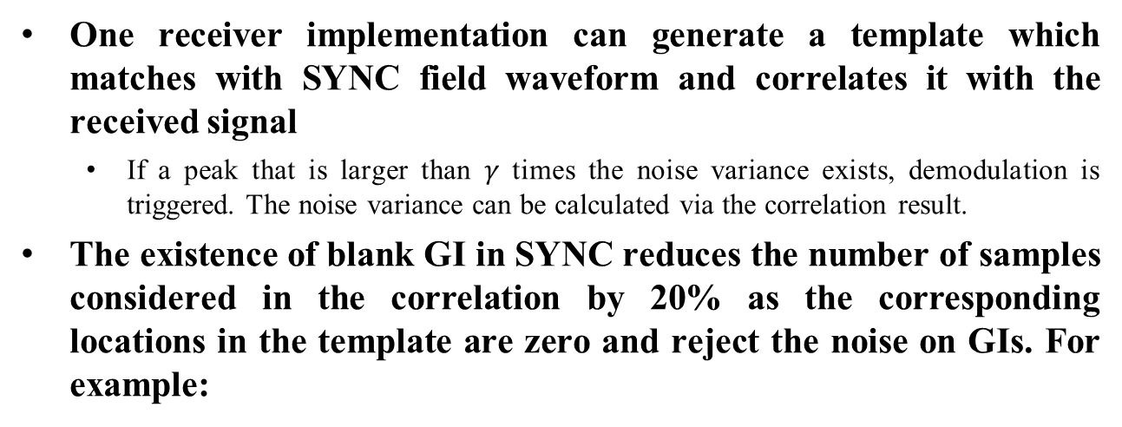

Detection of SYNC Field with GI
One receiver implementation can generate a template which matches with SYNC field waveform and correlates it with the received signal
  If a peak that is larger than $γ$ times the noise variance exists, demodulation is triggered. The noise variance can be calculated via the correlation result.
The existence of blank GI in SYNC reduces the number of samples considered in the correlation by 20% as the corresponding locations in the template are zero and reject the noise on GIs. For example:
“10”
“01”
“00”
“11”
Transmitted
SYNC:
Power
GI
GI
GI
GI
Time
4 $μ$s
4 $μ$s
4 $μ$s
4 $μ$s
Template at RX for correlation:
1
-1
“0” due to the GI

Slide 5












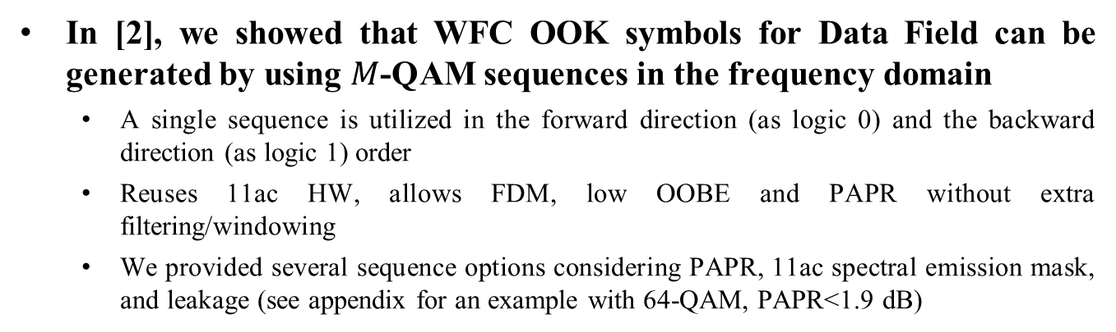






















Re-cap: Constellation-based OOK
In [2], we showed that WFC OOK symbols for Data Field can be generated by using $M$-QAM sequences in the frequency domain
  A single sequence is utilized in the forward direction (as logic 0) and the backward direction (as logic 1) order
  Reuses 11ac HW, allows FDM, low OOBE and PAPR without extra filtering/windowing
  We provided several sequence options considering PAPR, 11ac spectral emission mask, and leakage (see appendix for an example with 64-QAM, PAPR<1.9 dB)
Logic 0
sequence
Logic 1
sequence
Logic 0
OOK
Logic 1
OOK
Mapping
IDFT
(64)
$$x_{0}$$
$$x_{0}$$
Logic 1
$$d_{1}$$
$$d_{12}$$
$$x_{1}$$
$$x_{63}$$
$$d_{2}$$
$$d_{11}$$
$$x_{2}$$
$$x_{62}$$
6 $M$-QAM symbols
$$d_{3}$$
$$d_{10}$$
…
Amplitude
$$d_{4}$$
$$d_{9}$$
Logic 1
sequence
$$d_{5}$$
$$d_{8}$$
Logic 0
t
1 center tone
$$d_{6}$$
$$d_{7}$$
Add GI
0
0
$$d_{7}$$
$$d_{6}$$
Logic 0
sequence
$$d_{8}$$
$$d_{5}$$
Amplitude
6 $M$-QAM symbols
$$d_{9}$$
$$d_{4}$$
$$d_{10}$$
$$d_{3}$$
Data
…
t
$$d_{11}$$
$$d_{2}$$
$$0$$
$$T_{GI}$$
$$d_{12}$$
$$d_{1}$$
$$x_{62}$$
$$x_{2}$$
$$x_{63}$$
$$x_{1}$$
IDFT output

Slide 6

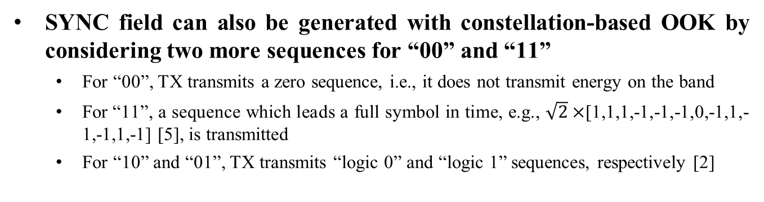
SYNC Field with Constellation-based OOK (1/2)
SYNC field can also be generated with constellation-based OOK by considering two more sequences for “00” and “11”
  For “00”, TX transmits a zero sequence, i.e., it does not transmit energy on the band
  For “11”, a sequence which leads a full symbol in time, e.g., $\sqrt{2}×$[1,1,1,-1,-1,-1,0,-1,1,-1,-1,1,-1] [5], is transmitted
  For “10” and “01”, TX transmits “logic 0” and “logic 1” sequences, respectively [2]
“01”
“00”
“00” seq.
IDFT
(64)
“01” seq.
Mapping
t
t
Add GI
“10”
“11”
“10” seq.
“11” seq.
Bits
t
t
$$0$$
$$0$$
IDFT output
IDFT output

Slide 7











SYNC Field with Constellation-based OOK (2/2)
This approach unifies the waveform for both SYNC and Data fields
  For example, high and low data rate WUS can use “01” and “10” sequences
High data rate WUS:
“Logic 0”
“Logic 1”
“Logic 1”
“10”
“01”
“00”
“11”
“10”
“01”
“01”
4 $μ$s
4 $μ$s
4 $μ$s
4 $μ$s
4 $μ$s
4 $μ$s
4 $μ$s
SYNC (64 $μs$)
Data field
“Logic 0”
“Logic 1”
Low data rate WUS:
“10”
“01”
“00”
“11”
“10”
“10”
“01”
“01”
4 $μ$s
4 $μ$s
4 $μ$s
4 $μ$s
4 $μ$s
4 $μ$s
4 $μ$s
4 $μ$s
SYNC (128 $μs$)
Data field

Slide 8
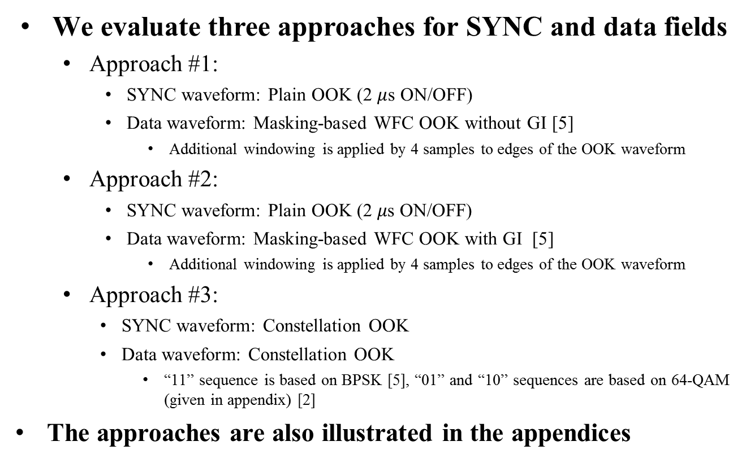
Simulation Assumptions (1/2)
We evaluate three approaches for SYNC and data fields
  Approach #1:
    SYNC waveform: Plain OOK (2 $μ$s ON/OFF)
    Data waveform: Masking-based WFC OOK without GI [5]
      Additional windowing is applied by 4 samples to edges of the OOK waveform
  Approach #2:
    SYNC waveform: Plain OOK (2 𝜇s ON/OFF)
    Data waveform: Masking-based WFC OOK with GI [5]
      Additional windowing is applied by 4 samples to edges of the OOK waveform
  Approach #3:
    SYNC waveform: Constellation OOK
    Data waveform: Constellation OOK
      “11” sequence is based on BPSK [5], “01” and “10” sequences are based on 64-QAM (given in appendix) [2]
The approaches are also illustrated in the appendices

Slide 9
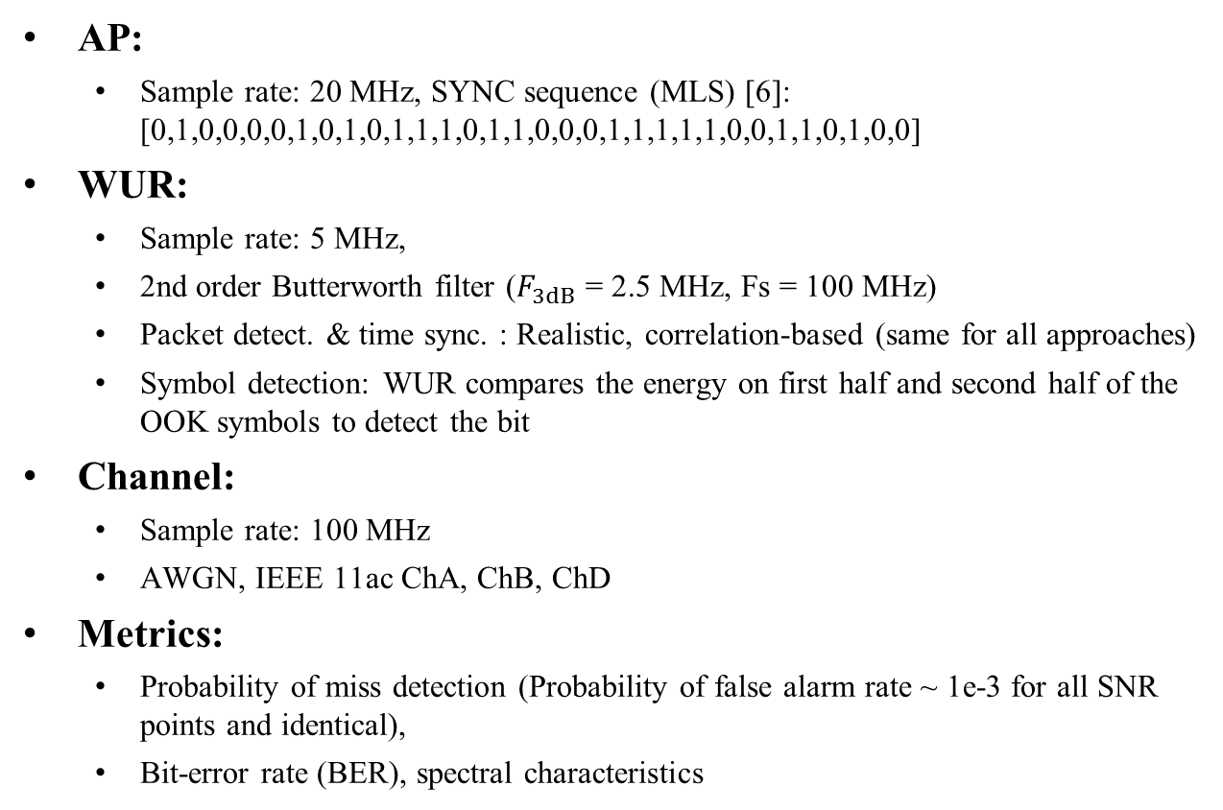
Simulation Assumptions (2/2)
AP:
  Sample rate: 20 MHz, SYNC sequence (MLS) [6]: [0,1,0,0,0,0,1,0,1,0,1,1,1,0,1,1,0,0,0,1,1,1,1,1,0,0,1,1,0,1,0,0]
WUR:
  Sample rate: 5 MHz,
  2nd order Butterworth filter ($F_{3dB}$ = 2.5 MHz, Fs = 100 MHz)
  Packet detect. & time sync. : Realistic, correlation-based (same for all approaches)
  Symbol detection: WUR compares the energy on first half and second half of the OOK symbols to detect the bit
Channel:
  Sample rate: 100 MHz
  AWGN, IEEE 11ac ChA, ChB, ChD
Metrics:
  Probability of miss detection (Probability of false alarm rate ~ 1e-3 for all SNR points and identical),
  Bit-error rate (BER), spectral characteristics

Slide 10
False Alarm Rate

Slide 11
Performance - AWGN
Approach 3 rejects the noise on GIs in SYNC field, and yields 1 dB better detection performance as compared to Approach 1 and Approach 2
In ideal time synch, BER for Approach 2 and Approach 3 are better than Approach 1 as they have GIs in Data field. However, Approach 2 loses its advantage in a realistic scenario as SYNC field does not have GIs

Slide 12
Performance – ChA
In Ch. A, the BER performance of Approach 3 yields 1 dB better BER performance as compared to Approach 1 and Approach 2
This gain is due to having GI in both SYNC and Data field

Slide 13
Performance – ChB
In Ch. B, the detection performance for Approach 3 is slightly better than that of Approach 1 and Approach 2.
The BER performance for different approaches is similar to each other in ChB with these simulation settings

Slide 14
Performance – ChD
The BER performance for different approaches is similar to each other in ChD

Slide 15
Spectral Characteristics
Approach 3 significantly reduces the OOB emission, which is promising for FDM
Approach 1 and 2 still satisfy the 802.11ac SEM mask for single band

Slide 16
Conclusions
In this contribution, we demonstrate that SYNC and Data field OOK waveforms can be generated without extra operation in time by using 64-QAM and BPSK sequences of length 13 in frequency
  This approach unifies the waveform for both SYNC and Data fields for both high and low
  It supports FDM with straightforward extensions
With realistic simulations, we show that the existence of GI for both SYNC and DATA fields yields 1 dB improvement in less dispersive channels

Slide 17
References
[1] Steve Shellhammer, Bin Tian, “Sync Structure Motions,” IEEE 802.11-17/1781r1
[2] Alphan Sahin, Rui Yang, Xiaofei Wang, Frank La Sita, Oghenekome Oteri, “Optimizing OOK Waveform for High Data Rate WUS,” IEEE 802.11-17/1634r0
[3] Leif Wilhelmsson, “Meeting Minutes July 2017,” IEEE 802.11-17/1197r1
[4] Leif Wilhelmsson, “Partial OOK – Generalizing the Blank GI Idea,” IEEE 802.11-17/1673r1
[5] Eunsung Park et al. “13-Length Sequence for OOK Waveform Generation,” IEEE 802.11-17/1613r2
[6] Leif Wilhelmsson, “WUR 128 us Preamble Design,” IEEE 802.11-17/1665r3

Slide 18
SP #1
Do you agree that the constellation-based OOK waveform should be considered as a candidate waveform for SYNC field of 802.11ba?
Y:
N:
A:

Slide 19
SP #2
Do you agree that the constellation-based OOK waveform should be considered as a candidate waveform for Data field of 802.11ba?
Y:
N:
A:

Slide 20
Appendix

Slide 21
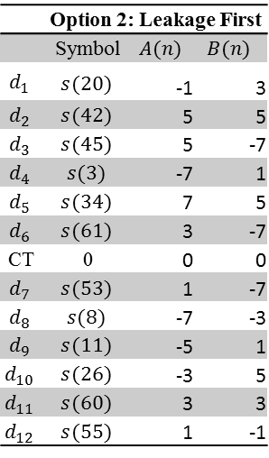
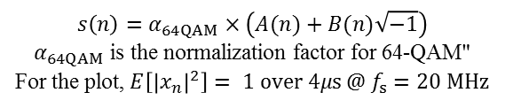
Constellation-based OOK with a 64-QAM Sequence
The following sequence with 64-QAM constellation minimizes the leakage during “OFF” duration while keeping PAPR low and the WUS’ PSD compliant with the 11ac spectral emission mask
 | Option 2: Leakage First
 | Symbol | $$A(n)$$ | $$B(n)$$
$$d_{1}$$ | $$s(20)$$ | -1 | 3
$$d_{2}$$ | $$s(42)$$ | 5 | 5
$$d_{3}$$ | $$s(45)$$ | 5 | -7
$$d_{4}$$ | $$s(3)$$ | -7 | 1
$$d_{5}$$ | $$s(34)$$ | 7 | 5
$$d_{6}$$ | $$s(61)$$ | 3 | -7
CT | 0 | 0 | 0
$$d_{7}$$ | $$s(53)$$ | 1 | -7
$$d_{8}$$ | $$s(8)$$ | -7 | -3
$$d_{9}$$ | $$s(11)$$ | -5 | 1
$$d_{10}$$ | $$s(26)$$ | -3 | 5
$$d_{11}$$ | $$s(60)$$ | 3 | 3
$$d_{12}$$ | $$s(55)$$ | 1 | -1
Low
fluctuation
(1.91 dB PAPR)
$$s\left(n\right)=α_{64QAM}×\left(A(n)+B(n)\sqrt{−1}\right)$$
$α_{64QAM}$ is the normalization factor for 64-QAM"
For the plot$\text{, }E\left[{\left|x_{n}\right|}^{2}\right]= 1 over 4μs @ f_{s}=20 MHz$
Low leakage

Slide 22


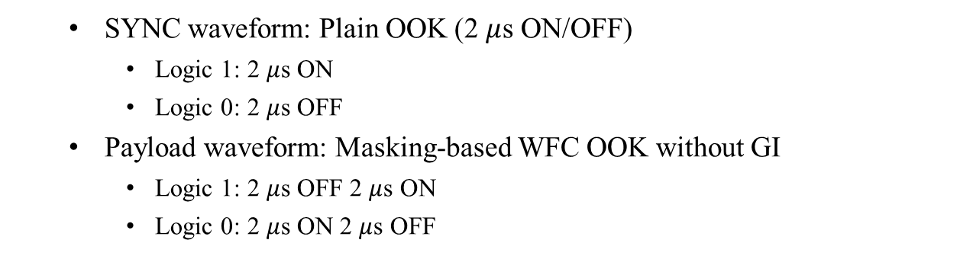



Approach #1
  SYNC waveform: Plain OOK (2 $μ$s ON/OFF)
    Logic 1: 2 $μ$s ON
    Logic 0: 2 $μ$s OFF
  Payload waveform: Masking-based WFC OOK without GI
    Logic 1: 2 $μ$s OFF 2 $μ$s ON
    Logic 0: 2 $μ$s ON 2 $μ$s OFF
SYNC (64 $μs$)
Payload (High-data rate)
1
0
1
$$…$$
1
0
1
1
Time
2 $μ$s
2 $μ$s
2 $μ$s
2 $μ$s
4 $μ$s
4 $μ$s
4 $μ$s

Slide 23
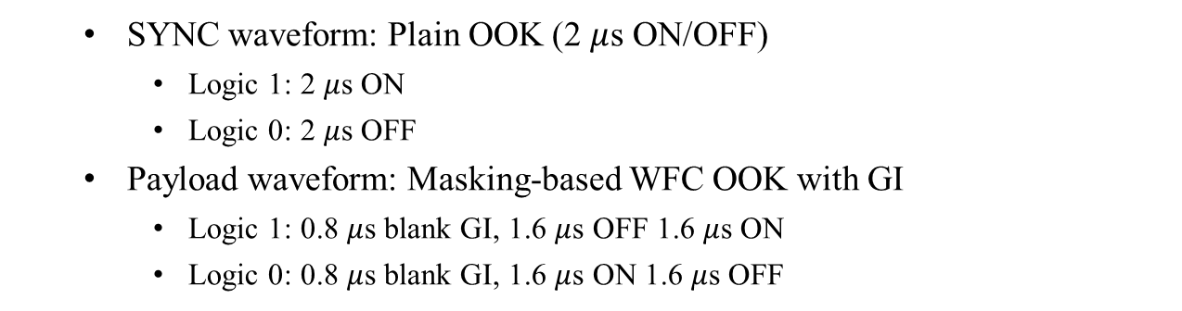

Approach #2
  SYNC waveform: Plain OOK (2 $μ$s ON/OFF)
    Logic 1: 2 $μ$s ON
    Logic 0: 2 $μ$s OFF
  Payload waveform: Masking-based WFC OOK with GI
    Logic 1: 0.8 $μ$s blank GI, 1.6 $μ$s OFF 1.6 $μ$s ON
    Logic 0: 0.8 $μ$s blank GI, 1.6 $μ$s ON 1.6 $μ$s OFF
SYNC (64 $μs$)
Payload (High-data rate)
1
0
1
$$…$$
1
0
1
1
Time
2 $μ$s
2 $μ$s
2 $μ$s
2 $μ$s
4 $μ$s
4 $μ$s
4 $μ$s

Slide 24
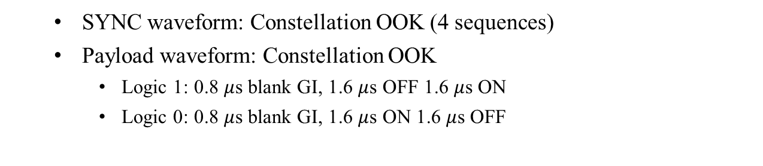
Approach #3
  SYNC waveform: Constellation OOK (4 sequences)
  Payload waveform: Constellation OOK
    Logic 1: 0.8 $μ$s blank GI, 1.6 $μ$s OFF 1.6 $μ$s ON
    Logic 0: 0.8 $μ$s blank GI, 1.6 $μ$s ON 1.6 $μ$s OFF
SYNC (64 $μs$)
Payload (High-data rate)
“10”
“01”
“00”
“11”
0
1
1
Time
4 $μ$s
4 $μ$s
4 $μ$s
4 $μ$s
4 $μ$s
4 $μ$s
4 $μ$s

