Slide 1
OOK Symbol Design
Date: 2018-01-14
Authors:

Slide 2
Abstract
Evaluate some different OFDM symbols to use for signalling “on”
3 different “fixed” symbols
1 random QPSK, meaning different symbol for each use
only DC component (benchmark for AWGN channel)

Slide 3
WUS: Symbol Design
The symbol is 4us long, and has the structure [CP OFDM], where CP is 0.8us long
We would like to be able to use the first, or the second half of the symbol to generate symbols that are 2us long (for the high rate mode)
Thus, we want the symbol to have “equal” energy on the first and second half
We may want the symbol to have low peak-to-average-power-ratio
We may want the symbol to have a nice “ramp up” from the zero-state
CP
OFDM
CP
OFDM

Slide 4
WUS: Symbol Design QPSK Script
There are 12 active subcarriers
QPSK is a good choice of modulation (each symbol equal power)
There are 2^24 = 16 777 216 possible symbols
Create a script that generates all possible OFDM symbols, and save those with properties according to previous page
Start simulation and go to sleep

Slide 5
WUS: Four Categories
We try all symbols, and store the symbols according to four different criteria
Energy difference: Means that the first half of the symbol have energy as close to as possible to the second half of the symbol
Peak to Average Power Ratio (PAPR): Lowest PAPR
Minimum power critical samples: Means that sample number 1, 40 and 80 all have as close as possible to 0 in amplitude. (i.e. min the sum s_1^2 + s_40^2 + s_80^2)
Balanced figure: A weighted average of the above (ad-hoc)

Slide 6
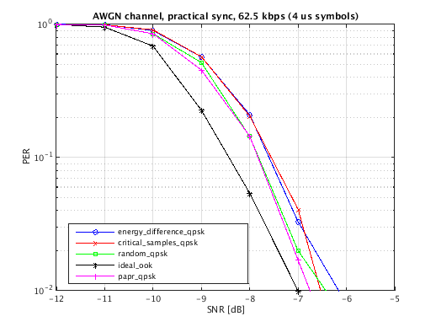
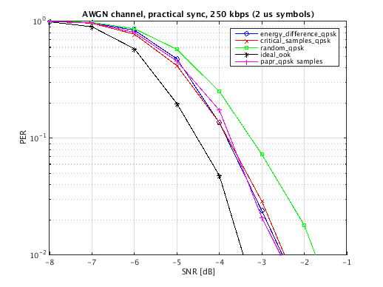
AWGN simulations
Results for the AWGN channel

Slide 7
Conclusions
There is a gain, albeit small, that can be obtained by optimizing the OFDM symbols
It seems OFDM symbols with low PAPR are good, but more studies would be needed

Slide 8
WUS: Script Output
abs(s(t))
real(s(t))

