Slide 1
Addition Results for 62.5 kb/s:
Symbol Structure and P-OOK
Date: 2018-01-14
Authors:

Slide 2
Outline
Discussion on the symbol structure “on on off off” vs “on off on off”
Additional results for P-OOK with a 4 MHz receiver and practical synchronization algorithm

Slide 3
Abstract
In [1], we agreed to the following:
Is this a good idea?
Theoretical considerations suggest that it is worth looking into the alternative signalling on on off off. The two alternatives have been compared by means of simulations
  Symbol structure of the data rate of 62.5Kbps for each information is as follows
    For 4us ON-signal, there is always energy
Information 0 | Information 1
4us ON + 4us OFF + 4us ON + 4us OFF | 4us OFF + 4us ON + 4us OFF + 4us ON

Slide 4
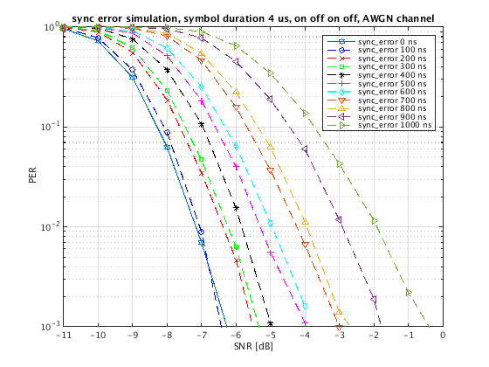
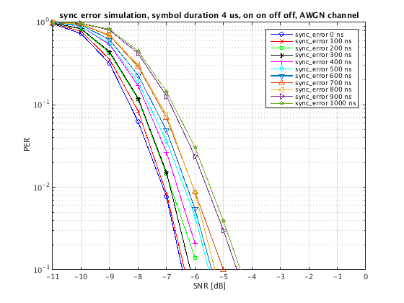
Simulation results with artificial synchronization error – AWGN
We introduce artificial synchronization error to evaluate how synchronization error affects the performance

Slide 5
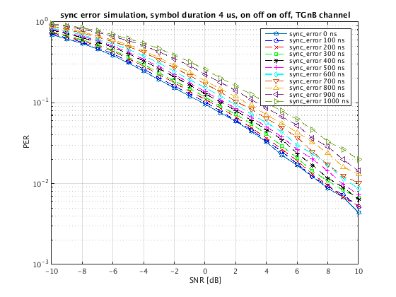
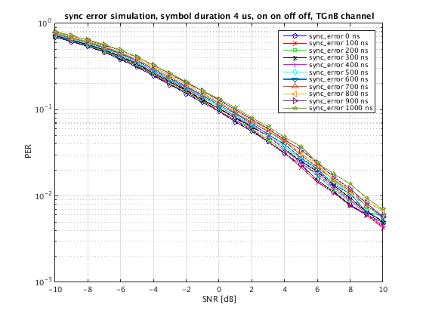
Simulation results with artificial synchronization error – TGnB

Slide 6
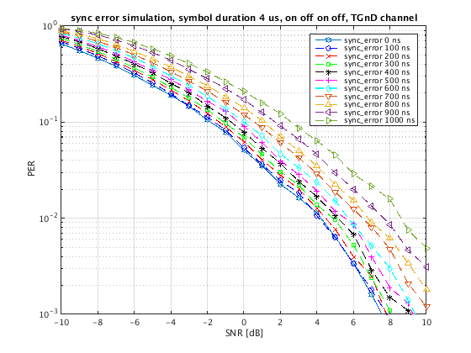
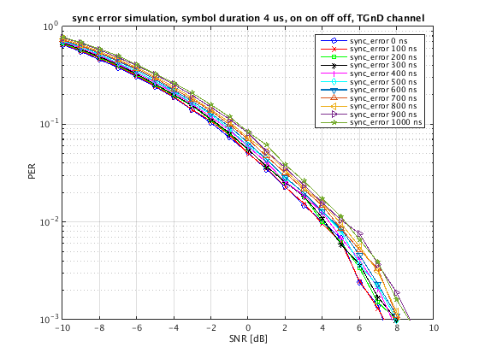
Simulation results with artificial synchronization error – TGnD

Slide 7
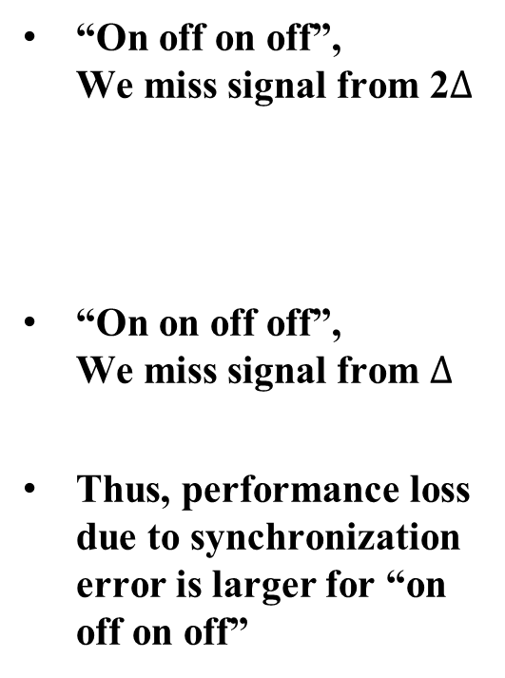
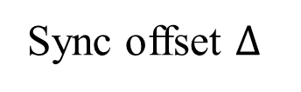
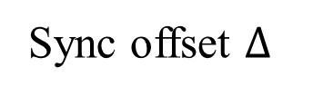
Why is this?
0
“On off on off”,
We miss signal from 2$∆$
“On on off off”,
We miss signal from $∆$
Thus, performance loss due to synchronization error is larger for “on off on off”
ON
OFF
ON
OFF
Sync offset $∆$
0
ON
ON
OFF
OFF
Sync offset $∆$

Slide 8
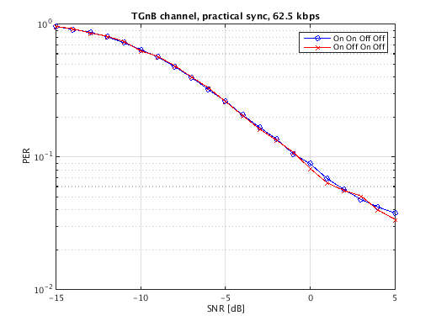
Results with practical receiver
Simulation with a practical synchronizer (i.e., no artificial synchronization errors)

Slide 9
Conclusions regarding symbol structure
In the presence of synchronization error, “on on off off” performs significantly better than “on off on off”
Depending on the synchronization algorithm and receiver impairments, “on on off off” performs at least as well or better than “on off on off”

Slide 10
Additional results for P-OOK
Assuming “on on off off”, we can shorten the “on” interval.
In [2], we showed that shortening the pulse provides potential performance gains: P-OOK
A concern from the group was how these results translates to a 4 MHz receiver
Here, we provide complementary results using a 4 MHz receiver

Slide 11
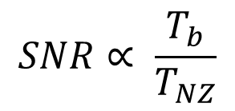

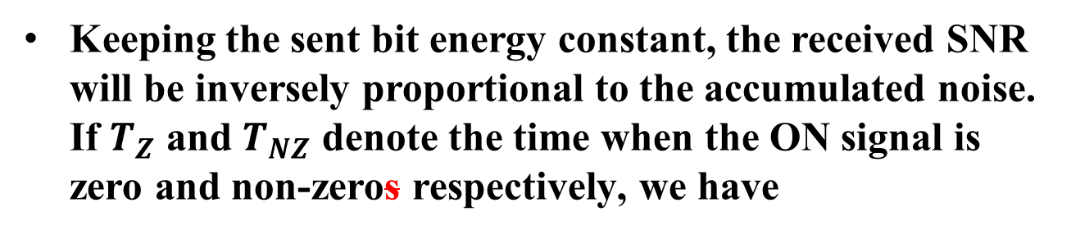


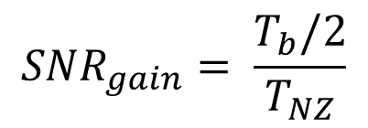
Short recap of P-OOK [1]
0
1
0
1
“WFC”
ON
OFF
OFF
ON
$$T_{b}$$
$$T_{Z}$$
$$T_{NZ}$$
Keeping the sent bit energy constant, the received SNR will be inversely proportional to the accumulated noise. If $T_{Z}$ and $T_{NZ}$ denote the time when the ON signal is zero and non-zeros respectively, we have
$$SNR∝ \frac{T_{b}}{T_{NZ}}$$
$${SNR}_{gain}= \frac{T_{b}/2}{T_{NZ}}$$
and

Slide 12
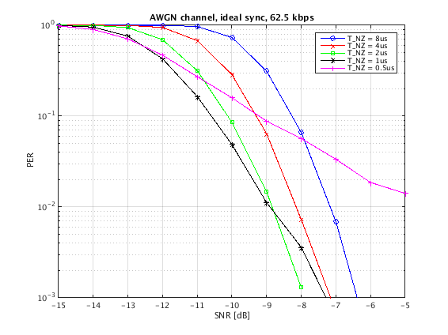
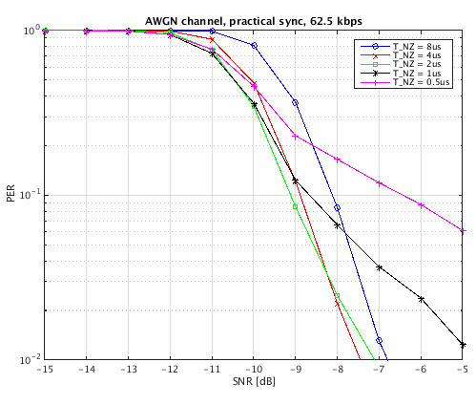

Simulation results – AWGN
4 MHz receiver
$$T_{b}=16 us$$

Slide 13
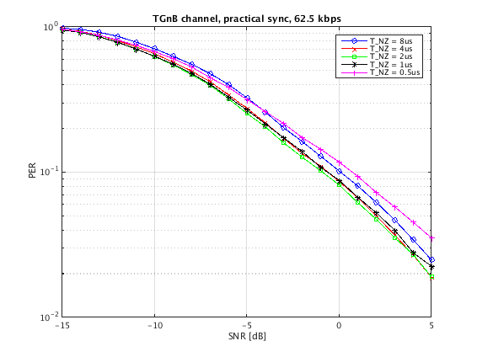
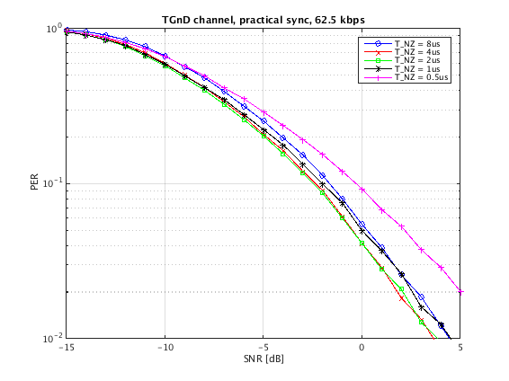
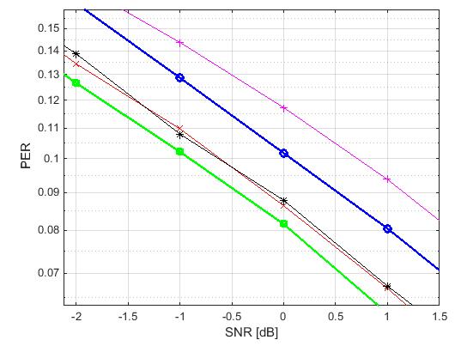
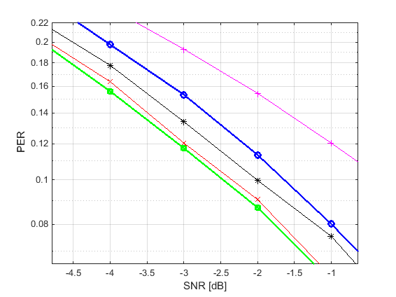
Simulation results – TGn
4 MHz receiver
$$T_{b}=16 us$$
1 dB
1 dB

Slide 14
Power amplifier limitations
In 802.11n, the PA operates at an output backoff (OBO) from full saturation of 8 dB [3]
  802.11n supports a modulation up to 64-QAM
  802.11ax supports a modulation of 1024-QAM
A 802.11ax device must have a PA that operates at an OBO of at least 14 dB from full saturation
Boosting due to Manchester coding is 3 dB
Boosting from 8 us to 2 us in P-OOK gives additional 6 dB
We require a boost of 9 dB → Assuming a 802.11ax AP, we can boost 14 dB → OK!
Adjacent carrier interference is not a problem since we are using smaller BW (4 MHz, 8 MHz, or 16 MHz) → OK!

Slide 15
Channel sensed idle due to > 16 us silence
Coverage area for Wake-up signal
Area where STAs will defer using ED
AP
WUR
Area where STAs will NOT defer using ED

Slide 16
Conclusions for P-OOK
We can increase the performance by 1 dB by reducing the duration of the ON time with practical algorithms and a 4 MHz receiver
This is possible as an optional feature
  It is transparent to a receiver with longer receiver window, since the same energy is sent (in shorter time)
It requires that the word type of the 62.5 kbit/s mode is using “on off”, i.e. “on on off off”.

Slide 17
Straw Poll
Do you agree that the symbol structure “on on off off” is preferable to “on off on off”?
Y/N/A:

Slide 18
References
[1] Eunsung Park, Symbol Structure Follow-up, IEEE 802.11-17/1612r3
[2] Leif Wilhelmsson, Discussion of ACI performance and ACI requirements for IEEE 802.11ax, IEEE 802.11-17/1673r1
[3] Shahrnaz Azizi et al., TGba Simulation scenarios and evaluation methodology document, 11-17/0188r10

