Slide 1
Distribution Networks and
Short Range Devices Coexistence
Name | Affiliation | Address | Phone | Email
Djordje Tujkovic | Facebook | 1 Hacker Way Menlo Park, CA 94025 |  | djordjet@fb.com
Sam Alex |  |  |  | sampalex@fb.com
Payam Torab |  |  |  | ptorab@fb.com
Michael Grigat | Deutsche Telekom | Deutsche-Telekom-Allee 7, 64372 Darmstadt, Germany |  | m.grigat@telekom.de

Slide 2

mmWave Distribution Network Use Cases
Multi-dwelling units (MDUs)

Slide 3
Interference cases
  In building penetration (outdoor-to-indoor) from Distribution Network to Short Range Devices (SRDs)
    Distribution Node (DN) to Client Node (CN) transmission
    CN to DN transmission

Slide 4
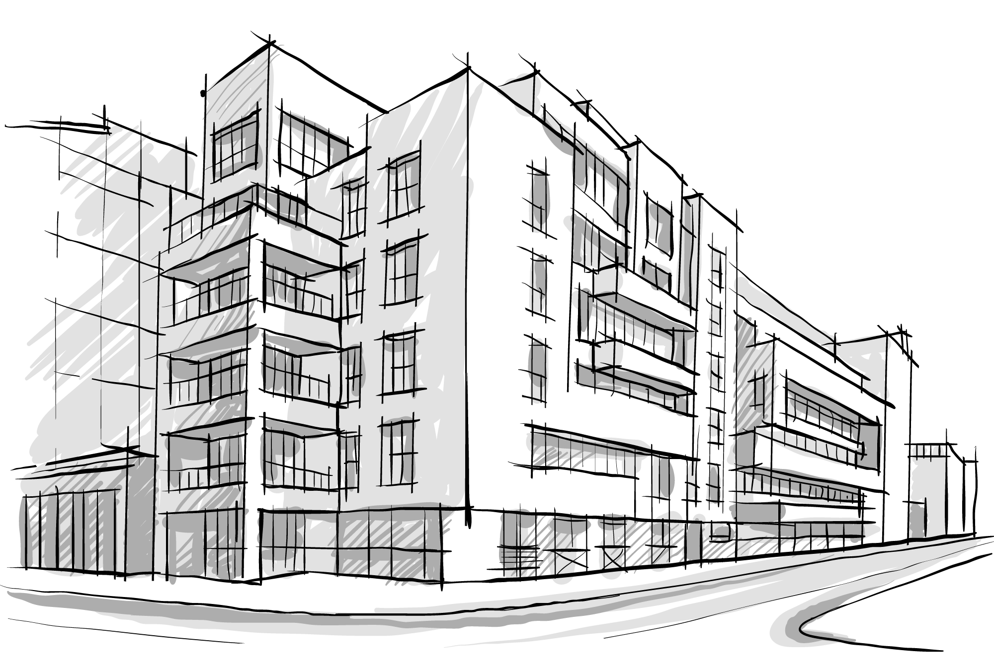
MDU access
DN STA typically serves 8-16 CN STAs (time multiplex) (no protocol limitation)
6-12% duty cycle for a DN to CN link activity
Potential interference to indoor SRDs behind the windows
CN mounted on balcony or near window
DN radio sector
Notes:
http://www.shutterstock.com/pic-179448743

Slide 5
Outdoor to indoor penetration (DN➭CN)
CCI thresholds
SRD
y
DN (Tx)
CN (Rx)
Window
Room
SNR_targ: DN aggressor applies active Transmit Power Control (TPC) to drive SNR target at CN receive (MCS12 18dB)
G_rx: Receive array gain of CN (30dBi)
G_srd(𝛼): front-to-back BF ratio plus box isolation of SRD (AP or STA), worst case none G_srd(0)=0dBi
R: In building penetration loss (worst case 3.6dB when interferer perpendicular to single pane glass, safety glass 12dB)
N: thermal noise, -174+10*log10(1.76e9)+NF = -72dBm
I: input referred interference signal level at victim SRD antenna
CCA threshold: ED -48dBm, PD -68dBm for SCPHY/CPHY
max{I} < SNR_targ – G_rx + N – R + G_srd < -87.6dBm
Interference below CCA thresholds, no impact to channel access for SRD devices

Slide 6
Outdoor to indoor penetration (DN➭CN)
SINR (1)
SRD CCA (-68dBm) not triggered anywhere within the room (DN transmissions does not block SRD transmission)
DN transmission could however interfere with SRDs reception, just like any other SRD device
  Depends on the pointing of SRD’s directional antenna (worst case directly towards window)
CDF of received signal at SRD simulated using antenna pattern shown below
  19dBi antenna gain (32 RF chains, 4dBi patch gain, zero trace loss assumption)
  Front-to-back ratio of only 20dB assumed for SRDs
CDF of SINR shows healthy levels at SRD receiver, assuming its AP transmitting at EIRP = 40dBm
    Duty cycle of DN to CN communication (6-12%) would reduce interference further
Window
w/ SRD antenna pattern
w/ SRD antenna pattern

Slide 7
Outdoor to indoor penetration (DN➭CN)
SINR (2)
Incident signal comes in at an angle of 45 & 25 degree wrt the normal to the window
Shallower incidence angles (larger angle from normal) results in more reflections from and lesser transmissions through the wall, and slightly increases interference within the room
SRD CCA (-68dBm) not triggered anywhere within the room (DN transmissions does not block SRD transmission)
Window
Window
w/ SRD antenna pattern

Slide 8
Outdoor to indoor penetration (CN➭DN)
CCI thresholds
SRD
y
DN (Tx)
CN (Rx)
Window
Room
EIRP: 40/43dBmi avr/ peak
B: front-to-back BF ratio plus box isolation of CN, e.g., 50dB conservative (ETSI simulation assumes 90dB)
G_srd(𝛼): front-to-back BF ratio plus box isolation of SRD (AP or STA), worst case G_srd(0)=0dBi
L: Free space propagation loss (delta between CN and SRD), L(1m)=68dB
R: In building penetration loss (worst case 3.6dB when interferer perpendicular to single pane glass, safety glass 12dB)
I: input referred interference signal level at victim SRD antenna
CCA threshold: ED -48dBm, PD -68dBm for SCPHY/CPHY
max{I} < EIRP – B – L(y) – R + G_srd < -81.6dBm
Interference below CCA thresholds, no impact to channel access for SRD devices

Slide 9
Outdoor to indoor penetration (CN➭DN)
SINR
SRD CCA (-68dBm) not triggered except when SRD is few centimeters directly behind the CN, and SRD pointing to CN, which happens with P(P_{RX}>= P_{th})<0.1% probability
  When SRD pointing away from window, no CCA triggered
CDF shows healthy levels at SRD receiver, assuming its AP transmitting at EIRP = 40dBm
      This is even without taking into account the duty cycle of DN to CN communication (6-12%)
Window
CDF
w/ SRD antenna pattern
w/ SRD antenna pattern

Slide 10
Summary
We analyzed the interference on Short Range Devices (SRDs) resulting from outdoor to indoor penetration of Distribution Network transmissions
  Simple yet aggressive scenario of CN STA outside an MDU room, installed on the glass, relatively small loss through the window
Results confirm that 11ad/ay Distribution Network STAs do not harm indoor operation
Scenario | CCA trigger (PD @ -68dBm) | Minimum SINR available to SRD
DN => CN transmission | Never | 45 dB
CN => DN transmission | <0.1% (SRD stuck to window, pointing outside (not realistic)) | 45 dB

Slide 11
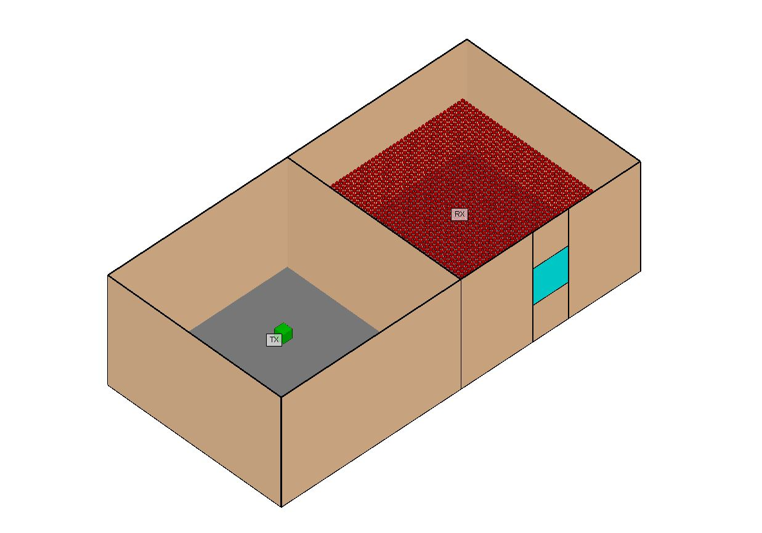
Appendix I: Ray tracing model
Materials
  Wall: ITU Layered drywall 60 GHz (3-layer)
  Floor: ITU Floorboard 60 GHz (1-layer)
  Ceiling: ITU Ceiling board 60 GHz (1-layer)
  Window: ITU Glass 60 GHz
1.5m
5m
1m
3m
1m
1m
5m
5m

Slide 12
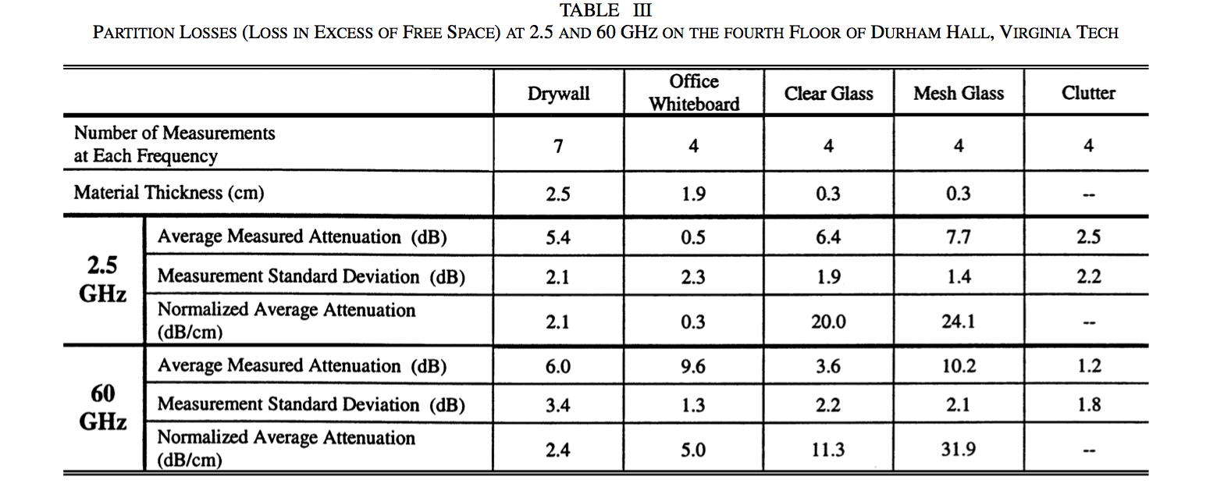
Appendix II: In building penetration
C.R. Anderson, T. S. Rappaport: In-Building Wideband Partition Loss Measurements at 2.5 and 60 GHz, IEEE Transactions on Wireless Communications, vol. 3, NO. 3, May 2004
Minimum attenuation of -3.6dB for clear single pane 3mm window
Attenuation can grow above 12dB for safety glass (see next page)

Slide 13
Appendix III: Glass penetration
Kai Siwiak, IEEE P802.15-05-0382-00-003c/r0, Transmission and Reflection Measurements of Safety Glass at 60GHz
Attenuation can grow above 12dB for safety glass
Frequency (GHz) | S11 (dB) | S11 (Glass)(dB) | S21 (dB) | S21 (Glass)(dB)
60.22 | -15.976 | -15.971 | -44.39 | -56
60.22125 | -12.843 | -12.6 | -40.8 | -58
60.2225 | -18.59 | -18.6 | -46.94 | -59
60.22375 | -10.482 | -10.2 | -50 | -58
60.225 | -11.563 | -11.7 | -49 | -63
60.22625 | -11.325 | -11.4 | -51 | -62
60.2275 | -10.674 | -10.73 | -48 | -60.1
60.22575 | -18.16 | -18.367 | -47 | -57
60.23 | -15.95 | -16.03 | -45 | -63

