Slide 1
Link Maintenance for
Distribution Networks
Name | Affiliation | Address | Phone | Email
Djordje Tujkovic | Facebook | 1 Hacker Way Menlo Park, CA 94025 |  | djordjet@fb.com
Nabeel Ahmed |  |  |  | nabeel@fb.com
Praveen Gopala |  |  |  | gopalap@fb.com
Alireza Mehrabani |  |  |  | tarighat@fb.com
Payam Torab |  |  |  | ptorab@fb.com
Michael Grigat | Deutsche Telekom | Deutsche-Telekom-Allee 7, 64372 Darmstadt, Germany |  | m.grigat@telekom.de

Slide 2
Overview
We present a set of functions to maintain operational links in mmWave Distribution Networks [1, 2], together with our example implementation
Discussed functions
  Link adaptation
  Bandwidth request
  Bandwidth reservation (TDD slot assignment)
For the first two we point to parallels with 802.11 existing mechanisms and highlight potential gaps
The slides could be viewed as a set of requirements for tools (packets, protocols) needed to operate mmWave Distribution Networks

Slide 3
Background – Sample Packet definitions (1)
Heartbeat, KeepAlive Action frames
Heartbeat message (Action frame), transmitted from a a DN node to a CN node once every BWGD (~25 milliseconds)
typedef struct _fbHeartbeatElement {
/* timestamp and swTimestamp are byte arrays to avoid unaligned accesses */
usint8 timestamp[8]; /* hardware timestamp */
usint8 swTimestamp[8]; /* sw timestamp offset from hw timestamp */
usint16 bwgdNumber;
usint8 txSlotBitmap[TGF_CEIL(SLOTS_IN_BWGD, BITS_PER_BYTE)];
usint8 rxSlotBitmap[TGF_CEIL(SLOTS_IN_BWGD, BITS_PER_BYTE)];
laFeedbackParams laFbParams;
usint8 syncMode : 1;
} __attribute__((__packed__)) fbHeartbeatElement;
Keepalive message (Action frame) transmitted between two DNs once every BWGD (~25 milliseconds)
typedef struct _fbKeepaliveElement {
/* timestamp and swTimestamp are byte arrays to avoid unaligned accesses */
usint8 timestamp[8]; /* hardware timestamp */
usint8 swTimestamp[8]; /* sw timestamp offset from hw timestamp */
usint16 bwgdNumber;
usint8 bfAssocIndication;
usint8 finalRxSlotBitmap[TGF_CEIL(SLOTS_IN_BWGD, BITS_PER_BYTE)];
usint8 rsvdMgmtBitmap[TGF_CEIL(NSF, BITS_PER_BYTE)];
laFeedbackParams laFbParams;
usint8 syncMode : 1;
l2SchedulerStats l2SchedStats;
} __attribute__((__packed__)) fbKeepaliveElement;

Slide 4
Background – Sample packet definitions (2)
Uplink Bandwidth Request Action frame
Uplink bandwidth request message (Action frame), transmitted from a a CN node to a DN node once every BWGD (~25 milliseconds)
typedef struct _fbUplinkBwReqElement {
l2SchedulerStats l2SchedStats;
laFeedbackParams laFbParams;
} _attribute__((__packed_)) fbUplinkBwReqElement;

Slide 5
(1) Link adaptation
Frames, Information
Sample Distribution Network
802.11
Frames
  Heartbeat, Keepalive, Uplink Bandwidth Request
  Association Request/Response/Ack (for future)
Parameters
  typedef struct _laFeedbackParams {
  sint8 stfMgmtSnr;
  sint8 rssi;
  } __attribute__((__packed__)) laFeedbackParams;
stfMgmtSnr and rssi can have the same definition as SNR and RSSI in beamforming text
In addition, we have recently added the following statistics
  Total LDPC codewords
  Average LDPC iterations
  Average LDPC syndromes
  Max LDPC iteration per block within a PPDU
    Helpful in setting the link to tolerate sporadic SINR without explicitly measuring min(SINR)
Frames
  9.6.7.4 Link Measurement Request frame format
  9.6.7.5 Link Measurement Report frame format
Information Elements / Fields
  9.4.2.17 TPC Report element
    Reports Transmit Power, Link Margin (dB, measured on the Link Measurement Request frame)
  9.4.2.142 DMG Link Margin element
    Reports Link Margin (dB, implementation specific, measured on plurality of data frames within a measurement period), SNR (dB, measurement methodology undefined) and measurement window information
  9.4.2.143 DMG Link Adaptation Acknowledgment element
    For TPC controlled by receiver (to acknowledge receiver’s MCS/Tx power change request)

Slide 6
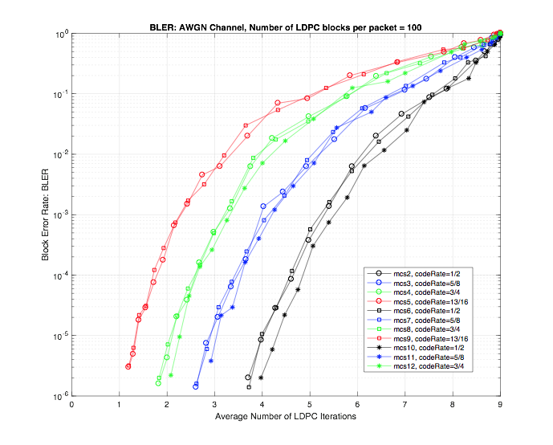
Link adaptation
LDPC Iteration Statistics (1/3)
“Average LDPC iteration” can be used for accurately predicting PER/BLER.
Typical on-chip SNR measurements can be several dB off from true SNR seen by the LDPC decoder. Such SNR measurements are further deviated from true SNR at high and low ends of SNR.
Given the static nature of DN compared to SRD, a more accurate and immediate predication of link quality can be very beneficial.

Slide 7
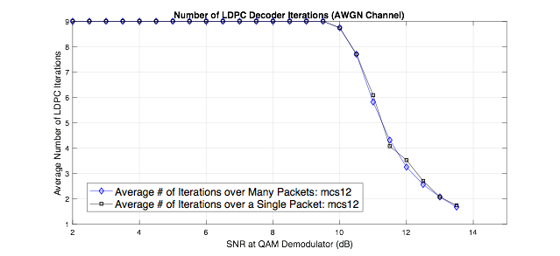
Link adaptation
LDPC Iteration Statistics (2/3)
LDPC iteration averaged over LDPC blocks within a single PPDU (~100 LDPC block), will have very small variance from one PPDU to the next.
  Average iterations from a single PPDU can project the long-term PER/BLER within +/-0.2dB accuracy.
  At low PER targets (e.g., 0.1%), average LDPC iterations from the first PPDU can accurately predict the lone-term PER over the next 1000s of PPDUs.

Slide 8
Link adaptation
LDPC Iteration Statistics (3/3)
Consider the following simulation scenario: 1000 PPDUs, MCS=9, SNR for all PPDUs=8dB, number of LDPC blocks per PPDU = 100.
Histograms of avg(Iterations), and corresponding projected SNR are plotted below. The narrow standard deviation confirms the reliability of link quality projection based on LDPC iterations. Using a single PPDU, BLER/SNR is projected within 0.2dB of the true 8dB value.

Slide 9
Link adaptation
LDPC Iteration to Predict min(SINR) (1/2)
In the presence of co-channel interference (CCI), direct calculation of min(SINR) becomes challenging and unreliable.
  Given the static nature of CCI profile in distributed networks, Link adaptation should be set based on min(SINR) and not avg(SINR) within the PPDUs.
While avg(Iterations) over DLPC blocks within a PPDU works well in the absence of interference, it fails to predict the link’s PER in the presence of not-fully-aligned desired and interfering PPDUs.
For a received PPDU, PHY would provide both the following values: average of LDPC iterations and max of LDPC iterations over the LDPC blocks within a PPDU.
Furthermore, the difference between avg(Iterations) and max(Iterations) can be used to determine link’s CCI profile/characteristics by calculating SNR, min(SINR), and proportion of target PPDU impacted by CCI.

Slide 10
Link adaptation
LDPC Iteration to Predict min(SINR) (2/2)
Consider a desired PPDU with 100 LDPC blocks: MCS=9
Only the last 20% of PPDU duration is hit by co-channel interference
avg(Iteration) over the PPDU = 0.8 → maps to SINR=9dB
  Too optimistic for link adaptation
max(Iteration) over the PPDU = 4 → maps to SINR=5.9dB
  Suitable for link adaptation (0.6dB margin to actual SINR floor of 6.5dB)
SNR=10dB, SIR=9dB, SINR=6.5dB
Co-Channel Interference
SNR=10dB, SINR=10dB
LDPC #1
LDPC #2
LDPC #80
LDPC #81
LDPC #100
Target PPDU

Slide 11
Link adaptation
802.11 functional gaps
SNR measurement method
  Post equalization
SNR measurement period
  Start and end time for measurement
RSSI
Short-term PER measurement (LDPC statistics)
Confidence interval (number of PPDUs used for measurement)

Slide 12
(2) Bandwidth request
Frames, information
Sample Distribution Network
802.11
Frames
  Uplink Bandwidth Request (CN => DN)
  Keepalive (DN < = > DN)
Parameters (not all used at the same time)
  typedef struct _l2SchedulerStats {
  // Queue size (in 256-byte units)
  usint16 queueSize;
  // Arrival rate (in units of 128 Kbps or 16 bytes/ms)
  usint16 arrivalRate;
  // MCS value
  usint8 mcs;
  // Requested Tx percentage in unit of 0.01 percent (used only for DN-DN links)
  usint16 reqTxPercent;
  } __attribute__((__packed__)) l2SchedulerStats;
Frames
  QoS Data frames (non-DMG)
Information Elements / Fields
  Queue Size (non-DMG)
    8 bits, in units of 256 bytes (per TID)
  TSPEC
    Some metrics (arrival rate, Tx air percentage) missing
  DMG TSPEC
    Not a good fit (good for creating SP/CBAP allocations)

Slide 13
Bandwidth request
802.11 functional gaps
Queue size (and with TID granularity)
  Removed from DMG
Derivative feedback (queue size change rate)
  Start and end time for measurement
Measurement period

Slide 14
(3) Bandwidth reservation (slot allocation)
Overview
Network time divided into time periods over which slot allocation (map) is valid (called Bandwidth Grant Duration (BWGD = 25,600 µs))
Slots are allocated through a 3-stage pipeline process
  BWGD N+0
    CNs communicate their bandwidth requirements to the parent DN (Uplink bandwidth request)
      Communicated information: Queue size (in units of 256 bytes), arrival rate (in units of 128 kbps)
    DNs communicate their bandwidth requirement to peer DNs (Keepalive message)
      Communicated information: Queue size, desired transmit airtime percentage to peer DN
    Using above pieces each DN assigns its own Rx slots (slots where other STAs will transmit to it)
  BWGD N+1
    DNs communicate their assigned Rx slot bitmap to each other (Keepalive message)
    With all DN-DN slots decided, each DN allocates remaining airtime (TX map) to its own CNs
  BWGD N+2
    Each DN communicates full Tx/Rx slot bitmap to CNs under its control
  BWGD N+3
    Slot map takes effect

Slide 15
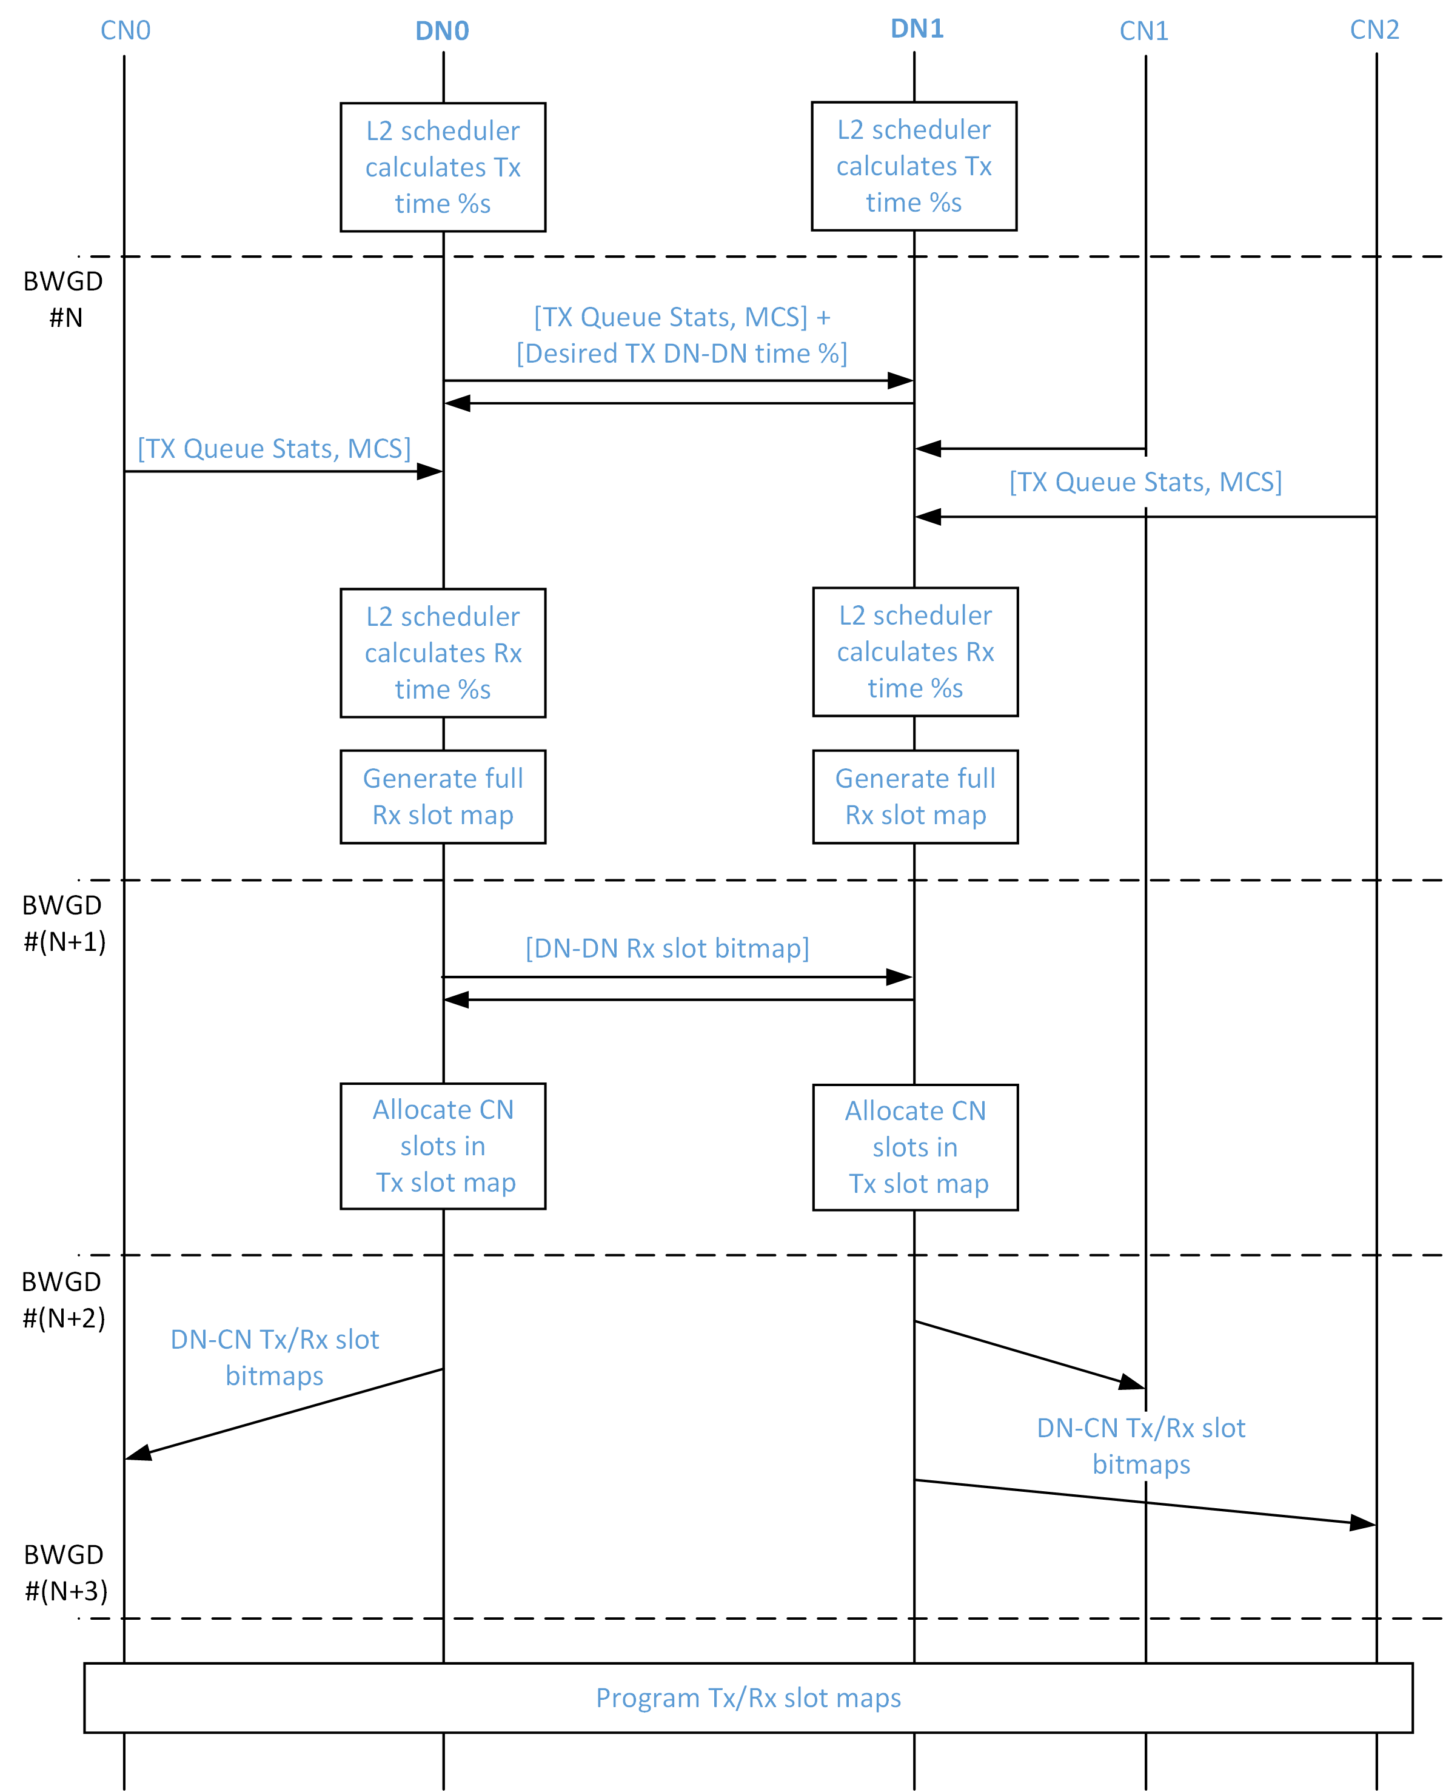
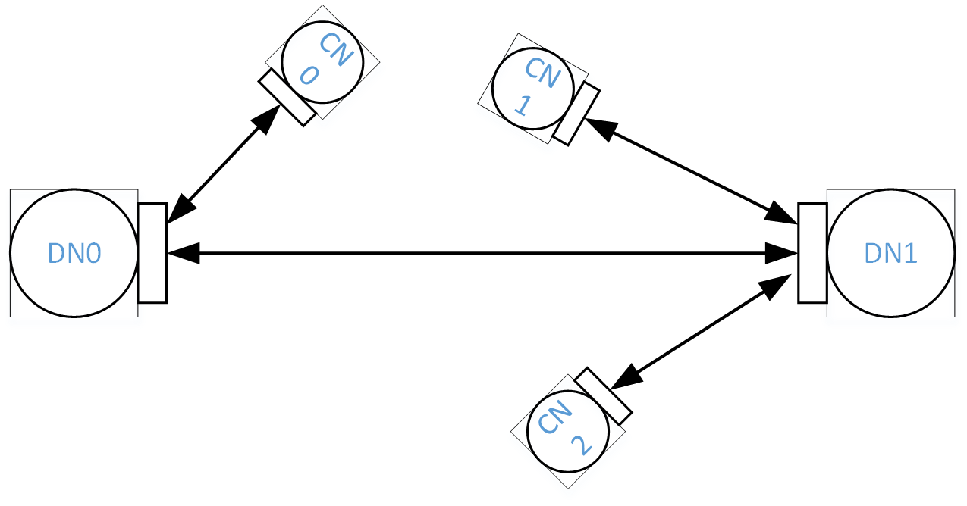
Bandwidth reservation flow
3-stage pipelining
Keepalive message
Uplink BW Request message
Uplink BW Request message
Keepalive message
Heartbeat message
Heartbeat message

Slide 16
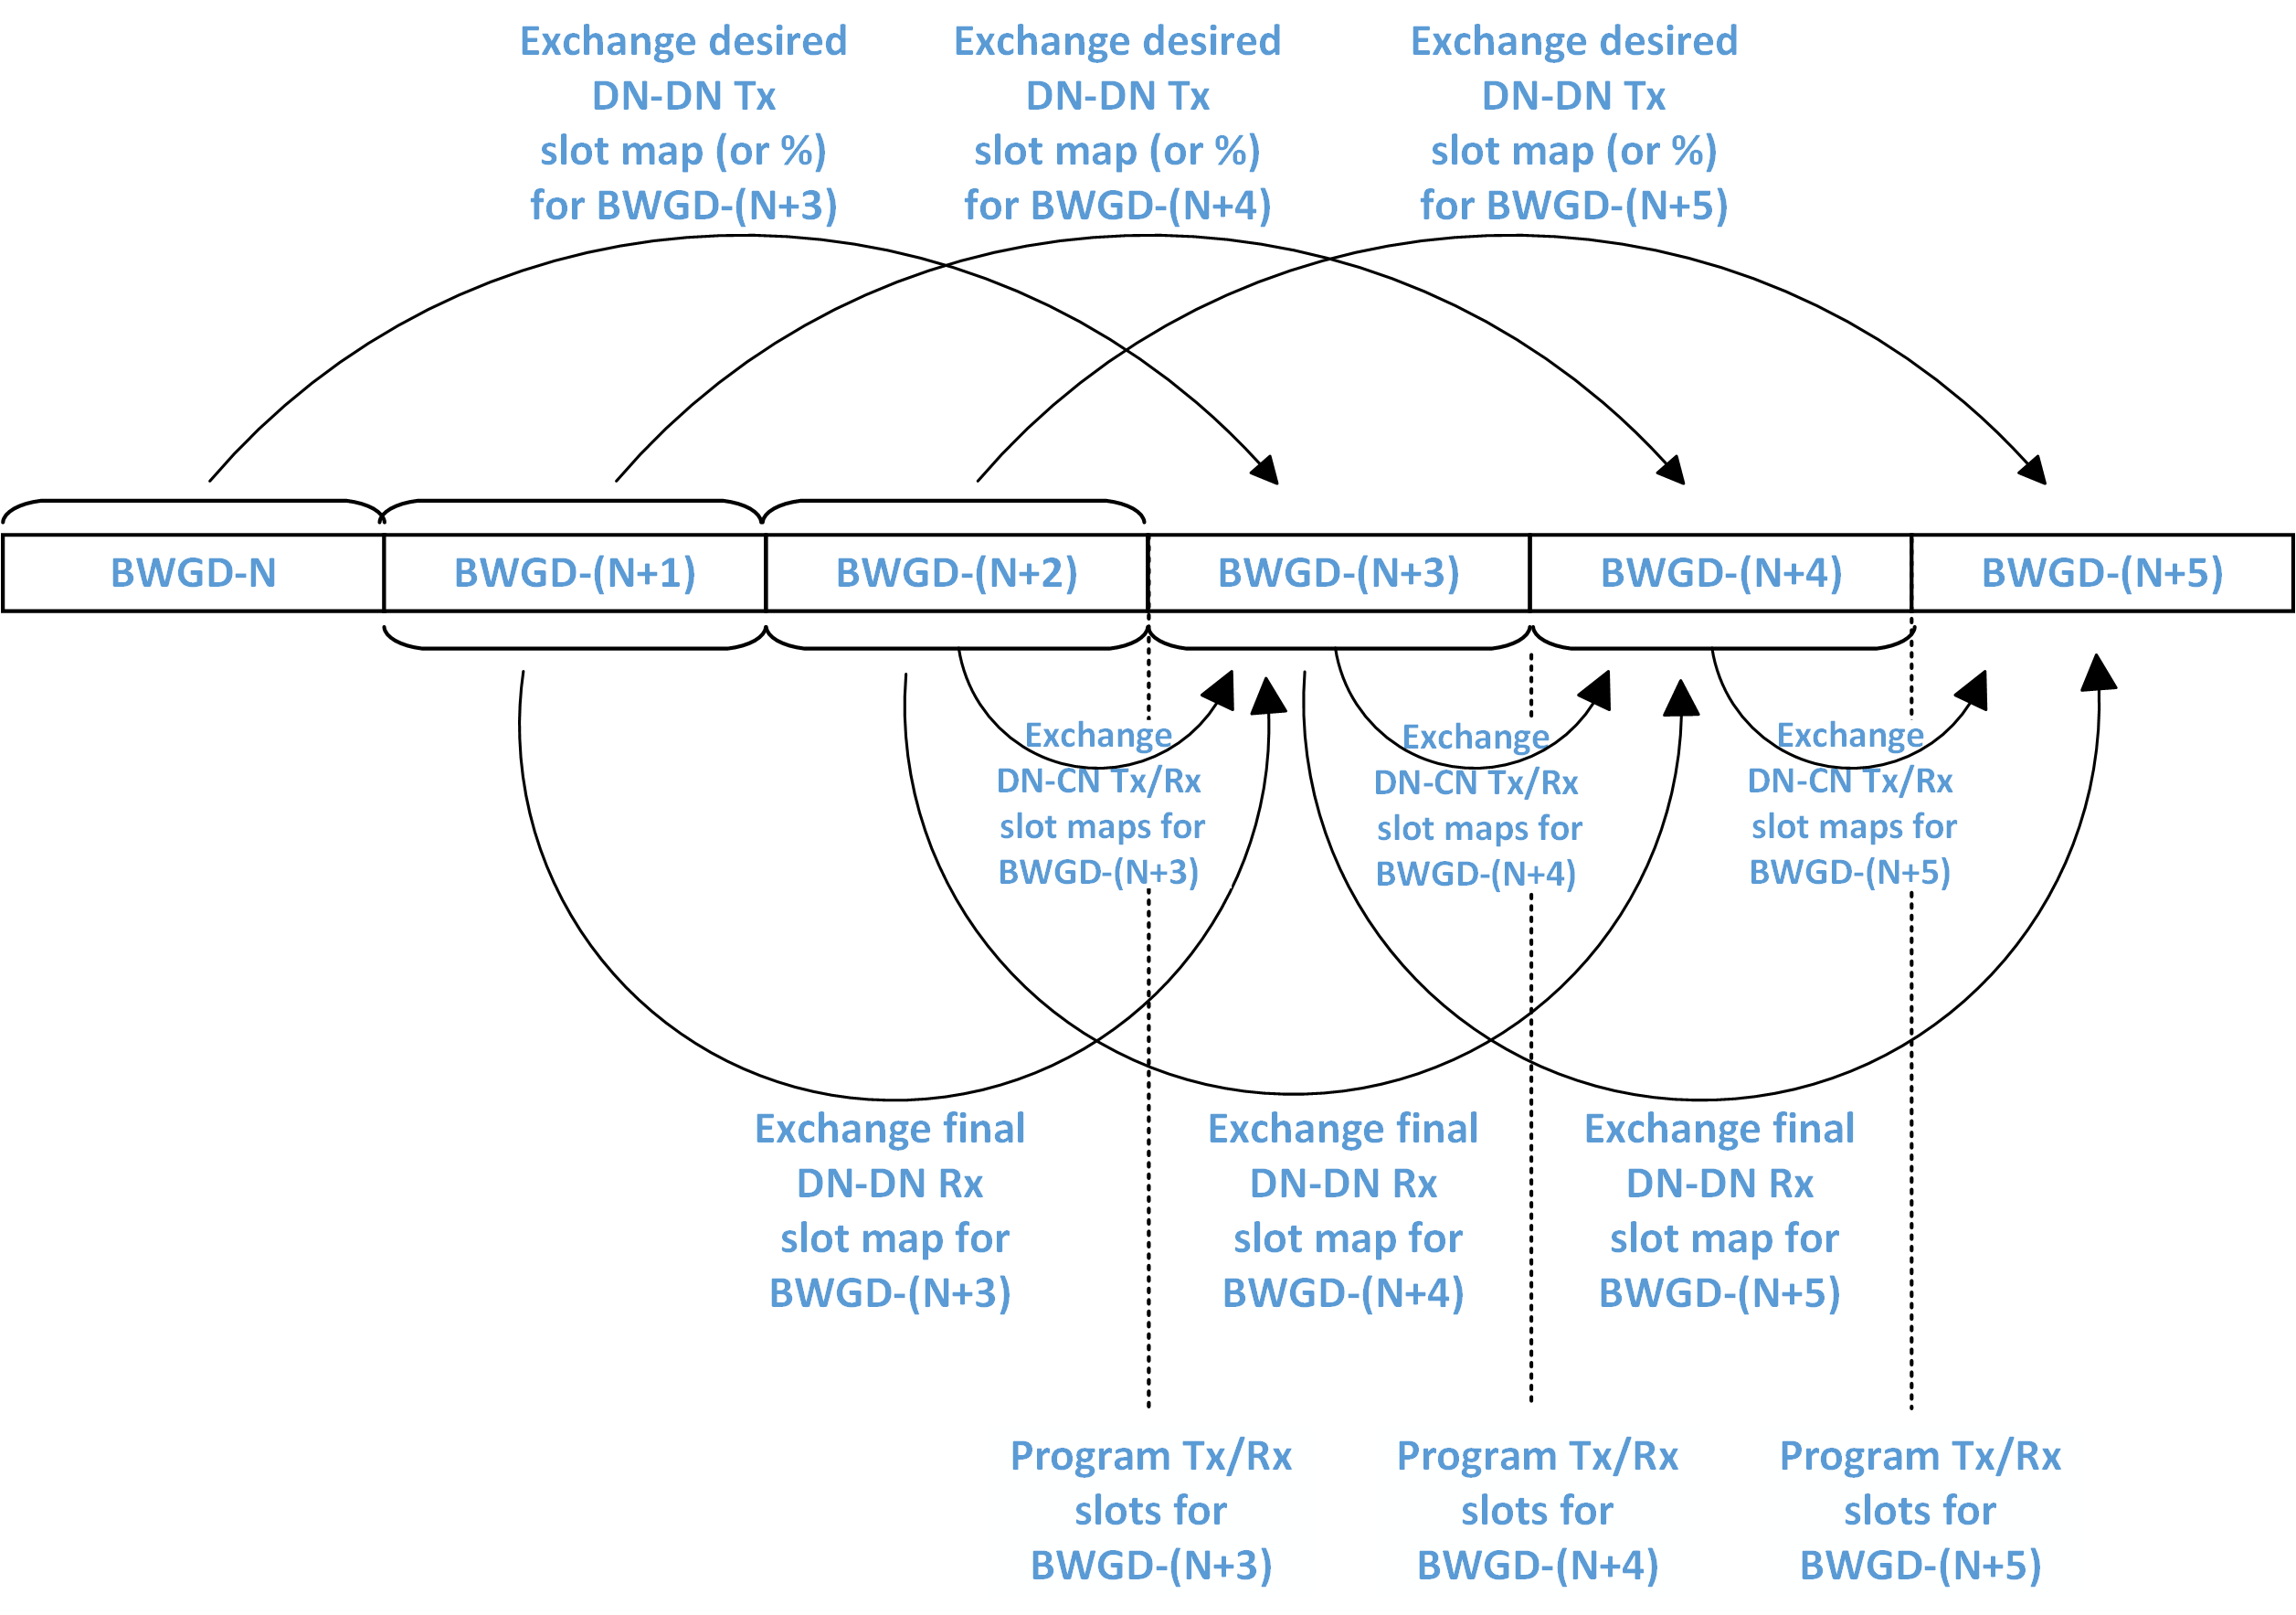
Bandwidth reservation flow
3-stage pipelining
(another view)

Slide 17
Bandwidth reservation example

Slide 18
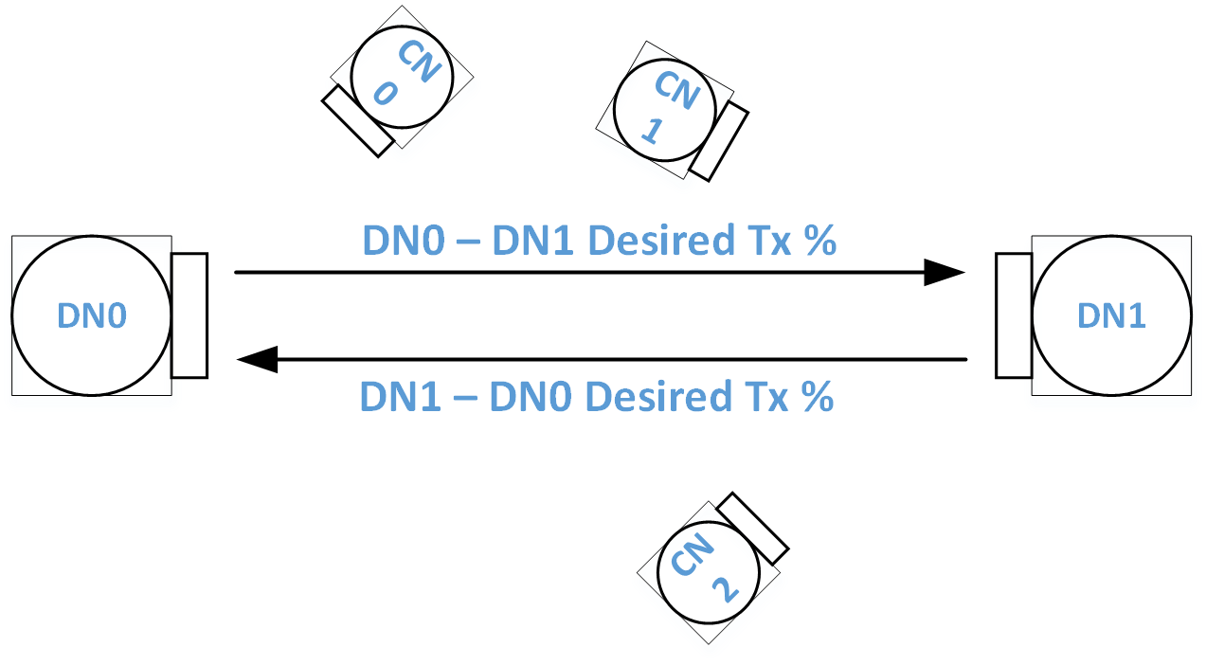
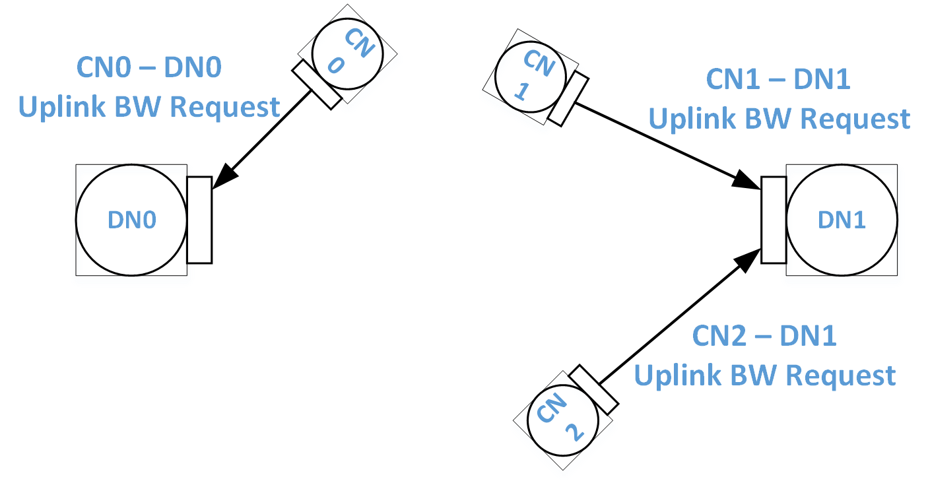
Bandwidth reservation example
BWGD N + 0
typedef struct _fbKeepaliveElement {
/* timestamp and swTimestamp are byte arrays to avoid unaligned accesses */
usint8 timestamp[8]; /* hardware timestamp */
usint8 swTimestamp[8]; /* sw timestamp offset from hw timestamp */
usint16 bwgdNumber;
usint8 bfAssocIndication;
usint8 finalRxSlotBitmap[TGF_CEIL(SLOTS_IN_BWGD, BITS_PER_BYTE)];
usint8 rsvdMgmtBitmap[TGF_CEIL(NSF, BITS_PER_BYTE)]; // constraints (do not ask me to transmit during these slots)
laFeedbackParams laFbParams;
usint8 syncMode : 1;
l2SchedulerStats l2SchedStats; // entire structure is used
} __attribute__((__packed__)) fbKeepaliveElement;
Each DN sends/receives desired Tx slot bitmaps (or time %) and L2 scheduler statistics to/from all peer DNs through Keepalive messages
Each DN receives bandwidth requirements from all its associated CNs through Uplink BW request messages
typedef struct _fbUplinkBwReqElement {
l2SchedulerStats l2SchedStats; // entire structure except requested Tx Percentage; wich is used only for DNs
laFeedbackParams laFbParams;
} _attribute__((__packed_)) fbUplinkBwReqElement;
and other bandwidth information same as in CNs
TX |  |  |  | RX
and other bandwidth information same as in CNs
TX |  |  |  | RX

Slide 19
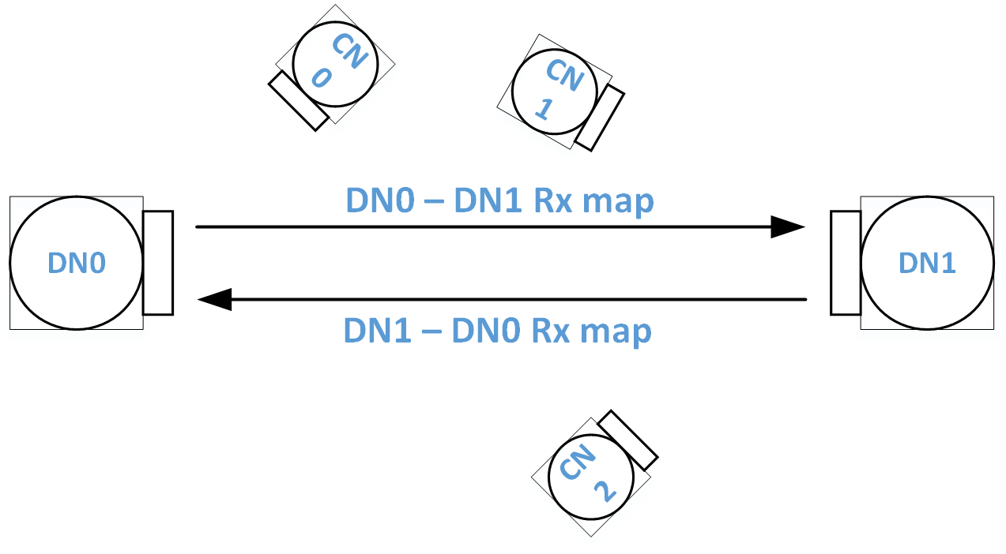
Bandwidth reservation example
BWGD N + 1
Each DN generates its full Rx slot map with slots for all associated peers
TX |  |  |  | RX
 |  |  |  | CN0 | CN0
 |  |  |  | DN1 | DN1
 |  |  |  | DN1 | DN1
 |  |  |  | DN1 | DN1
TX |  |  |  | RX
 |  |  |  | DN0 | DN0
 |  |  |  | CN1 | CN1
 |  |  |  | DN0 | DN0
 |  |  |  | CN2 | CN2

Slide 20
Bandwidth reservation example
BWGD N + 1
Each DN sends/receives the decided (final) Rx slot bitmaps to/from all peer DNs through KeepAlive messages
typedef struct _fbKeepaliveElement {
/* timestamp and swTimestamp are byte arrays to avoid unaligned accesses */
usint8 timestamp[8]; /* hardware timestamp */
usint8 swTimestamp[8]; /* sw timestamp offset from hw timestamp */
usint16 bwgdNumber;
usint8 bfAssocIndication;
usint8 finalRxSlotBitmap[TGF_CEIL(SLOTS_IN_BWGD, BITS_PER_BYTE)];
usint8 rsvdMgmtBitmap[TGF_CEIL(NSF, BITS_PER_BYTE)];
laFeedbackParams laFbParams;
usint8 syncMode : 1;
l2SchedulerStats l2SchedStats;
} __attribute__((__packed__)) fbKeepaliveElement;
TX |  |  |  | RX
DN1 | DN1 |  |  | CN0 | CN0
 |  |  |  | DN1 | DN1
DN1 | DN1 |  |  | DN1 | DN1
 |  |  |  | DN1 | DN1
TX |  |  |  | RX
 |  |  |  | DN0 | DN0
DN0 | DN0 |  |  | CN1 | CN1
DN0 | DN0 |  |  | DN0 | DN0
DN0 | DN0 |  |  | CN2 | CN2

Slide 21
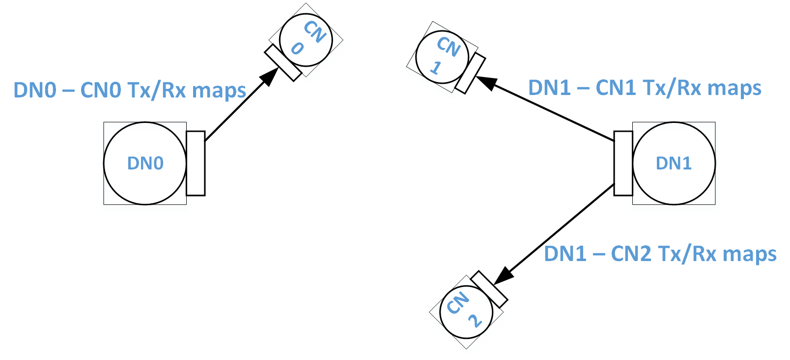
Bandwidth reservation example
BWGD N + 2
Each DN allocates the remaining Tx slots to its associated CNs
TX |  |  |  | RX
DN1 | DN1 |  |  | CN0 | CN0
CN0 | CN0 |  |  | DN1 | DN1
DN1 | DN1 |  |  | DN1 | DN1
CN0 | CN0 |  |  | DN1 | DN1
TX |  |  |  | RX
CN1 | CN2 |  |  | DN0 | DN0
DN0 | DN0 |  |  | CN1 | CN1
DN0 | DN0 |  |  | DN0 | DN0
DN0 | DN0 |  |  | CN2 | CN2

Slide 22
Bandwidth reservation example
BWGD N + 2
Each DN sends Tx/Rx slot bitmaps to all associated CNs through Heartbeat messages
typedef struct _fbHeartbeatElement {
/* timestamp and swTimestamp are byte arrays to avoid unaligned accesses */
usint8 timestamp[8]; /* hardware timestamp */
usint8 swTimestamp[8]; /* sw timestamp offset from hw timestamp */
usint16 bwgdNumber;
usint8 txSlotBitmap[TGF_CEIL(SLOTS_IN_BWGD, BITS_PER_BYTE)];
usint8 rxSlotBitmap[TGF_CEIL(SLOTS_IN_BWGD, BITS_PER_BYTE)];
laFeedbackParams laFbParams;
usint8 syncMode : 1;
} __attribute__((__packed__)) fbHeartbeatElement;
TX |  |  |  | RX
DN0 | DN0
 |  |  |  | DN0 | DN0
 |  |  |  | DN0 | DN0
TX |  |  |  | RX
 |  |  |  | DN1
DN1 | DN1
TX |  |  |  | RX
DN1 | DN1 |  |  | CN0 | CN0
CN0 | CN0 |  |  | DN1 | DN1
DN1 | DN1 |  |  | DN1 | DN1
CN0 | CN0 |  |  | DN1 | DN1
TX |  |  |  | RX
CN1 | CN2 |  |  | DN0 | DN0
DN0 | DN0 |  |  | CN1 | CN1
DN0 | DN0 |  |  | DN0 | DN0
DN0 | DN0 |  |  | CN2 | CN2
TX |  |  |  | RX
 |  |  |  |  | DN1
DN1 | DN1

Slide 23
Summary
We described 3 aspects of link maintenance in mmWave Distribution Networks
We encourage companies to define fields, IEs and messages with these requirements in mind, on top of developed constructs (e.g., Slot Structure and Slot Schedule IEs) in 11ay Draft 1.0 [3].

Slide 24
References
[1] IEEE 802.11-17/1019r2 “mmWave Mesh Network Usage Model”
[2] IEEE 802.11-17/1321r0 “Features for mmW Distribution Network Use Case”
[3] IEEE 802.11ay Draft 1.0

