Slide 1
2 us OOK pulse for high rate
Date: 2018-01-12
Authors:

Slide 2
Introduction
WUR needs to support two data rates: 62.5 Kbps and 250 Kbps
For WUR rate 250 Kbps, coded bit duration is 2 us
Time-masking approach of generating 2 us OOK pulse was suggested in [1-3]
Reduced FFT size based approach of generating 2 us OOK pulse was suggested in [4]
In this presentation, we study the impact of OOK pulse shape on the performance
Determine the optimum IFFT coefficients for the Reduced FFT size approach
Compare the performance of optimal pulse shapes for the above two approaches of generating the 2 us OOK Pulse

Slide 3
Preamble structure to support two rates
Use the same sequence, signal the lower rate by including two repetitions, signal high rate using bit complement
24 µs
Legacy+WUR mark
Wake-up preamble
MAC header
Payload
FCS
Low Rate
S
S
128 µs
Higher Rate
S Complement
64 µs

Slide 4
WUR packet structure
24us
Data
Legacy+WUR Mark
Wake-up preamble
MAC header
Payload
FCS
Data
Low rate (62.5 Kbps) –Manchester code
‘1’ – 4us OFF, 4us ON, 4us OFF, 4us ON
‘0’ – 4us ON, 4us OFF, 4us ON, 4us OFF
Standard 4 us OOK pulse in the on period (4 MHz BW)
Generated using the 13 L-STF Coefficients
High rate (250 Kbps) – Manchester code
‘1’ – 2us OFF, 2us ON
‘0’ – 2us ON, 2us OFF
Need to design shorter (2us) OOK pulse

Slide 5
2us OOK Pulse Design Options: Time-Masking
Time-Masking approach
Applying time-mask to 4us OOK pulse
Use either first or second half of the 4us pulse
The pulses are normalized to have same energy
0us 2us 4us
0us 2us 4us
Information “0”
Information “1”

Slide 6
2us OOK pulse design options: FFT based
FFT based approach
Increase the subcarrier spacing to 625 KHz
32 pt. FFT in 20 MHz Bandwidth
WUR pulse occupying the center 7 subcarriers (including DC)
Choice of subcarrier weights
Approach 1: Randomly selected from 64 QAM constellation set
Approach 2: Subcarrier weights from rotated BPSK {1+1j,-1-1j} – 64 combinations of pulse shapes
2 (a): chose the weights with min SNR @10% PER
2 (b): chose the weights with min PAPR

Slide 7
Simulation parameters (Transmitter)
24 µs
Legacy+WUR mark
Wake-up preamble
MAC header
Payload
FCS
High rate transmissions
Preamble
Repetition of 32-bit seq (zero padded 31 bit PN seq)
Bit duration: 2 us
4 MHz, 2 us OOK pulse wih 7 L-STF coefficients
Data
Manchester code, Bit duration: 2 us
4 MHz, 2 us OOK pulse
Generated by time masking the 4 us OOK pulse
Generated using 32 pt. FFT approach

Slide 8
Simulation parameters (Receiver)
The known 64 us preamble sequence is cross correlated (normalized output) with a sliding window of the received samples and detect two peaks
4 MHz LPF (IIR) – generated using MATLAB
3rd order butterworth filter
Cutoff freq. = 2.5MHz, Sampling freq. =160MHz
WUR processing both I and Q components
Channels: AWGN and Channel D
No phase noise and no ACI
2.4 GHz band operation
SNR is measured after the 4 MHz LPF and 4 MHz sampling

Slide 9
Performance with 32 pt FFT Approach (Channel D)
Performance shown for 64 different pulse shapes
Shape of the pulse has a significant impact on performance, although the energy in the pulse is the same
1.5dB @ 10% PER, 4 dB @ 1% PER

Slide 10
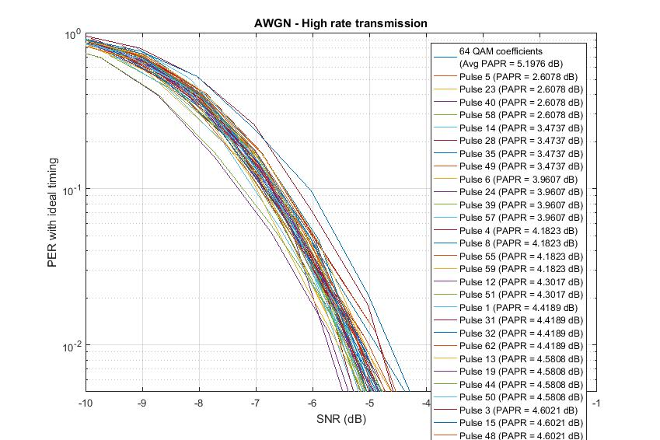
Performance with 32 pt FFT Approach (AWGN)
Performance shown for 64 different pulse shapes
Shape of the pulse has a significant impact on performance, although the energy in the pulse is the same
1.5dB @ 10% PER and @ 1% PER

Slide 11
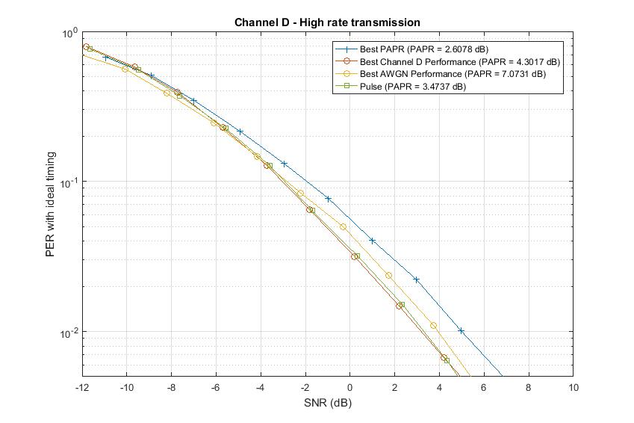
Performance with 32 pt FFT Approach
Performance shown for pulse with best sensitivity, best PAPR, and pulse with good tradeoff between PAPR and performance
Best PAPR pulse: Performance gap of 0.5 dB in AWGN and 1 dB in Channel D
Best pulse for Channel D: Performance gap of 0.5 dB in AWGN, high PAPR
Best pulse for AWGN: Performance gap of 0.2 dB in Channel D, very high PAPR
The tradeoff pulse: Performance gap of 0.5 dB in AWGN, no observable loss in Channel D

Slide 12
Coefficients for the optimum pulse shapes
Best PAPR pulse: Performance gap of 0.5 dB in AWGN and 1 dB in Channel D
IFFT Coefficients: [0 0 0 … 0 -1 -1 -1 0 1 -1 1 0 0 0 … 0]
Best pulse for Channel D: Performance gap of 0.5 dB in AWGN, high PAPR
IFFT Coefficients: [0 0 0 … 0 1 1 -1 0 -1 1 1 0 0 0 … 0]
Best pulse for AWGN: Performance gap of 0.2 dB in Channel D, very high PAPR
IFFT Coefficients: [0 0 0 … 0 1 -1 1 0 -1 1 -1 0 0 0 … 0]
The tradeoff pulse: Performance gap of 0.5 dB in AWGN, no observable loss in Channel D
IFFT Coefficients: [0 0 0 … 0 1 1 -1 0 -1 -1 1 0 0 0 … 0]

Slide 13
Performance with time-masking Approach
Similar study needs to be repeated for pulses generated using time-masking approach
Difficult to identify best performance pulses for AWGN and Channel D
12 subcarrier coefficients: 4096 combinations of pulse shapes
Can do constrained search:
PER simulations only for pulse shapes with reasonable PAPR
Number of pulse shapes to search is < 100

Slide 14
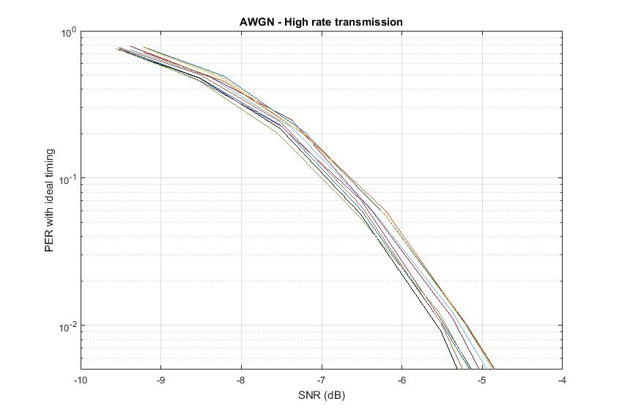
Performance with time-masking Approach (PAPR constrained search)
Performance evaluated for pulse shapes with PAPR <= 3 dB
Shape of the pulse has some impact on performance, although the energy in the pulse is the same
Channel D: 0.2dB @ 10% PER, 0.5 dB @ 1% PER
AWGN: 0.4 dB @ 10% PER, @1% PER

Slide 15
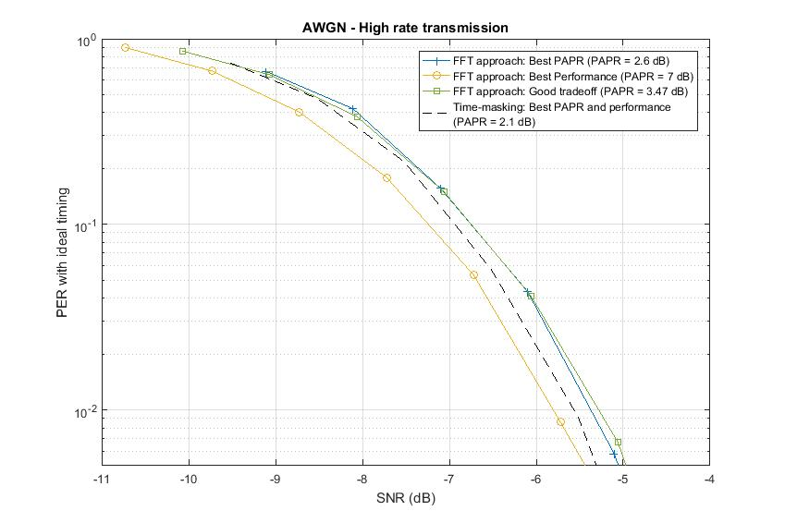
Performance comparison of time-masking and FFT
Performance gap between the best performance time-masking pulse with optimum FFT based pulse
Channel D: Optimum FFT pulse is better by 1 dB @ 10% PER and 1.5 dB @ 1% PER
AWGN: best time-masking pulse is better by 0.2 dB @ 10% PER and 1% PER
Optimum FFT based pulse has PAPR of 3.47 dB when compared to best performance time-masking pulse which has PAPR of 2.38 dB

Slide 16
Summary
Discussed different approaches for 2us OOK pulse generation
Time making
32 pt. FFT approach
Evaluated the performance with different FFT coefficients for 32 pt. FFT approach and time-masking approach
OOK decoding performance significantly dependent on the shape of the pulse (equivalently FFT coefficients)
The optimum 32 pt. FFT based pulse has PAPR of 3.47 dB and it has very good performance in Channel D and AWGN
The optimum 32 pt. FFT based pulse outperforms the constrained best time-masking pulse in channel D by 1 dB (@ 10% PER) and 2 dB (@1% PER)
But at the expense of increased PAPR

Slide 17
References
[1] Junghoon Suh, et.al., “Blank GI choices under Timing Errors,” IEEE 802.11-17/1390r1
[2] Junghoon Suh, et.al., “ Blank GI for the Waveform Coding ,” IEEE 802.11-17/0696r0
[3] Eunsung Park , et.al., “ Symbol Structure,” IEEE 802.11-17/1347r3
[4] Vinod Kristem, et.al., “OOK waveform generation for high data rate,” IEEE 802.11-17/1615r0

Slide 18
Appendix

