Slide 1
WUR SYNC DESIGN
Date: 2018-01-12
Authors:

Slide 2
Preamble structure to support two rates
Based on the discussions [1]-[5], the motion has been passed for the following preamble structure to support two different rates
  The exact bit sequence S and the bit duration is TBD
24 µs
Legacy+WUR mark
Wake-up preamble
MAC header
Payload
FCS
Low Rate
S
S
128 µs
Higher Rate
S Complement
64 µs

Slide 3
Rate and timing detection the receiver
Received samples correlated with sequence S
Rate detection
  Low rate transmission: 2 positive peaks, separated by PN seq length
  High rate transmission: Single negative peak
Timing estimation
  Correlation exceeds a threshold

Slide 4
Candidate sequence S: PN sequence with different bit durations
Sequence S (64 us duration)
  Zero padded 15 bit PN sequence, with 4 us bit duration
  Zero padded 31 bit PN sequence, with 2 us bit duration
We evaluate and compare the performance of 4 us and 2 us preamble bit durations
  Sequences with even smaller bit duration (1 us and below) can result in significant ISI and hence are not considered.

Slide 5
Simulation parameters (Transmitter)
24 µs
Legacy+WUR mark
Wake-up preamble
MAC header
Payload
FCS
  Preamble: Low rate: [S S], High rate: [S complement]
    Case 1: S - [0 15 bit PN seq.], with 4 us bit duration
      4 us OOK pulse constructed using 13 L-STF coefficients
    Case 2: S - [0 31 bit PN seq.], with 2 us bit duration
      2 us OOK pulse generated using 32 pt. FFT in 20 MHz
  Data portion: Manchester coding
    Low rate scenario
      ‘0’- 4 us ON, 4 us OFF, 4 us ON, 4 us OFF
      ‘1’- 4 us OFF, 4 us ON, 4 us OFF, 4 us ON
      4 us OOK pulse constructed using 13 L-STF coefficients
    High rate scenario
      ‘0’- 2 us ON, 2 us OFF
      ‘1’- 2 us OFF, 2 us ON
      2 us OOK pulse generated using 32 pt. FFT in 20 MHz

Slide 6
Simulation parameters (Receiver)
4 MHz LPF (IIR) – generated using MATLAB
  Third order Butterworth filter
  Cutoff freq. = 2.5 MHz, Sampling freq. =160 MHz
WUR processes (i) in-phase only (single rx chain); (ii) processes both I and Q
Channels: AWGN and Channel D
No phase noise and ACI modeled
2.4 GHz band operation
SNR is measured at 20 MHz bandwidth, post 4 MHz LPF
Performance quantified with respect to ideal rate and timing

Slide 7
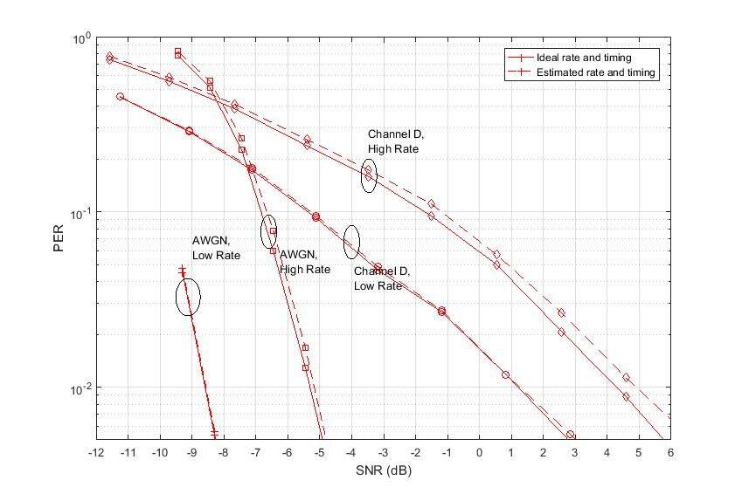
Performance of 4 us bit duration
(WUR processes both I and Q)
Low rate scenario: No observable gap between ideal and estimated timing
High rate scenario: 0.25 dB loss in AWGN and 0.5 dB loss in Channel D

Slide 8
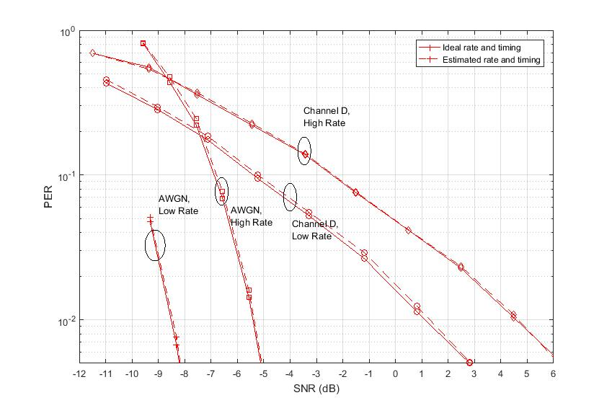
Performance of 2 us bit duration
(WUR processes both I and Q)
Performance gap < 0.2 dB, for both low and high rate scenarios

Slide 9
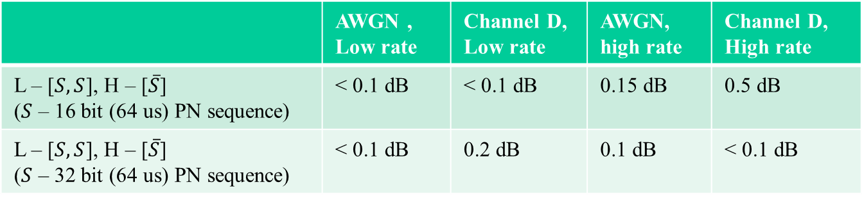
Performance comparison (4 us Vs 2 us)
Performance measured with respect to ideal rate and ideal timing
  Delta SNR corresponding to 10% PER levels
Good performance for both 2 us and 4 us bit durations
  2 us case is little better for High rate scenario in Channel D
 | AWGN , Low rate | Channel D, Low rate | AWGN, high rate | Channel D, High rate
L – [$S,S$], H – [$\overline{S}$] ($S$ – 16 bit (64 us) PN sequence) | < 0.1 dB | < 0.1 dB | 0.15 dB | 0.5 dB
L – [$S,S$], H – [$\overline{S}$] ($S$ – 32 bit (64 us) PN sequence) | < 0.1 dB | 0.2 dB | 0.1 dB | < 0.1 dB

Slide 10
Other metrics for picking a preamble sequence
Desirable metrics for picking a preamble sequence
  Good PER performance, measured in terms of SNR gap between the ideal timing and estimated timing
    Ratio of strongest peak/next strongest peak in auto-correlation of sequence is one indicator
  Smaller OFF (Silence) period in the preamble
    Maximum consecutive 1’s or 0’s (run length) in the sequence S
    Smaller OFF period is desirable
      Other devices does not sense the channel as idle
      Good for AGC implementation
    At least 4 usec of OFF duration for preamble bit duration of 2 us
  Sequence that enables efficient AGC implementation
    Desirable to have small silence period at the beginning of the sequence

Slide 11
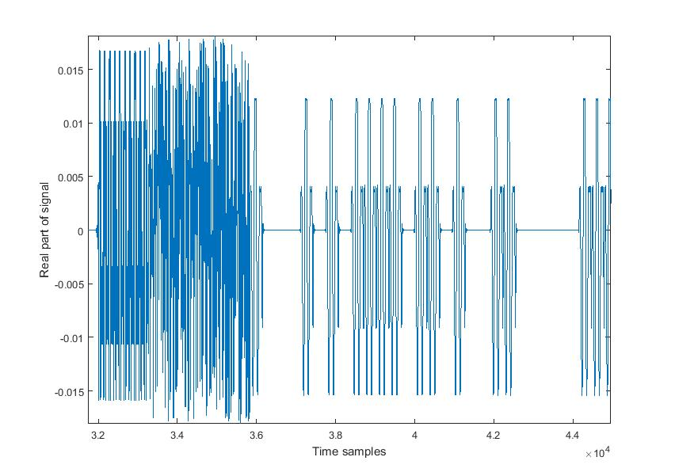
Impact of silence period on AGC (1)
Legacy Preamble + WUR-Mark
(24μs)
WUR Preamble (32- bit, 2us bit duration)
Energy accumulation window
for AGC gain setting
6us OOK symbol gap
8us OOK symbol gap
AGC gain typically set based on energy in the legacy preamble portion
  Energy accumulation window location can be arbitrary because of unknown packet start
  Large silence period results in inaccurate gain setting
Small OFF period in preamble is desirable
  Enables smaller accumulation window and faster AGC gain convergence

Slide 12
Impact of silence period on AGC (2)
Legacy Preamble + WUR-Mark
(24μs)
WUR Preamble (32- bit, 2us bit duration)
Energy accumulation window
for AGC gain setting
6us OOK symbol gap
8us OOK symbol gap
Desirable to have smaller silence period at the beginning of the sequence
  Consecutive zeros in the beginning can cause significant fluctuations in the AGC gains.
  Enables faster AGC gain convergence and locking
  Metric (Silence Period Location): How far into the preamble sequence, do we get a silence period of 4 us or more
    For ex: [1 0 1 0 1 0 0 1……] with bit duration of 2 us, Metric = 10 us
    Larger values are better for AGC

Slide 13
Candidate sequences S with 2 us bit durations
Sequence S1: Zero padded PN sequence
  S1 = [0 1 1 1 0 1 0 1 0 0 0 0 1 0 0 1 0 1 1 0 0 1 1 1 1 1 0 0 0 1 1 0]
  Maximum off time in S/S-Complement = 10 us
  Silence period location: 2 us into the sequence
Sequence S2: Proposed sequence in [6]
  S2 = [0 1 1 1 0 1 0 1 0 0 1 0 1 0 0 1 0 1 1 0 0 1 1 0 1 1 0 0 0 1 1 0]
  Maximum off time in S/S-Complement = 6 us
  Silence period location: 2 us into the sequence
Sequence S3: Proposed sequence in [7]
  S3 = [1 0 1 0 0 1 0 0 1 0 1 1 1 0 1 1 0 0 0 1 0 1 1 1 0 0 1 1 1 0 0 0]
  Maximum off time in S/S-Complement = 6 us
  Silence period location: 6 us into the sequence

Slide 14
Candidate sequences S with 2 us bit durations
Sequence S4: Our proposed sequence
  S4 = [1 0 0 1 1 0 0 1 1 0 0 1 0 1 1 0 0 1 0 1 1 0 1 0 1 0 1 0 0 1 0 1]
  Maximum off time in S/S-Complement = 4 us
  Silence period location: 2 us into the sequence
  Generated by applying Manchester encoding [1 0]/[0 1] to zero padded 15 bit PN sequence
Sequence S5: Our proposed sequence
  S5 = [1 0 1 0 1 0 1 0 0 1 0 1 1 0 0 1 1 0 0 1 1 0 0 1 0 1 1 0 0 1 0 1]
  Maximum off time in S/S-Complement = 4 us
  Silence period location: 14 us into the sequence
  Generated by applying cyclic shift to Sequence S4

Slide 15
Metrics of sequences S1-S5
Sequence | ACM (first maximum/second maximum) | Max OFF time in S/S-complement | Silence period location
S1 | 8 | 10 us | 2 us
S2 | 5.33 | 6 us | 2 us
S3 | 8 | 6 us | 6 us
S4 | 5.33 | 4 us | 2 us
S5 | 5.33 | 4 us | 14 us
S4 and S5 have the least OFF times
S4 and S5 have smaller ACM values than S1 and S3
  Does not necessarily translate to higher PER, as can be seen from simulation results
S5 has the maximum silence period location
  Consecutive 0’s/1’s in the sequence will start much later into the sequence

Slide 16
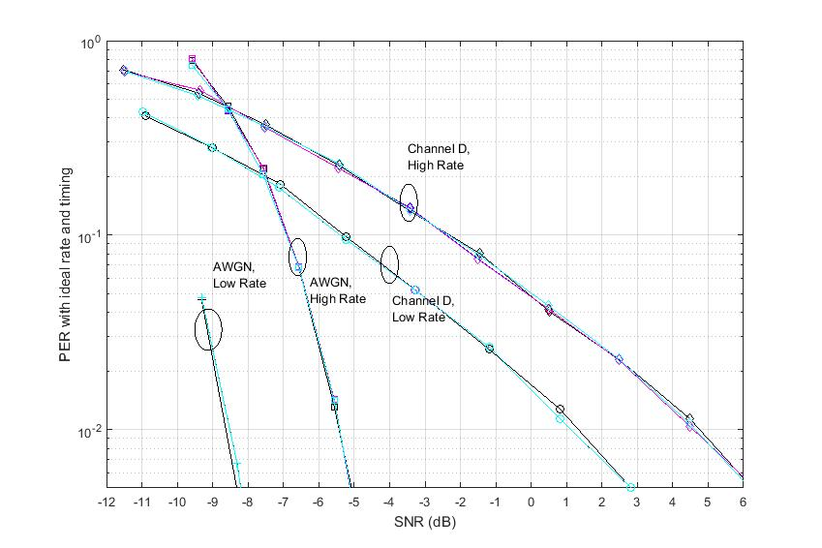
PER with ideal rate and timing
Color codes: 5 different sequences – S1 to S5
Very similar PER values for different sequences S
  Expected as the timing is perfect

Slide 17
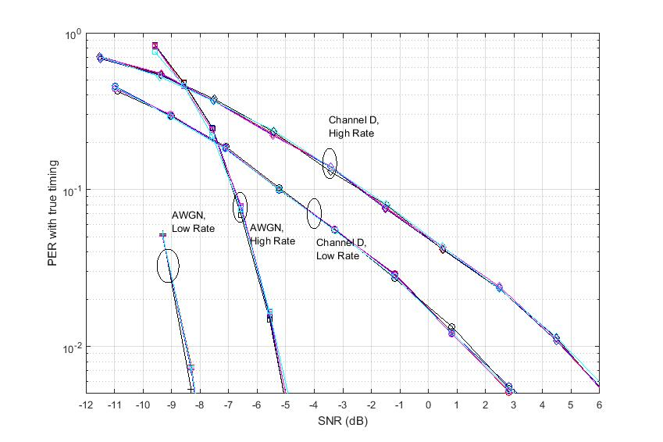
PER with estimated rate and timing
Very similar performance for different sequences S, under different Tx rates and channel conditions
  Performance gap between different sequences < 0.2 dB (@10% PER, 1% PER)
PER includes miss detection, rate miss classification, and false alarms

Slide 18
Summary
Evaluated and compared the performance of preamble sequences with 2us and 4 us bit durations
  Very similar performance for low rate scenario
  2 us case slightly better in Channel D, for high rate scenario
Proposed 2 us bit duration sequences (S4 and S5), suitable for efficient AGC implementation
  Smaller off period (especially at the beginning of preamble) is better for AGC
Evaluated the performance of different 32-bit preamble sequences S, with bit duration of 2 us
  Similar PER values for different channel models and Tx rates
  The proposed sequences S4 and S5 have smallest OFF period (4 us)
  Among the studied sequences, S5 has the OFF period (>2 us), farthest into the preamble sequence

Slide 19
Straw poll 1
Which of the options do you support for preamble bit duration
Option 1: 4 us bit duration
  Yes
  No
  Abstain
Option 2: 2 us bit duration
  Yes
  No
  Abstain

Slide 20
Straw Poll 2
Do you support the following?
The design of preamble sequence S or its complement (Low rate is indicated by [S S], High rate is indicated by [S complement]) should consider maximum OFF period.
Yes
No
Abstain

Slide 21
Straw Poll 3
Do you support the following?
The design of preamble sequence S or its complement (Low rate is indicated by [S S], High rate is indicated by [S complement]) should consider maximum OFF duration to enable fast AGC and to reduce the impact of channel sensing on third party 802.11 stations.
Yes
No
Abstain

Slide 22
Straw Poll 4
Do you support the following proposal?
We propose to use the following 32-bit preamble sequence S (S5 in the presentation), with 2 us bit duration.
S = [1 0 1 0 1 0 1 0 0 1 0 1 1 0 0 1 1 0 0 1 1 0 0 1 0 1 1 0 0 1 0 1].
(Low rate is indicated by [S S], High rate is indicated by [S complement])
Yes
No
Abstain

Slide 23
Straw Poll 5
Do you support the following?
The preamble sequence S or its complement (Low rate is indicated by [S S], High rate is indicated by [S complement]) should be designed such that the contiguous OFF period is no more than 8 us .
Yes
No
Abstain

Slide 24
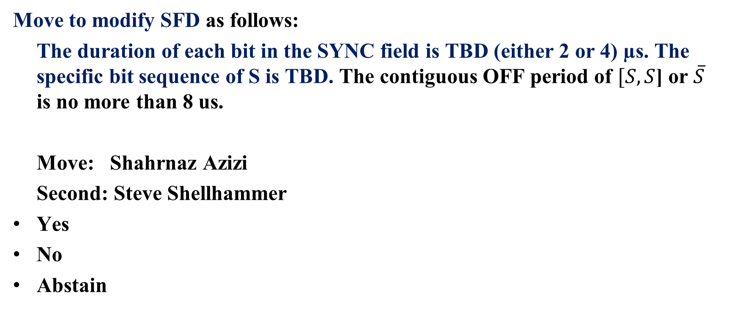
Motion
Move to modify SFD as follows:
The duration of each bit in the SYNC field is TBD (either 2 or 4) µs. The specific bit sequence of S is TBD. The contiguous OFF period of $[S,S$] or $\overline{S}$ is no more than 8 us.
Move: Shahrnaz Azizi
Second: Steve Shellhammer
Yes
No
Abstain

Slide 25
References
[1] 17/0997r0 Preamble Options, IEEE 802.11 TGba, July 2017
[2] 17/1781r1 Sync Structure Motions, IEEE 802.11 TGba, Nov. 2017
[3] 17/1355r1 WUR Preamble Evaluation, IEEE 802.11 TGba, September 2017
[4] 17/1345r5 11ba PHY Frame Format Proposal, IEEE 802.11 TGba, September 2017
[5] 17/1614r1 Preamble studies to indicate different data rates, IEEE 802.11 TGba, Nov. 2017
[5] 18/0123r0 Options for Sync Field Bit Sequence, IEEE 802.11 TGba, January 2018
[6] 18/0100r0 WUR Preamble Sequence Performance Evaluation, IEEE 802.11 TGba, January 2018

Slide 26
Appendix

Slide 27
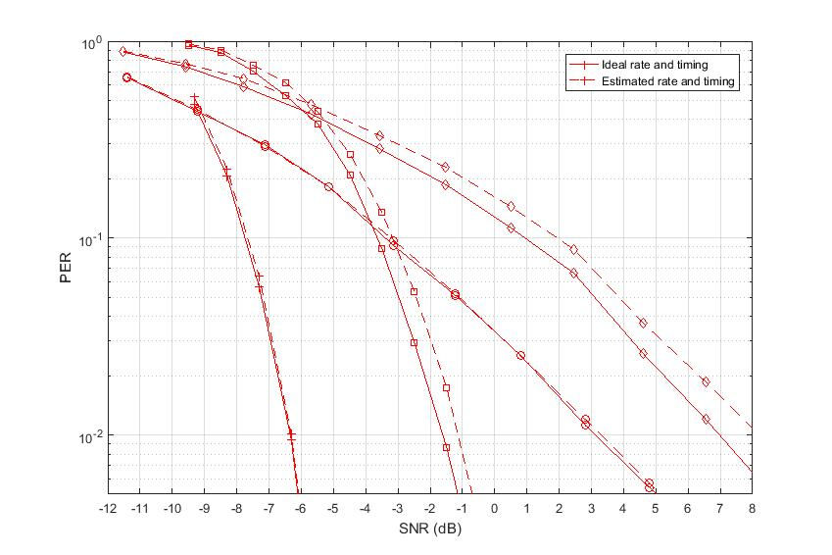
Performance of 4 us bit duration
(WUR processes only Inphase component)
Low rate scenario: No observable gap between ideal and estimated timing
High rate scenario: 0.5 dB loss in AWGN and 1 dB loss in Channel D

Slide 28
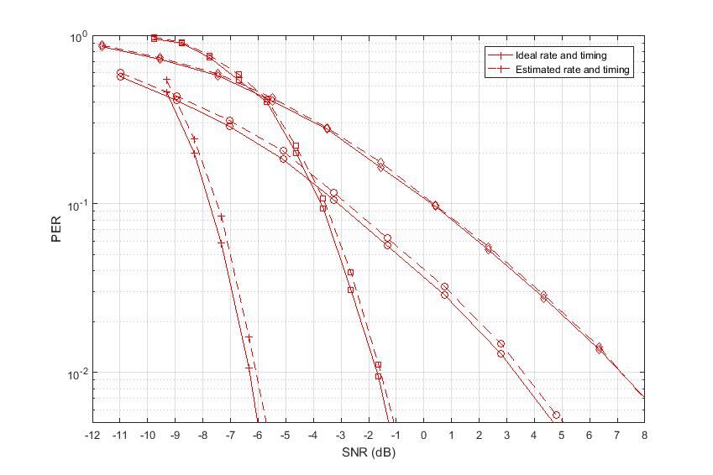
Performance of 2 us bit duration
(WUR processes only Inphase component)
Performance gap < 0.2 dB, for high rate scenarios
Performance gap of 0.4 dB for low rate scenario

Slide 29
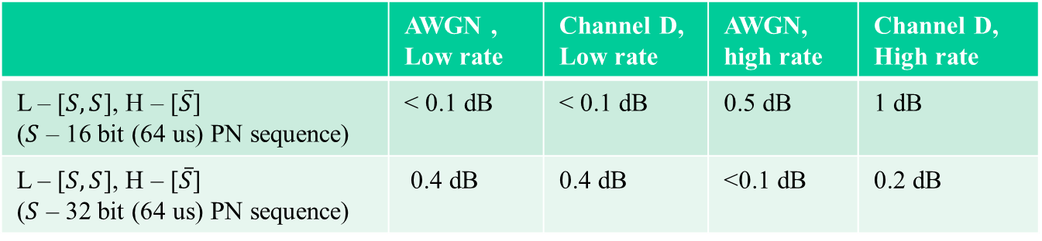
Performance comparison (4 us Vs 2 us)
(WUR processes only Inphase component)
Performance measured with respect to ideal rate and ideal timing
  Delta SNR corresponding to 10% PER levels
2 us case is better for High rate scenario
 | AWGN , Low rate | Channel D, Low rate | AWGN, high rate | Channel D, High rate
L – [$S,S$], H – [$\overline{S}$] ($S$ – 16 bit (64 us) PN sequence) | < 0.1 dB | < 0.1 dB | 0.5 dB | 1 dB
L – [$S,S$], H – [$\overline{S}$] ($S$ – 32 bit (64 us) PN sequence) | 0.4 dB | 0.4 dB | <0.1 dB | 0.2 dB

Slide 30
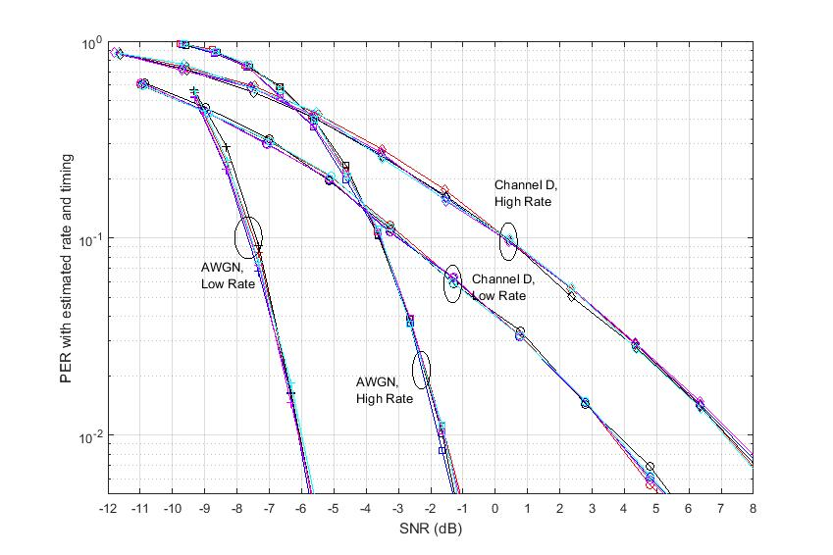
PER with estimated rate and timing
(WUR processing Only Inphase component)
Very similar performance for different sequences S
  Performance gap between different sequences < 0.2 dB (@10% PER, 1% PER)

