Slide 1
WUR Synchronization Straw Poll
Date: 2018-1-11
Authors:
Name | Company | Address | Phone | Email
Lei Huang | Panasonic Corporation |  |  | lei.huang@sg.panasonic.com
Rojan Chitrakar
Yoshio Urabe

Slide 2
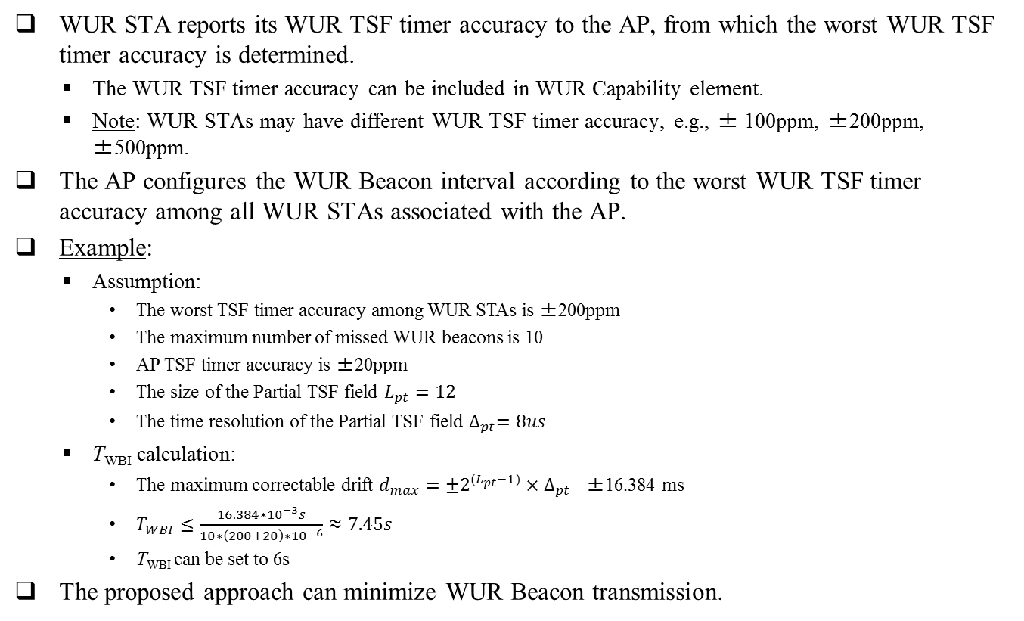
Recap: Approach for Configuring WUR Beacon interval [1]
WUR STA reports its WUR TSF timer accuracy to the AP, from which the worst WUR TSF timer accuracy is determined.
  The WUR TSF timer accuracy can be included in WUR Capability element.
  Note: WUR STAs may have different WUR TSF timer accuracy, e.g., ± 100ppm, ±200ppm, ±500ppm.
  The AP configures the WUR Beacon interval according to the worst WUR TSF timer accuracy among all WUR STAs associated with the AP.
Example:
  Assumption:
    The worst TSF timer accuracy among WUR STAs is ±200ppm
    The maximum number of missed WUR beacons is 10
    AP TSF timer accuracy is ±20ppm
    The size of the Partial TSF field $L_{pt}=12$
    The time resolution of the Partial TSF field $∆_{pt}=8us$
  T_{WBI} calculation:
    The maximum correctable drift $d_{max}={±2}^{{(L}_{pt}−1)}×∆_{pt}$= ±16.384 ms
    $T_{WBI}≤\frac{16.384∗{10}^{−3}s}{10∗\left(200+20\right)∗{10}^{−6}}≈7.45s$
    T_{WBI} can be set to 6s
  The proposed approach can minimize WUR Beacon transmission.

Slide 3
Reference
11-17-1607-01-00ba-WUR-synchronization

Slide 4
SP
Do you support adding the following to 11ba SFD?
  WUR STA should report its WUR TSF timer accuracy to the AP using WUR capability element.
  Y/N/A:

