Slide 1
802.11 Working Group Opening Report
January 2018
Authors:
Date: 2018-01-15

Slide 2
Introduction
This presentation, together with the reports cited on the next slide, forms the opening report of the IEEE 802.11 Working Group for January 2018.
Subgroup status is reported in the “Snapshots” submission (see documents slide for link). This is incorporated by reference into this opening report.
“Mx.y.z” terminology indicates that the item was on the tentative agenda for the Monday 802.11 plenary, and was agenda item x.y.z.

Slide 3
M1.3 Meeting Decorum
%
Photography or recording is not allowed
Press (i.e., anyone reporting publicly on this meeting) are to announce their presence (December 2015 IEEE-SA Standards Board Ops Manual 5.3.3.3)
Laptop speakers, cell phone / tablet ringers off
Wear your badges at all times in meeting areas
  Help the hotel security staff improve the general security of the meeting rooms
  Laptops HAVE BEEN STOLEN at previous meetings
  DO NOT assume that meeting areas are secure
Please observe proper decorum in meetings

Slide 4
M2.3.1 Summary of Liaisons - Incoming
From WFA to 3GPP on Coexistence Testing
  https://mentor.ieee.org/802.11/dcn/17/11-17-1853-00-0000-liaison-statement-from-wfa-on-coexistence-tests.doc
  For information to Coex SC

Slide 5
M2.5 802 EC decisions
On 2017-11-10 the EC approved:
802.11ax & 802.11az PAR modifications
802.11aj to RevCom (conditional)
LC SG “recharter” (proper term is now "recharter")
LC SG press release
WBA liaison - the same content as approved by 802.11 was approved by an 802.1 motion, so the 802.11 motion was not made.
The EC did not approve TGaq conditional approval to go to RevCom, and did not discuss the mandatory coordination waiver.

Slide 6
M2.5 IEEE-SA Standards Board (SASB) decisions
In December the IEEE-SA Standards Board approved:
P802.11ax PAR modification – see: http://www.ieee802.org/11/PARs/P802.11ax.pdf
To maintain SASB oversight of TGax until the end of the project.
Note the P802.11az PAR modification is on the January NesCom agenda.

Slide 7
M3.1 802.11 Working Group Session Documents
WG Session Reports
WG Agenda | https://mentor.ieee.org/802.11/dcn/11-17-1803
Opening report | https://mentor.ieee.org/802.11/dcn/11-17-1804
Snapshots | https://mentor.ieee.org/802.11/dcn/11-18-0016
1st vice chair | https://mentor.ieee.org/802.11/dcn/11-18-0002
2nd vice chair | https://mentor.ieee.org/802.11/dcn/11-18-0017
Treasurer | https://mentor.ieee.org/802.11/dcn/11-18-0001
Chair's Supplementary Material | https://mentor.ieee.org/802.11/dcn/11-17-1805
Motions | https://mentor.ieee.org/802.11/dcn/11-18-0018
Closing report | https://mentor.ieee.org/802.11/dcn/11-18-0019
Previous Session Minutes | https://mentor.ieee.org/802.11/dcn/11-17-1573

Slide 8
M3.2 Joint meetings and Reciprocal Credit
Reciprocal credit is provided to 802.11 voters for attendance at: 802.18, 802.19, 802.24, 802.1**
  Reciprocal credit for 802.1 is for 801.1Qbz, 802.1CF, 802E
** When meeting

Slide 9
M4.1.1 Type of Groups
Type of Group | Description
WG | Working Group
SC | Standing Committee
TG | Task Group
SG | Study Group
TIG | Topic Interest Group

Slide 10
M4.1.1 Groups
Type | Group | Description
WG | WG11 | The IEEE 802.11 Working Group
SC | AANI | Advanced Access Networking Interface (AANI)
SC | ARC | Architecture
SC | PAR | PAR review
SC | WNG | Wireless Next Generation
802 SC | JTC1 | ISO/IEC JTC1/SC6
TG | AJ | China Milli-Meter Wave (CMMW)
TG | AQ | Pre-association Discovery (PAD)
TG | AK | General Link (GLK)
TG | AX | High Efficiency Wireless LAN (HEW)
TG | AY | Next Generation 60 GHz (NG60)
TG | AZ | Next Generation Positioning (NGP)
TG | BA | Wake-up Radio
TG | MD | Revision (REVmd)
SG | LC | Light Communication SG

Slide 11
M4.1.2 PAR Expiration/Renewal Schedule
Project | PAR Expiration Date
AJ | 31-DEC-2018
AK | 31-DEC-2018
AQ | 31-DEC-2018
AX | 31-DEC-2018
AY | 31-DEC-2019
AZ | 31-DEC-2019
BA | 31-DEC-2020
802.11 (REVmd) | 31-DEC 2021
http://www.ieee802.org/11/PARs/index.html

Slide 12
M4.1.3 802.11 WG Appointed positions
WG Secretary – Stephen McCann
Treasurer – Jon Rosdahl
ANA Authority – Robert Stacey
WG Technical Editors – Robert Stacey, Peter Ecclesine

Slide 13
M4.1.3 Officers
Cat | Group | Chair | Vice Chair | Technical Editor | Secretary
WG |  | Adrian STEPHENS | Jon ROSDAHL Dorothy STANLEY | Robert STACEY Peter ECCLESINE | Stephen MCCANN
SC | AANI | Joseph LEVY | Roger Marks
SC | ARC | Mark HAMILTON | Joseph LEVY |  | Joseph LEVY
SC | Coex | Andrew MYLES
SC | PAR | Jon ROSDAHL | Michael MONTEMURRO |  | Michael MONTEMURRO
SC | WNG | Jim LANSFORD | Lei WANG
TG | MD | Dorothy STANLEY | Mark HAMILTON Michael MONTEMURRO | Emily QI Edward AU (subeditor) | Jon ROSDAHL
TG | AJ | Jiamin CHEN | Haiming WANG | Jiamin CHEN Shiwen HE (subeditor) | Open
TG | AK | Donald EASTLAKE | Mark HAMILTON | Donald EASTLAKE Norm FINN | Open
TG | AQ | Stephen MCCANN | Yunsong YANG | Lee ARMSTRONG | Open
TG | AX | Osama ABOUL-MAGD | Simone MERLIN Ron PORAT | Robert STACEY | Yasuhiko INOUE
TG | AY | Edward AU | Sang Kim | Carlos CORDEIRO | Jeorge HURTARTE
TG | AZ | Jonathan SEGEV | Carlos ALDANA | CC WANG | Roy WANT
TG | BA | Minyoung PARK | Yunsong YANG Eunsung PARK | Po-Kai Huang | Leif WILHELMSSON
SG | LC | Nikola SERAFIMOVSKI | Qiang (John) LI |  | Volker JUNGNICKEL
New last meeting

Slide 14
M4.1.3 Officers - January
Cat | Group | Chair | Vice Chair | Technical Editor | Secretary
WG |  | Adrian STEPHENS | Jon ROSDAHL Dorothy STANLEY | Robert STACEY Peter ECCLESINE | Stephen MCCANN
SC | AANI | Joseph LEVY | Roger Marks
SC | ARC | Mark HAMILTON | Joseph LEVY |  | Joseph LEVY
SC | Coex | Andrew MYLES
SC | PAR | Jon ROSDAHL | Michael MONTEMURRO |  | Michael MONTEMURRO
SC | WNG | Jim LANSFORD | Lei WANG
TG | MD | Dorothy STANLEY | Mark HAMILTON Michael MONTEMURRO | Emily QI Edward AU (subeditor) | Jon ROSDAHL
TG | AJ | Jiamin CHEN | Haiming WANG | Jiamin CHEN Shiwen HE (subeditor) | Open
TG | AK | Donald EASTLAKE | Mark HAMILTON | Donald EASTLAKE Norm FINN | Open
TG | AQ | Stephen MCCANN | Yunsong YANG | Lee ARMSTRONG | Open
TG | AX | Osama ABOUL-MAGD | Simone MERLIN Ron PORAT | Robert STACEY | Yasuhiko INOUE
TG | AY | Edward AU | Sang Kim | Carlos CORDEIRO | Jeorge HURTARTE
TG | AZ | Jonathan SEGEV | Carlos ALDANA | CC WANG | Roy WANT
TG | BA | Minyoung PARK | Yunsong YANG Eunsung PARK | Po-Kai Huang | Leif WILHELMSSON
SG | LC | Nikola SERAFIMOVSKI | Qiang (John) LI |  | Volker JUNGNICKEL
Grey = absent this meeting

Slide 15
IEEE 802.11 Revisions
802.11
-2016
802.11
-2012
802.11
-2007
802.11
-2003
11aa
Video Transport
11k
RRM
11s
Mesh
11e
QoS
MAC
11u
WIEN
11v
Network
Management
11h
DFS & TPC
IEEE
Std
802.11
-1997
11ae
QoS Mgt Frames
11z
TDLS
11i
Security
11d
Intl roaming
11w
Management
Frame
Security
11r
Fast Roam
11f
Inter AP
11af
TV Whitespace
11n
High
Throughput
(>100 Mbps)
11j
JP bands
11a
54 Mbps
5GHz
PHY & MAC
11ac -VHT
>1 Gbps @ 5GHz
11p
WAVE
11y
Contention
Based
Protocol
11g
54 Mbps
2.4GHz
11b
11 Mbps
2.4GHz
11ad - VHT
>1 Gbps @ 60GHz
Notes:
doc.: IEEE 802.11-11/0483r0
May 2011
Bruce Kraemer (Marvell)
Page 15

Slide 16
IEEE 802.11 Standards Pipeline
MAC
802.11
-2016
802.11
REVmd
802.11aq
PAD
802.11az
NGP
802.11ak
GLK
802.11ai
FILS
802.11ba
WUR
WNG
Light Comms
(LC) SG
802.11ax
HEW
802.11ah
< 1Ghz
802.11ay
NG60
802.11aj
CMMW
MAC & PHY
Discussion Topics
TIG/Study
groups
TG without
Approved draft
WG
Letter Ballot
Sponsor
Ballot
Published
Amendment
Published
Standard
16
Notes:
doc.: IEEE 802.11-11/0483r0
May 2011
Bruce Kraemer (Marvell)
Page 16

Slide 17
M4.1.5 Summary of ballots and comment collections
Type | Label | Group | Opened (mm-dd) | Dur (d) | # Comments | Ballot Group | Approve | Disapprove + invalid | Abstain | Return % | Approve % | Result
CC | 27 | LC SG | 11-09 | 18 | 72
SR | 4 | TGaj | 12-07 | 10 | 0 | 140 | 123 | 0 | 3 | 90 | 100 | P
SR | 2 | TGak | 12-22 | 10 | 1 | 108 | 87 | 3 | 0 | 84 | 96 | P
SR | 7 | TGaq | 12-12 | 15 | 14 | 125 | 111 | 2 | 2 | 92 | 98 | P
WI | 231 | TGay | 11-14 | 44 | 1343 | 288 | 147 | 51+1 | 31 | 80 | 74 | F

Slide 18
M4.1.6 Current Membership Status
Data as of 2018-01-09
Status | Number
Aspirant | 130
Potential Voter | 28
Voter | 275 **
Ex Officio Voter | 13
** LB231 result not applied. This will result in the loss of 20 voters after this session (TBC).
Definitions:
  Aspirant: a member who has attended 1 qualifying meeting
  Potential Voter: a member who has attended 2 qualifying meetings and will become a voter at the start of the next plenary they attend
  Ex Officio Voter: a voter who has voting rights by virtue of their membership of the 802 EC and has requested to be recorded as an ex officio voter in 802.11

Slide 19
M4.1.6 Recent voting member history

Slide 20
background data

Slide 21
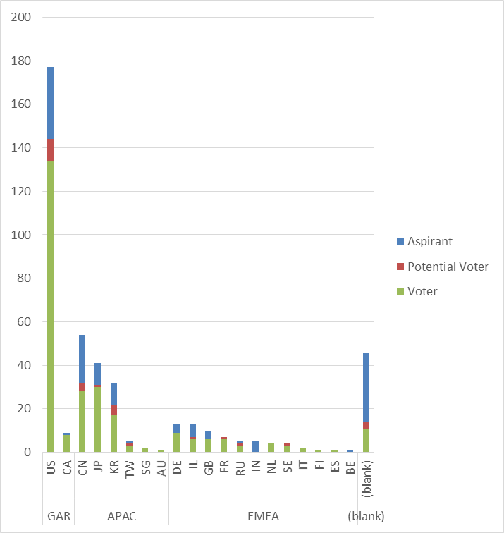
Membership by Country and Region

Slide 22
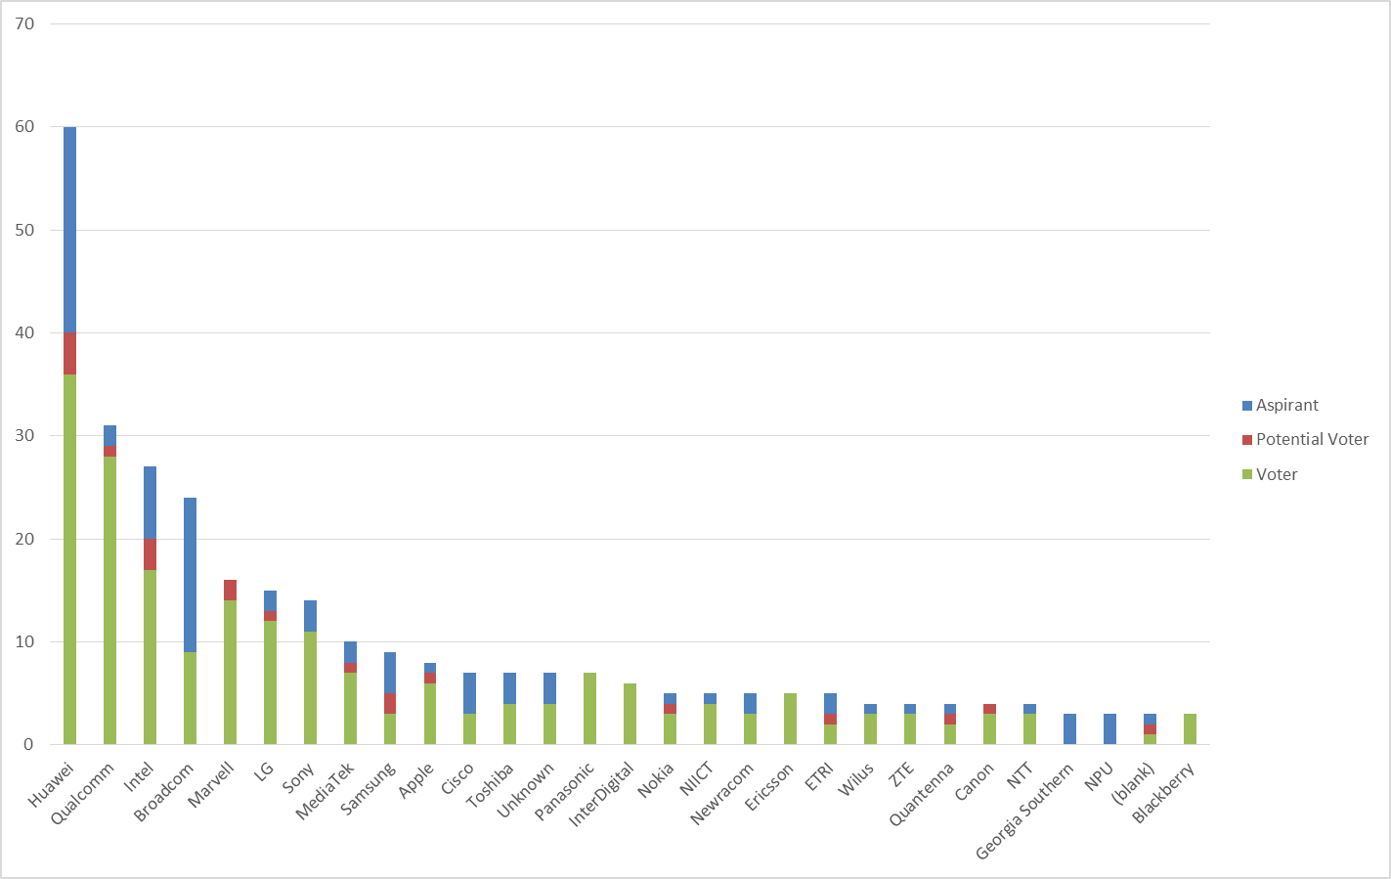
Members by Affiliation

Slide 23
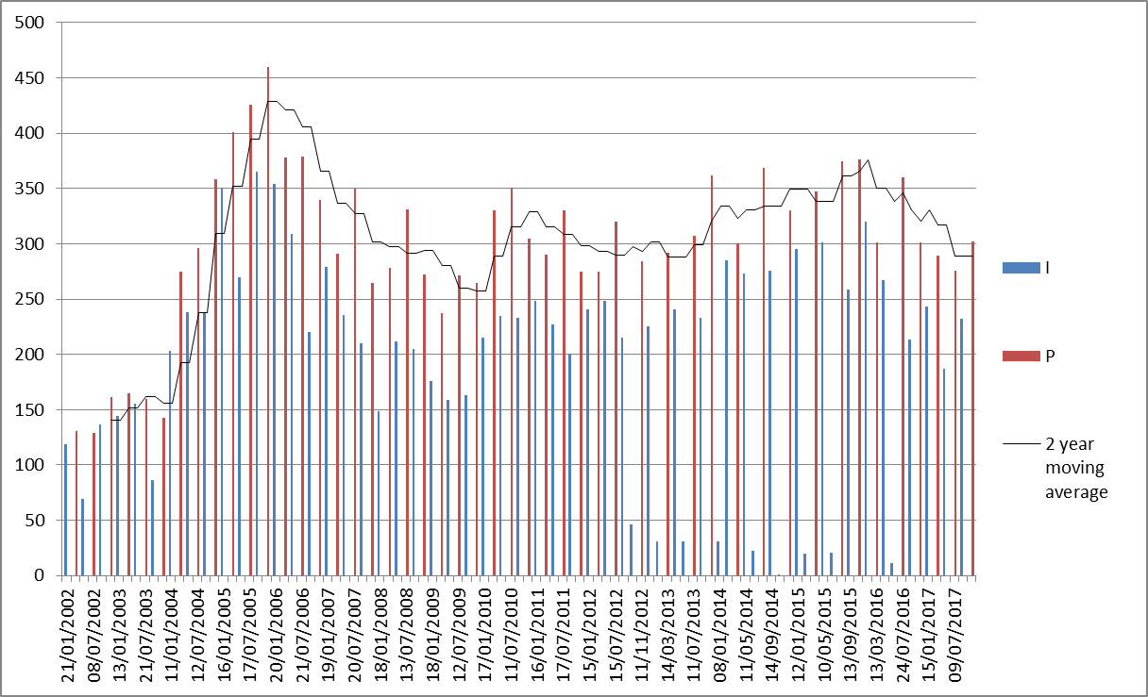
Meeting Attendance – Historic Data

Slide 24
Membership – Historic Data

