Slide 1
Sync Structure Motions
Date: 2017-11-07
Authors:

Slide 2
Motion #1
Move to add the following text to the SFD:
“The Sync field duration depends on the data rate of the Data Field. When the Data Field uses the low data rate the duration of the Sync field is 128 µs. When the Data Field uses the high data rate the duration of the Sync field is 64 µs.”
Move: Steve Shellhammer
Second:

Slide 3
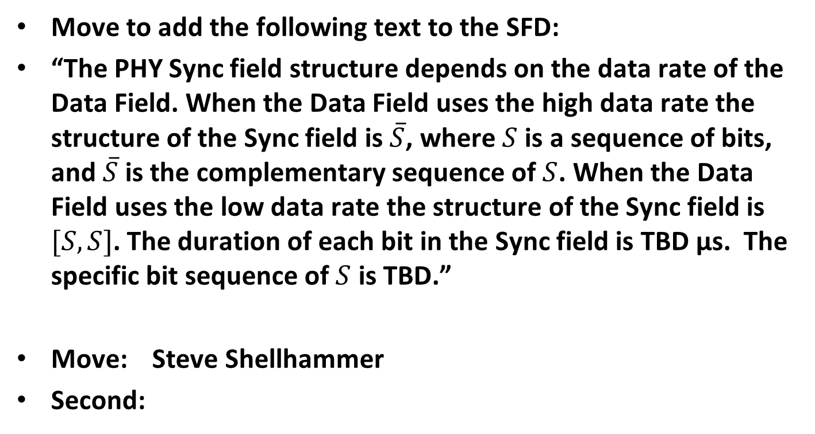
Motion #2
Move to add the following text to the SFD:
“The PHY Sync field structure depends on the data rate of the Data Field. When the Data Field uses the high data rate the structure of the Sync field is $\overline{S}$, where $S$ is a sequence of bits, and $\overline{S}$ is the complementary sequence of $S$. When the Data Field uses the low data rate the structure of the Sync field is $[S,S]$. The duration of each bit in the Sync field is TBD µs. The specific bit sequence of $S$ is TBD.”
Move: Steve Shellhammer
Second:

