Slide 1
Power Save Operation for Ranging Measurements
Date: 2017-11-08
Authors:
Chittabrata Ghosh, Intel

Slide 2
Abstract
Nov 2017
        doc.: IEEE 802.11-17/1739r0
In this presentation, we propose a power efficient scheduling mechanism for power save STAs that intend to perform 11az-based measurement
Chittabrata Ghosh, Intel

Slide 3
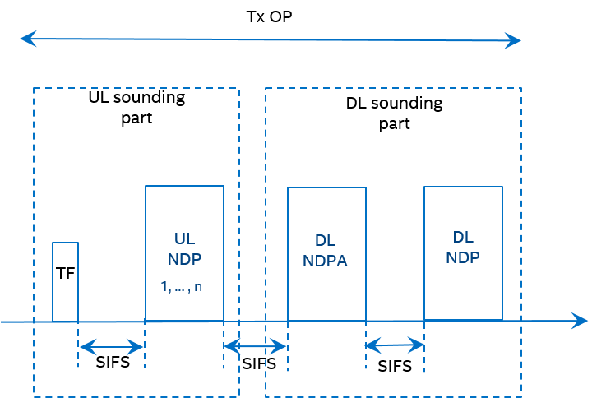
Introduction
Nov 2017
        doc.: IEEE 802.11-17/1739r0
    The 11az amendment has agreed on using NDP-based sounding mechanism for measurement in the measurement phase
      Within a single TXOP, the UL sounding is followed by the DL sounding
      In UL sounding, UL NDPs are solicited from STAs assigned resources identified in the Trigger frame
    However, for efficient resource allocation, the AP needs to identify the STAs that intend to perform measurements
    We have agreed to have a polling phase prior to the MU measurement phase
Chittabrata Ghosh, Intel

Slide 4
Discussion on Single Availability Window
Nov 2017
        doc.: IEEE 802.11-17/1739r0
A single availability window shall consist of the following frame exchanges:
A polling phase consisting of a TF for polling all STA assigned to the availability window
Sounding phase comprising of the TF for UL sounding, UL NDPs, DL NDPA, and DL NDP
Single Location Measurement Report (LMR) from AP to STAs, followed by LMRs from STA s to the AP
  The sequence is TBD
Polling
Position (FTM) Sounding part
UL NDP
STA n
Tx m
Polling subset of STAs due to BW constraint
TF
UL NDP
NDPA
DL NDP
Location
Meas.
Report
SIFS
SIFS
SIFS
SIFS
SIFS
Single availability window
Chittabrata Ghosh, Intel

Slide 5
Discussion on Single Availability Window – Contd.
Nov 2017
        doc.: IEEE 802.11-17/1739r0
In case of BW constraint when the rSTA is not capable of polling all STAs assigned to this availability window
- Propose to have an indication within the TF Poll that an additional TF Poll is expected within the
same availability window
- Propose to use the Cascade Indication subfield in Common Info field of Trigger frame for indication
Polling
Position (FTM) Sounding part
Polling
Cascade Indication = 1
UL NDP
STA n
Tx m
Cascade Indication = 0
Polling larger # of STA for
resource request.
Identify the STA require meas.
TF
UL NDP
NDPA
DL NDP
Location
Meas.
Report
Polling remaining STAs due to BW constraint
SIFS
SIFS
SIFS
SIFS
SIFS
Single availability window
Chittabrata Ghosh, Intel

Slide 6
Construction of Trigger Frame for Poll – Reuse of Cascade Indication
Nov 2017
        doc.: IEEE 802.11-17/1739r0
Value type subfiled = 11az
Cascade Indication
  Cascade Indication: This subfield indicates whether there is an additional TF for poll in the same current availability window
    If the bit is set to 1, an additional TF for poll will be transmitted by the rSTA in the same availability window
    Otherwise, set to 0
Trigger sub-type = Poll
Chittabrata Ghosh

Slide 7
Summary
Nov 2017
        doc.: IEEE 802.11-17/1739r0
We have proposed the frame exchange sequence within a single availability window
In case of limited BW availability, we propose to use Cascade Indication subfield to extend the availability window
Chittabrata Ghosh

Slide 8
Straw Poll 1
Nov 2017
        doc.: IEEE 802.11-17/1739r0
In each availability window there is nominally a single poll, each poll is to all STAs assigned to the availability window.
If the available BW does not allow for the polling of all STAs within the group there is an indication within the TF Poll that an additional TF Poll is expected within the availability window.
Within the availability window there is a single measurement for those STAs responding to the poll (and correctly received) with the relevant LMRs feedbacks.
Chittabrata Ghosh, Intel

