Slide 1
Broadcast Service on WLAN
Date: 2018-01-15
Authors:

Slide 2
Abstract
This presentation describes a proposal of broadcast service on WLAN.

Slide 3
Motivation
Currently broadcast on WLAN is mainly used for communication management protocols, such as
  Beacon and Probe for IEEE802.11
  ARP, DHCP and NDP for higher layer
Broadcasting contents will enhance user experience.
Many people need common information at specific locations, such as
  Live comments at a stadium,
  Explanation at a tourist attraction,
  Timetable at a train station,
  Floor plan at a shopping mall, or
  Emergency information.
We call them “local information” in this presentation.
Currently people need to do the following actions to get local information.
  Search web site.
  Get the local information by unicast traffic.
These actions waste channel time/bandwidth.
Broadcasting local information on WLAN can reduce per user bandwidth.

Slide 4
Broadcast Service on WLAN
WLAN is a suitable medium for local broadcasting service, but it is not used.
  Radio wave is suitable for broadcasting based on its nature.
    Anyone in the range can receive.
  Frequently changed information, such as vacant space at a parking lot, can be reflected in real time.
  IEEE802.11 WLAN has broadcast mechanism (group address)
  Unlicensed
  Locality
  Low cost

Slide 5
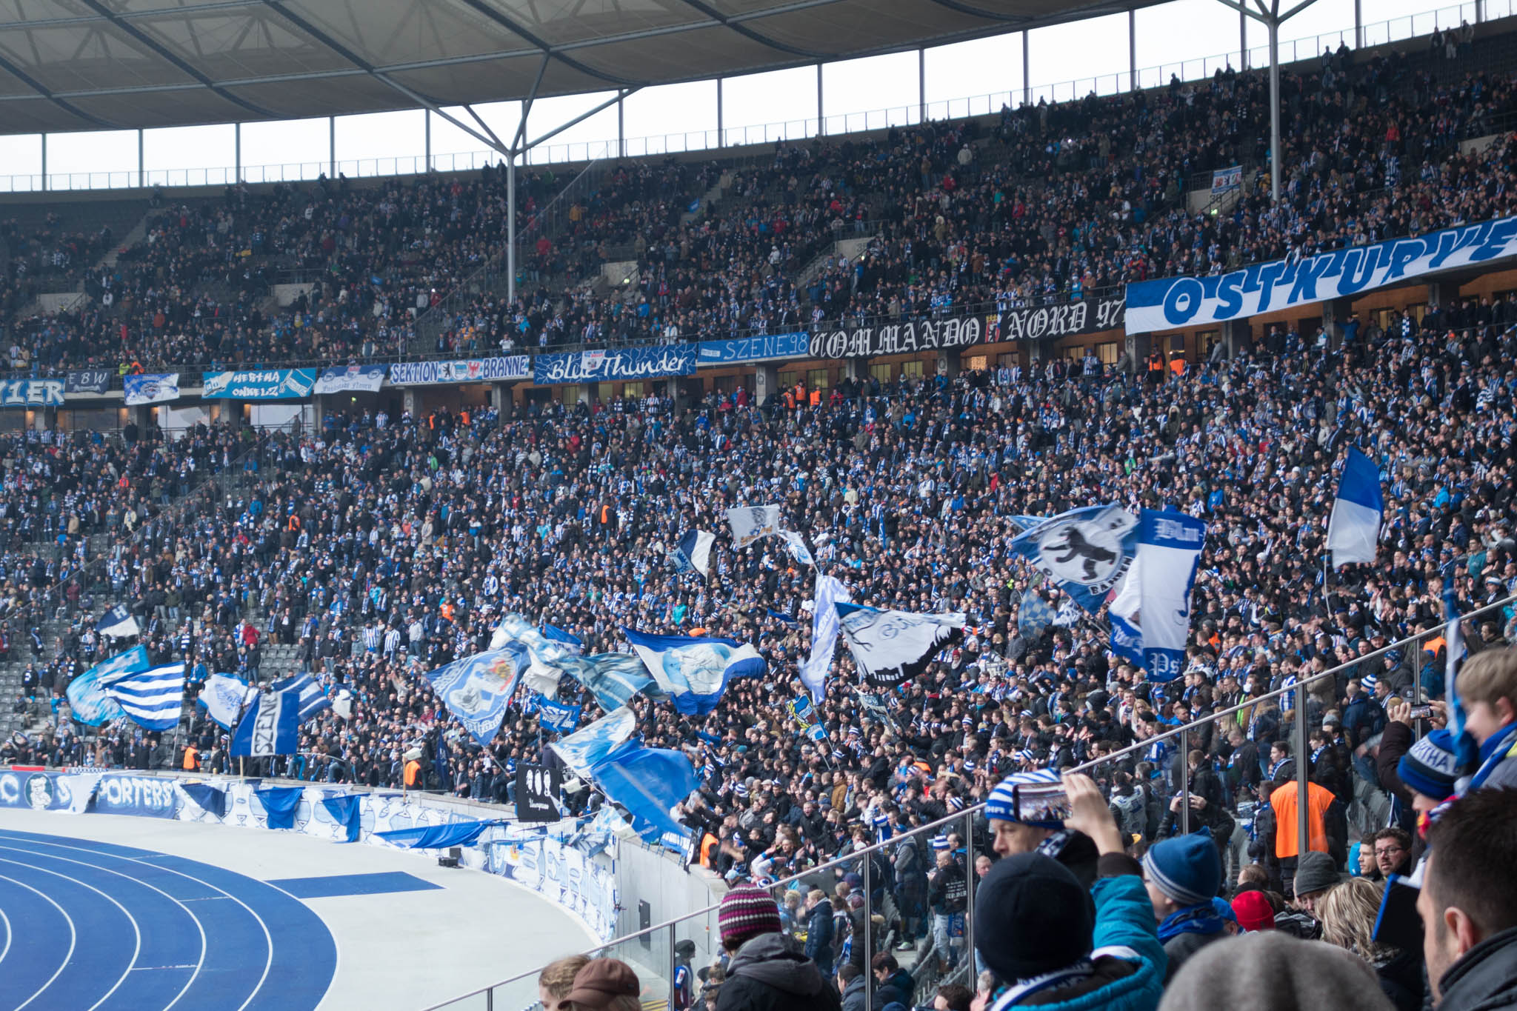
Use Case 1 (Audio Guidance)
AP
Train
STA
Anyone in stadium, museum or zoo who has a smartphone can listen audio guidance/comments without additional hardware.
Multiple logical channels can be used. Multilingual broadcasting can be supported on a single radio channel.
Of course, any type of data can be broadcast, such as video, text, HTML…

Slide 6
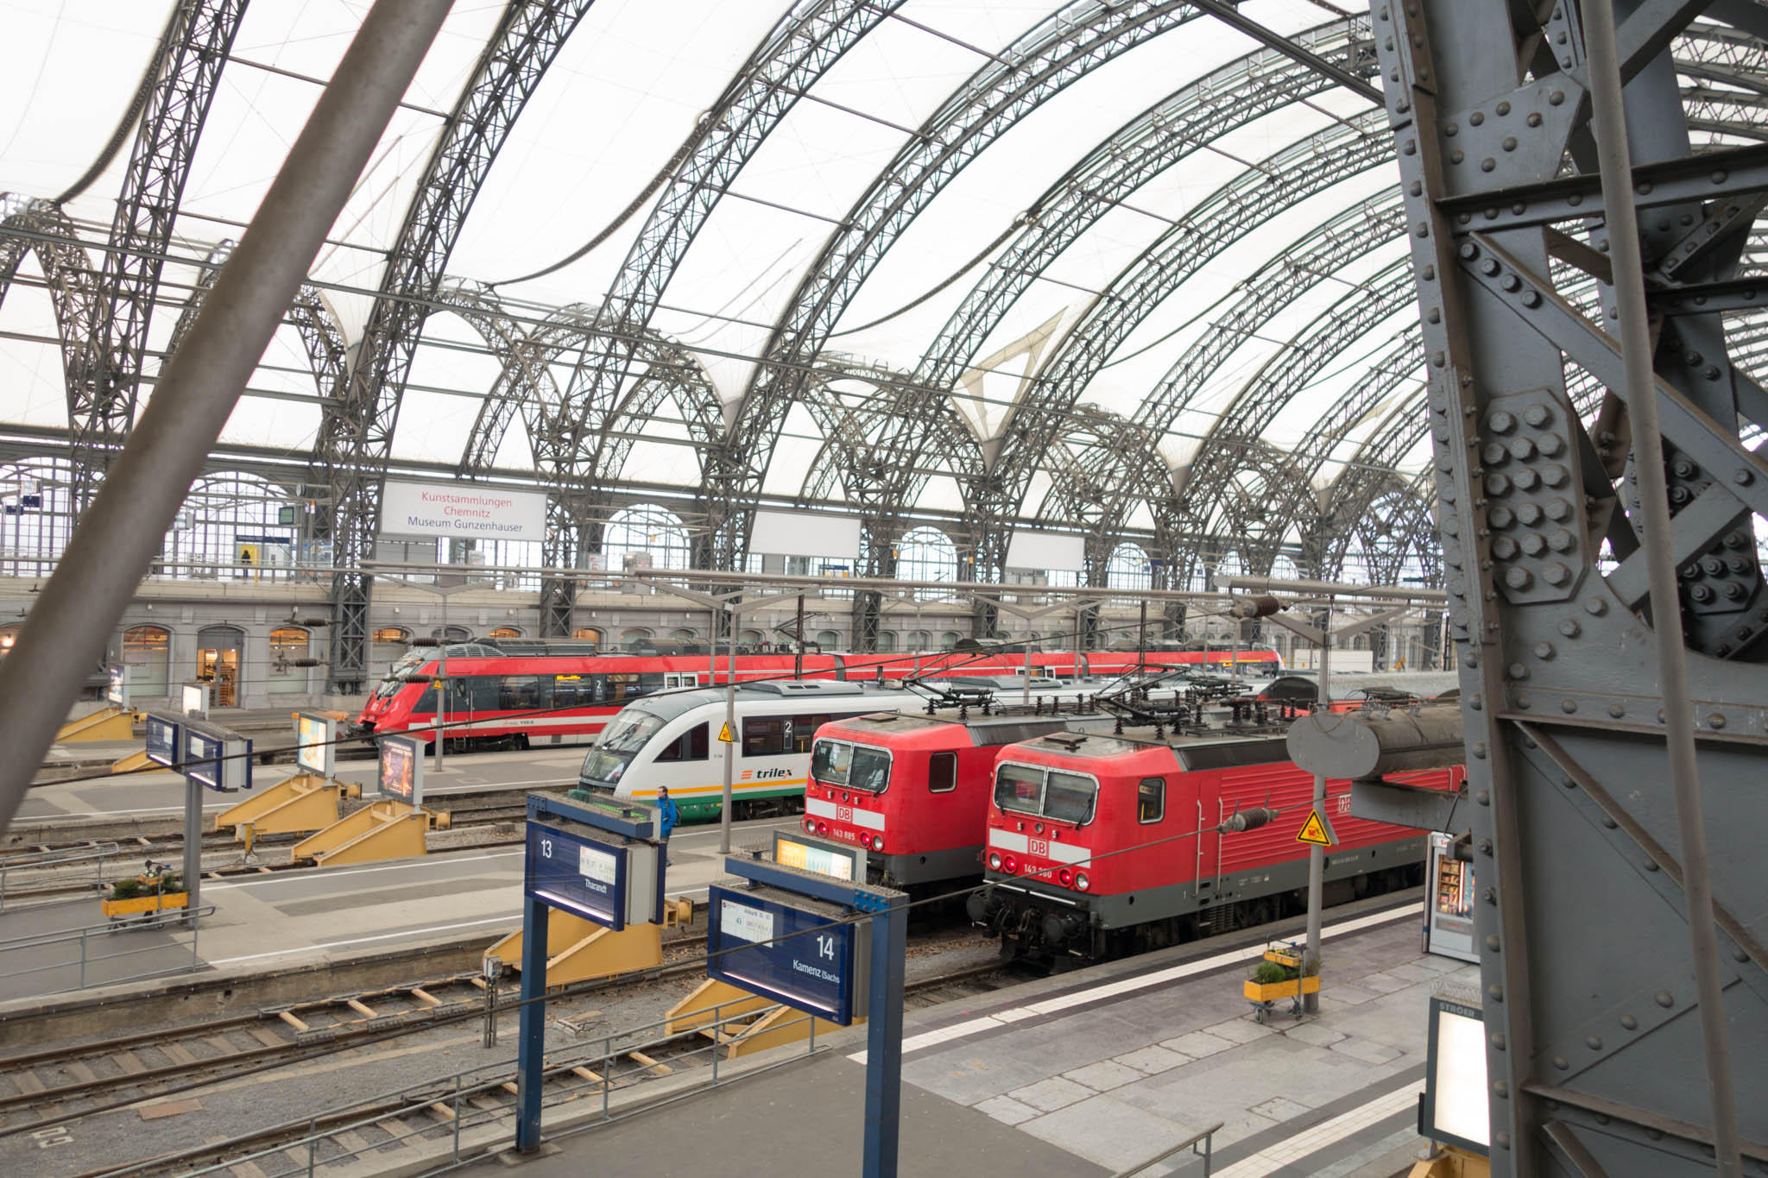
Use Case 2
(Floor Guide, Timetable, Advertisement)
AP
Train
STA
Smartphone
Digital Signage Device
Anyone in a shopping mall, conference venue like here, who has a smartphone can see the floor guide on their device.
Anyone in a train station who has a smartphone can see the timetable on their device.
Digital signage device in the area can show the same information.

Slide 7
Use Case 3
(Emergency Information)
Broadcasting infrastructure can be used for distributing emergency information such as:
  Evacuation guidance in case of fire.
  Earthquake warning.
  Food information in a evacuation shelter.

Slide 8
Use Case 4
(Sensor Data Collection)
Sensors can broadcast their data.
  Assume to collect sensor data periodically.
  If association is not required, sensors transmit just data frames periodically.
  This means periodical data collection by broadcast may reduce sensor power consumption.
  In this case, a sensor works as AP (broadcast station).
Data Collector
Sensor
(as AP)
Data Collector
Sensor
Sensor
Sensor
Periodical Data
Association
Data Collector
Data
Data
Sensor
Sensor
By existing standard
By broadcast

Slide 9
What to Consider
Security
  Transmitters have to be authenticated by receivers.
  Encryption should be optionally supported.
Session Establishment
  Simplify the session establishment.
QoS
  For broadcast frames.
  For other frames.
Application Selector
  Identify the type of contents (text, audio, video...) to select application.

Slide 10
Security Requirements
To prevent fake information distribution, the source of information shall be identified.
  Because of dense deployment in the assumed use cases, the fake AP causes a disruption of the services.
  Every broadcast frame shall be authenticated by the receivers.
Encryption may be optional.
  Most broadcasting contents are considered as public and preferred to be widely distributed.
  But private broadcast service should be supported.

Slide 11
Current Broadcast Security on WLAN
Required to join GTKSA.
  GTK and Key RSC are shared by EAPOL-key or, in case of 802.11ai, Key Delivery element in Association Response.
Current GTKSA uses AES, a kind of “Symmetric-key algorithm”.
  An AP and non-AP STAs in a GTKSA shares the same GTK and Key RSC/TSC.
  The AP encrypts broadcast frames by using the GTK and the Key TSC.
  The non-AP STA decrypts broadcast frames by using the GTK and the Key RSC.
  This means “Any STAs which can decrypt broadcast frames can produce encrypted broadcast frames”.
  So a malicious user can produce fake broadcast frames.
  The receivers can NOT check the integrity of broadcast frames.
AP
Encrypt
(GTK, TSC)
AP
Mac address spoofing
STA
STA
STA
malicious
STA
Decrypt
(GTK, RSC)
STA
Decrypt
(GTK, RSC)
Decrypt
(GTK, RSC)
STA
Encrypt
(GTK, RSC)
Decrypt
(GTK, RSC)
Decrypt
(GTK, RSC)

Slide 12
Issue on the Current GTKSA
If all STAs in the GTKSA are trusted, the current GTKSA works well.
  “Trust” means that all STAs don’t have malicious intent.
In case of public WLAN, like assumed use case, malicious users can join.
Security enhancement is required even if using current security mechanism (.11i, .11ai).

Slide 13
Public Key Based Frame Authentication
AP
STA
To prevent fake AP issue, use public key.
  Public key algorithms are high cost.
  It may be combined with shared key algorithm.
Every frame shall have an authenticator to provide per frame authentication.
Limit the receivers by the existing GTKSA mechanism
  Encrypt the key and data by GTK.
  Or, create new mechanism.
Public Key
Data + Authenticator
Data + Authenticator
Data + Authenticator
Data + Authenticator
Data + Authenticator
AP
STA
Establish GTKSA
encrypt(Public Key)
encrypt(Data + Authenticator)
encrypt(Data + Authenticator)
encrypt(Data + Authenticator)
encrypt(Data + Authenticator)
encrypt(Data + Authenticator)

Slide 14
Session Establishment
AP
STA
In case of not using encryption, the required security can be provided without existing Authentication/Association.
Other negotiations in existing Association are not required in broadcast services.
  All parameters are decided only by the AP.
This may cause state machine modification and new broadcast data frame definition.
In case of using encryption, existing Authentication/Association can be used for establishing GTKSA.
If the AP and the STAs have pre-shared key, existing Authentication/Association may be omitted even in case of using encryption.
Public Key
Data + Authenticator
Data + Authenticator
Data + Authenticator
Data + Authenticator
Data + Authenticator
AP
Establish GTKSA
STA
or have pre-shared key
encrypt(Public Key)
encrypt(Data + Authenticator)
encrypt(Data + Authenticator)
encrypt(Data + Authenticator)
encrypt(Data + Authenticator)
encrypt(Data + Authenticator)

Slide 15
QoS Considerations
Contents broadcasting may use much bandwidth.
  QoS for both broadcast frames and unicast frames should be considered.
QoS for broadcast frames
  In general, the loss rate of broadcast frame is higher than unicast frame.
  Broadcast does not have ACK mechanism.
  Existing 802.11 uses BCC/LDPC.
  Is required stronger FEC/Interleaving algorithm?
  Consider to apply 802.11aa GCR mechanism.
    In this case, association to AP is required.
QoS for other .11 frames
  How much bandwidth can be used for broadcasting?
  Define limit of bandwidth?
  Adaptive control?
  Consider to apply 802.11aa OBSS management.

Slide 16
Higher Layer Support
In November session, we proposed that the application
layer locates just above the IEEE802.11 layer.
Broadcast service on WLAN is used only between an AP and STAs.
  Routing is not required.
  IP is not required.
Broadcast service on WLAN is one-way service from an AP to STAs.
  Flow control, such as TCP is not required.
To simplify the protocol, application layer will locate just above the IEEE802.11 layer.
  IEEE802.11 should define application selector such as RTP, MIME.
IEEE802.11 header
Application selector
Application data
Expected frame format

Slide 17

Issues on This Layer Design
This model seems to make layer violation.
  IP and UDP layer should be used.
How does the AP identify the frames to be broadcasted?
  The frames to be broadcasted should be identified by their destination MAC address.
Frame
Server
AP
Broadcast or not?

Slide 18
Solution
To use IP layer, IP address has to be assigned to every STA.
  IPv4 has no standards to assign IP address without frame transmission by STA.
  IPv6 can assign IP address without frame transmission by STA.
    By using Router Advertisement
    Duplicate Address Detection is not required. (STA never transmit frames)
Mapping IPv6 multicast address to MAC address is defined in RFC2464.
AP can select frames to be broadcasted by the specified MAC address ( = IPv6 multicast address)

Slide 19
Updated Layer Design
IEEE802.11 header
IEEE802.11 header
Application selector
IPv6 header
Application data
UDP header
Application data
(e.g. RTP)
IETF standards can be used to identify application data type.

Slide 20
Conclusion
Broadcast service on WLAN can improve user experience.
For broadcast service on WLAN, the following works are required.
  Make frame authentication mechanism
  Modify state machine
  Define broadcast data frame
  Consider QoS
  Application selector

Slide 21
Comments & Questions

Slide 22
Straw poll
Do you support to form study group for “broadcast service on WLAN”?
  Yes:
  No:
  Don’t care:
  Need more info:

