Slide 1
Introducing multiple primary channels to exploit unused resources scattered in multiple channels/bands
Date: 2018-01-15
Authors:

Slide 2
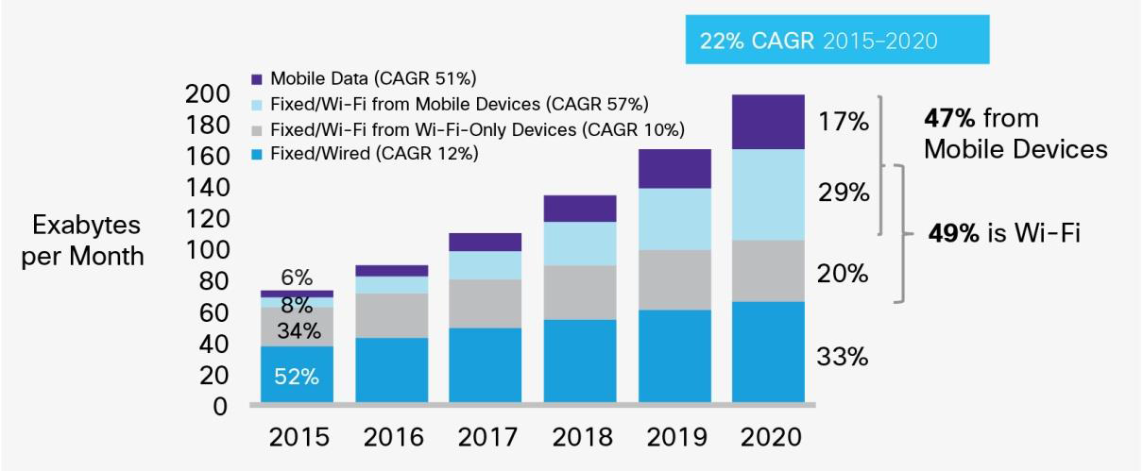
Background (1)
The amount of wireless LAN traffic is still increasing due to expansion of applications and off-loading of cellular traffic.
To meet the increasing demand, enhancement of system throughput of the wireless LAN is still necessary.
WLAN traffic becomes
4 times in 5 years.
Growth of IP traffic forecasted by Cisco [1].

Slide 3
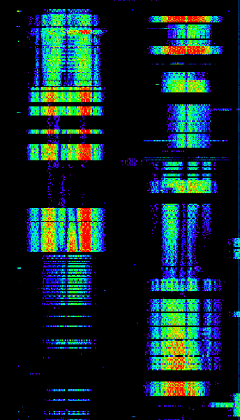
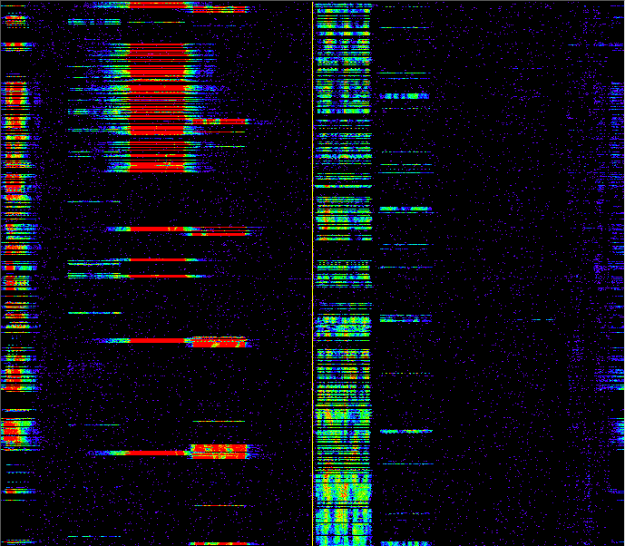
Background (2)
500
We conducted measurements of channel usage at a main-line railway station in Japan [2,3].
Measured spectrogram shows that even though some channels are crowded, there are many short unused resources with durations of typically 10-70 ms.
If we can utilize these scattered unused resources at a STA, we can obtain more transmission chances and can improve QoS.
400
300
200
100
0
Ch. 1
6
108
112
116
(Left) 2.4 and (Right) 5 GHz Spectrogram

Slide 4
Background (3)
In current IEEE 802.11 wireless LAN, a BSS sets one primary channel (PCH) on which each STA invokes the back-off procedure to obtain a transmission opportunity (TXOP) [4].
However, if channel load of the PCH is relatively high, some STAs would hardly obtain enough TXOPs to achieve required QoS even though unused resources exist on other channels.
Frequency
Frame from other STA
My transmitted frame
PCH
Secondary channel
Time
These unused resources are not available.

Slide 5
Contents of this presentation
We have presented some basic ideas to exploit such scattered unused resources to obtain more transmission chances [2,3,5].
This presentation proposes to employ multiple PCHs to exploit such unused resources.
This presentation also introduces several ways of channel access to utilize multiple PCHs.
Some simulation results show that achievable throughput becomes more than double by employing two PCHs.

Slide 6
Multiple PCHs on multiple channels/bands
To obtain a transmission chance even when the primary channel is busy, we propose to set multiple PCHs.
These PCHs can be set in different frequency bands.
A STA independently invokes the back-off process using EDCAF (or DCF) on each PCH.
Frequency
Waiting on back-off
My transmitted frame
Frame from other STA
Band A
PCH 1
Secondary channel for PCH 1
PCH 2
Secondary channel for PCH 2
Band B
PCH 3
Secondary channel for PCH 3
Time

Slide 7
How to access multiple PCHs
There are three ways to transmit a frame on PCHs.
  Simultaneous transmission on multiple PCHs : Transmit a channel-bonded frame across multiple PCHs on which transmission chances are obtained (similar to 80+80 MHz non-contiguous transmission in 802.11ac).
  Concurrent (asynchronous) transmission on multiple PCHs : Transmit a frame immediately on a PCH if a transmission chance is obtained on the PCH. If inter-channel interference is negligible (frequency separation between PCHs is large), multiple frames can be concurrently transmitted on different PCHs.
  Non-concurrent transmission : Transmit a frame immediately on a PCH if a transmission chance is obtained on the PCH. If inter-channel interference is not negligible (frequency separation between PCHs is small), only one frame can be transmitted at a time.

Slide 8
Simultaneous transmission on multiple PCHs
If transmission chances are obtained on multiple PCHs, a channel-bonded frame is transmitted on the PCHs.
If OFDM(A) is used, this method is available even when PCH separation is small due to synchronous transmission.
If the PCHs used for simultaneous transmission are far apart in the frequency domain, high frequency-diversity gain is expected.
Frequency
Waiting to finish back-off on other PCH
Back-off slot
Back-off finish
Band A
PCH 1
Secondary channel for PCH 1
PCH 2
Secondary channel for PCH 2
Band B
PCH 3
Secondary channel for PCH 3
Time

Slide 9
Concurrent transmission on multiple PCHs
If a transmission chance is obtained on one of the multiple PCHs, a frame is immediately transmitted on that PCH.
Concurrent transmission is available only when PCH separation is large so that inter-channel interference is negligible.
A STA may delay frame transmission until another PCH finishes back-off to perform simultaneous transmission.
Frequency
Band A
PCH 1
Secondary channel for PCH 1
~
~
PCH 2
Secondary channel for PCH 2
Band B
PCH 3
Secondary channel for PCH 3
Time

Slide 10
Non-concurrent transmission
If inter-channel interference is not negligible, a STA can transmit a frame only on one PCH at a time even when transmission chances are obtained on multiple PCHs.
However, transmission chances will be increased by setting multiple PCHs if unused resources are scattered.
Frequency
Busy due to inter-channel interference
Band A
PCH 1
Secondary channel for PCH 1
PCH 2
Secondary channel for PCH 2
Time

Slide 11
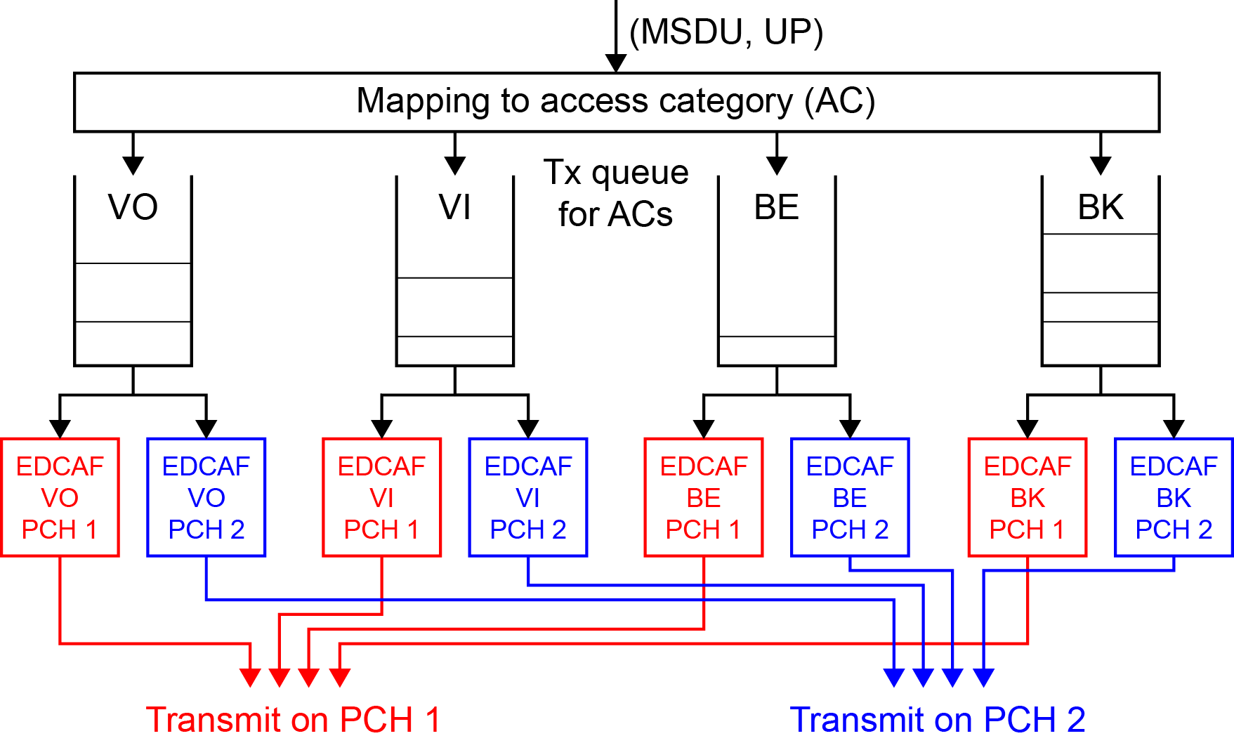
Queue sharing among PCHs
To effectively exploit unused resources scattered in the time and frequency domains, EDCA queue is shared by multiple PCHs.
MSDU is de-queued to the PCH on which a transmission chance is obtained.

Slide 12
Loading simulation (1/3)
We assume one target BSS and 8 legacy OBSSs. Each BSS has 2 non-AP STAs.
2 PCHs (ch 36 and ch 100) are set in 5 GHz band.
  The target BSS can use both PCHs.
  Each OBSS can use either of PCHs. Both ch 36 and ch 100 are used by 4 OBSSs.
Each STA has downlink traffic with 96000-byte payload.
  The target BSS has full-buffer traffic to evaluate achievable throughout.
  Each OBSS has traffic with exponentially-distributed packet arrival interval. (Average packet arrival interval : 100 ms)
The multi-PCH performance is compared with single-PCH.
One RF chain is employed for each PCH.

Slide 13
Loading simulation (2/3)
For simplicity, we conduct simulations based on 802.11ac with maximum transmission bandwidth of 80 MHz.
Following cases are compared:
  The target BSS uses only one PCH on ch 36.
  The target BSS performs concurrent transmission (CT).
  The target BSS performs simultaneous transmission (ST).
  It waits up to 120 μs to obtain TXOP on both PCHs.
  If a STA judges that it cannot obtain TXOP on another PCH,
  it immediately transmits a frame on one PCH with non-concurrent transmission (non-CT).

Slide 14
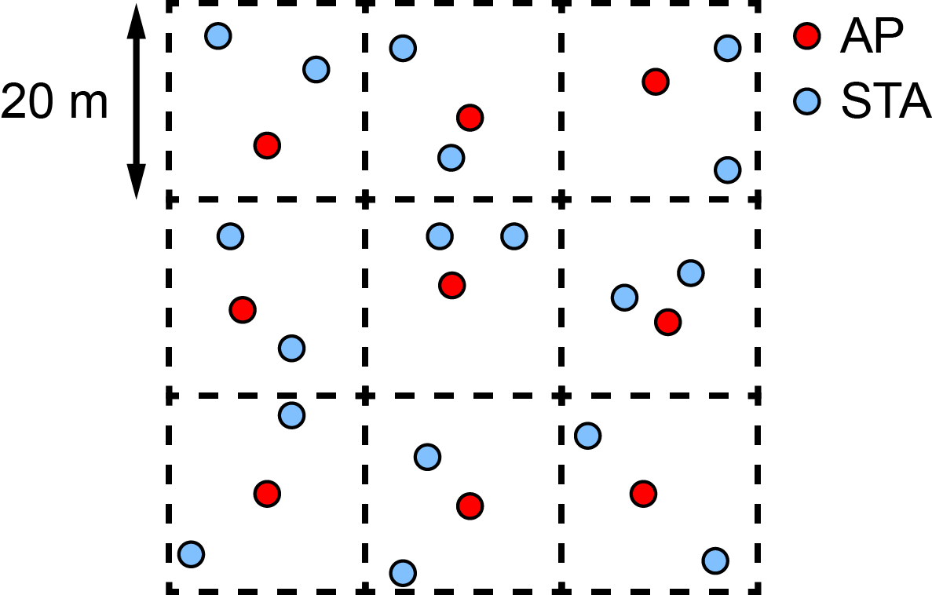
Loading simulation (3/3)
Area size : 60 m x 60 m (20 m x 20 m segment, 3 x 3 segments)
Position of AP/STA : uniformly random in a segment
Propagation model : based on the residential scenario (SS1) in the IEEE 802.11 TGax simulation scenarios [6].
Tx power : 20 dBm per PCH (AP), 15 dBm per PCH (STA)

Slide 15
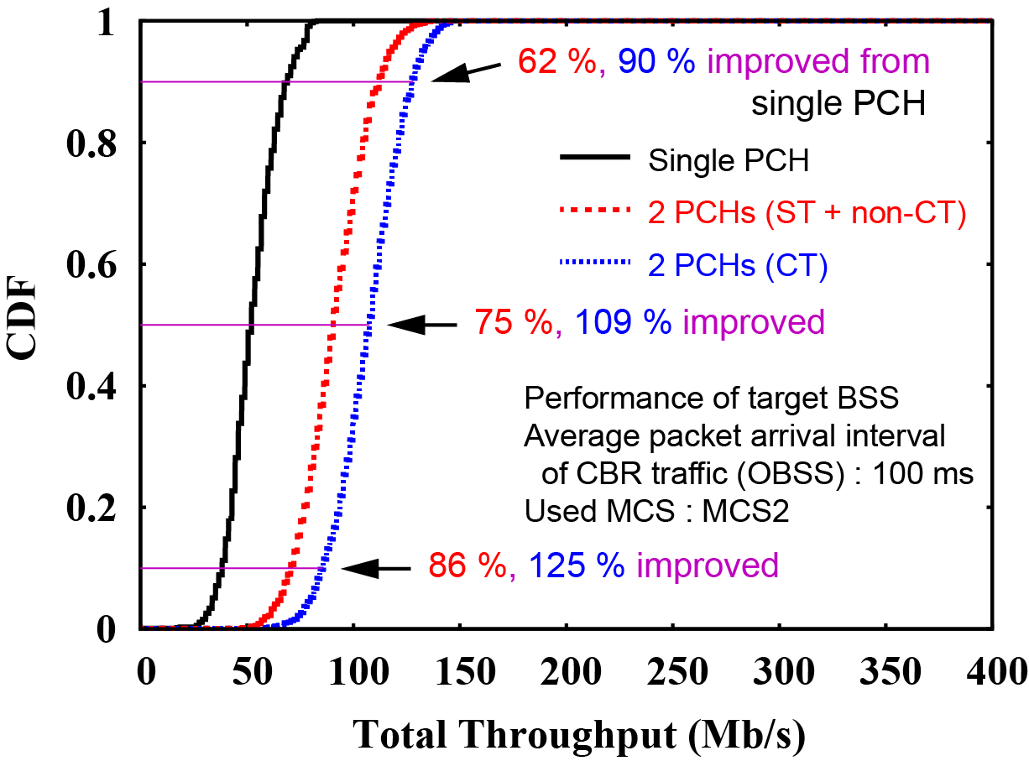
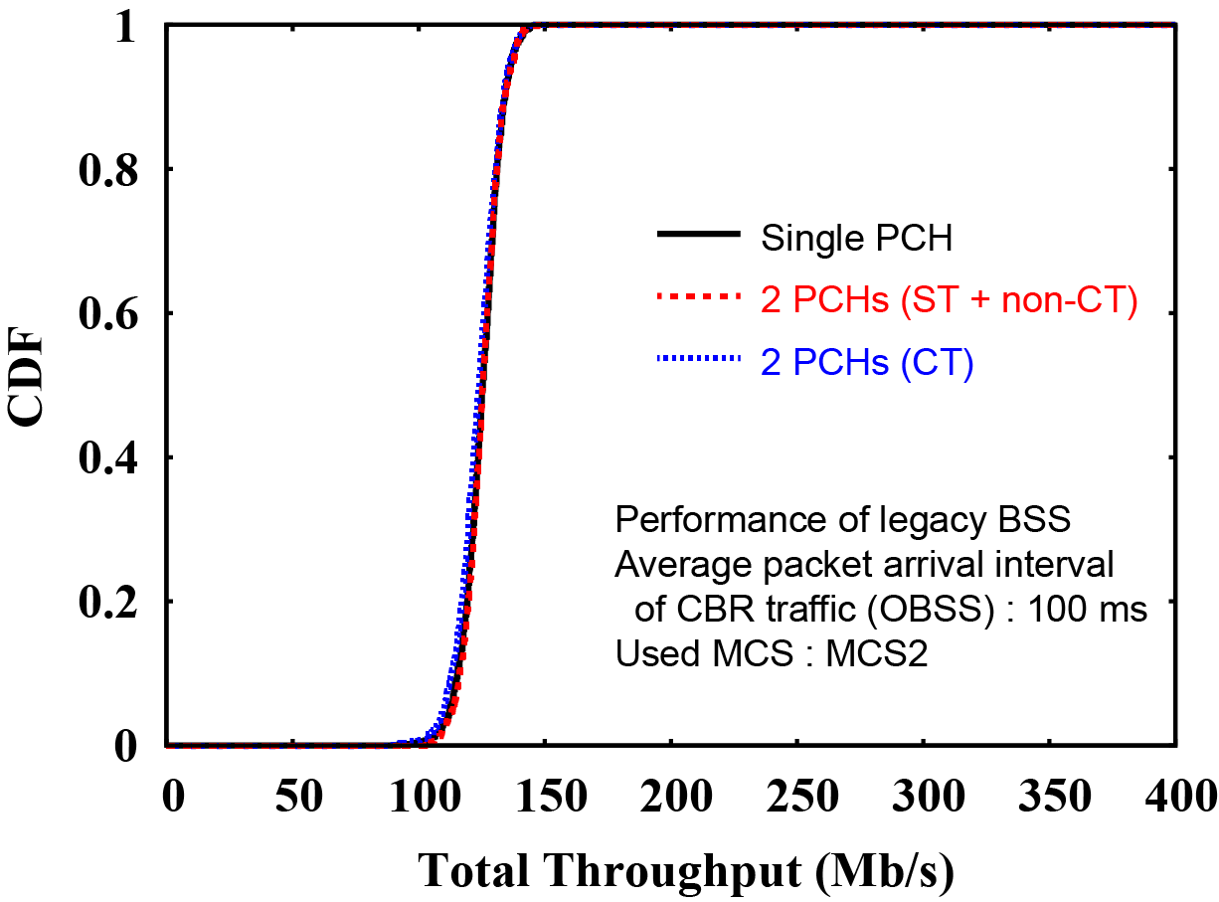
Simulation results (1/3)
Used MCS Index : 2
Average offered traffic load of OBSSs : 70 % (in PHY layer)
CT improves 10%, 50%, 90% throughput by 125%, 109%, 90% without degrading OBSS’s performance.
ST improves 10%, 50%, 90% throughput by 86%, 75%, 62%.
Target BSS
OBSSs (8 BSSs)

Slide 16
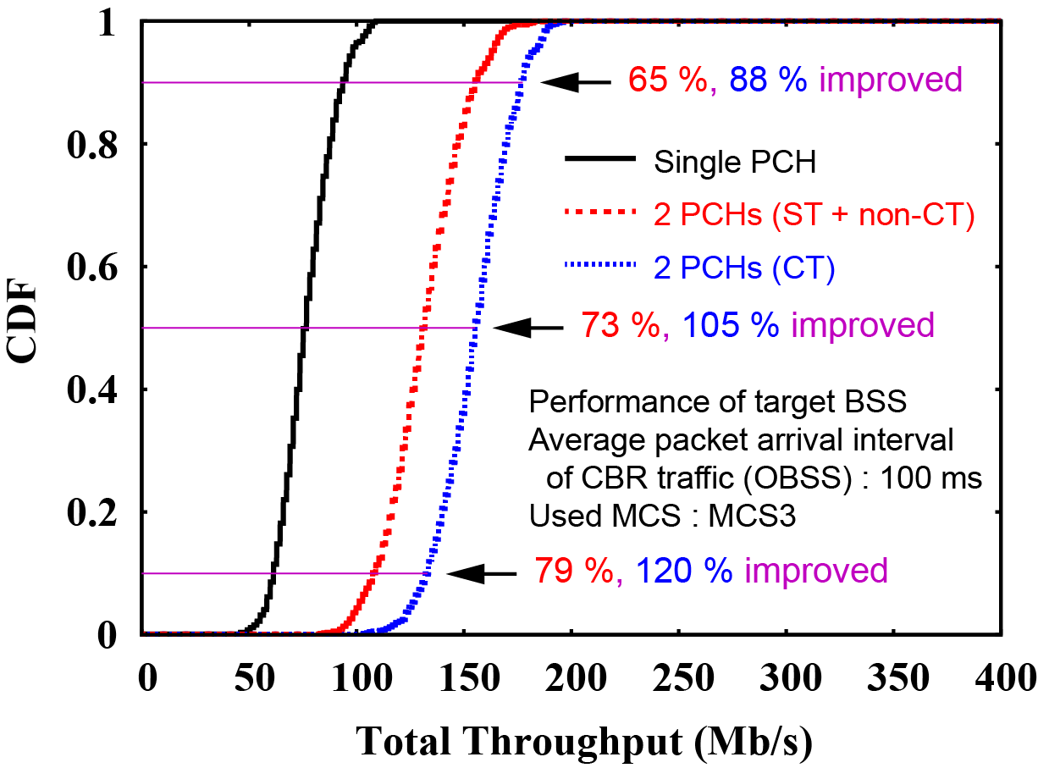
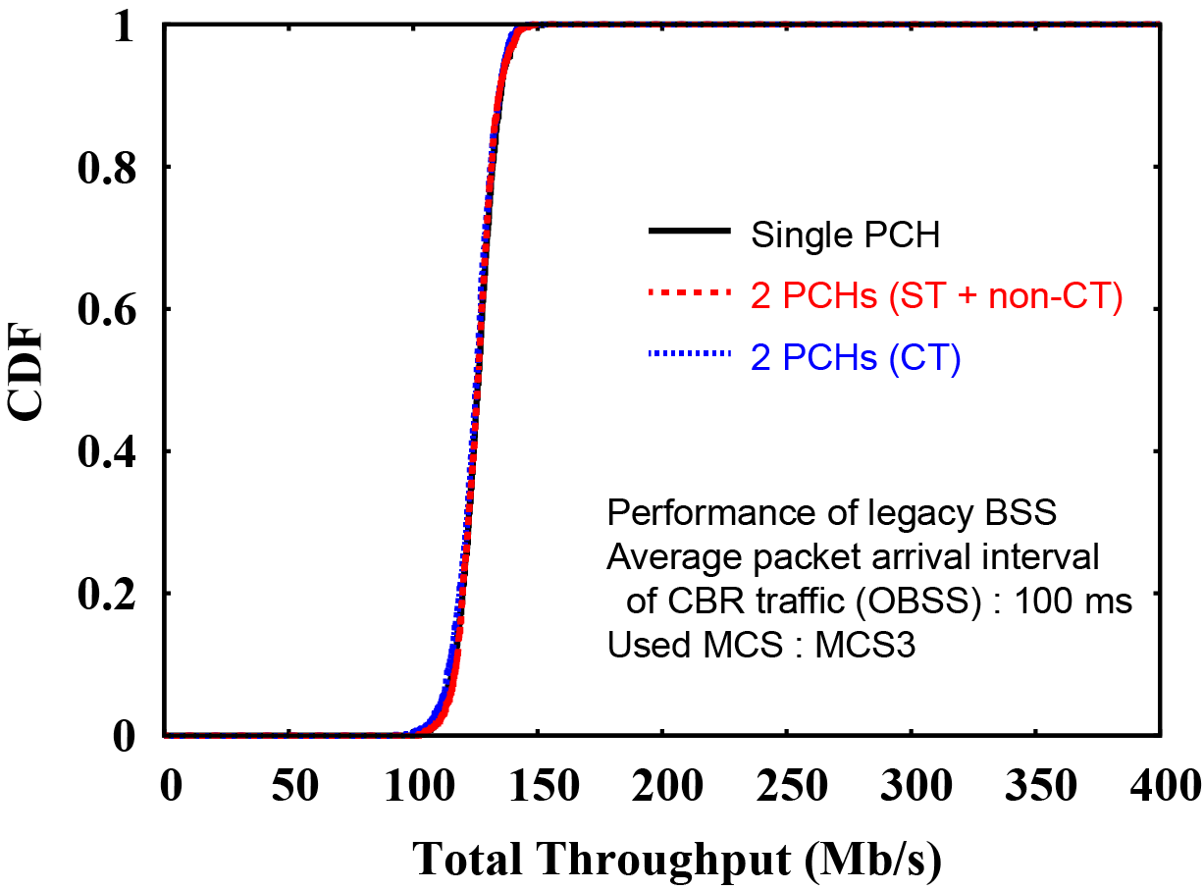
Simulation results (2/3)
Used MCS Index : 3
Average offered traffic load of OBSSs : 53 % (in PHY layer)
CT improves 10%, 50%, 90% throughput by 120%, 105%, 88% without degrading OBSS’s performance.
ST improves 10%, 50%, 90% throughput by 79%, 73%, 65%.
Target BSS
OBSSs (8 BSSs)

Slide 17
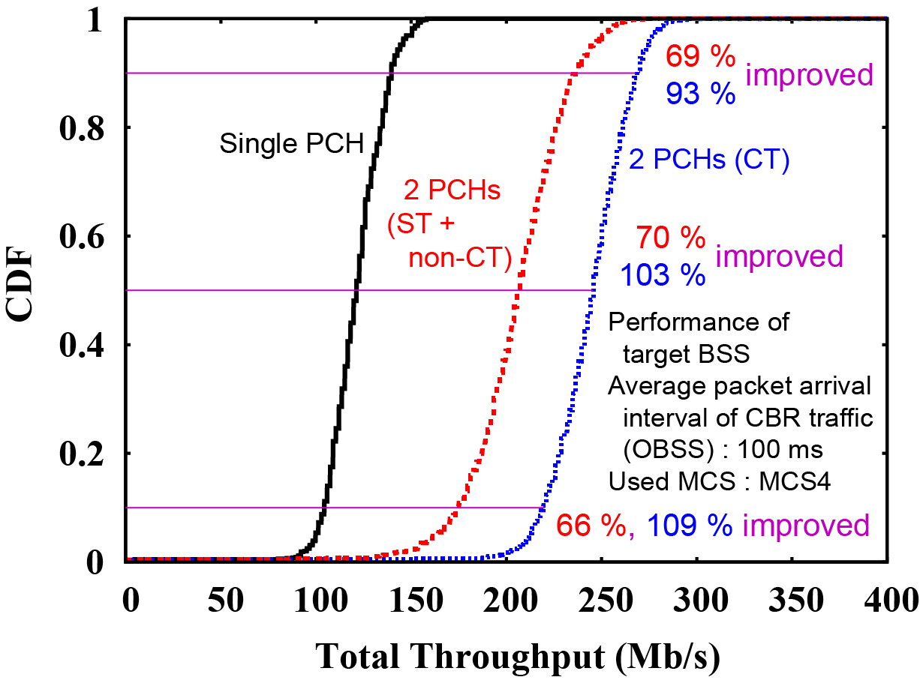
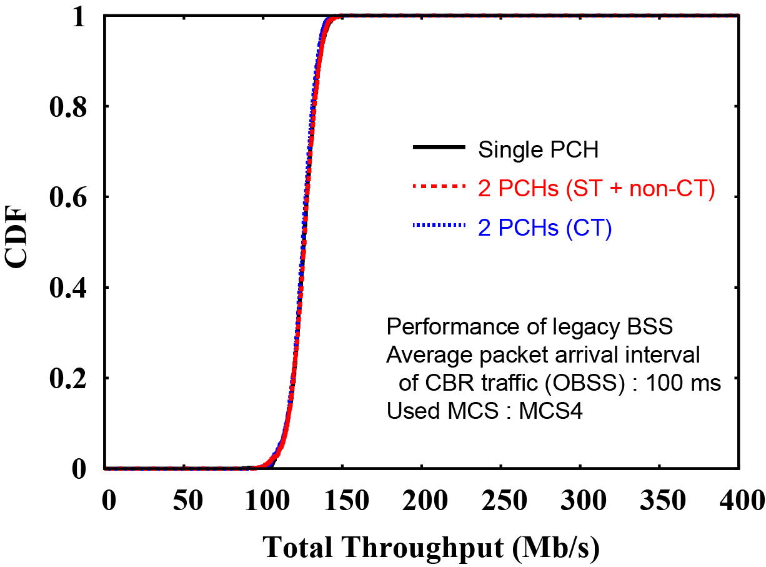
Simulation results (3/3)
Used MCS Index : 4
Average offered traffic load of OBSSs : 35 % (in PHY layer)
CT improves 10%, 50%, 90% throughput by 109%, 103%, 93% without degrading OBSS’s performance.
ST improves 10%, 50%, 90% throughput by 66%, 70%, 69%.
Target BSS
OBSSs (8 BSSs)

Slide 18
Summary
To exploit unused resources scattered in time and frequency domains and obtain transmission chances on such resources, we have proposed to set multiple PCHs and three ways to use obtained transmission chances.
    Simultaneous (channel-bonded) transmission on multiple PCHs
    Concurrent (asynchronous) transmission on multiple PCHs
    Non-concurrent transmission
We have confirmed through computer simulation that the proposed methods can achieve higher average area throughput than current single-PCH transmission without degrading the performance of legacy WLANs.

Slide 19
Straw Poll
Do you think that introducing multiple primary channels is an effective way to enhance achievable QoS?
  Yes:
  No:
  Need more information:
  Abstain:

Slide 20
References
[1] Cisco, “Cisco Visual Networking Index: Global Mobile Data Traffic Forecast Update, 2016–2021,” Cisco White Paper C11-738429-00, February 2017.
[2] doc. IEEE 802.11-17/0410r0.
[3] doc. IEEE 802.11-17/0767r0.
[4] IEEE 802.11-2016.
[5] doc. IEEE 802.11-17/0129r3.
[6] doc. IEEE 802.11-14/0980r16.

