Slide 1
Introducing multiple primary channels to exploit unused resources scattered in multiple channels/bands
Date: 2017-11-06
Authors:

Slide 2
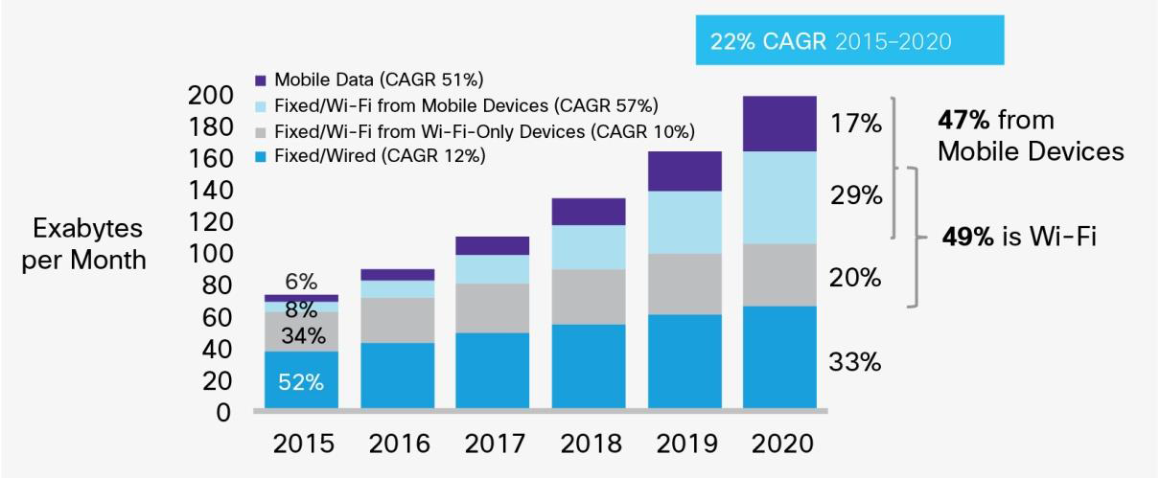
Background (1)
The amount of wireless LAN traffic is still increasing due to expansion of applications and off-loading of cellular traffic.
To meet the increasing demand, enhancement of system throughput of the wireless LAN is still necessary.
WLAN traffic becomes
4 times in 5 years.
Growth of IP traffic forecasted by Cisco [1].

Slide 3
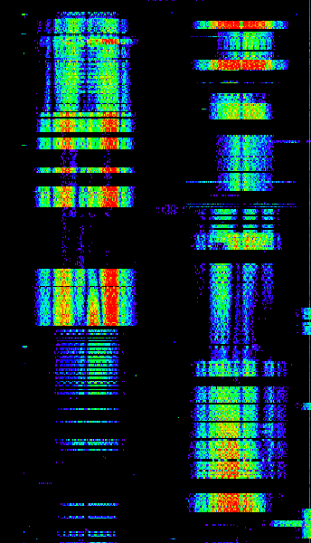
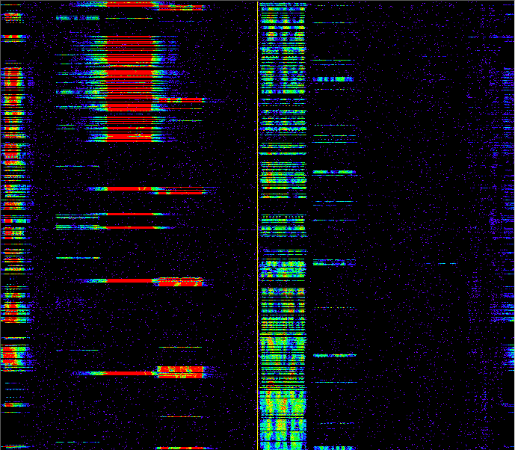
Background (2)
500
We conducted measurements of channel usage at a main-line railway station in Japan [2,3].
Example 500 ms snapshot of spectrogram shows there are many short unused resources with durations of typically 10-70 ms.
If we can utilize these scattered unused resources, we can obtain more transmission chances and can improve QoS.
400
300
200
100
0
Ch. 1
6
108
112
116
(Left) 2.4 and (Right) 5 GHz Spectrogram

Slide 4
Background (3)
In current IEEE 802.11 wireless LAN, a BSS sets one primary channel (PCH) on which each STA invokes the back-off procedure to obtain a transmission opportunity (TXOP) [4].
However, if channel load of the PCH is relatively high, some STAs would hardly obtain enough TXOPs to achieve required QoS even though unused resources exist on other channels.
Frequency
Frame from other STA
My transmitted frame
PCH
Secondary channel
Time
These unused resources are not available.

Slide 5
Contents of this presentation
We have presented some basic ideas to exploit such scattered unused resources to obtain more transmission chances. [2,3,5].
This presentation proposes detailed methods to exploit such unused resources.
This presentation also shows some evaluation results of area throughput when our proposed methods are employed.

Slide 6
Multiple PCHs to obtain transmission chances on multiple channels/bands
To obtain a transmission chance even when the primary channel is busy, we propose to set multiple PCHs.
These PCHs can be set in different frequency bands.
A STA independently invokes the back-off process using EDCAF (or DCF) on each PCH.
Frequency
Waiting on back-off
My transmitted frame
Frame from other STA
Band A
PCH 1
Secondary channel for PCH 1
PCH 2
Secondary channel for PCH 2
Band B
PCH 3
Secondary channel for PCH 3
Time

Slide 7
How to access multiple PCHs
There are three ways to transmit a frame on PCHs.
  Simultaneous transmission on multiple PCHs : Transmit a channel-bonded frame across multiple PCHs on which transmission chances are obtained (similar to 80+80 MHz non-contiguous transmission in 802.11ac).
  Concurrent (asynchronous) transmission on multiple PCHs : Transmit a frame immediately on a PCH if a transmission chance is obtained on the PCH. If inter-channel interference is negligible (frequency separation between PCHs is large), multiple frames can be concurrently transmitted on different PCHs.
  Non-concurrent transmission : Transmit a frame immediately on a PCH if a transmission chance is obtained on the PCH. If inter-channel interference is not negligible (frequency separation between PCHs is small), only one frame can be transmitted at a time.

Slide 8
Simultaneous transmission on multiple PCHs
If transmission chances are obtained on multiple PCHs, a channel-bonded frame is transmitted on the PCHs.
If OFDM(A) is used, this method is available even when PCH separation is small due to synchronous transmission.
If the PCHs used for simultaneous transmission are far apart in the frequency domain, high frequency-diversity gain is expected.
Frequency
Waiting to finish back-off on other PCH
Back-off slot
Back-off finish
Band A
PCH 1
Secondary channel for PCH 1
PCH 2
Secondary channel for PCH 2
Band B
PCH 3
Secondary channel for PCH 3
Time

Slide 9
Concurrent transmission on multiple PCHs
If a transmission chance is obtained on one of the multiple PCHs, a frame is immediately transmitted on that PCH.
Concurrent transmission is available only when PCH separation is large so that inter-channel interference is negligible.
A STA may wait frame transmission until another PCH finishes back-off to perform simultaneous transmission.
Frequency
Band A
PCH 1
Secondary channel for PCH 1
~
~
PCH 2
Secondary channel for PCH 2
Band B
PCH 3
Secondary channel for PCH 3
Time

Slide 10
Non-concurrent transmission
Even when transmission chances are obtained on multiple PCHs, a STA can transmit a frame only on one PCH at a time if PCH separation is small so that inter-channel interference doesn’t occur.
However, transmission chances will be increased by multiple PCHs if unused resources are scattered.
Frequency
Busy due to inter-channel interference
Band A
PCH 1
Secondary channel for PCH 1
PCH 2
Secondary channel for PCH 2
Time

Slide 11
Impact of MIMO gain on frame length
The duration of payload in DATA frame is almost inversely proportional to the MIMO gain. If the payload size of DATA frame is large, the time necessary to transmit DATA is also inversely proportional to the MIMO gain.
If the payload size is small, MIMO gain has less affect on the time necessary to transmit DATA because the duration of payload size becomes comparable to the durations of preamble and SIGs.
Long DATA case
Preamble + SIG
Payload (DATA)
Payload (ACK/BA)
MIMO gain becomes
a half
Time
Time
Short DATA case
MIMO gain becomes
a half
Time
Time

Slide 12
Effect of introducing multiple PCHs
Simultaneous transmission increases the transmission rate by spending RF chains to increase the signal bandwidth. It will have a gain when the length of data frame is long.
Concurrent transmission increases the number of transmission chances by spending RF chains (reducing MIMO gain). It will have a large gain when the length of data frame is short.
Single PCH
Time
Simultaneous transmission
Time
Single PCH
Time
Concurrent transmission
Time

Slide 13
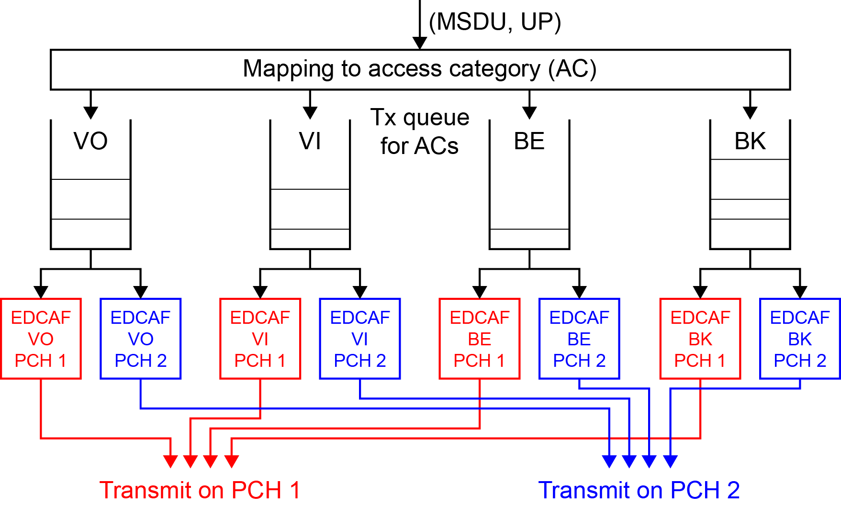
Queue sharing among PCHs
To effectively exploit unused resources scattered in the time and frequency domains, EDCA queue are shared by multiple PCHs.
MSDU is de-queued to the PCH on which a transmission chance is obtained.

Slide 14
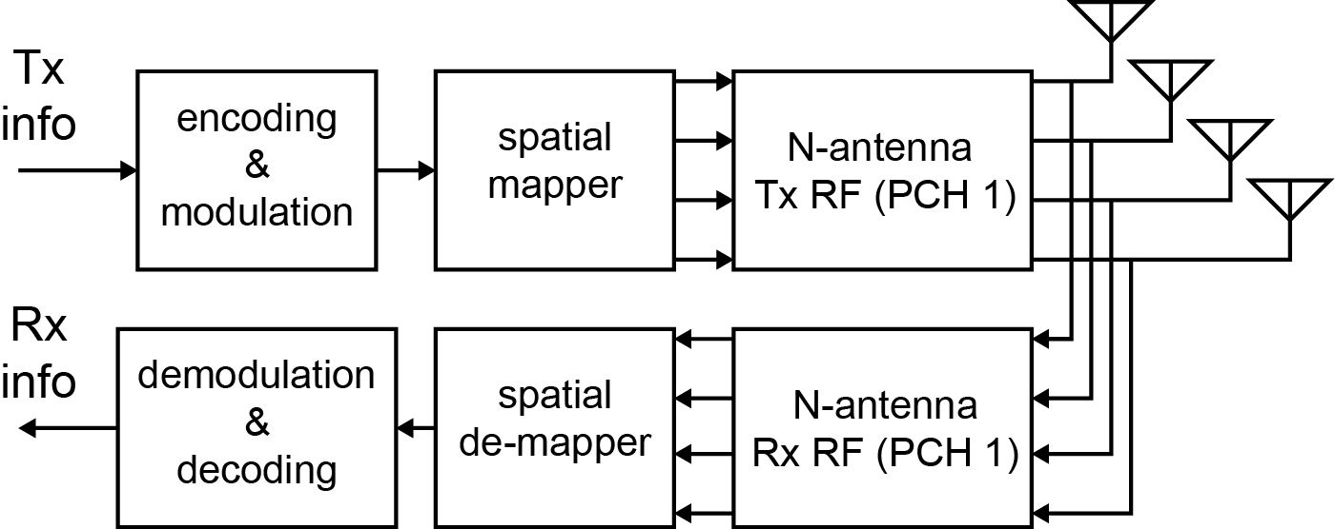
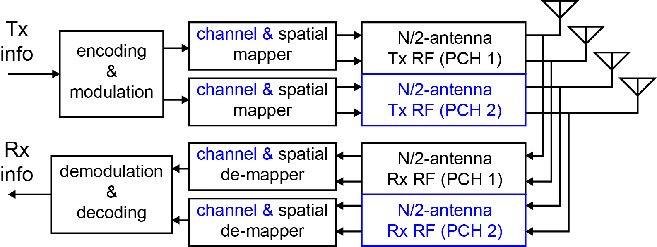
Hardware structure for multiple PCHs
Since current STA have multiple BB/RF units for MIMO transmission, we consider that some of BB/RF units are tuned to additional PCH(s) to save the increase of hardware complexity.
Even when a STA has many antennas, the achievable transmission rate of MIMO would not be high if fading correlation is high (as in LOS environment). In such a condition, using multiple PCHs will be beneficial even though the number of antennas per PCH is small.
MIMO transceiver
(N-antenna)
2-channel parallel contention transceiver
(N/2-antenna, 2 PCHs)

Slide 15
Mode switching of single/multiple PCHs
The gain brought by multiple PCHs will depend on channel environment (whether fading correlation is high or low) and channel status (whether under congestion or not) of each band.
We consider to switch operating mode between legacy (single-PCH) mode and multi-PCH mode according to environment and channel status.
An AP will announce new mode to associated STAs by a broadcast packet (such as beacon) when the channel condition changes.
Announcement to switch operating mode
Single-PCH
Operating on single-PCH mode (e.g. 4 x 4 MIMO)
Multi-PCH
Operating on multi-PCH mode
(e.g. 2 x 2 MIMO x 2 PCHs)
Time
Fading correlation is low
Other channel is crowded
Fading correlation becomes high
Other channel gets less crowded

Slide 16
Performance evaluation
To evaluate the gain brought by multiple PCHs, we conducted computer simulations assuming 2.4 GHz and 5 GHz bands.
For simplicity, we conduct simulation based on 802.11n (2.4 GHz band) and 802.11ac (5 GHz band).
Following cases are compared (all STAs have 4 RF chains):
  All BSSs are legacy WLAN (one PCH in either band, 4x4 MIMO).
  Some of BSSs (proposed BSS) employ 2 PCHs (one PCH in each band, with concurrent transmission (CT) between 2 bands, 2x2 MIMO).
  Proposed BSSs employ 4 PCHs (two PCHs in each band, with CT between 2 bands and non-concurrent transmission in each band, SISO).
  Proposed BSSs employ 4 PCHs (two PCHs in each band, with CT between 2 bands and non-concurrent but in-band simultaneous transmission (ST) in each band, SISO).

Slide 17
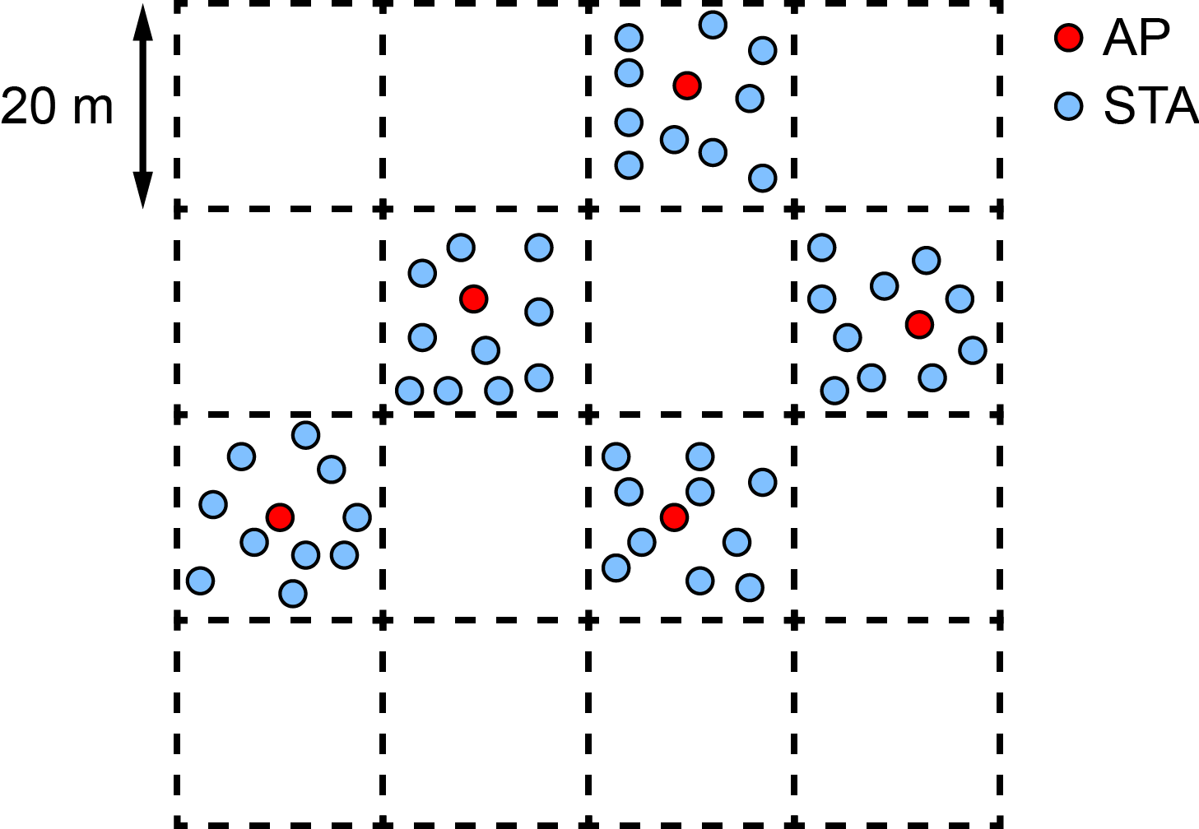
Evaluation configuration (1/2)
Area size : 80 m x 80 m (20 m x 20 m segment, 4 x 4 segments)
Number of BSSs : 15 (Proposed BSSs : 0 or 2)
Number of STAs per BSS : 10
Position of AP/STA : uniformly random in a segment

Slide 18
Evaluation configuration (2/2)
Tx power per antenna : 14 dBm (AP), 9 dBm (STA)
Max. Tx bandwidth per PCH : 40 MHz (2.4 GHz), 80 MHz (5 GHz)
Traffic : All STAs have downlink traffic.
  Full buffer traffic : 2 links (assigned to proposed BSSs if they exist, otherwise assigned to legacy BSSs)
  HTTP traffic (data size is 20 times larger in average as TGax Evaluation Methodology [6])
Channel model : ITU-R IMT-Adv MCM UMi LOS
  MIMO gain is simply obtained based on the results in [7].
PCH selection : Select channel with min. busy rate (every 10 s)
Frame aggregation : 16 MSDUs are aggregated, or not employed

Slide 19
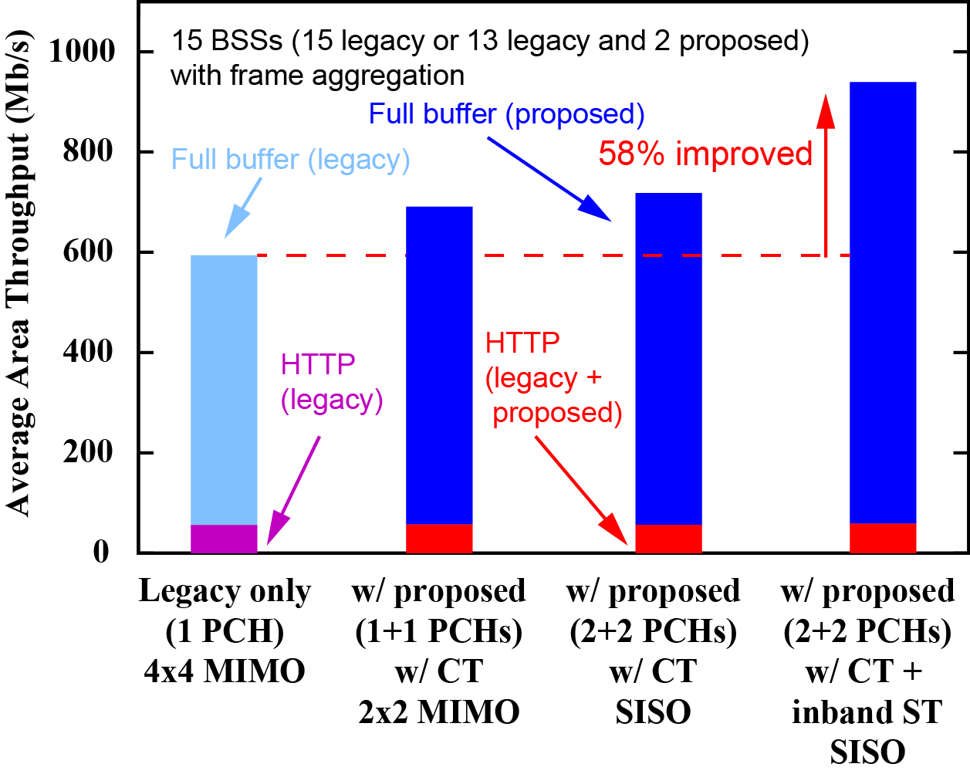
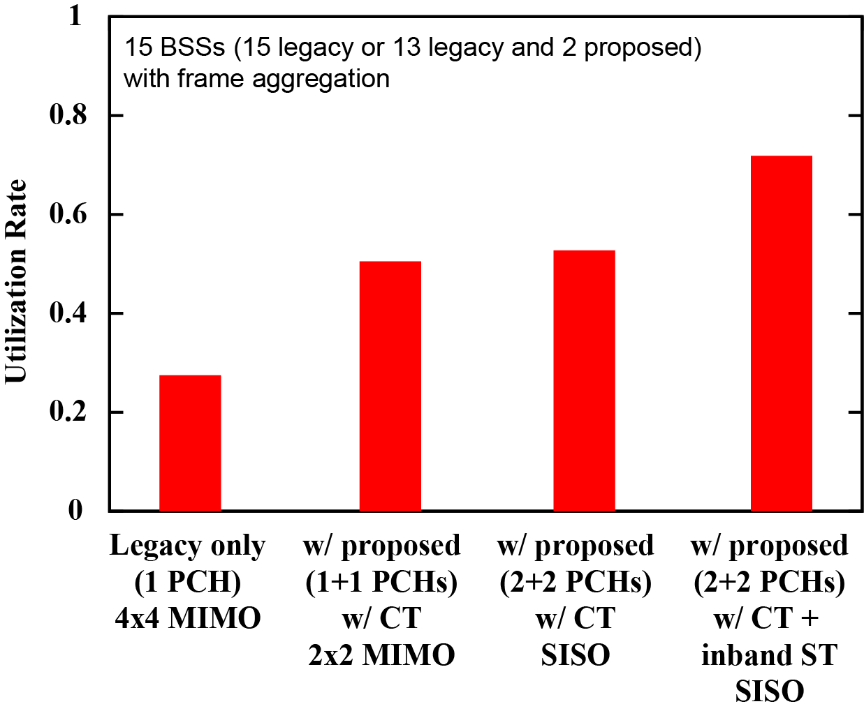
Simulation result (w/ frame aggregation)
Following two cases are assumed:
  15 legacy BSSs (3 BSS in 2.4 GHz band, 12 BSSs in 5 GHz band)
  2 proposed and 13 legacy BSSs (2 and 11 BSSs in 2.4 GHz and 5 GHz bands)
The proposed approach improves area throughput by 58 %.
Average area throughput
Utilization rate in PHY layer

Slide 20
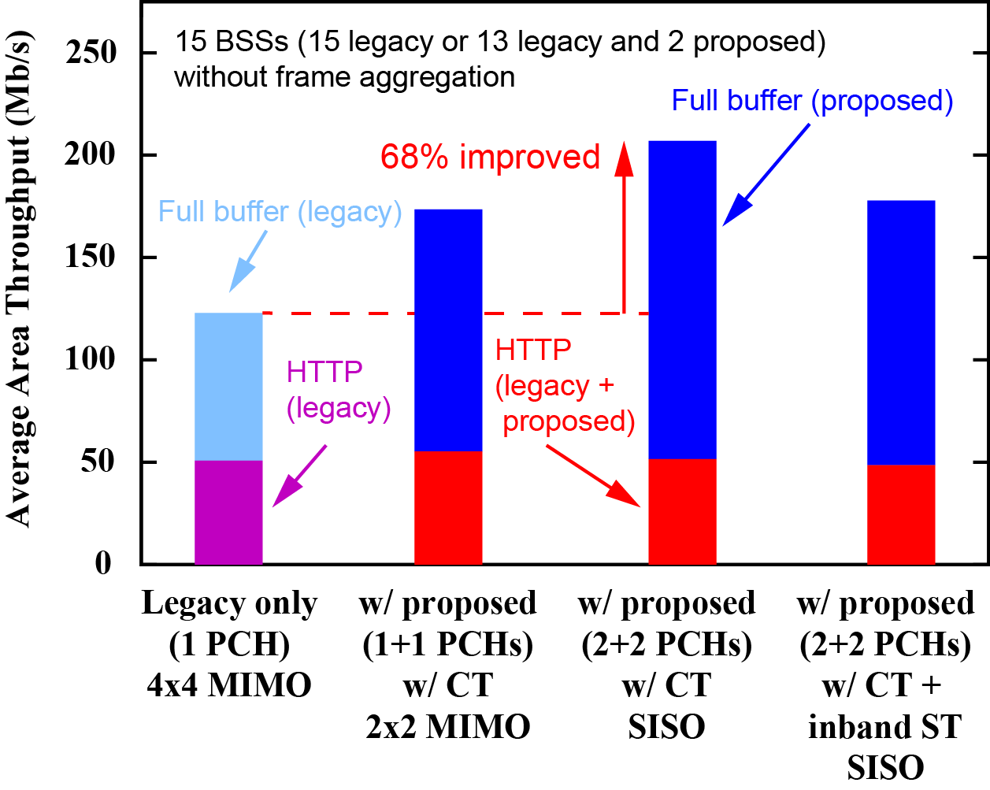
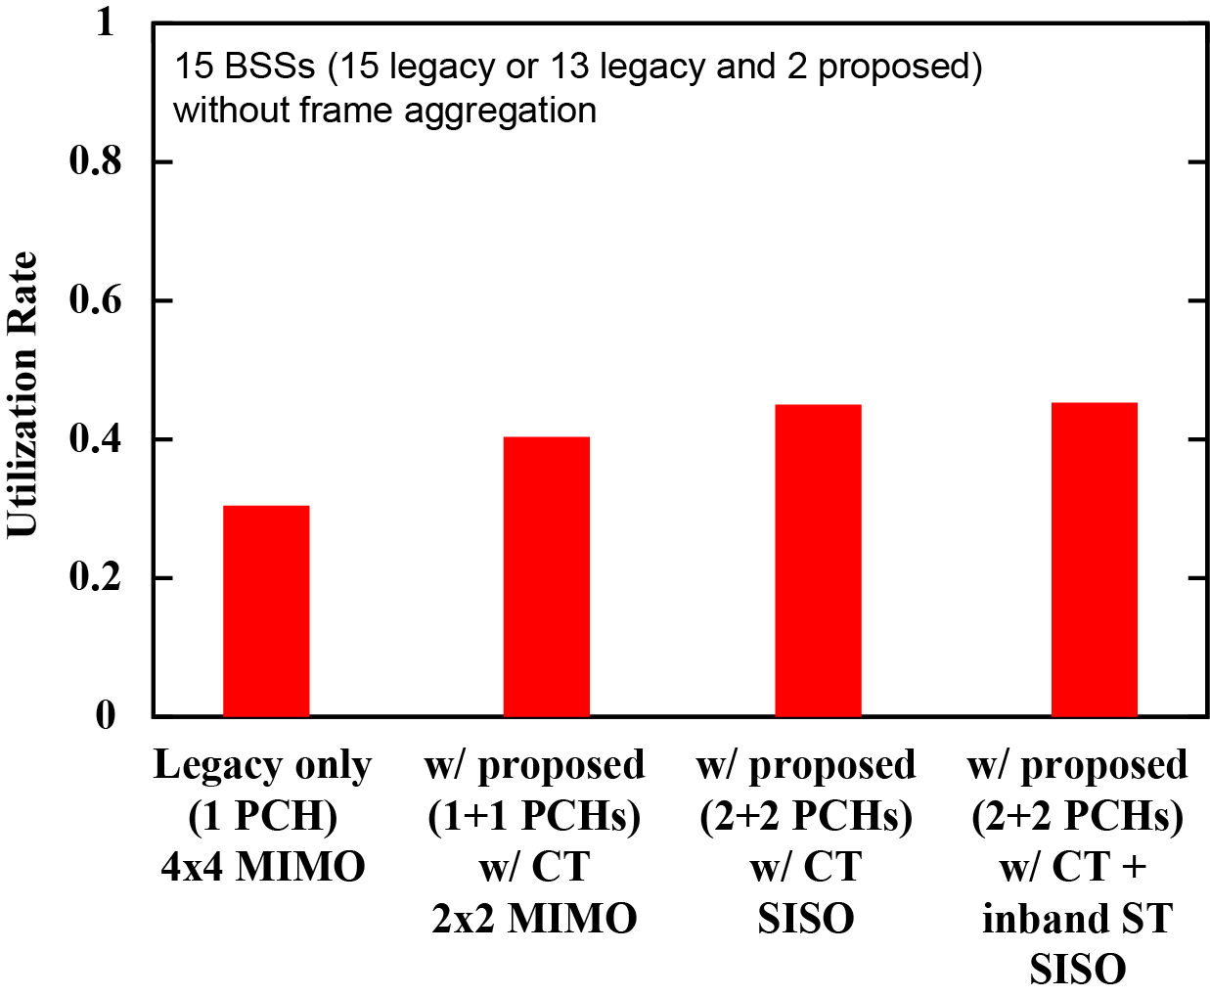
Simulation result (w/o frame aggregation)
Following two cases are assumed:
  15 legacy BSSs (3 BSS in 2.4 GHz band, 12 BSSs in 5 GHz band)
  2 proposed and 13 legacy BSSs (2 and 11 BSSs in 2.4 GHz and 5 GHz bands)
The proposed approach improves area throughput by 68 %.
Average area throughput
Utilization rate in PHY layer

Slide 21
Summary
To exploit unused resources scattered in time and frequency domains and obtain transmission chances on such resources, we have proposed to set multiple PCHs and three ways to use obtained transmission chances.
    Simultaneous (channel-bonded) transmission on multiple PCHs
    Concurrent (asynchronous) transmission on multiple PCHs
    Non-concurrent transmission
We have confirmed through computer simulation that the proposed methods can utilize more radio resources and achieve higher average area throughput than current single-PCH transmission without increase of RF chains.

Slide 22
Straw Poll #1
Do you think that introducing multiple primary channels is an effective approach to enhance achievable QoS?
  Yes:
  No:
  Need more information:
  Abstain:

Slide 23
References
[1] Cisco, “Cisco Visual Networking Index: Global Mobile Data Traffic Forecast Update, 2016–2021,” Cisco White Paper C11-738429-00, February 2017.
[2] doc. IEEE 802.11-17/0410r0.
[3] doc. IEEE 802.11-17/0767r0.
[4] IEEE 802.11-2016.
[5] doc. IEEE 802.11-17/0129r3.
[6] doc. IEEE 802.11-14/0571r12.
[7] IEICE Trans. Commun., vol. E92-B, no. 9, pp. 2773-2788, Sept. 2009.

Slide 24
Appendix

Slide 25
Calculation of MIMO gain and Tx rate
We define “MIMO gain” as the ratio of capacity between MIMO transmission and SISO transmission. (Therefore, the MIMO gain of SISO transmission is 1.)
The CCDF of MIMO gain of 4 x 4 transmission is obtained from the result shown in [7]. The MIMO gain of 2 x 2 transmission is obtained by linear interpolation.
The transmission rate of MIMO transmission is calculated by multiplying the transmission rate of SISO with the MIMO gain.
MIMO gain
MIMO gain of
4 x 4 trans.
Given as a random value based on the result in [7]
1
1
2
4
Number of antennas

