Slide 1
WUR Guard Time follow-up
Date: 2017-11-06
Authors:

Slide 2
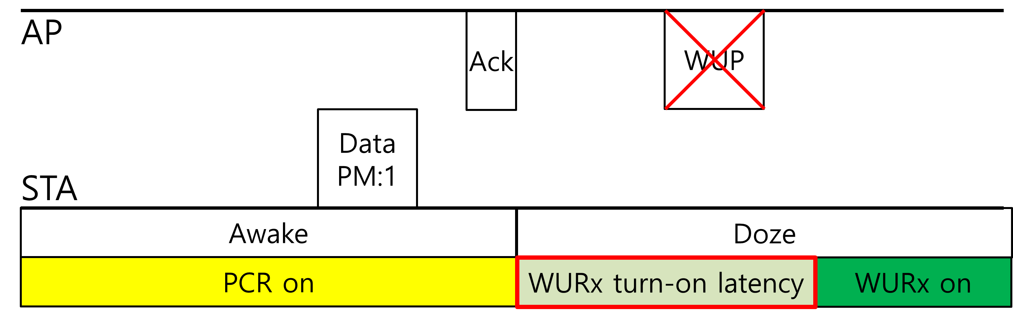
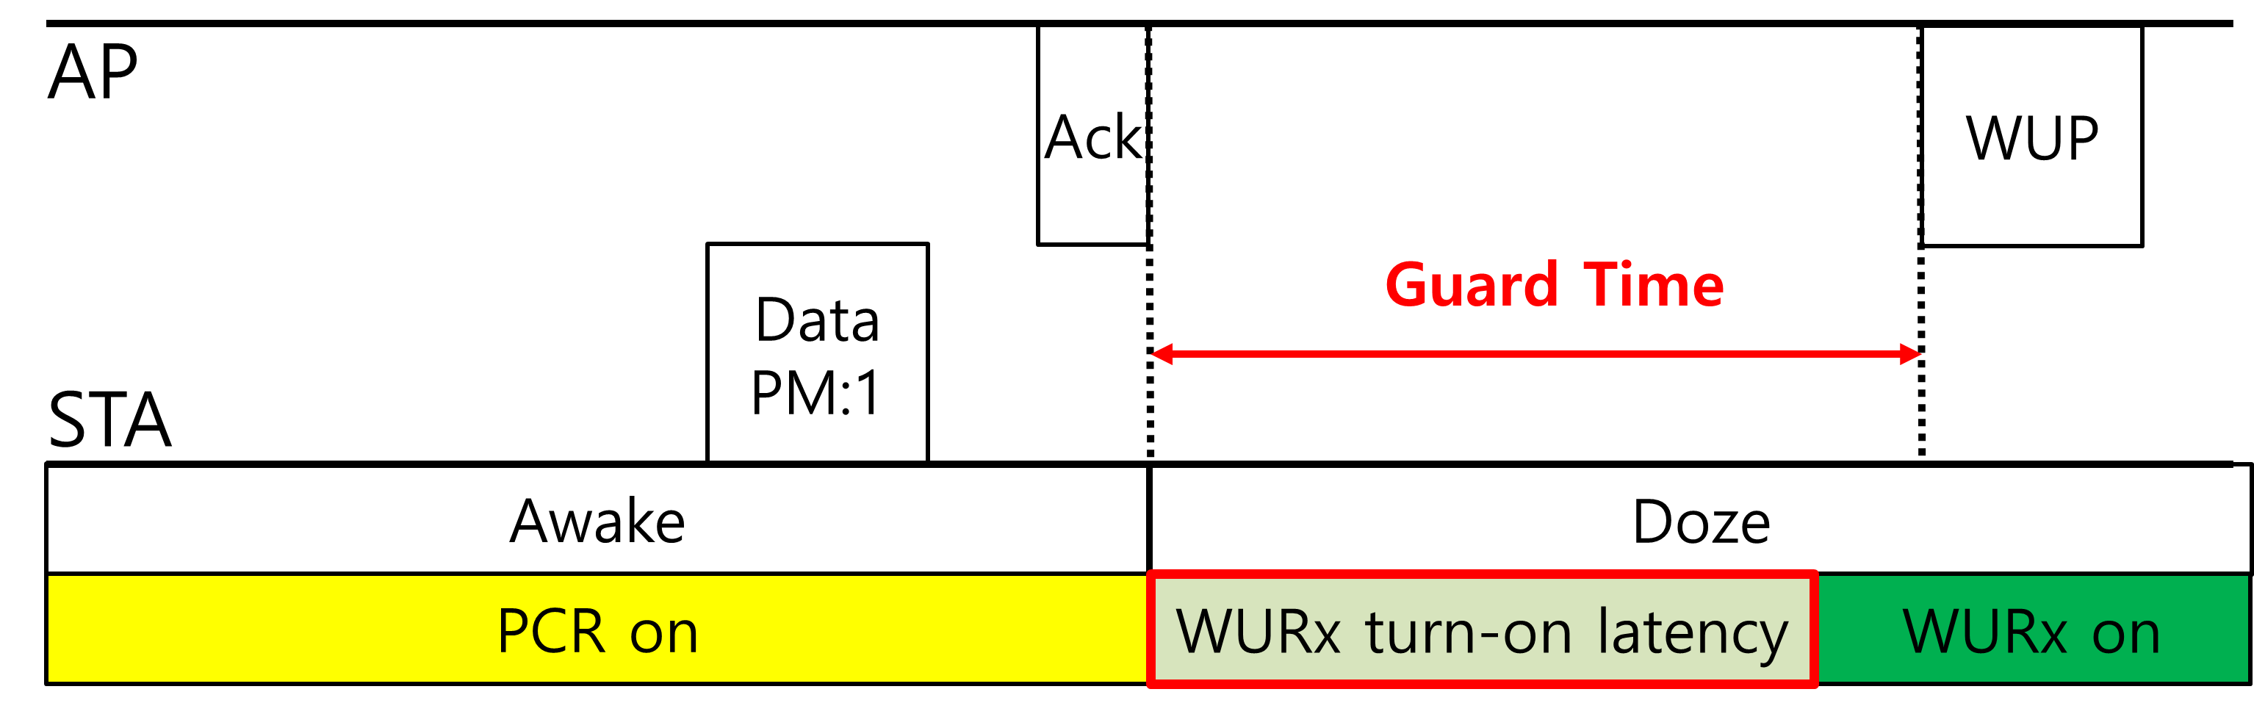
Introduction
In [1], we discussed the turn-on latency of WURx
  When a WUR STA starts to use its WURx, it may require some time to turn on the WURx → turn-on latency
  If AP transmits a WUP to the STA during the turn-on latency, the STA cannot receive the WUP
To prevent the mismatch problem, we proposed to define a guard time
  AP sets a guard time when a WUR STA is supposed to turn on the WURx
  Within the guard time, AP does not send a WUP destined to the WUR STA
In this contribution,
  Use cases of WUR guard time
  Considerations on WUR guard time setup

Slide 3
Turn-on latency of WURx
Turn-on latency of WURx is not a negligible value
  Turn-on latency could be a few microseconds [2]
    Extremely low-cost H/W design may require a longer latency
Turn-on latency might occur whenever a WUR STA enters doze state from awake state
  If a WUR STA keeps its WURx on during awake state, it wastes much power by running both PCR and WURx
  A WUR STA can save more power as it turns off the WURx during awake state
  In this case, the STA turns on its WURx when it enters doze state
When AP needs to wake-up a WUR STA shortly after the STA enters doze state, a mismatch problem might happen

Slide 4
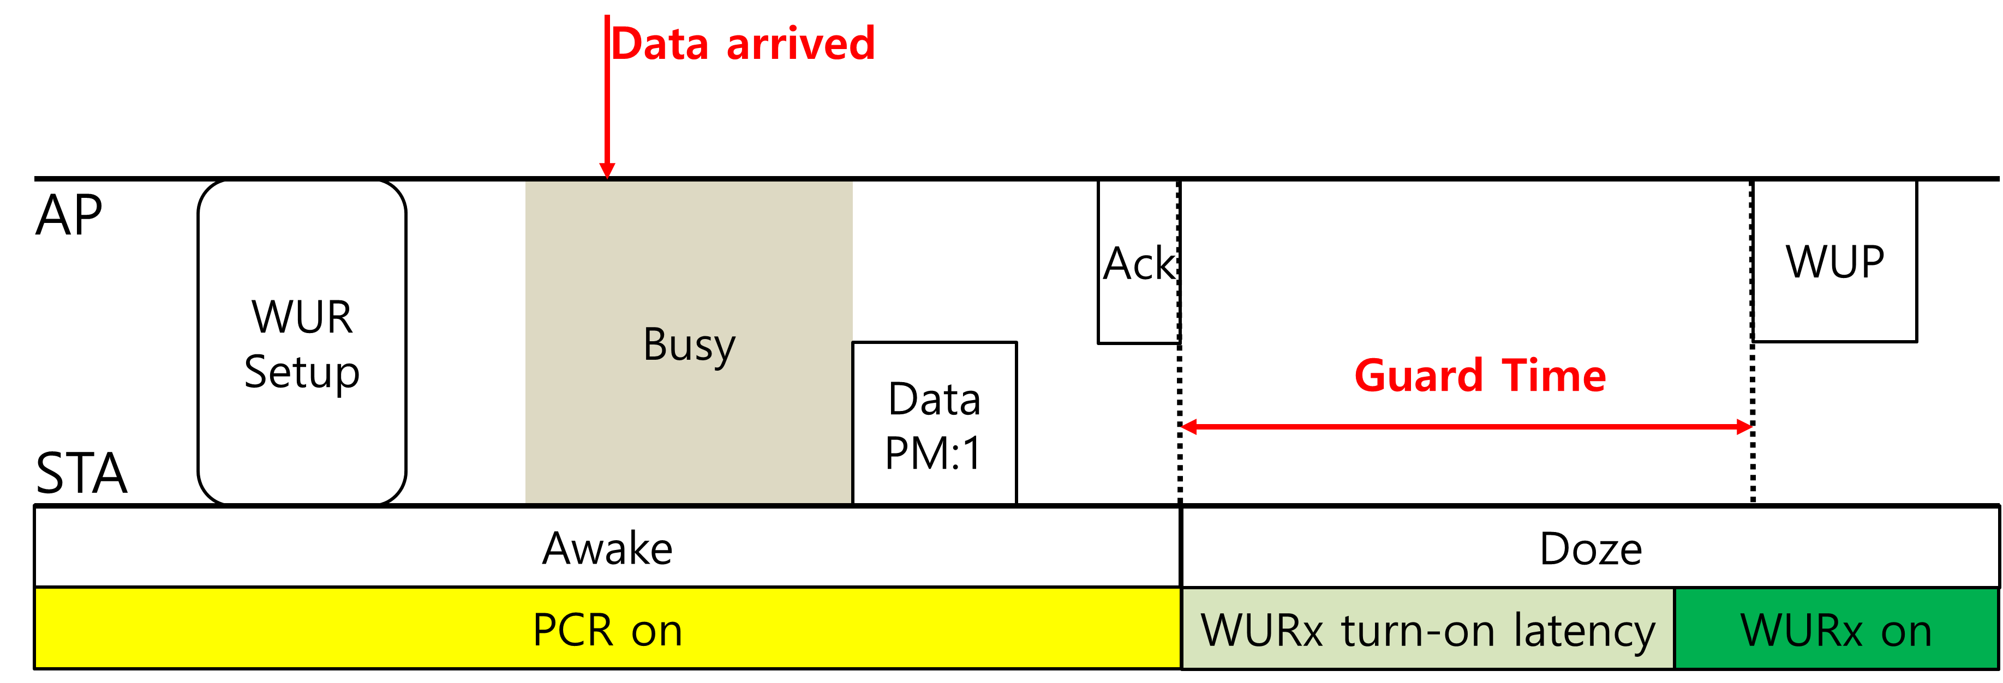
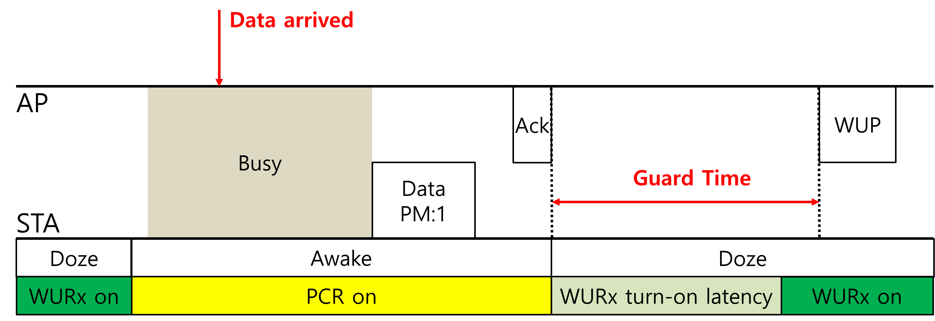
Guard Time Use Cases (1)
1) After the initial WUR setup
  A STA starts to use the WURx by a successful frame transmission with the PM bit set to 1
2) After an UL transmission of an WUR STA
  A STA could automatically return to doze state automatically after a successful UL transmission
Unless the AP accesses the channel prior to the STA, the AP should transmit WUP to the STA

Slide 5
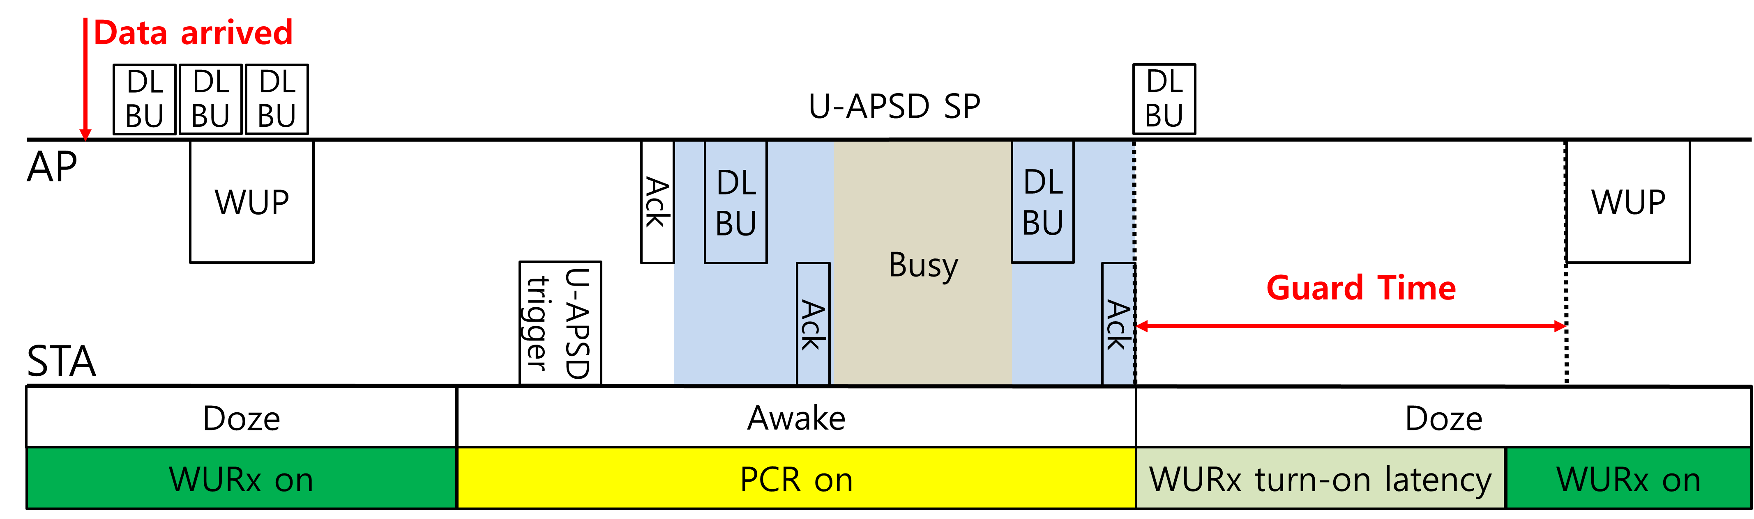
Guard Time Use Cases (2)
3) After a successful wake-up event of STA using U-APSD
  A STA using U-APSD might enter doze state when the max SP length is reached
    Note: The More Data only indicates the presence of the buffered BU of non delivery-enabled ACs when the STA is using U-APSD not for all ACs
  If the AP hasn’t finished all buffered BUs for the STA, it may want to wake-up the STA again
In the aforementioned examples, the guard time could prevent mismatch problem caused by turn-on latency

Slide 6
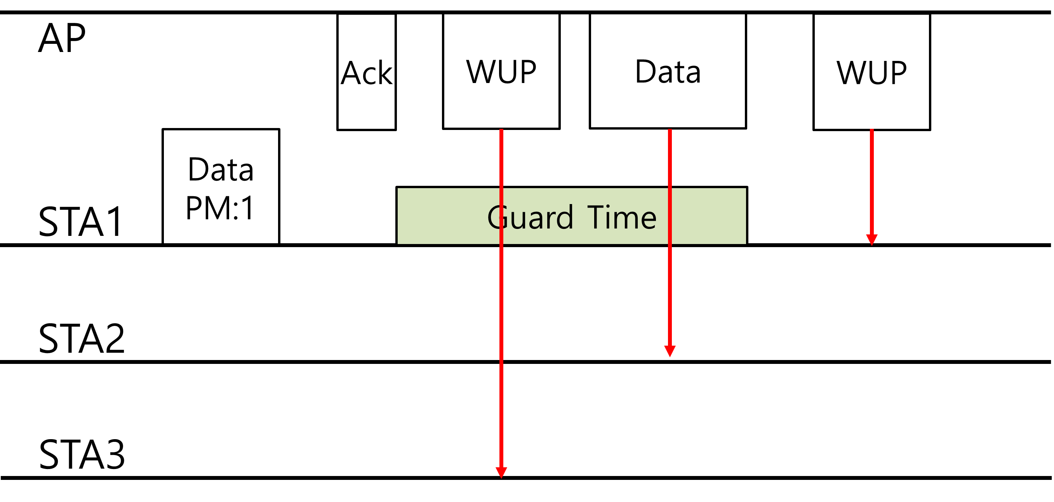
Other benefits of using guard time
Guard time not only prevents the mismatch problem but also provide a reference point on the expected behaviors of both AP and STA
  AP expects that the STA will not receive a WUP by the end of the guard time
    Transmissions for other STAs (PCR frames, WUPs) until the guard time ends
      AP could further optimize scheduling
  STA expects that AP might send a WUP destined to it after the guard time
    Recommended to turn on the WURx before the guard time ends
    If another PCR frame transmission is scheduled, the STA is recommended to transmit it before the guard time ends

Slide 7
Guard time setup
AP defines the guard time of a WUR STA based on the turn-on latency value reported by the WUR STA using PCR frame
  Turn-on latency is a hardware specific parameter
    Need not to be reported frequently
  Could be indicated during the capability negotiation
    WUR Capabilities element
  A few representative values may be defined
    Reducing bit assignment in the element
Probe/
Association
Request
…
WUR capabilities
…
…
Turn-on latency
…

Slide 8
Summary
In this contribution,
  Reviewed some use cases of WUR guard time
  Considerations on WUR guard time setup
    AP defines a guard time of a WUR STA based on the turn-on latency value reported by the WUR STA using PCR frame
    The turn-on latency value is indicated in WUR Capabilities element

Slide 9
Strawpoll 1
Do you agree to add the following in the SFD?
  AP sets a guard time when a WUR non-AP STA is supposed to enter doze state from awake state. Within the guard time, AP shall not send a unicast WUP destined to the non-AP STA.

Slide 10
Strawpoll 2
Do you agree to add the following in the SFD?
  The guard time is defined based on the WURx turn-on latency value included in WUR capabilities element received from the non-AP STA.

Slide 11
Reference
[1] 11-17/1051r1, UL transmission behavior of WUR STA
[2] R1-1712501, Wake-up signal for feNB-IoT

