Slide 1
Beamforming protocol reuse for mmWave Distribution Networks
Date: 2017-11-07
Name | Affiliation | Address | Phone | Email
Djordje Tujkovic | Facebook | 1 Hacker Way, Menlo Park, CA 94025, USA | +1-650-796-9812 | djordjet@fb.com
Krishna Gomadam | Facebook | 1 Hacker Way, Menlo Park, CA 94025, USA | +1-949-241-3323 | kgomadam@fb.com
Payam Torab | Facebook | 1 Hacker Way, Menlo Park, CA 94025, USA | +1-310-699-0510 | ptorab@fb.com
Reza Tusi | Facebook | 1 Hacker Way, Menlo Park, CA 94025, USA | +1-408 717-1391 | rezat@fb.com
Michael Grigat | Deutsche Telekom AG | Deutsche-Telekom-Allee 7, 64295 Darmstadt, Germany | +49-6151-5833533 | m.grigat@telekom.de

Slide 2
Overview
802.11ad sector sweep concept assumes back-to-back transmission of Sector Sweep (SSW) frames in different spatial directions
  It is applied in case of discovery or a major link loss
Proposed concept for the distribution network use case [1] makes continuous use of the sector sweep model, interlaced with data to bound latency [2]
  Same protocol for new link establishment (discovery) and link maintenance
  Directional receive pattern, reciprocal reception & transmission
We describe an example beamforming flow and show how it can serve different applications within a distribution network

Slide 3
I. Beamforming protocol
In [1], [2] we described three beamforming training applications for the distribution network use case
  “Initial beamforming” – discovery
  “Periodic beamforming” – beam refinement
  “Interference scan”– link maintenance and interference management
We describe a protocol that can be largely reused for all three applications
  Initiator behavior largely the same, small differences in field values
  Responder behavior slightly different
We formalize the applications into asynchronous and synchronous beamforming
  Difference being whether the responder has a beamforming training schedule or not at the beginning of training

Slide 4
Formalizing the beamforming flows
Asynchronous beamforming
 |  |  | Initiator |  |  | Responder |  |  | Notes
 | Trigger |  | Through SME/MLME primitive |  |  | Through SME/MLME primitive
 | Scan parameters (not comprehensive) |  | Mode (asynchronous) |  |  | Mode (Asynchronous)
 |  |  | Target station |  |  | Single Rx beam index duration
 |  |  | Tx beam list, Periodicity |  |  | Rx beam list
 | Sweep completion |  | Through SME/MLME primitive |  |  | Protocol signaling from Initiator
 | Information exchanges after sweep completion |  | Responder-to-initiator beam list |  |  | Initiator-to-responder beam list
Synchronous beamforming
 |  |  | Initiator |  |  | Responder |  |  | Notes
 | Trigger |  | Through SME/MLME primitive |  |  | Through SME/MLME primitive
 | Scan parameters (not comprehensive) |  | Mode (synchronous) |  |  | Mode (synchronous)
 |  |  | Beamforming schedule |  |  | Beamforming schedule
 |  |  | Tx beam index |  |  | Rx beam list
 | Sweep completion |  | Through SME/MLME primitive |  |  | Through SME/MLME primitive
 | Information exchanges after sweep completion |  | None |  |  | Initiator-to-responder beam list |  |  | Optional
“Periodic beamforming” and “Interference scan” in [1] and [2] are applications of synchronous beamforming
  Periodic beamforming (beam refinement): unicast target address with beam exchange at the end
  Interference scan: broadcast target address without beam exchange at the end

Slide 5
Asynchronous beamforming
Initiator – synchronized to network timing
  Sweeping total of N Tx beams (e.g., N=31)
  Using the same Tx beam during a beamforming window of N frames (F frame duration)
    Duration per Tx beam N×F, (e.g., 31×400 µs = 12.4 milliseconds)
  Each Tx beam used once during a designated slot in each of the frames 0, …, N-1 within a beamforming window to send multiple urTrnReq packets (typically two)
  Rx Slot 0 in Frame (N-1)/2 of beamforming window W used to receive on the Rx beam that matches the TX beam in beamforming window W-1
Responder – continuously sweeping at the beginning
  Sweeping receive beams continuously back to back, keeping each Rx beam for a programmable “Single Rx beam index duration”
    For example twice the urTrnReq + IFS
  Switching from back to back sweeping pattern to slotted (once per “Periodicity”) when first urTrnReq packet successfully received

Slide 6
Protocol description (1)
200 µs
200 µs
Responder sweep start time asynchronous (power ON upon installation)
 | Transmit slots |  |  | Receive slots
Frame 0 | Tx beam 0
Frame 1 | Tx beam 0
… | Tx beam 0
0 + 15 | Tx beam 0 |  |  | Reserved
…
0 + 30 | Tx beam 0 *
31 | Tx beam 1
32 | Tx beam 1
…
31 + 15 | Tx beam 1 |  |  | Rx beam 0
…
31 + 30 | Tx beam 1 *
…
…
31 x 30 | Tx beam 30
931
…
930 + 15 | Tx beam 30 |  |  | Rx beam 29
…
930 + 30 | Tx beam 30 *
961 | Tx beam 0
962 | Tx beam 0
… | Tx beam 0
961 + 15 | Tx beam 0 |  |  | Rx beam 30
… | Tx beam 0
961 + 30 | Tx beam 0 |30
… | Tx beam 1
 | Receive slots |  |  | Transmit slots
 |  |  |  | Tx beam 24
0
1
2
3
4
5
6
7
7
7
8
9
10
11
12
13
14
Beamforming window 0
(Transmit on
Tx beam 0)
(12.400 ms)
Responder continuously sweeping Rx beams, camping on each Rx beam for “Single Rx beam index duration”
Responder switches to a slotted Rx beam sweep (following the initiator periodicity) after receiving the first training frame (urTrnReq)
Training frame needs to indicate (1) Initiator offset and transmit period, (2) when responder can send a response if hit with a Tx beam transmission
Responder starts in continuous sweep mode, unaware of the transmit pattern and timing
Assuming there is at least one Tx-Rx beam combination that will close the link, it can be shown that responder will be hit for any phase difference in sweeping if all of the following are true:
Receive “Single Rx beam index duration” (50 µs in this example) counts the transmit periodicity (400 µs in this example)
Number of transmit beams and number of receive beams are the same
Number of beams is a prime number
Rx beam 0 matching the Tx beam 0 direction
(different AWV in general)
Beamforming window 1
(Transmit on Tx beam 1)
One complete Tx sector sweep
(384.4 ms)
First Tx/Rx beam hit, switching to slotted sweeping
Sweeping 31 Rx beams
(12.400 ms)
[all 31 Rx beams are scanned every 31 frames in arbitrary order, eg, one way to implement f(k)=mod(x+k*8,30)+1 to make Rx sweep follow the original pattern]
x=24
Rx beam f(k=1)
Beamforming window 30
(Transmit on Tx beam 30)
Rx beam f(k+14)
Rx beam f(k+29)
Tx beam 30/ Rx beam 24 hit happened, offset for response (urTrnRes) and ack communicated in urTrnReq
Every Tx slot filled with two or more urTrnReq packets
Rx beam 30 matching the Tx beam 30 direction
( different AWV in general)
Rx beam f(k+30)
urTrnReq
urTrnReq
Rx beam f(k+45)
IFS options (RIFS, SBIFS, SIFS or programmable) under study
Rx beam f(k+60)|24
(Last Tx slot in beamforming window)
Tx slot filled with two or more urTrnReq packets and one or more urTrnResAck packets if training response received from responder
Initiator
Responder
Continued (next slide)
Responder will switch the Rx beam after urTrnReq duration to receive urTrnResAck (in case hit with previous beamforming window happened)
urTrnReq
urTrnReq
urTrnResAck (sent using the Tx beam in the previous beamforming window, responder needs to switch the beam to receive urTrnResAck)
IFS options (RIFS, SBIFS, SIFS or programmable) under study

Slide 7
Protocol description (2)
200 µs
200 µs
200 µs
200 µs
 | Transmit slots |  |  | Receive slots
Frame F | Tx beam 0
Frame F + 1 | Tx beam 0
… | Tx beam 0
F + 15 | Tx beam 0 |  |  | Reserved
…
F + 30 | Tx beam 0 *
F + 31 | Tx beam 1
F + 32 | Tx beam 1
…
F + 31 + 15 | Tx beam 1 |  |  | Rx beam 0
…
F + 31+ 30 | Tx beam 1|0
… | Tx beam Z
…
F + 31N | Tx beam N
F + 31N + 1
…
… | Tx beam N |  |  | Rx beam 29
…
F + 31N +30
… | Management frame transmit --- Using best Tx beam to Responder |  |  | Management frame receive --- Using best Rx beam to Responder
…
…
…
…
…
…
 | Receive slots |  |  | Transmit slots
Frame 0
Frame 1
…
0 + 15
…
0 + 30
31
32
…
31 + 15
…
31 + 30
…
…
31 x 30
931
…
930 + 15
…
930 + 30
… | Management frame receive --- Using best Rx beam to Initiator |  |  | Management frame transmit --- Using best Tx beam to Initiator
…
…
…
…
…
…
Rx beam f(k)
Beamforming window
(Transmit on
Tx beam 0)
(12.400 ms)
Beamforming window
(Sweeping all Rx beams)
(12.400 ms)
Responder switches the sweeping mode to slotted, synchronized with initiator
End of training is administrative (decided by Initiator SME)
At the end of training, full list of Tx-Rx beams in both directions, and other configuration parameters are exchanged using management frames, and using the same slots that were used for beamforming
Rx beam f(k+15)
Tx beam 0/ Rx beam f(k+15)
hit happened, offset for response and ack communicated in urTrnReq
Rx beam f(k+30)
Rx beam 0 matching the Tx beam 0 direction
(different AWV in general)
Rx beam f(k+45)
Tx beam matching the direction of the Rx beam that was hit, if any (different AWV in general)
Beamforming window
(Sweeping all Rx beams)
Tx sector sweep continues until stopped by initiator (SME/ administrative)
Beamforming window
(Transmit on Tx beam 1)
Rx beam f(k+60)
Tx beam f(k+15)
Responder will switch the Rx beam after urTrnReq duration to receive urTrnResAck
Rx beam f(k+75)|f(k+15)
Rx beam f(l)
Tx beam Z/ Rx beam f(l)
hit happened, offset for response and ack communicated in urTrnReq
Rx beam f(g)
Tx beam matching the direction of the Rx beam that was hit, if any (different AWV in general)
All request and ack frames indicate end of training
Beamforming window
(Transmit on Tx beam N)
Tx beam f(l)
Tx beam N|Z
Rx beam f(g+30)|f(l)
End of beamforming; full beam list (route) and other configuration parameters exchange, all using management frames, and using the same slots that were used for beamforming
Every Tx slot filled with two or more urTrnReq packets
urTrnReq
urTrnReq
IFS options (RIFS, SBIFS, SIFS or programmable) under study
(Last Tx slot in beamforming window)
Tx slot filled with two or more urTrnReq packets and one or more urTrnResAck packets
Initiator
Responder
urTrnReq
urTrnReq
urTrnResAck (sent using the Tx beam in the previous beamforming window, responder needs to switch the beam to receive ack)
IFS options (RIFS, SBIFS, SIFS or programmable) under study

Slide 8
Beam exchange
Strictly speaking, the beamforming protocol is not symmetric
  Searching STA: Initiator, Discoverable STA: Responder
  All initiator Tx beams are tried against all responder Rx beams
  Not all responder Tx beams are tried against all initiator Rx beams
  Taking advantage of beam directions (geometric beamforming)
Periodic beamforming and interference scan are using the same protocol with initiator and responder roles assignable to any two STAs
  For periodic beamforming responder sends an ordered I-to-R beam table to initiator

Slide 9
Protocol Summary
Protocol area | 11ad concepts | Comments
One-sided sector sweep | I-TXSS, I-RXSS | Reciprocity sufficient for protocol exchange (MCS 0) Data transmission does NOT assume reciprocity
Transmission times mapped to slot boundaries | SBIFS, MBIFS, LBIFS | Protocol packets need to indicate a “beamforming schedule” Beamforming slots can be scheduled once per N ≥ 1 TDD frames [2]
End of scan | Sweep completion | Administrative (SME) in distribution network use case
Targeted responder | A-BFT responder address | Unicast or broadcast address Broadcast used for link loss and also interference scan
Multiple TX-RX sector combination feedback | “Sector ID Order” field of Channel Measurement Feedback element | Need to carry a similar structure, together with link quality metrics Exchange does not need to be real-time (management frames OK)

Slide 10
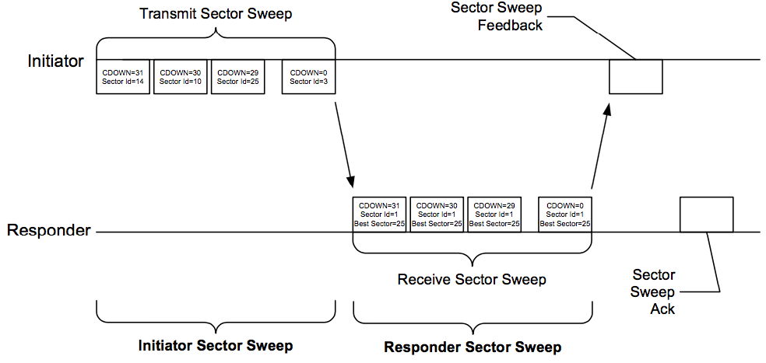
II. Beamforming packets
Differences relative to 11ad TXSS
Transmissions spaced out in time (slots designated for beamforming)
Responder sweeping receive beam synchronously or asynchronously for link budget
Differences relative to 11ad TXSS
No responder TXSS; use the transmit beam corresponding to the hit receive beam to respond
Transmit time implicit or signaled
No SLS equivalent;
Similarity to MIDC

Slide 11
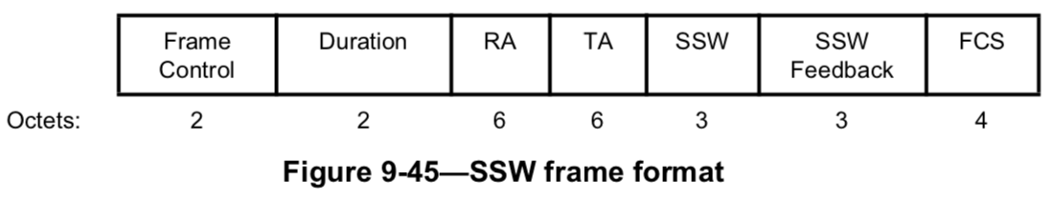
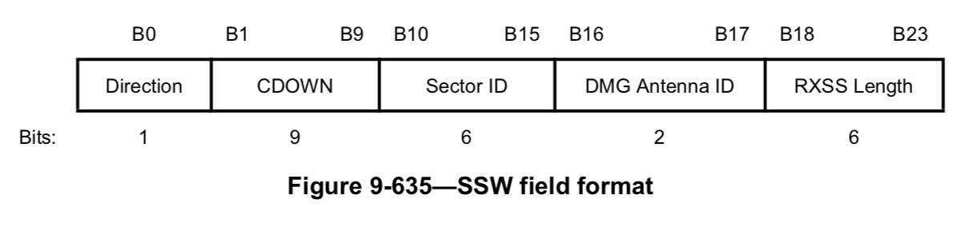
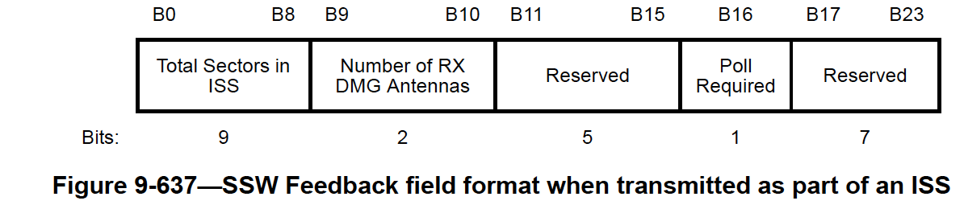
Beamforming packets – functionality (1)
Beamforming Training Request (urTrnReq) comparison to 11ad SSW
Functional gaps wrt 11ay SSW
  Timestamp | Synchronization
  Packet multiplicity
  End of training
  Response time | schedule

Slide 12
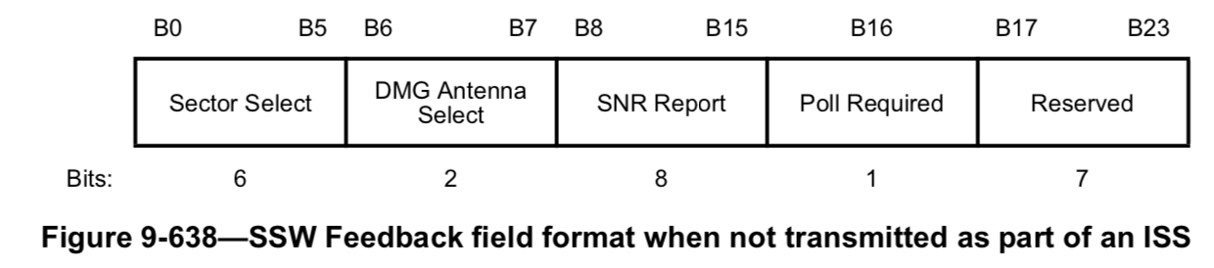
Beamforming packets – functionality (2)
Beamforming Training Response (urTrnRes) comparison to 11ad SSW
Functional gaps wrt 11ay SSW
  Reporting multiple Rx beams for the Tx beam STA responder was hit with
    Nice to have, ie, ok to have strongest only

Slide 13
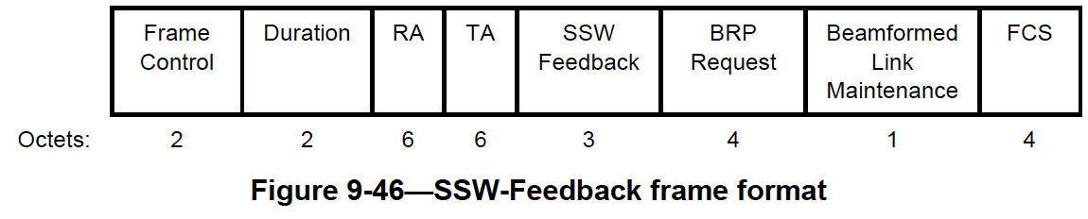
Beamforming packets – functionality (3)
Beamforming Training Response Ack (urTrnResAck) comparison to 11ad SSW-Feedback
Functional gaps wrt 11ay SSW
  Ability to stop the training

Slide 14
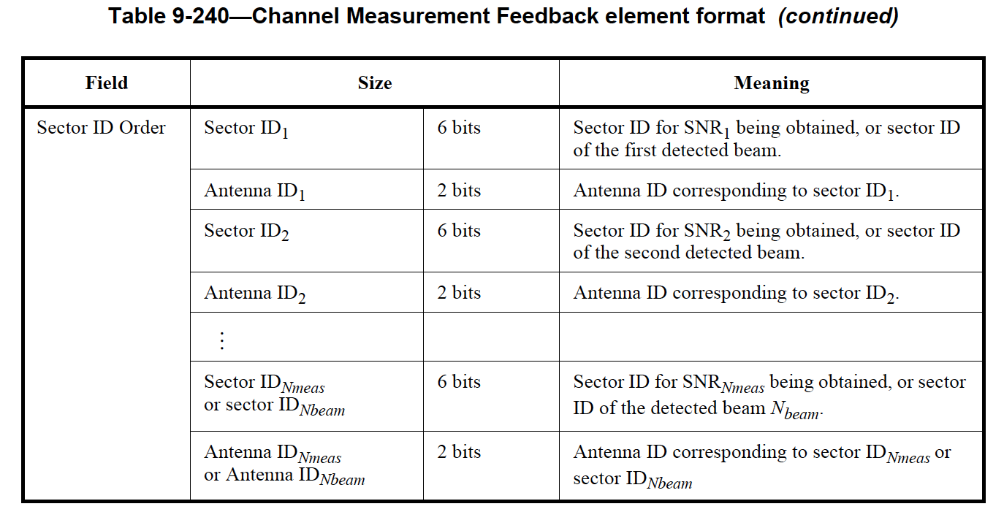
Beamforming packets – functionality (4)
Beamforming Order Request/Response (urOrderReq/Res) comparison to 11ad BRP
Functional gaps wrt 11ay SSW
  Multiple sector feedback

Slide 15
Packets Summary
Packets | 11ad control/extension packet equivalents [differences expected] | Comments
urTrnReq | SSW | Control packet
urTrnRes | SSW, BRP | Protocol packets need to indicate a “beamforming schedule”; beamforming slots can be scheduled once per N ≥ 1 TDD Intervals
urTrnResAck | SSW, and {SSW Feedback, SSW ACK} exchange | Includes the link quality metric for the received urTrnRes packet
We recommend defining equivalent control packets for the TDD use case

Slide 16
References
[1] IEEE 802.11-17/1019r2 “mmWave Mesh Network Usage Model”
[2] IEEE 802.11-17/1321r0 “Features for mmW Distribution Network Use Case”

Slide 17
Backup

Slide 18
Link Establishment
Newly installed sector boots up in responder mode continuously sweeping beams in Rx mode
  Responder does not have information about configuration (e.g., slot structure, polarity assignment, Golay code assignment or DN/CN role)
In each initialization cycle, a sector with already established connection to controller is instructed to switch to initiator mode and start BF acquisition with targeted MAC address responder
  Initiator starts sweeping of Tx beams with BF training request (urTrnReq) and using default 802.11ad/ay Golay code
  No blind discovery
  No broadcast MAC transmission or promiscuous mode reception

Slide 19
BF Acquisition Requirements
Directional beams on both sides of link
  Compensate for long distance, i.e., no quasi-omni antennas
  Assume reciprocity on reverse link for initiator to receive BF training response (urTrnRes) from responder
Initiator could have active traffic with other nodes while instructed to initialize new DN/CN sector
  Add new nodes in point-to-multipoint (P2MP) configuration
CN’s timing unsynchronized with rest of NW
  Start with asynchronous scan
  Upon the first successful detection of BF training request by responder, switch to synchronous scan

Slide 20
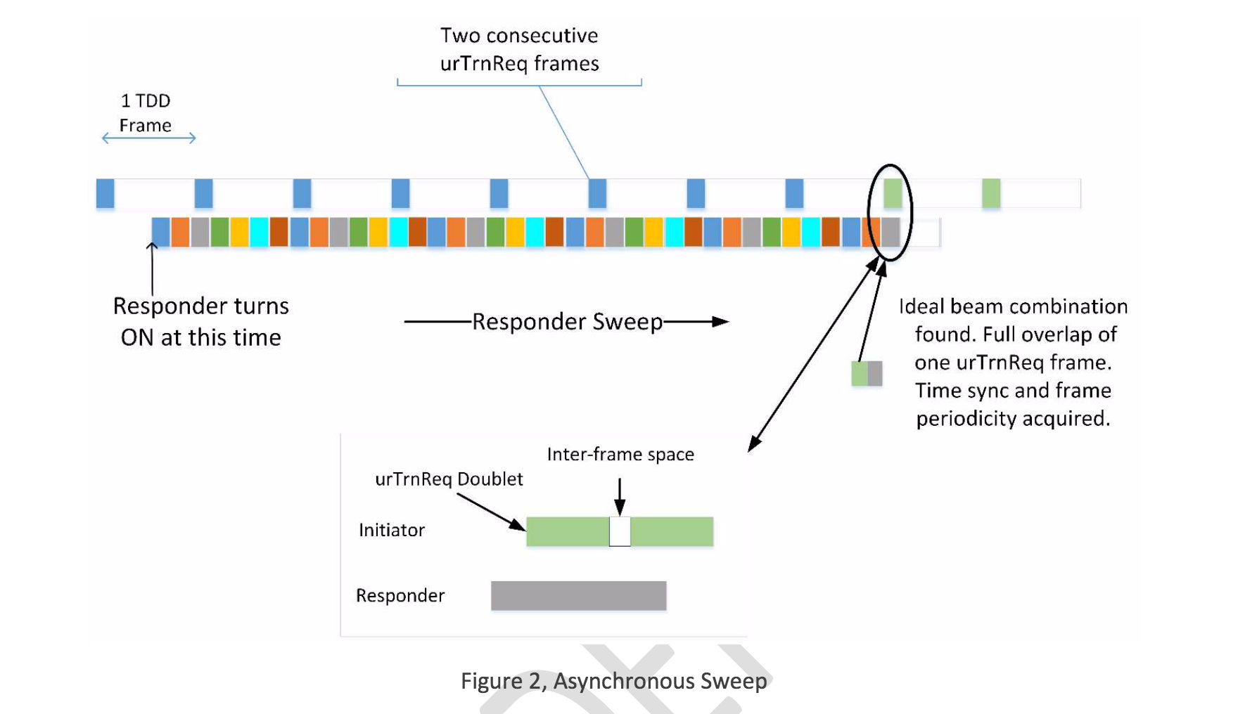
Asynchronous Scan Example
Prime number of receive beams and fast receive sweep with 50 µs window; This is to ensure the scheme works for all TDD interval sizes that are multiple of 50 µs and completes the training in one transmitter cycle.
TDD Interval = 400 µs
N = 31 transmissions (“beamforming window”)
Sweep N = 31 beams
Generally multiple transmissions to improve detection
Rx beam switching at responder’s Rx slot boundary, which is not synced with initiator’s slots yet, and
Time drift; with only one beam combination working, it will take one cycle to catch the same packet again and stop the training. The drift can easily be more than a few us with typical crystal and typical BF cycle (31 x 31 x 400 us ~ 400ms)
Rx beam will be communicated in the first slot of frame 15 (exactly in the middle) of the next “beamforming window”, when initiator will be listening using the same beam it used for transmission in the current “beamforming window”.
By that time there could be multiple “hits”, hence multiple sectors in the Beamforming Training response packet.
Final sorted list sent in route exchange
~5us
~20us
~20us
~50usec
Initiator uses only the first slot in each Tx sub-frame per its polarity assignment to transmit urTrnReq
Allows to maintain traffic on existing links (P2MP) while initializing new ones

Slide 21
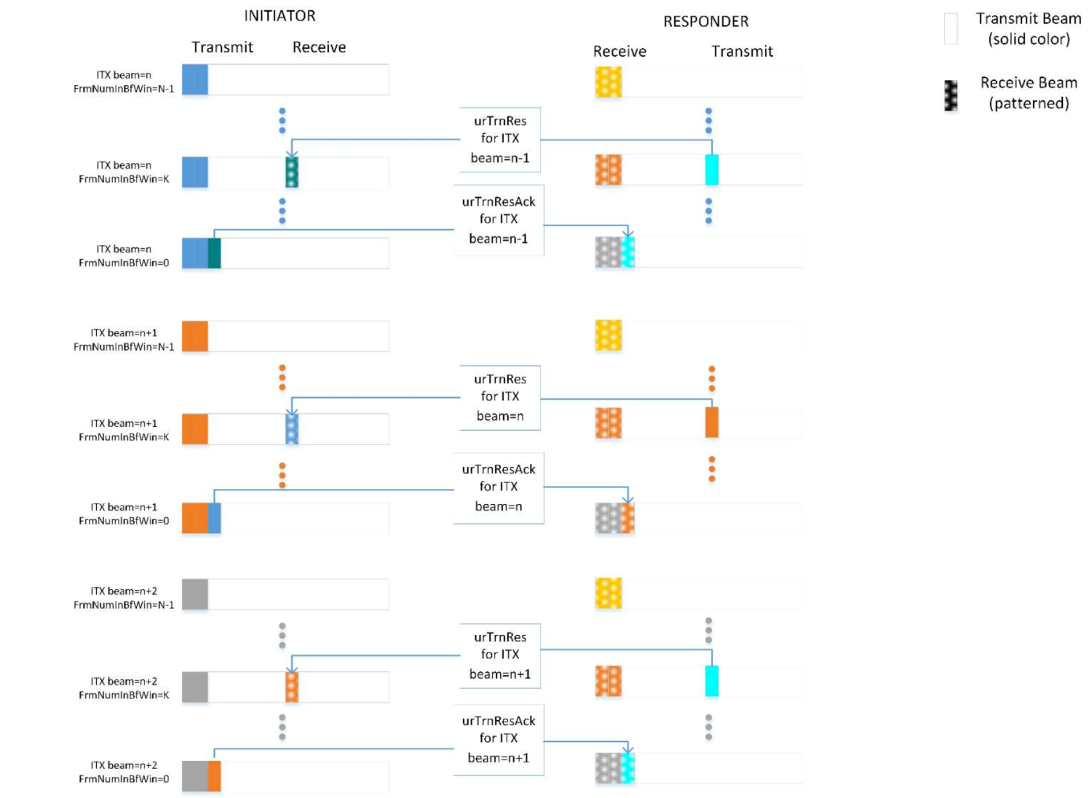
Synchronous Scan Example
Initiator behavior does not change relative to asynchronous scan
Responder synchronizes its Rx beam switching to overlap with initiator transmission in the first slot of its Rx TDD subframe
This is not very important for BF acquisition stage (nothing to be saved in Rx slot occupancy) but it is crucial for periodic BF scan in steady state

