Slide 1
Configurations Options for Distribution Networks
Date: 2017-11-06
Authors:

Slide 2
Overview
Introduction
Distribution Networks Terminology
Distribution Networks Challenges
Configurations for Distribution Networks Entities
Conclusions

Slide 3
Introduction
Distribution Network usage model has been approved by 11ay [1]
[4] presented high-level network architecture for distribution networks with three entities:
  Cloud controller (CC) / Distribution nodes (DN) / Client nodes (CN)
These entities need to be configured under 11ay framework to provide the needed functionalities
  E.g., when a link is formed between an DN sector and a CN sector, which should be configured as an AP and which as a STA
In this presentation, we propose options of configurations utilizing 802.11ay protocols/procedures, and discuss these options in terms of real-life deployment challenges such as deployment flexibility and scheduling complexities

Slide 4
mmWave Distribution Networks: Terminology
Cloud controller (CC): Provides self-organizing capabilities and optimizes network performance (resource utilization, congestion control, failure recovery, etc.).
Sector: A sector in a DN or CN consists of a mmW antenna, radio and 802.11ay protocol stack.
Distribution nodes (DN): A DN may have multiple mmW sectors, each containing an antenna, radio and 802.11ay protocol stack. A DN sector may connect to multiple DNs and CNs [4].
Client nodes (CN): A CN has a single mmW sector, containing an antenna, radio and 802.11ay protocol stack. In addition, a CN sector may connect to multiple CNs or DNs. (See Slide 9 - 11)

Slide 5
Real-world Deployment and Scheduling Challenges (1/2)
Downtown city deployments are dense with significant Line-of-Sight (LoS) blockages and non-uniform layouts
  A flexible configuration is needed to address deployments in sub-urban or dense urban environments. A few urban deployment examples are shown below:
Source: From [2]
Source: CCS Whitepaper - Rapid small cell deployment in the urban jungle

Slide 6
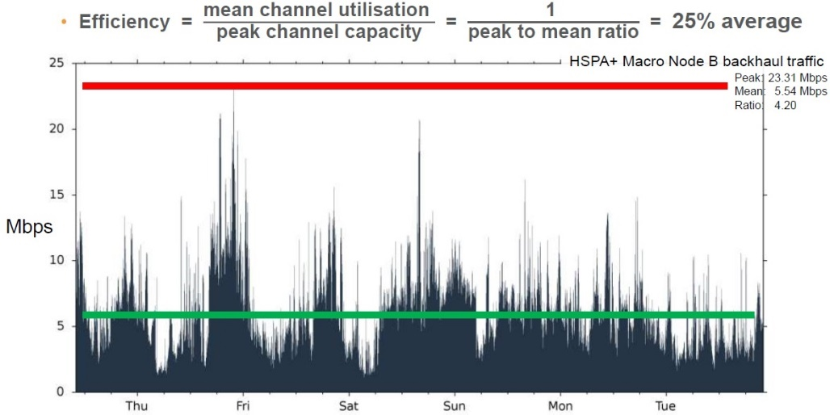
Real-world Deployment and Scheduling Challenges (2/2)
Backhaul traffic for Wireless small-cell (Cellular/Wi-Fi) and fixed wireless-to-home has a high peak and is bursty
This requires efficient resource allocation and reactive scheduling mechanisms.
Efficiency (UL) = ~25%-30% Efficiency (DL)=~17%-25%
Source: Cambridge Broadband Networks Whitepaper – Small Cells in a Big City
Source: Small Cell Backhaul Requirements, NGMN Whitepaper, 2012.

Slide 7
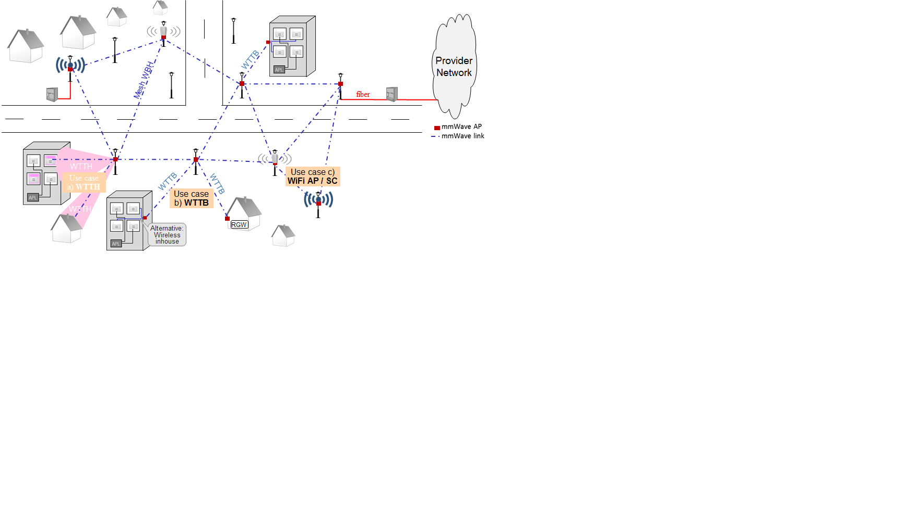
Configuration Options (1/2)
In order to address these real-world deployment challenges, the DNs and CNs need to be configured in such a way to provide:
  Flexibility, scalability, ease, resilience and redundancy in deployment
  Reactive, efficient and flexible scheduling with low complexity
To meet these requirements, the easiest way may be to configure entities such as DNs and CNs at one end of each link to be an AP, and at the other end a STA
  Minimum impact on current 802.11ay specifications.
  However, the choice may not be trivial and can have impact on deployment and performance of the Distribution Networks

Slide 8
Configuration Options (2/2)
Configuration 1: DN sectors are PCPs/APs and CN sectors are STAs.
  DN sectors are discoverable by new DNs and CNs since they continuously transmit beacons.
  DN-CN scheduling is not a problem since it follows existing 11ay framework.
Configuration 2: DN sectors can be PCPs/APs or STAs, whereas CN sectors are STAs.
  DN sectors operating as PCP/APs are discoverable by new DNs and CNs.
Configuration 3: DN and CN sectors may assume either PCP/AP or STA functionality.
  A sector with already established connection to controller continues to operate in initiator mode to perform BF training with any new DN or CN sector.
  A sector may switch functionality (between PCP/AP and STA) under higher layer control.

Slide 9
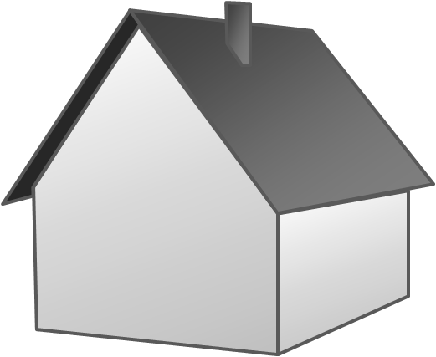
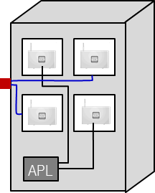


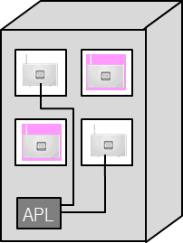
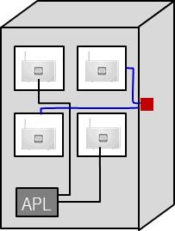
Configuration Option 1: Network Formation Problem #1
DN-DN (PCP/AP-PCP/AP) connectivity is not possible per current 11ay specifications
Provider
Network
Small cell
CN
DN
  WTTB
Wi-Fi AP
DN
Fiber PoP
(cabinet)
DN
Fiber PoP (to Provider Network)
fiber
DN
mmWave AP
mmWave link
CN
DN
  mmWave Distribution Network
  LOS 60 GHz narrow beam system
  Own management and control per mmWave wireless access area
  Route control protocol supports re-routing over radio links
  Auto-alignment installations via adaptive beamforming
  Redundancy of active equipment at “first” pole next to fiber PoP or via connections to 2 or more fiber PoPs
  Radio link degradation and outage recognition w/ failure localisation
  WTTH
DN
Small cell
Use case c) WiFi AP / SC
  WTTB
DN
Use case
b) WTTB
  WTTB
CN
  WTTH
CN
CN
Wi-Fi-AP
DN
Use case
a) WTTH
Alternative: Wireless inhouse
RGW
Source: From [1], with additional labels

Slide 10
Configuration Options 1 & 2: Network Formation Problem #2
Provider
Network
Small cell
CN
DN
  WTTB
Wi-Fi AP
DN
Fiber PoP
(cabinet)
DN
Fiber PoP (to Provider Network)
fiber
DN
mmWave AP
mmWave link
CN
DN
  mmWave Distribution Network
  LOS 60 GHz narrow beam system
  Own management and control per mmWave wireless access area
  Route control protocol supports re-routing over radio links
  Auto-alignment installations via adaptive beamforming
  Redundancy of active equipment at “first” pole next to fiber PoP or via connections to 2 or more fiber PoPs
  Radio link degradation and outage recognition w/ failure localisation
  WTTH
DN
Small cell
Use case c) WiFi AP / SC
  WTTB
DN
Use case
b) WTTB
  WTTB
CN
  WTTH
CN
CN
Wi-Fi-AP
DN
Use case
a) WTTH
Alternative: Wireless inhouse
RGW
CN cannot see any DN. Even though it can see another CN → no link possible
Source: From [1], with additions

Slide 11
Configuration Option 3 – Network Formation
DN-DN connectivity is possible per current 11ay specifications (PCP/AP-STA link)
Small
cell
DN
Wi
Provider
-
Fi
DN
Network
AP
DN
DN
Fiber PoP
(cabinet)
Fiber PoP
fiber
(to Provider
Network)
mmWave AP
mmWave link
CN
DN
mmWave
Distribution
Network
WTTH
DN
•
LOS 60 GHz narrow beam system
Small
Use case c)
•
Own management and control per
cell
mmWave
wireless access area
DN
WiFi
AP / SC
•
Route
control protocol
supports re
-
Use case
routing over
radio
links
•
Auto
-
b)
WTTB
DN
alignment installations via
Use case
CN
Wi
adaptive beamforming
-
Fi
a)
WTTH
CN
AP
-
•
Redundancy
of active equipment at
WTTH
Alternative:
RGW
“first” pole next to
fiber
PoP
or via
CN
Wireless
connections to 2 or more
fiber
PoPs
inhouse
•
Radio link degradation and outage
CN can connect to neighboring CN (which is now an AP) since no DN is visible
recognition w/ failure localisation
Source: From [1], with additions

Slide 12
Configuration Option 1 – Scheduling Challenges (1/2)
Assuming PCP/AP – PCP/AP link is enabled in 11ay, Semi-Static resource allocation is problematic because:
  Resources common to multiple PCPs/APs (Masters) have to be allocated/reserved in advance, perhaps taking into account statistical traffic characteristics, but without knowledge of instantaneous requirements.
  Therefore, scheduling may not be able to fully accommodate locally transient Backhaul traffic load, resulting in unused resources on some links and non-empty queues for other links from the same sector.
Use cases:
A
6
B
a) WTTH
5
Fiber PoP
fiber
A
4
B
b) WTTB
3
Provider
Network
A
2
B
c) Wi-Fi AP/ Small Cell
1
mmWave
Distribution
Network
Fiber PoP
fiber
Source: From [2], with additional labels

Slide 13
Configuration Option 1 – Scheduling Challenges (1/2)
Dynamic scheduling in a well-connected network is also challenging. Consider the example in [2]:
  DN2 can divide resources among DN1 and DN3 only after learning their instantaneous requirements.
  However, DN3 can allocate resources on its two associated links only after receiving resource requests from DN2 and DN4.
  Such dependencies extend throughout the network rendering dynamic scheduling difficult.
Use cases:
A
6
B
a) WTTH
5
Fiber PoP
fiber
A
4
B
b) WTTB
3
Provider
Network
A
2
B
c) Wi-Fi AP/ Small Cell
1
mmWave
Distribution
Network
Fiber PoP
fiber
Source: From [2], with additional labels

Slide 14
Configuration Option 3 – Network Formation and Scheduling
This configuration framework simplifies network formation and enables efficient and dynamic scheduling:
Network formation
  Flexible to allow CN and DN sectors to operate as PCP/APs or STAs.
  A sector with already established connection to controller continues to operate in initiator mode to perform BF training with any new DN or CN sector.
  A sector may switch functionality (between PCP/AP and STA) under higher layer control.
Scheduling: PCP/AP schedules transmissions from and to STA
  The TDD slot structure including slots, subframes and frames proposed in contribution 17/1323r2 works well with the proposed architecture.
  The scheduling mechanism proposed in contribution 17/1323r2 also works well with the proposed architecture.
    This includes use of TDD-SPs and TDD bitmaps for assignment.

Slide 15
Configuration Options: Summary
Configuration 1: DN sectors are PCPs/APs and CN sectors are STAs. This choice has the following limitations:
  Restricts real-world deployment options (Slide 9 - 10)
  Introduces scheduling challenges (Slides 12 - 13)
  Significant updates required to the 802.11ay standard
    E.g., need to define AP-AP over-the-air protocols in 11ay
Configuration 2: DN sectors can be PCPs/APs or STAs, whereas CN sectors are STAs. This choice has the following limitations:
  Restricts real-world deployment options (Slide 10)
Configuration 3: DN and CN sectors may assume either PCP/AP or STA functionality.
  This allows deployment flexibility, enables path redundancies, removes scheduling challenges with minimal standards impact.

Slide 16
Conclusion
We presented three options for configuring Distribution Network entities, in particular, DNs and CNs, to enable their functionalities.
We discussed each configuration options in terms of benefit and limitations for real-world deployment and scheduling.
Configuration Option 3 seems to provide the most flexibility, resilience and redundancy in deployment and enables efficient and dynamic scheduling.

Slide 17
References
[1] IEEE 11-15/625r5 “IEEE 802.11 TGay Usage Scenarios”, August 2017
[2] IEEE 802.11-17/1019r2 “mmWave Distribution Network Usage Model”, July 2017
[3] IEEE 802.11-17/1022r0 “Changes to 802.11ay in support of mmW Distribution Network Use Cases”, July 2017
[4] IEEE 802.11-17/1321r0 “Features for mmW Distribution Network Use Case”, September 2017
[5] IEEE 802.11-17/1323r2 “Scheduling for mmWave Distribution Networks”, September, 2017

Slide 18
Straw Poll
Do you agree that Configuration Option 3 (as shown on Slide 8) should be considered for realizing mmW Distribution Networks?
Y/N/A

