Slide 1
Optimizing OOK Waveform for High Data Rate WUS
Date: 2017-11-05
Authors:

Slide 2
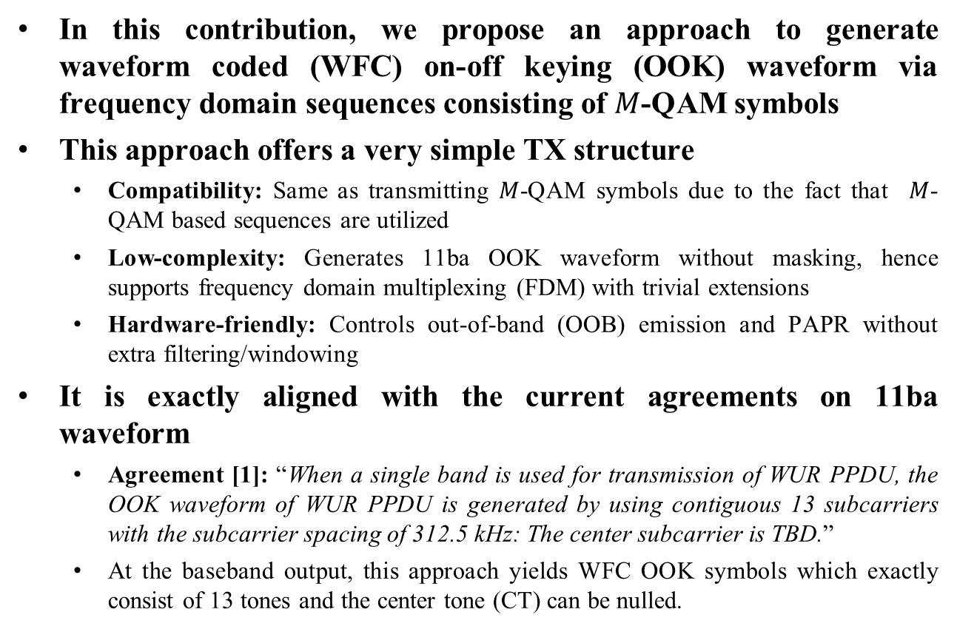
Introduction
In this contribution, we propose an approach to generate waveform coded (WFC) on-off keying (OOK) waveform via frequency domain sequences consisting of $M$-QAM symbols
This approach offers a very simple TX structure
  Compatibility: Same as transmitting $M$-QAM symbols due to the fact that $M$-QAM based sequences are utilized
  Low-complexity: Generates 11ba OOK waveform without masking, hence supports frequency domain multiplexing (FDM) with trivial extensions
  Hardware-friendly: Controls out-of-band (OOB) emission and PAPR without extra filtering/windowing
It is exactly aligned with the current agreements on 11ba waveform
  Agreement [1]: “When a single band is used for transmission of WUR PPDU, the OOK waveform of WUR PPDU is generated by using contiguous 13 subcarriers with the subcarrier spacing of 312.5 kHz: The center subcarrier is TBD.”
  At the baseband output, this approach yields WFC OOK symbols which exactly consist of 13 tones and the center tone (CT) can be nulled.

Slide 3












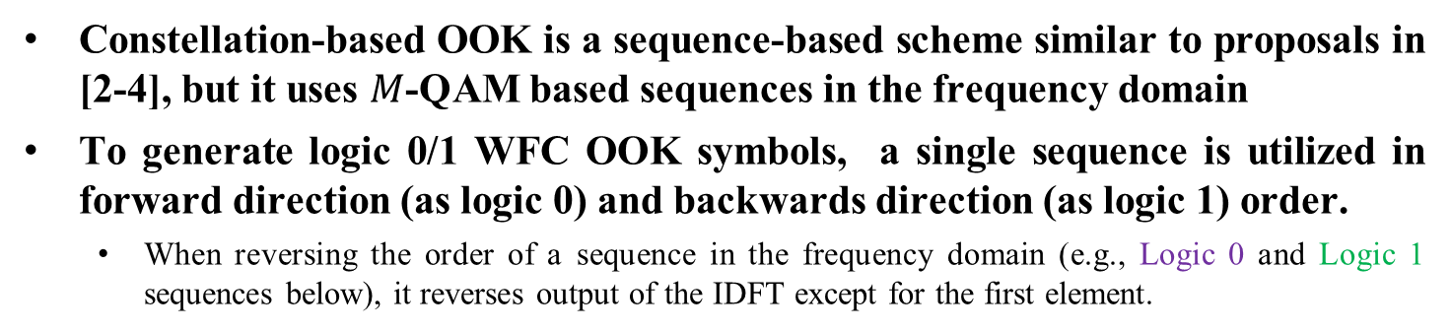























Constellation-based OOK
Constellation-based OOK is a sequence-based scheme similar to proposals in [2-4], but it uses $M$-QAM based sequences in the frequency domain
To generate logic 0/1 WFC OOK symbols, a single sequence is utilized in forward direction (as logic 0) and backwards direction (as logic 1) order.
  When reversing the order of a sequence in the frequency domain (e.g., Logic 0 and Logic 1 sequences below), it reverses output of the IDFT except for the first element.
Logic 0
sequence
Logic 1
sequence
Logic 0
OOK
Logic 1
OOK
Mapping
IDFT
(64)
$$x_{0}$$
$$x_{0}$$
Logic 1
$$d_{1}$$
$$d_{12}$$
$$x_{1}$$
$$x_{63}$$
$$d_{2}$$
$$d_{11}$$
$$x_{2}$$
$$x_{62}$$
6 $M$-QAM symbols
$$d_{3}$$
$$d_{10}$$
…
Amplitude
$$d_{4}$$
$$d_{9}$$
Logic 1
sequence
$$d_{5}$$
$$d_{8}$$
t
1 center tone
$$d_{6}$$
$$d_{7}$$
Add GI
Logic 0
0
0
$$d_{7}$$
$$d_{6}$$
Logic 0
sequence
$$d_{8}$$
$$d_{5}$$
Amplitude
6 $M$-QAM symbols
$$d_{9}$$
$$d_{4}$$
$$d_{10}$$
$$d_{3}$$
Data
…
t
$$d_{11}$$
$$d_{2}$$
$$0$$
$$T_{GI}$$
$$d_{12}$$
$$d_{1}$$
$$x_{62}$$
$$x_{2}$$
$$x_{63}$$
$$x_{1}$$
IDFT output

Slide 4
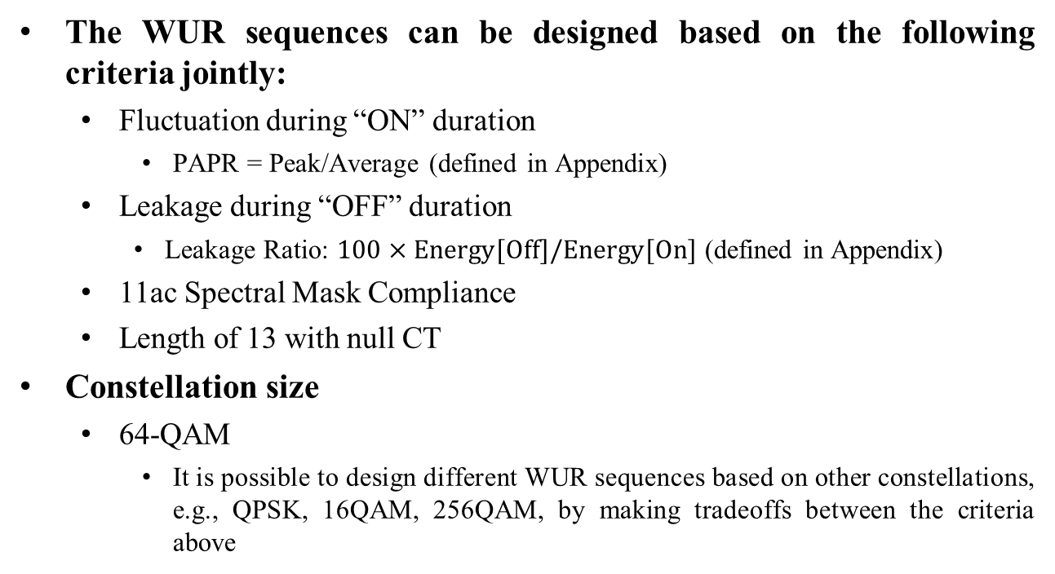
Design Criteria
The WUR sequences can be designed based on the following criteria jointly:
  Fluctuation during “ON” duration
    PAPR = Peak/Average (defined in Appendix)
  Leakage during “OFF” duration
    Leakage Ratio: $100×Energy[Off]/Energy[On]$ (defined in Appendix)
  11ac Spectral Mask Compliance
  Length of 13 with null CT
Constellation size
  64-QAM
    It is possible to design different WUR sequences based on other constellations, e.g., QPSK, 16QAM, 256QAM, by making tradeoffs between the criteria above

Slide 5
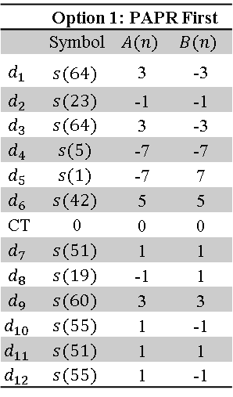
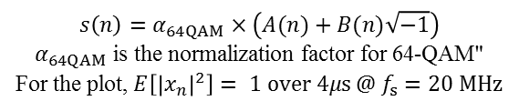
Example 1 - Prioritize PAPR First
The following sequence with 64-QAM constellation minimizes the fluctuation during “ON” duration while keeping the leakage during ‘OFF’ duration low and the WUS’ PSD compliant with the 11ac spectral emission mask
 | Option 1: PAPR First
 | Symbol | $$A(n)$$ | $$B(n)$$
$$d_{1}$$ | $$s(64)$$ | 3 | -3
$$d_{2}$$ | $$s(23)$$ | -1 | -1
$$d_{3}$$ | $$s(64)$$ | 3 | -3
$$d_{4}$$ | $$s(5)$$ | -7 | -7
$$d_{5}$$ | $$s(1)$$ | -7 | 7
$$d_{6}$$ | $$s(42)$$ | 5 | 5
CT | 0 | 0 | 0
$$d_{7}$$ | $$s(51)$$ | 1 | 1
$$d_{8}$$ | $$s(19)$$ | -1 | 1
$$d_{9}$$ | $$s(60)$$ | 3 | 3
$$d_{10}$$ | $$s(55)$$ | 1 | -1
$$d_{11}$$ | $$s(51)$$ | 1 | 1
$$d_{12}$$ | $$s(55)$$ | 1 | -1
Minimal
fluctuation
(1.08 dB PAPR)
$$s\left(n\right)=α_{64QAM}×\left(A(n)+B(n)\sqrt{−1}\right)$$
$α_{64QAM}$ is the normalization factor for 64-QAM"
For the plot$\text{, }E\left[{\left|x_{n}\right|}^{2}\right]= 1 over 4μs @ f_{s}=20 MHz$
Leakage ratio = 2.55%

Slide 6
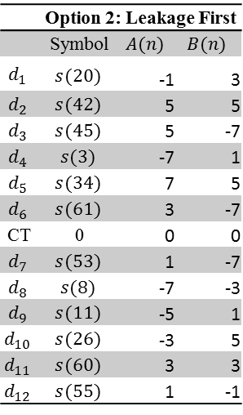
Example 2 - Prioritize Leakage First
The following sequence with 64-QAM constellation minimizes the leakage during “OFF” duration while keeping PAPR low and the WUS’ PSD compliant with the 11ac spectral emission mask
 | Option 2: Leakage First
 | Symbol | $$A(n)$$ | $$B(n)$$
$$d_{1}$$ | $$s(20)$$ | -1 | 3
$$d_{2}$$ | $$s(42)$$ | 5 | 5
$$d_{3}$$ | $$s(45)$$ | 5 | -7
$$d_{4}$$ | $$s(3)$$ | -7 | 1
$$d_{5}$$ | $$s(34)$$ | 7 | 5
$$d_{6}$$ | $$s(61)$$ | 3 | -7
CT | 0 | 0 | 0
$$d_{7}$$ | $$s(53)$$ | 1 | -7
$$d_{8}$$ | $$s(8)$$ | -7 | -3
$$d_{9}$$ | $$s(11)$$ | -5 | 1
$$d_{10}$$ | $$s(26)$$ | -3 | 5
$$d_{11}$$ | $$s(60)$$ | 3 | 3
$$d_{12}$$ | $$s(55)$$ | 1 | -1
Low
fluctuation
(1.91 dB PAPR)
$$s\left(n\right)=α_{64QAM}×\left(A(n)+B(n)\sqrt{−1}\right)$$
$α_{64QAM}$ is the normalization factor for 64-QAM"
For the plot$\text{, }E\left[{\left|x_{n}\right|}^{2}\right]= 1 over 4μs @ f_{s}=20 MHz$
Leakage ratio = 0.55%

Slide 7
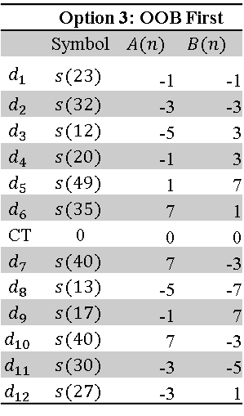
Example 3 - Prioritize OOB First
The following sequence with 64-QAM constellation minimizes the OOB emission by forcing the first sample of the output of IDFT to be zero (zeroth-order continuity)
 | Option 3: OOB First
 | Symbol | $$A(n)$$ | $$B(n)$$
$$d_{1}$$ | $$s(23)$$ | -1 | -1
$$d_{2}$$ | $$s(32)$$ | -3 | -3
$$d_{3}$$ | $$s(12)$$ | -5 | 3
$$d_{4}$$ | $$s(20)$$ | -1 | 3
$$d_{5}$$ | $$s(49)$$ | 1 | 7
$$d_{6}$$ | $$s(35)$$ | 7 | 1
CT | 0 | 0 | 0
$$d_{7}$$ | $$s(40)$$ | 7 | -3
$$d_{8}$$ | $$s(13)$$ | -5 | -7
$$d_{9}$$ | $$s(17)$$ | -1 | 7
$$d_{10}$$ | $$s(40)$$ | 7 | -3
$$d_{11}$$ | $$s(30)$$ | -3 | -5
$$d_{12}$$ | $$s(27)$$ | -3 | 1
Low
fluctuation
(1.6 dB PAPR)
Zeroth-order continuity
$$s\left(n\right)=α_{64QAM}×\left(A(n)+B(n)\sqrt{−1}\right)$$
$α_{64QAM}$ is the normalization factor for 64-QAM"
For the plot$\text{, }E\left[{\left|x_{n}\right|}^{2}\right]= 1 over 4μs @ f_{s}=20 MHz$
Leakage ratio = 1.75%

Slide 8
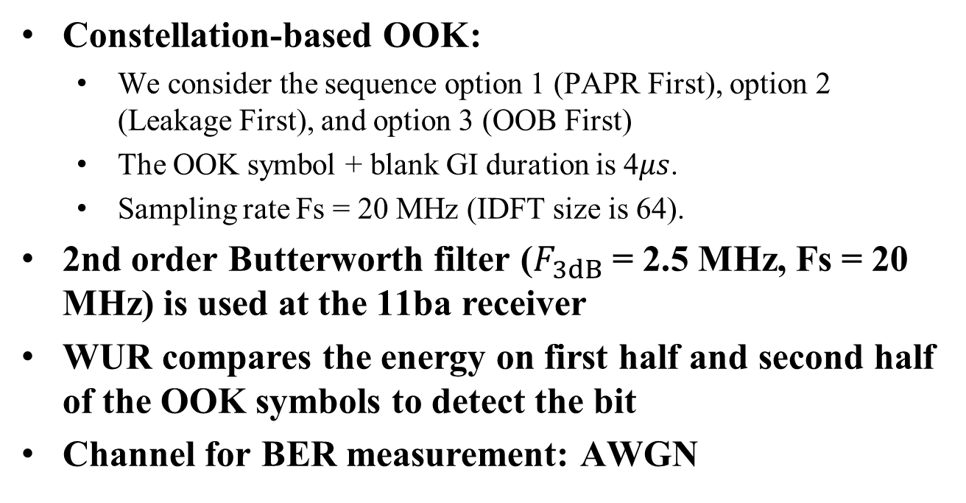
Simulation Assumptions
Constellation-based OOK:
  We consider the sequence option 1 (PAPR First), option 2 (Leakage First), and option 3 (OOB First)
  The OOK symbol + blank GI duration is 4$μs$.
  Sampling rate Fs = 20 MHz (IDFT size is 64).
2nd order Butterworth filter ($F_{3dB}$ = 2.5 MHz, Fs = 20 MHz) is used at the 11ba receiver
WUR compares the energy on first half and second half of the OOK symbols to detect the bit
Channel for BER measurement: AWGN

Slide 9
OOB Emission
While Option 3 (OOB first) significantly reduces the OOB emission, Option 1 (PAPR first) and Option 2 (Leakage first) still satisfy the 802.11ac SEM mask

Slide 10
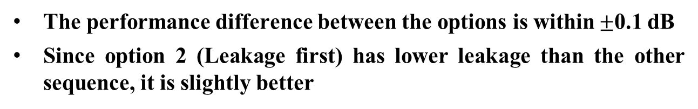
BER Performance
The performance difference between the options is within$±$0.1 dB
Since option 2 (Leakage first) has lower leakage than the other sequence, it is slightly better

Slide 11
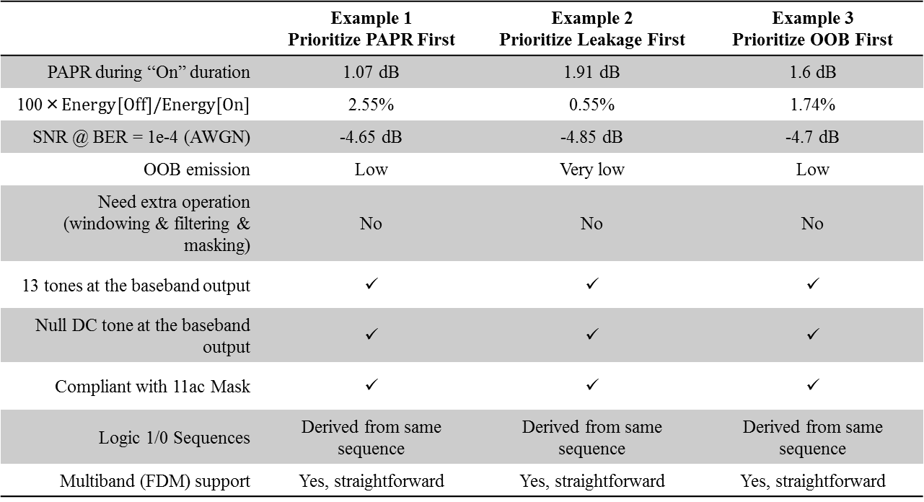
Summary
 | Example 1 Prioritize PAPR First | Example 2 Prioritize Leakage First | Example 3 Prioritize OOB First
PAPR during “On” duration | 1.07 dB | 1.91 dB | 1.6 dB
$$\text{100×}Energy[Off]/Energy[On]$$ | 2.55% | 0.55% | 1.74%
SNR @ BER = 1e-4 (AWGN) | -4.65 dB | -4.85 dB | -4.7 dB
OOB emission | Low | Very low | Low
Need extra operation (windowing & filtering & masking) | No | No | No
13 tones at the baseband output | ✓ | ✓ | ✓
Null DC tone at the baseband output | ✓ | ✓ | ✓
Compliant with 11ac Mask | ✓ | ✓ | ✓
Logic 1/0 Sequences | Derived from same sequence | Derived from same sequence | Derived from same sequence
Multiband (FDM) support | Yes, straightforward | Yes, straightforward | Yes, straightforward

Slide 12
Conclusions
In this contribution, we demonstrate that WFC OOK waveforms can be generated without extra operation in time by using 64-QAM sequences of length of 13 (with null center tone) in frequency
  This is aligned with the current agreement on 11ba OOK waveform
  It utilizes the existing 802.11n/ac IDFT and modulator (64-QAM)
  Supports FDM with straightforward extensions
We show that Logic 1 and Logic 0 OOK symbols can be generated from the same base sequence by changing the order of its elements
We provide three example sequences which prioritize PAPR (1.07 dB), or leakage, or OOB emission.
  All of the design options comply with the 802.11ac mask

Slide 13
References
[1] Leif Wilhelmsson, “Meeting Minutes July 2017,” IEEE 802.11-17/1197r1
[2] Alphan Sahin, Rui Yang, Xiaofei Wang, Hanqing Lou, Frank La Sita, “On the Coexistence of 802.11ax and 802.11ba Signals,” IEEE 802.11-17/0659r3
[3] Alphan Sahin, Rui Yang, Xiaofei Wang, “Performance Evaluation of OOK Waveform Coding Schemes with Impairments,” IEEE 802.11-17/1037r2
[4] Alphan Sahin, Rui Yang, Xiaofei Wang, “Waveform Coding Schemes for Frequency Domain Multiplexing,” IEEE 802.11-17/1419r0

Slide 14
SP
Do you agree that the constellation-based OOK waveform should be considered as a candidate waveform for the 802.11ba?
Y:
N:
A:

Slide 15
Appendix

Slide 16

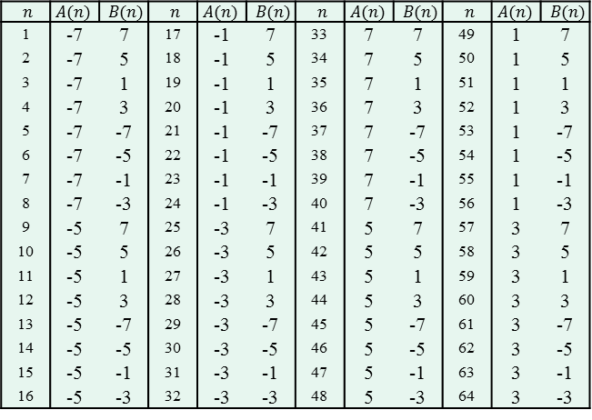
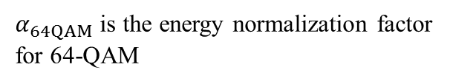
Index-to-Symbol Mapping for 64-QAM
$$s\left(n\right)=α_{64QAM}×\left(A(n)+B(n)\sqrt{−1}\right)$$
$α_{64QAM}$ is the energy normalization factor for 64-QAM
$n$ | $$A(n)$$ | $B(n)$ | $n$ | $$A(n)$$ | $B(n)$ | $n$ | $$A(n)$$ | $B(n)$ | $n$ | $$A(n)$$ | $B(n)$
1 | -7 | 7 | 17 | -1 | 7 | 33 | 7 | 7 | 49 | 1 | 7
2 | -7 | 5 | 18 | -1 | 5 | 34 | 7 | 5 | 50 | 1 | 5
3 | -7 | 1 | 19 | -1 | 1 | 35 | 7 | 1 | 51 | 1 | 1
4 | -7 | 3 | 20 | -1 | 3 | 36 | 7 | 3 | 52 | 1 | 3
5 | -7 | -7 | 21 | -1 | -7 | 37 | 7 | -7 | 53 | 1 | -7
6 | -7 | -5 | 22 | -1 | -5 | 38 | 7 | -5 | 54 | 1 | -5
7 | -7 | -1 | 23 | -1 | -1 | 39 | 7 | -1 | 55 | 1 | -1
8 | -7 | -3 | 24 | -1 | -3 | 40 | 7 | -3 | 56 | 1 | -3
9 | -5 | 7 | 25 | -3 | 7 | 41 | 5 | 7 | 57 | 3 | 7
10 | -5 | 5 | 26 | -3 | 5 | 42 | 5 | 5 | 58 | 3 | 5
11 | -5 | 1 | 27 | -3 | 1 | 43 | 5 | 1 | 59 | 3 | 1
12 | -5 | 3 | 28 | -3 | 3 | 44 | 5 | 3 | 60 | 3 | 3
13 | -5 | -7 | 29 | -3 | -7 | 45 | 5 | -7 | 61 | 3 | -7
14 | -5 | -5 | 30 | -3 | -5 | 46 | 5 | -5 | 62 | 3 | -5
15 | -5 | -1 | 31 | -3 | -1 | 47 | 5 | -1 | 63 | 3 | -1
16 | -5 | -3 | 32 | -3 | -3 | 48 | 5 | -3 | 64 | 3 | -3

Slide 17
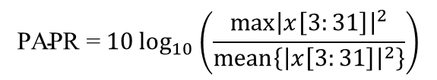
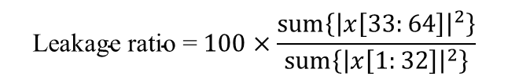
PAPR & Leakage Measurements
Inverse DFT output (64 point)
“On” duration
“Off” duration
PAPR measurement
Amplitude
…
…
1
2
3
4
31
32
33
64
time
Smooth transition to reduce OOB
$$\text{PAPR}\text{ =} 10\log_{10}\left(\frac{\max{{\left|x\left[3:31\right]\right|}^{2}}}{mean\left\{{\left|x\left[3:31\right]\right|}^{2}\right\}}\right)$$
$$\text{Leakage} \text{ratio}\text{ =} 100×\frac{sum\left\{{\left|x\left[33:64\right]\right|}^{2}\right\}}{sum\left\{{\left|x\left[1:32\right]\right|}^{2}\right\}}$$

