Slide 1
WUR Performance Studies With Blank GI
Date: 2017-11-06
Authors:

Slide 2
Abstract
In this presentation, the performance of Blank GI as proposed in [1-3] is studied
  It includes the real preamble acquisition and timing detection
    Using “Repeated PN sequences” proposed in 11-17/0997r0 [4]
    With simulation parameters as defined in 11-17/1442r1 [5]

Slide 3
Tx Setup
The legacy portion is inserted prior to the WUR packet for inclusion of false alarm in the final results
Packet length: 32 bits (assumption: 16-bit ID, 8-bit payload, 8-bit CRC)
WUR signal OOK pulse:
  BW = 4.06 MHz (13 tones including DC)
  13 L-STF coefficients
  Symbol period = 4 µsec (including 0.8 µsec GI)
20 µs
128 µs
Legacy
100 symbols of silence
Wake-up preamble
MAC header
Payload
FCS
0
15-bit PN seq.
15-bit PN seq.
0

Slide 4
Tx Waveform
Data: Manchester coding (MC)
  MC 250 kbps as defined in [1] for WFC I & III
    WFC I (Normal GI)
      Bit 1 → [1 0], i.e. 2 µsec on, 2 µsec off
      Bit 0 → [0 1], i.e. 2 µsec off, 2 µsec on
    WFC III (Blank GI)
    Generated by applying time-domain mask to 4.06 MHz OOK pulse
    Normalized pulses such that same energy in WFC I and III
  MC 1/4, 62.5 kbps
    Bit 1 → [1 0 1 0], i.e. 4 µsec on, 4 µsec off, 4 µsec on, 4 µsec off
    Bit 0 → [0 1 0 1], i.e. 4 µsec off, 4 µsec on, 4 µsec off, 4 µsec on
    4 µsec on period
      0.8 µsec CP, 3.2 µsec OOK pulse (Normal GI)
      0.8 µsec blank GI, 3.2 µsec OOK pulse (Blank GI)
    Two cases of Blank GI:
      (i) Only data and (ii) To both preamble and data portion
Blank
GI
ON
Blank
GI
OFF
Blank
GI
OFF
Blank
GI
ON
0us 0.8us 2.0us 2.8us 4us
0us 0.8us 2.0us 2.8us 4us
Information “1”
Information “0”

Slide 5
Rx Setup
The known preamble sequence is cross correlated (normalized output) with a sliding window of the received samples
  The first two peaks (using the repeated structure) are compared against two different fixed threshold and timing is obtained by examining the delta between two peaks
  False alarm is fixed at or about 1% (slight variations at different ACIs)
4 MHz LPF (IIR) – generated using MATLAB
  Numerator order=1, denominator order=1
  Passband freq. = 2MHz, Stopband freq.=6MHz, Sampling freq. =160MHz
WUR with in-phase only (single rx chain)
Channels: AWGN and Channel D
Without including phase noise model [6]
  no phase noise
2.4 GHz band operation
25MHz away ACI: 16 dB & 20 dB higher than the received signal
SNR is measured after the 4 MHz LPF and 4 MHz sampling

Slide 6
Rx Procedure
To isolate the impact of ISI, two different Rx procedures are considered at the receiver for both normal GI and blank GI:
  Use all samples
  Discard GI samples
For the case where blank GI is applied to both preamble and data
  The preamble acquisition is performed exactly the same

Slide 7
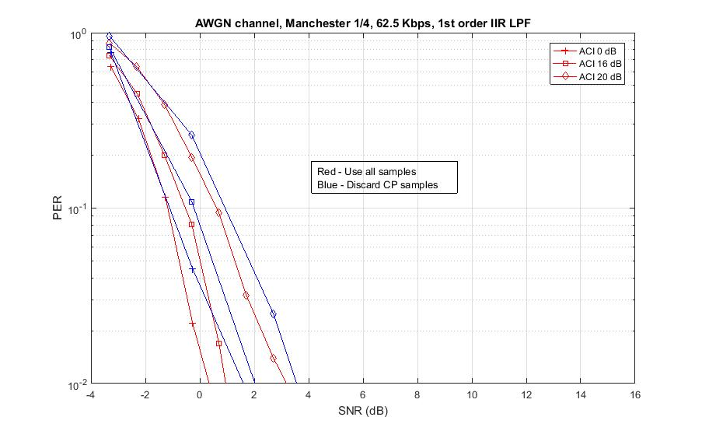
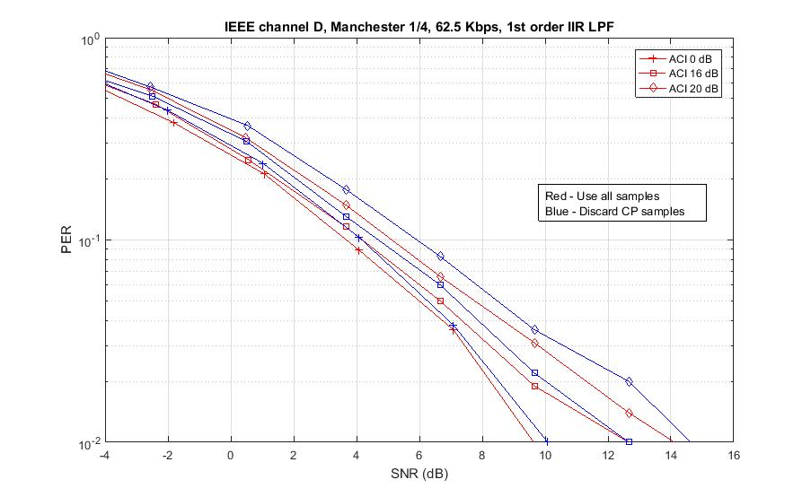
62.5 kbit/s PER - Normal GI Case
Using all Samples vs. discarding CP samples
Using all samples is better for data decoding
  Loss in signal energy by discarding the CP portion

Slide 8
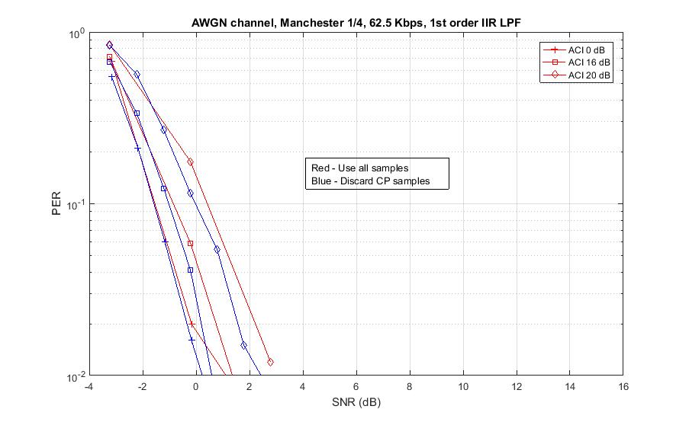
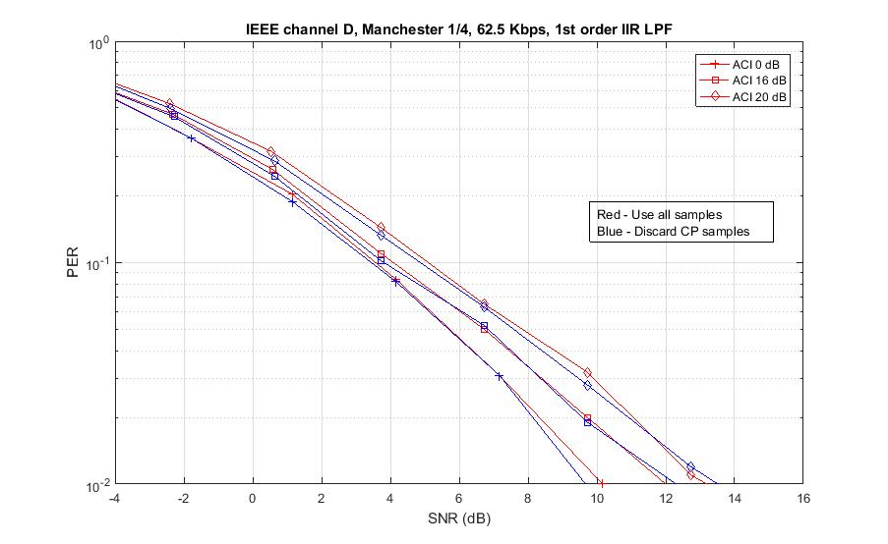
62.5 kbit/s PER - Blank GI Only For Data
Using all Samples vs. discarding CP samples
Discarding CP samples is better for data decoding (when ACI is present)
  Using all samples will result in accumulation of interference

Slide 9
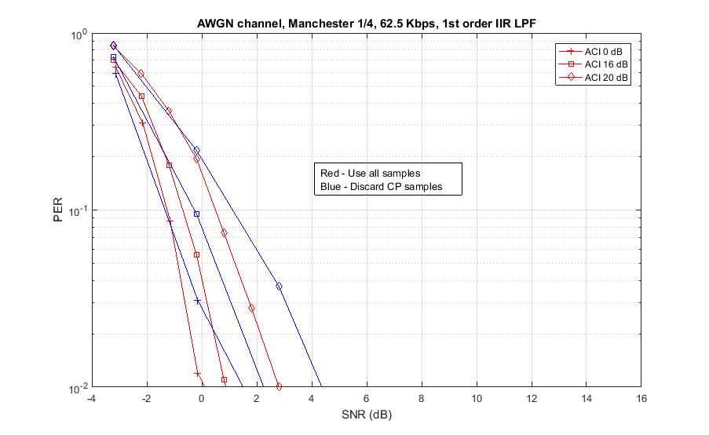
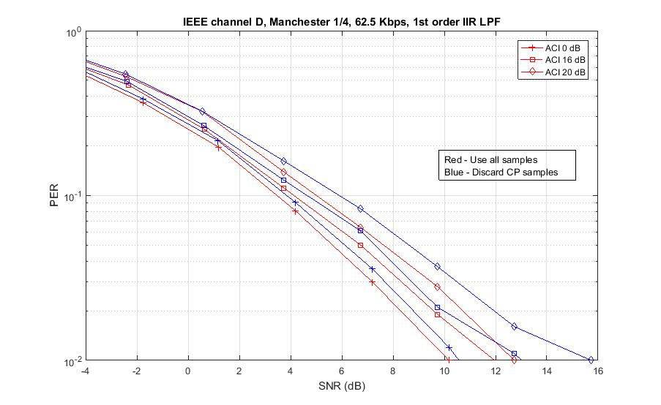
62.5 kbit/s PER – Use of Blank GI For Both Preamble and Data
Using all Samples vs. discarding CP samples
Using all samples is better for data decoding
  Timing uncertainty of GI samples
    Loss in signal energy by dropping the GI samples

Slide 10
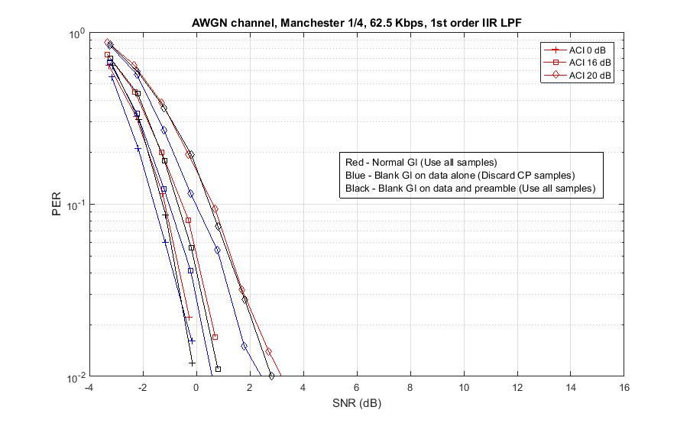
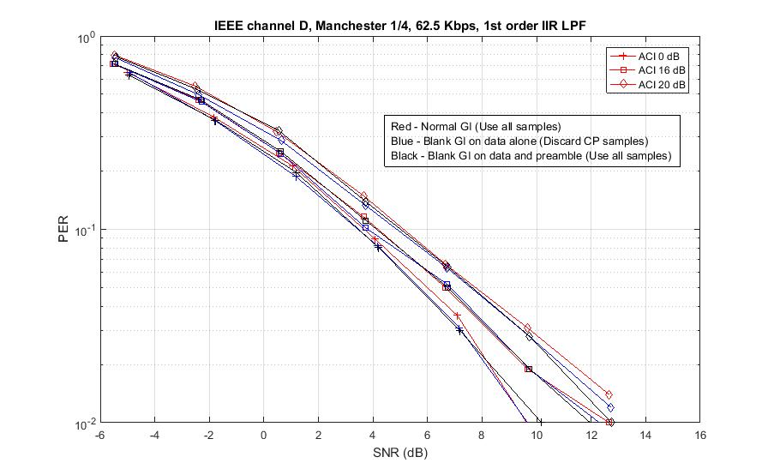
62.5 kbit/s PER – Normal GI vs. Blank GI
Decoder
  Using all Samples for Normal GI vs. discarding CP samples for blank GI
Performance
  No performance gains with blank GI in IEEE Channel D
  Marginal SNR gains (<0.4 dB) in AWGN with Blank GI

Slide 11
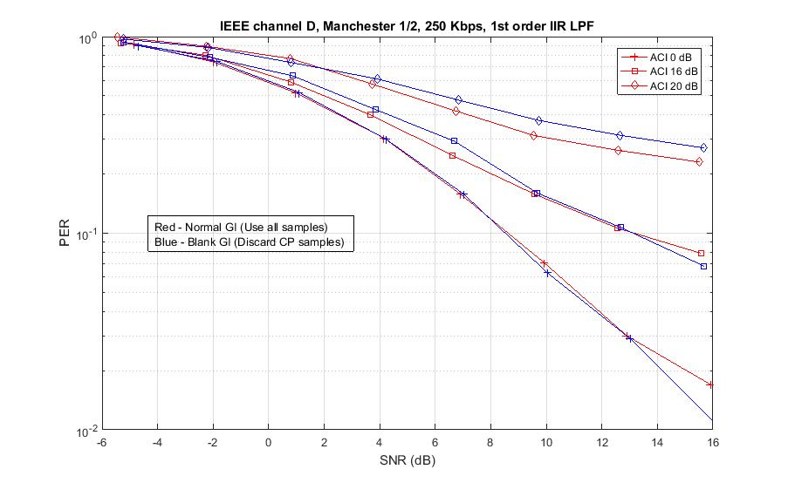
250 kbit/s PER – Normal GI vs. Blank GI
Decoder
  Using all Samples for Normal GI vs. discarding CP samples for blank GI
Performance
  No performance gains with blank GI in IEEE Channel D

Slide 12
Observations: Blank GI and ISI
In case of normal GI, accumulating energy during the GI portion provides performance gain
  This is true even in case of Channel D because the impact of the delay spread is negligible
Blank GI should not be applied to the preamble portion
  Timing uncertainty by GI samples
When Blank GI is only applied to the data portion, there is no considerable gain in Channel D because the main performance degradation is caused by timing errors and the removal of CP does not have much impact
  Obviously in AWGN, blank GI just have noise, and therefore removal of CP samples reduces the noise level

Slide 13
Summary and Conclusions
The blank GI does not provide considerable gain when real acquisition and timing is considered. Therefore we propose not to adopt it.
Not recommended to have blank GI on the preamble

Slide 14
References
[1] Junghoon Suh, et.al., “Blank GI choices under Timing Errors,” IEEE 802.11-17/1390r1
[2] Junghoon Suh, et.al., “ Blank GI for the Waveform Coding ,” IEEE 802.11-17/0696r0
[3] Eunsung Park , et.al., “ Symbol Structure,” IEEE 802.11-17/1347r3
[4] Shahrnaz Azizi, et. al., “Preamble Options,” IEEE 11-17/0997r0
[5] Shahrnaz Azizi, et. al., “WUR Preamble Performance Study With Phase Noise and ACI,” IEEE 802.11-17/1442r1
[6] Minyoung Park, et. al., “ WUR Phase Noise Model – Follow Up,” IEEE 11-17/326r0

