Slide 1
Discussion on OOK Pulse Design for Higher Rate
Date: 2017-11-06
Authors:

Slide 2
WUR packet structure
24us
Data
Legacy+WUR Mark
Wake-up preamble
MAC header
Payload
FCS
Data
Low rate (62.5 Kbps) –Manchester code
‘1’ – 4us on, 4us off, 4us on, 4us off
‘0’ – 4us off, 4us on, 4us off, 4us on
Standard 4 us OOK pulse in the on period (4 MHz BW)
High rate (250 Kbps) – Manchester code
‘1’ – 2us on, 2us off
‘0’ – 2us off, 2us on
Need to design shorter (2us) OOK pulse

Slide 3
2us OOK Pulse Design Options: Time-Masking
Time-Masking approach
Applying time-mask to 4us OOK pulse as suggested in [1-2]
Use either first or second half of the 4us pulse
Issues:
Distortion in the spectrum of the pulse
Spillage beyond the 4 MHz bandwidth
Different error rates for symb ‘0’ and ‘1’
Different pulse shapes during the ON period
0us 2.0us 4us
0us 2.0us 4us
Information “1”
Information “0”

Slide 4
2us OOK pulse design options: FFT based
FFT based approach
Increase the subcarrier spacing to 625 KHz
32 pt. FFT in 20 MHz Bandwidth
WUR pulse occupying the center 7 subcarriers (including DC)
Can choose subcarrier weights to be subset of the 13 L-STF coefficients
Example: S=1.436*[-1-1i -1-1i 1+1i 0 -1-1i -1-1i 1+1i]
They can be optimized further

Slide 5
Simulation parameters (Transmitter)
24 µs
Legacy+WUR mark
Wake-up preamble
MAC header
Payload
FCS
High rate transmissions
Preamble
Repetition of 15-bit PN seq
Just for study (to be consistent with our earlier low rate results)
Preamble design for high rate under investigation
Bit duration: 4 us
Standard 4 MHz, 4 us OOK pulse (0.8 us CP)
13 L-STF coefficients
Data
Manchester code, Bit duration: 2 us
4 MHz, 2 us OOK pulse
Time masking Vs FFT approach

Slide 6
Simulation parameters (Receiver)
The known 64 us preamble sequence is cross correlated (normalized output) with a sliding window of the received samples and detect two peaks
4 MHz LPF (IIR) – generated using MATLAB
Numerator order=1, denominator order=1
Passband freq. = 2MHz, Stopband freq.=6MHz, Sampling freq. =160MHz
WUR with in-phase only (single rx chain)
Channels: AWGN and Channel D
No phase noise
2.4 GHz band operation
25 MHz away ACI: 16 dB higher than the received signal
SNR is measured after the 4 MHz LPF and 4 MHz sampling

Slide 7
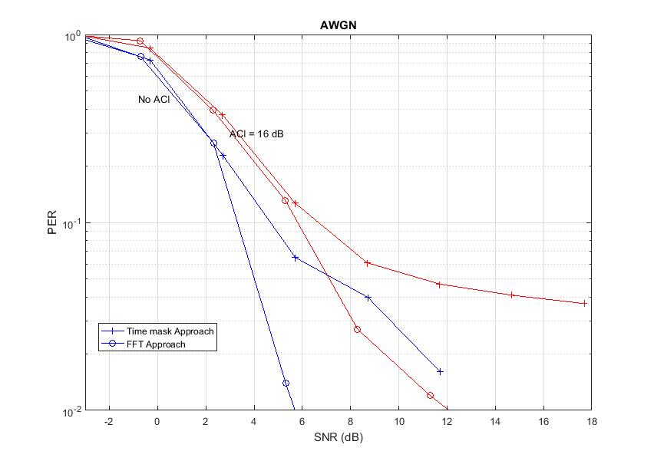
Performance with timing acquisition
Smaller FFT approach gives better performance than time making approach
2-3 dB performance gap

Slide 8
Summary
Discussed two approaches for 2us OOK pulse generation
Time making
FFT approach with increased subcarrier spacing
With timing acquisition, FFT based approach performs better by 2-3 dB

Slide 9
References
[1] Junghoon Suh, et.al., “Blank GI choices under Timing Errors,” IEEE 802.11-17/1390r1
[2] Junghoon Suh, et.al., “ Blank GI for the Waveform Coding ,” IEEE 802.11-17/0696r0

Slide 10
Backup

Slide 11
Timing Errors
Similar errors as in Low rate case

Slide 12
WUR Pulse Shapes
Pulse generated from smaller FFT size
Energy more concentrated at the center and less at the edges
Relatively poor OOK decoding performance
More robust to small timing errors

