Slide 1
Discussion on Preamble Sequences For Indication of the WUR Rates
Date: 2017-11-06
Authors:

Slide 2
Introduction
In this presentation, options of WUR Preamble to support different data rates are discussed
Considering the discussions in [1-4] and the results of straw polls during the IEEE meeting, the following two cases are discussed to provide two different preamble durations for the rate indication
  Use of one and two 15-bit PN and/or complement of the 15-bit PN sequences
  Shorter OOK symbol duration of 2usec (option 5 in backup slides)

Slide 3
Proposal 1: Use of 4usec Bit Duration Sequence S
Use S = 15-bit Maximal Length PN sequence for higher rate, and signal the lower rate by including two repetitions of S.
  The bit 0 is added to make it 16 bits, which gives equal number of ones and zeroes
24 µs
Legacy + WUR Mark
Wake-up preamble
MAC header
Payload
FCS
Low Rate
0
15-bit PN seq.
0
15-bit PN seq.
128 µs
64 µs
Higher Rate
0
15-bit PN seq.

Slide 4
Rate Detection at The Receiver
Earlier proposal [1-2]
  Correlate with 32-bit (128 us) sequence (see backup slides)
    Low rate transmission: 3 peaks, with strong center peak
    High rate transmission: 2 peaks, with similar strength
  The Discussion with other members during the September session and offline indicated that finding 3 peaks and identifying the strongest one appear to be complex to them. Therefore:
Current proposal
  Use 16-bit (64 us) correlator
    Low rate transmission: 2 peaks, separated by PN seq length
    High rate transmission: single peak
  Advantages
      Lower complexity compared to single long (128 us) correlator by exploiting the structure
      Lower overhead for higher rate

Slide 5
Detection Method for the Common Sequence
Case: lower Rate
Correlating with the known sequence results in two peaks:
The two peaks roughly separated by PN seq length
0
15-bit PN seq.
Other received samples
Received samples prior to the preamble
no peak
0
15-bit PN seq.
0
15-bit PN seq.
Other received samples
Received samples prior to the preamble
0
15-bit PN seq.
0
15-bit PN seq.
1st Peak
Other received samples
0
Received samples prior to the preamble
2nd Peak
0
15-bit PN seq.
15-bit PN seq.
Other received samples
Received samples prior to the preamble
0
15-bit PN seq.
15-bit PN seq.
0
no Peak

Slide 6
Detection Method for the Common Sequence Case: Higher Rate
Correlating with the known sequence results in one peaks:
0
15-bit PN seq.
Other received samples
Received samples prior to the preamble
no peak
0
15-bit PN seq.
Other received samples
Received samples prior to the preamble
0
15-bit PN seq.
1st Peak
Other received samples
Received samples prior to the preamble
No Peak
0
15-bit PN seq.

Slide 7

Proposal 2: 4usec bit-duration S and Its Complement
Use sequence S = 15-bit Maximal Length PN sequence.
Signal higher rate using $\overline{S}$; Signal the lower rate by including concatenating S and S
    $\overline{S}$ is the bit-wise logical complement of $S$
24 µs
Legacy + WUR Mark
Wake-up preamble
MAC header
Payload
FCS
Low Rate
S
S
128 µs
64 µs
Higher Rate
S Complement

Slide 8
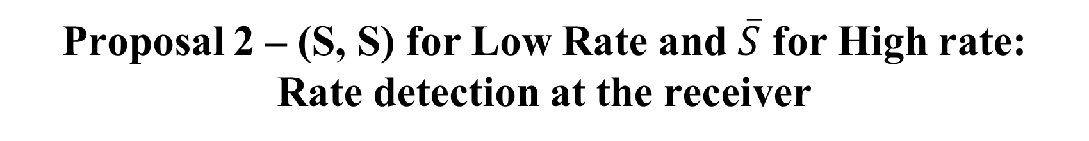
Proposal 2 – (S, S) for Low Rate and $\overline{S}$ for High rate:
Rate detection at the receiver
Correlate with short sequence
    Low rate transmission: Two positive peaks, separated by PN seq length
    High rate transmission: one negative peak
Advantages
    Easy to differentiate the two rates compared to proposal 1
    Similar to proposal 1: Lower complexity compared to single long (128 us) correlator
    Similar to proposal 1: Lower overhead for higher rate

Slide 9
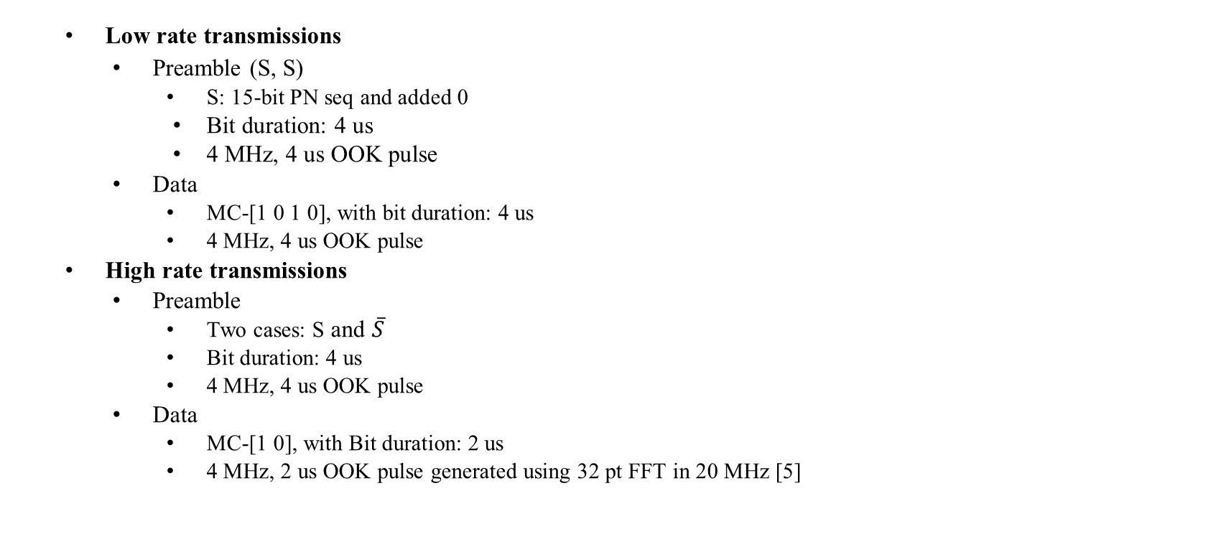
Simulation parameters (Transmitter)
20MHz Bandwidth (legacy)
100 symbols of silence
Wake-up preamble
MAC header
Payload
FCS
  Low rate transmissions
    Preamble (S, S)
      S: 15-bit PN seq and added 0
      Bit duration: 4 us
      4 MHz, 4 us OOK pulse
    Data
      MC-[1 0 1 0], with bit duration: 4 us
      4 MHz, 4 us OOK pulse
  High rate transmissions
    Preamble
      Two cases: S and $\overline{S}$
      Bit duration: 4 us
      4 MHz, 4 us OOK pulse
    Data
      MC-[1 0], with Bit duration: 2 us
      4 MHz, 2 us OOK pulse generated using 32 pt FFT in 20 MHz [5]

Slide 10
Simulation parameters (Receiver)
The known S sequence is cross correlated (normalized output) with a sliding window of the received samples
  Low rate: Two positive peaks, spaced apart by PN seq length
  High rate: Single peak (positive or negative)
4 MHz LPF (IIR) – generated using MATLAB
  Numerator order=1, denominator order=1
  Passband freq. = 2MHz, Stopband freq.=6MHz, Sampling freq. =160MHz
WUR with in-phase only (single rx chain)
Channels: AWGN and Channel D
No phase noise
2.4 GHz band operation
25 MHz away ACI: 16 dB higher than the received signal
SNR is measured at 20 MHz bandwidth
Performance quantified with respect to Genie approaches

Slide 11
Genie Approaches
Genie with ideal rate and timing
  Genie knows incoming rate and the precise Timing
  Best possible performance
  Non-realistic, but acts like a baseline
Genie with ideal rate
  Genie only knows if packet is low/high rate, but not the timing
  Timing acquisition
    Low rate transmission: Considered several approaches and picked the best
      Correlating with 128 us sequence and comparing strongest peak to threshold
      Correlating with 128 us sequence and looking for three peaks (strong center peak)
      Later approach gave better PER performance
    High rate transmission
      Correlating with 64 us sequence and comparing strongest peak to threshold was good

Slide 12
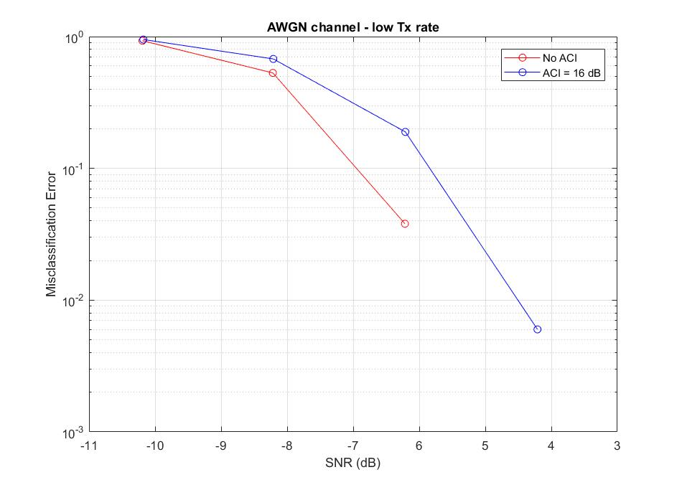
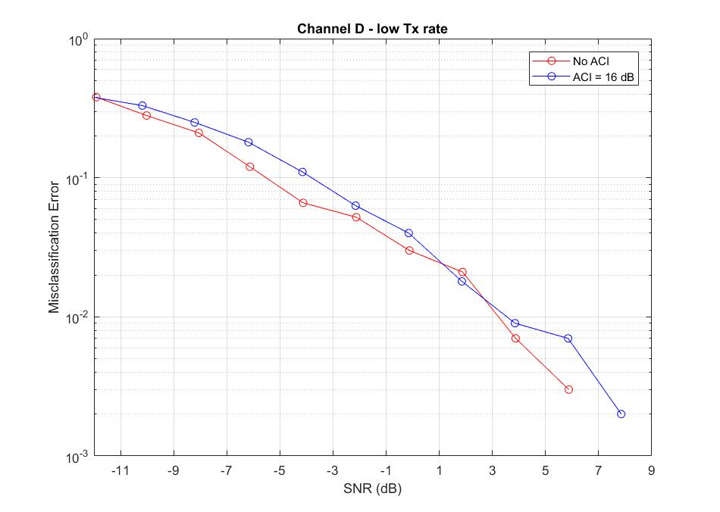
Miss Classification of Low Rate (S, S) as High Rate (S)
(Proposal 1)
16 bit correlator better than 32 bit correlator, as expected

Slide 13
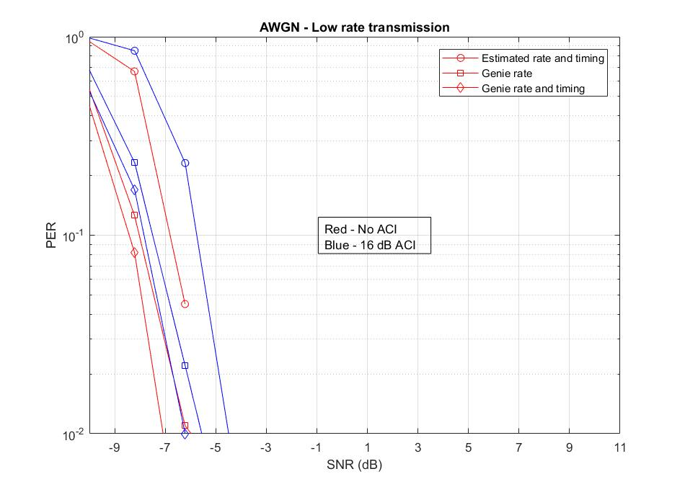
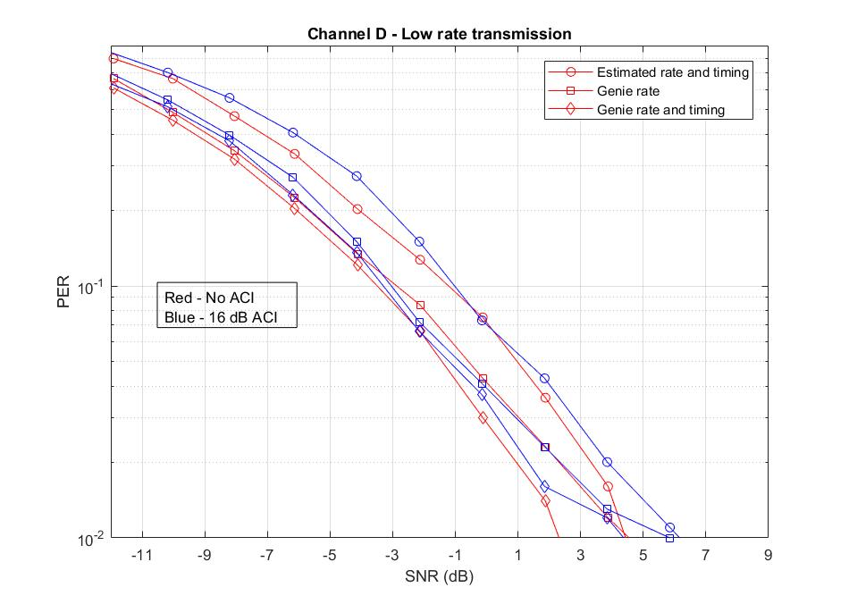
PER- Low Rate (S, S) Transmission (Proposal 1)
1.5 dB performance gap compared to genie Rate case
2 dB performance gap compared to genie Rate and Timing

Slide 14
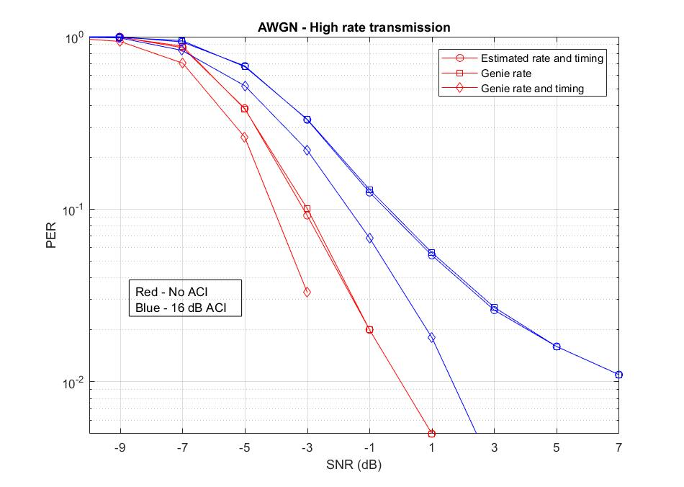
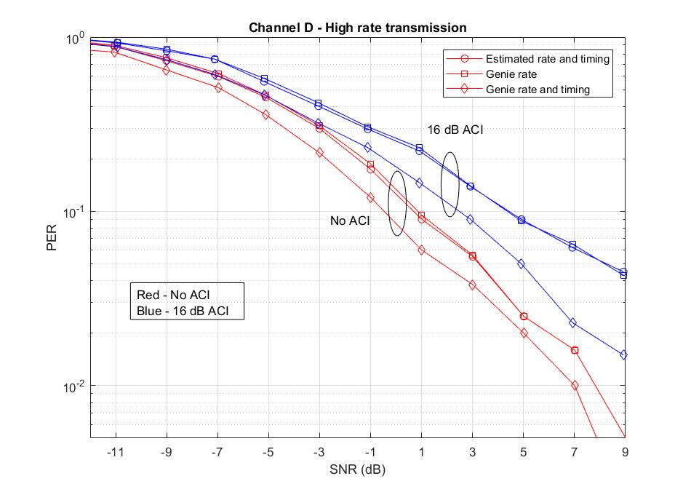
PER- High Rate S Transmission (Proposal 1)
64 us correlator is as good as the genie rate case (No performance gap)
1-2 dB dB performance gap compared to genie Rate and Timing

Slide 15
Conclusions of proposal 1: S and (S, S)
Repeated PN sequence with 16-bit (64 us) correlator is suited to differentiate two rates
  1 dB Performance gap compared to genie rate case
    No performance gap for high rate transmissions
    Performance gap of 1 dB for low rate transmissions
  2 dB Performance gap compared to genie rate and timing
    Performance gap of 2 dB for high rate transmissions
    Performance gap of 1 dB for low rate transmissions

Slide 16
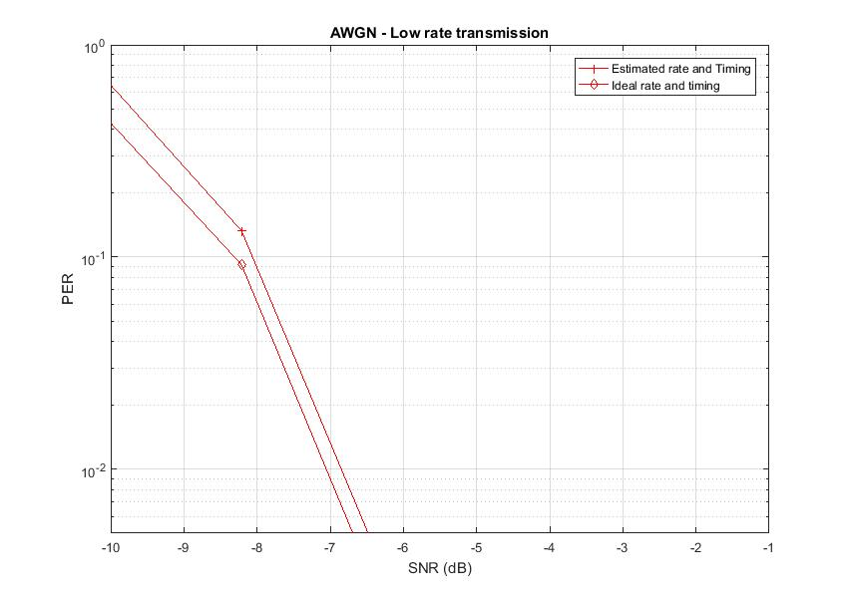
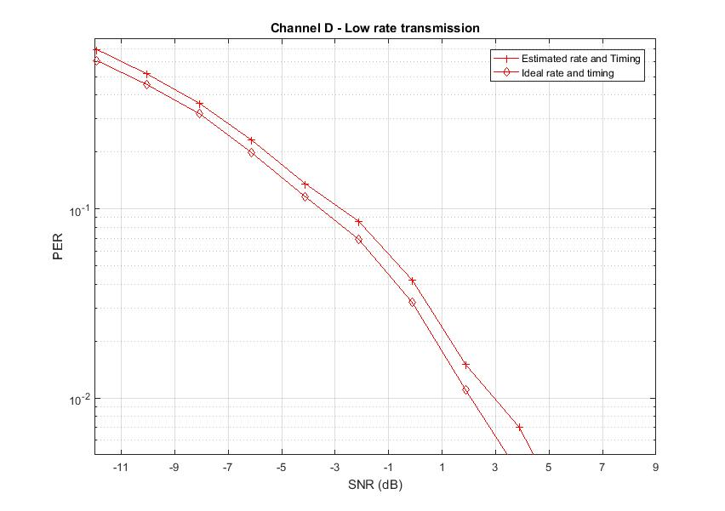
PER- Low Rate (S, S) Transmission (Proposal 2)
Performance relative to genie Rate and Timing
  0.3 dB loss in AWGN and 0.6 dB loss in Channel D
Misclassification error is very small

Slide 17
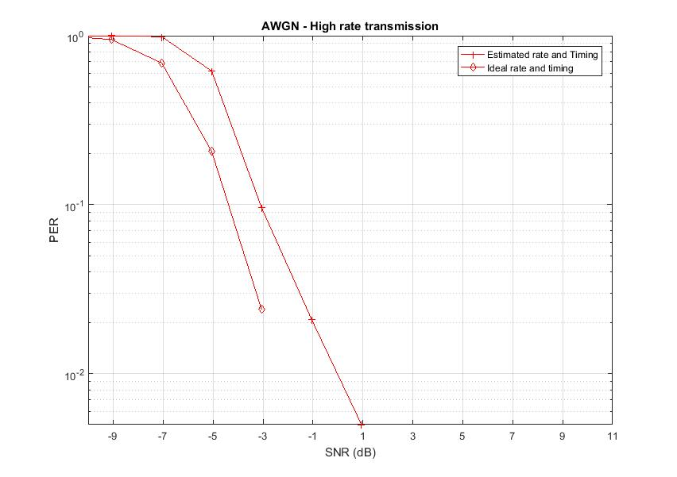
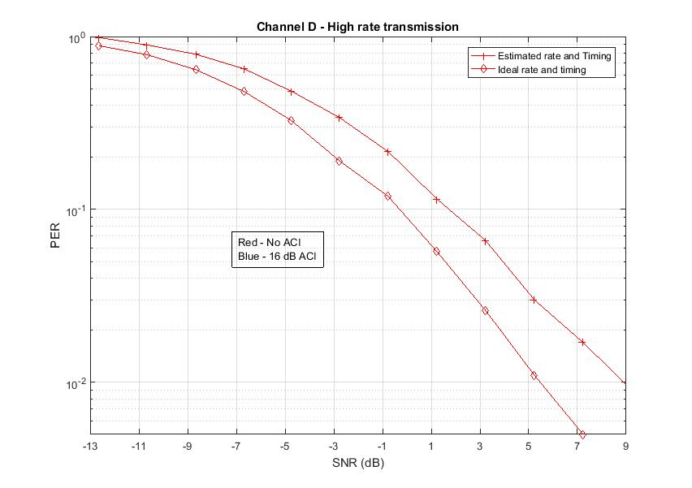

PER- High Rate $\overline{S}$ Transmission
(S, S) is used for Lower Rate (Proposal 2)
Performance relative to genie Rate and Timing
  1.3 dB loss in AWGN and 2 dB loss in Channel D
Misclassification error is very small

Slide 18

Conclusions of proposal 2: $\overline{S}$ and (S, S)
  Use of complement sequence reduces misclassification rate
  Small misclassification errors
  0.3-0.6 dB loss compared to ideal timing and rate (low rate)
  1.3-2 dB loss compared to ideal timing and rate (high rate)

Slide 19
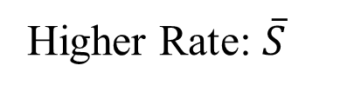
Option 3: Single 31-bit sequence
24 µs
Legacy+WUR mark
Wake-up preamble
MAC header
Payload
FCS
Low Rate: S
0
31-bit PN seq.
128 µs
Higher Rate: $\overline{S}$
1
31-bit PN seq Complement.
128 µs

Slide 20
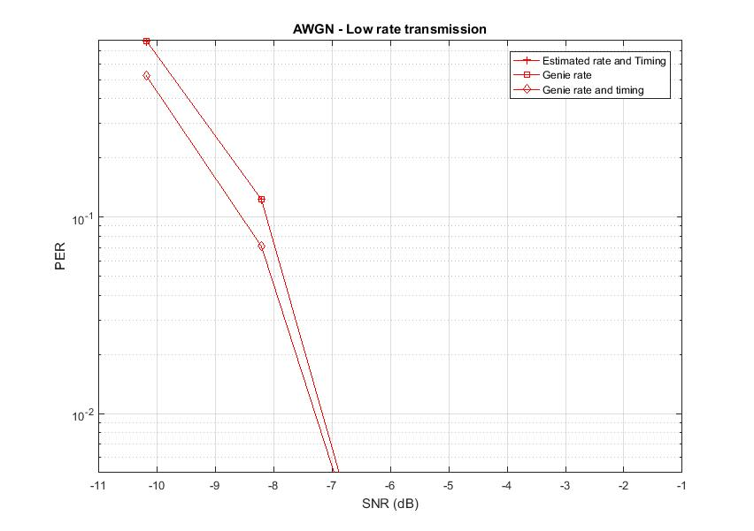
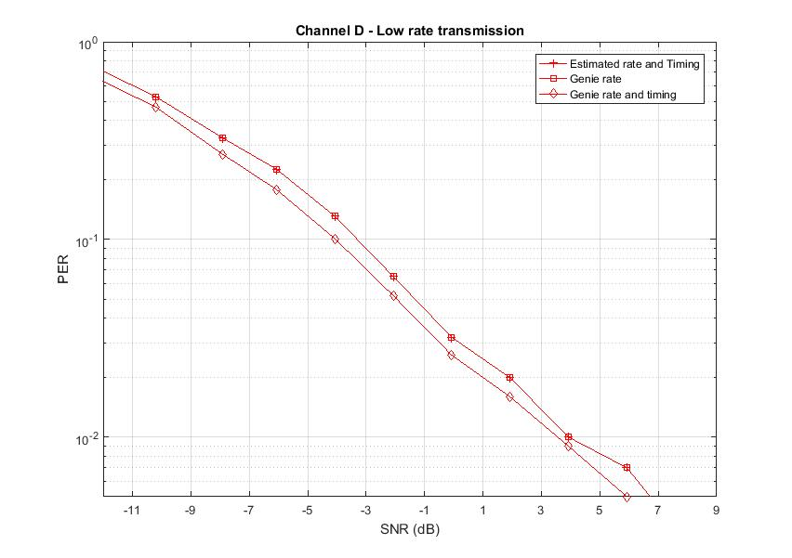
PER- Low Rate 31-bit PN Sequence Transmission
Performance relative to genie Rate and Timing
  0.4 dB loss in AWGN and 0.8 dB loss in Channel D

Slide 21
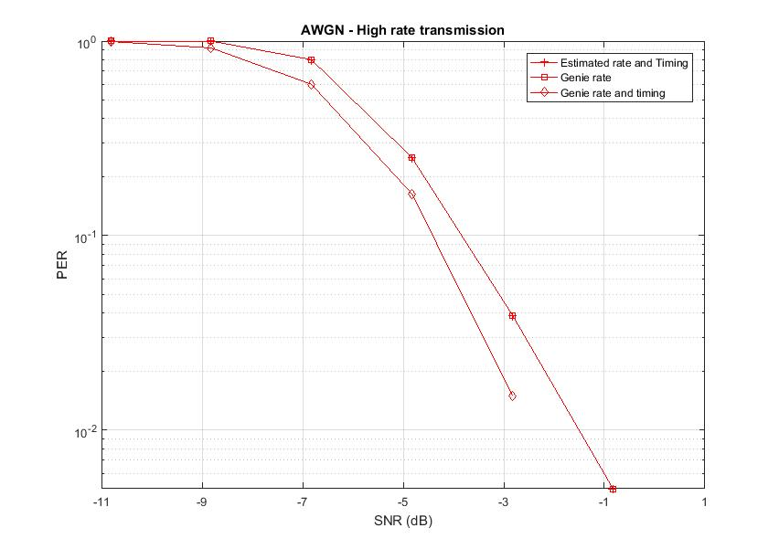
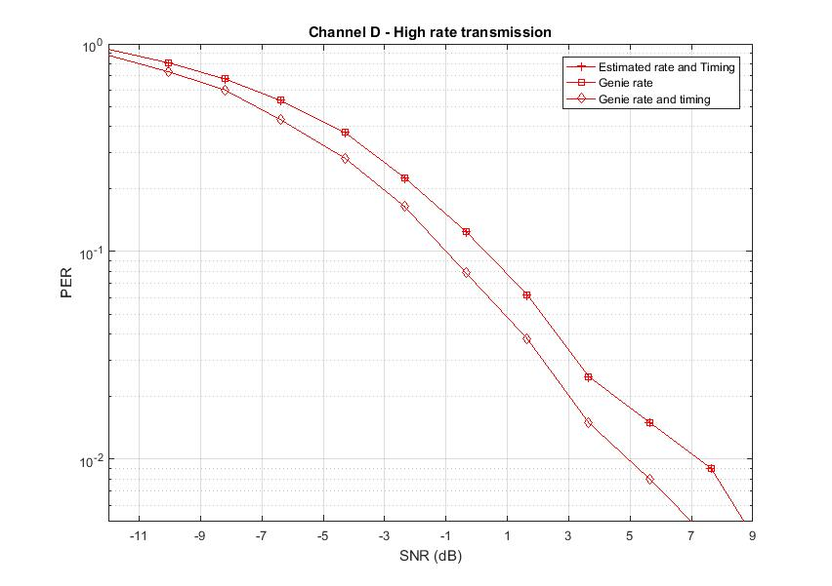
PER- High Rate: Complement of 31-bit of Low Rate
Performance relative to genie Rate and Timing
  0.6 dB loss in AWGN and 1.3 dB loss in Channel D

Slide 22
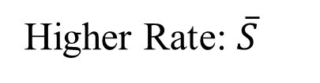
Option 4: Single 15-bit sequence
24 µs
Legacy+WUR mark
Wake-up preamble
MAC header
Payload
FCS
Low Rate: S
0
15-bit PN seq.
64 µs
Higher Rate: $\overline{S}$
1
15-bit PN seq Complement.
64 µs

Slide 23
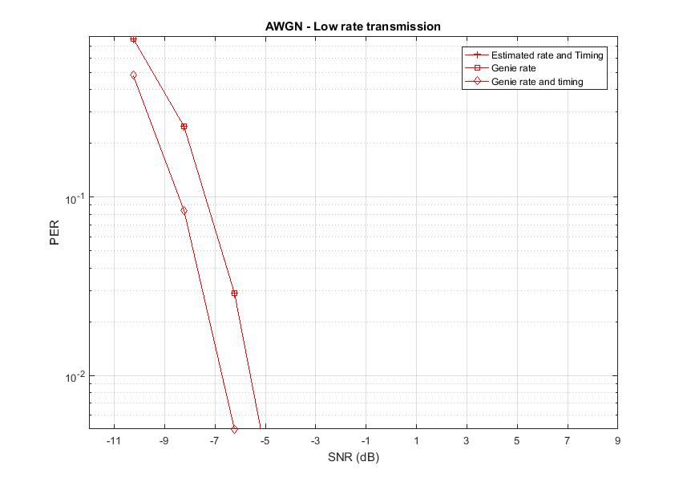
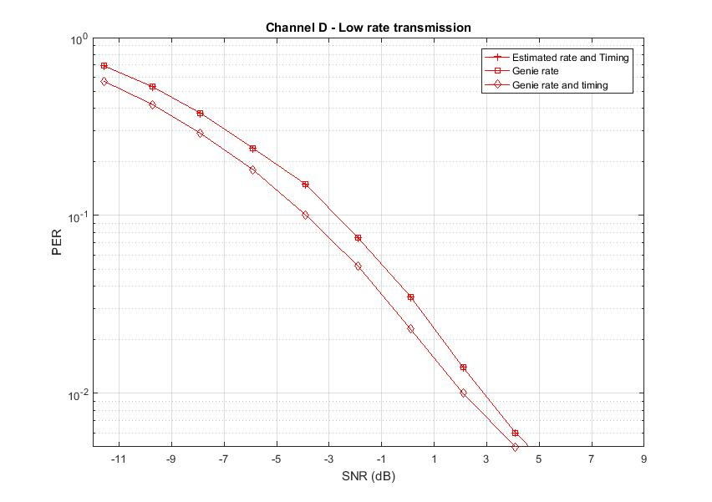
PER- Low Rate 15-bit PN Sequence Transmission
Performance relative to genie Rate and Timing
  1 dB loss in AWGN and 1.2 dB loss in Channel D

Slide 24
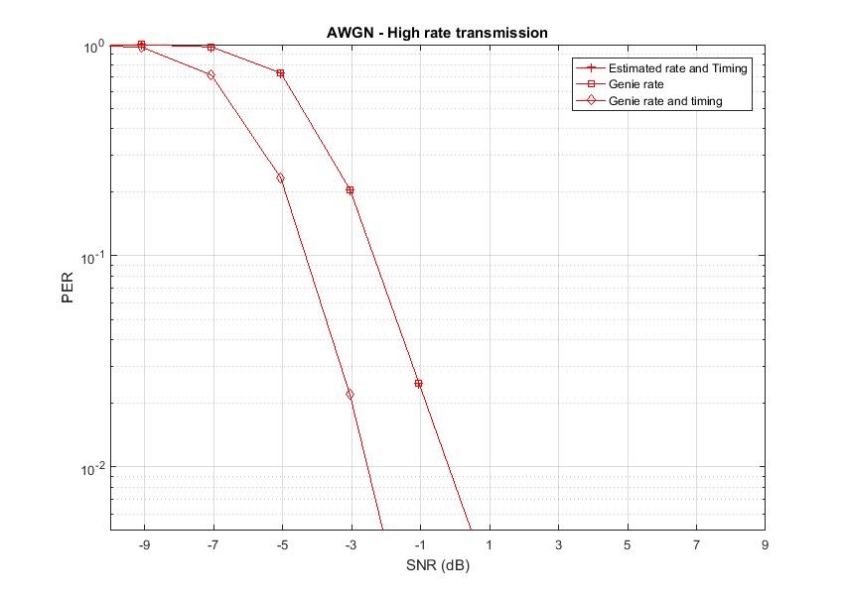
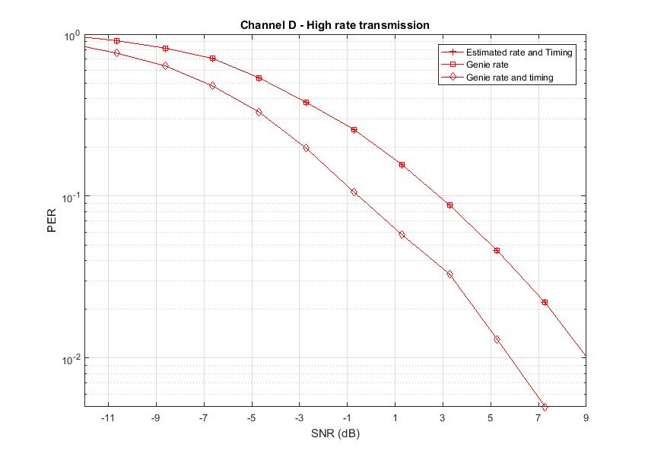
PER- High Rate: Complement of 15-bit of Low Rate
Performance relative to genie Rate and Timing
  2 dB loss in AWGN and 4 dB loss in Channel D
  64 us preamble not sufficient for high rate scenario

Slide 25
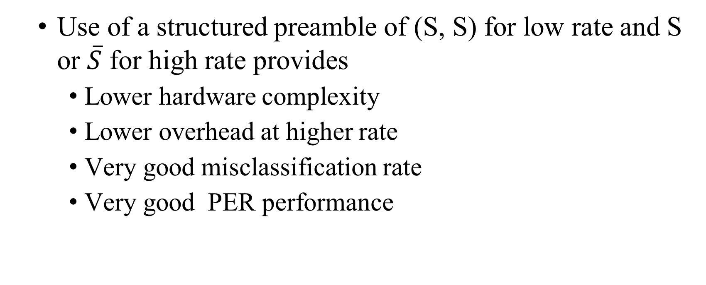
Conclusions
  Use of a structured preamble of (S, S) for low rate and S or $\overline{S}$ for high rate provides
    Lower hardware complexity
    Lower overhead at higher rate
    Very good misclassification rate
    Very good PER performance

Slide 26
References
[1] 17/0997r0 Preamble Options, IEEE 802.11 TGba, July 2017
[2] 17/1442r0 WUR Preamble Performance Study with
Phase Noise and ACI, IEEE 802.11 TGba, September 2017
[3] 17/1355r1 WUR Preamble Evaluation, IEEE 802.11 TGba, September 2017
[4] 17/1345r5 11ba PHY Frame Format Proposal, IEEE 802.11 TGba, September 2017
[5] 17/1615r0 OOK waveform generation for high data rate, IEEE 802.11 TGba, November 2017

Slide 27
Backup

Slide 28
Detection Method for the Common Sequence Case: lower Rate
Correlating with the known 32-bit sequence results in three peaks:
0
15-bit PN seq.
0
15-bit PN seq.
Other received samples
Received samples prior to the preamble
no peak
0
15-bit PN seq.
0
15-bit PN seq.
Other received samples
Received samples prior to the preamble
0
15-bit PN seq.
0
15-bit PN seq.
1st Peak
Other received samples
0
Received samples prior to the preamble
the 2nd larger Peak
0
15-bit PN seq.
15-bit PN seq.
Other received samples
Received samples prior to the preamble
0
15-bit PN seq.
15-bit PN seq.
0
3rd Peak

Slide 29
Detection Method for the Common Sequence
Case: Higher Rate
Correlating with the known sequence results in three peaks:
0
15-bit PN seq.
0
15-bit PN seq.
Other received samples
Received samples prior to the preamble
no peak
0
15-bit PN seq.
Other received samples
Received samples prior to the preamble
0
15-bit PN seq.
1st Peak
Other received samples
Received samples prior to the preamble
2nd Peak (same size)
0
15-bit PN seq.
Other received samples
15-bit PN seq.
0
Received samples prior to the preamble
no peak

Slide 30
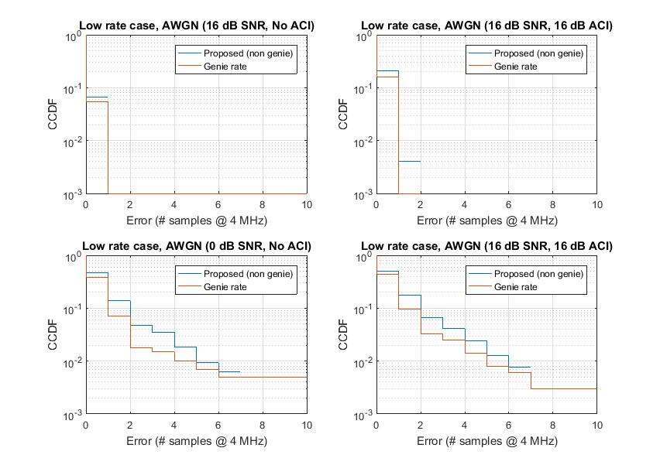
Timing Error for Low Rate (S, S) Transmission– AWGN
SNR
Genie rate has better timing
Timing error less than 8 samples (2 us), > 99% of times
ACI

Slide 31
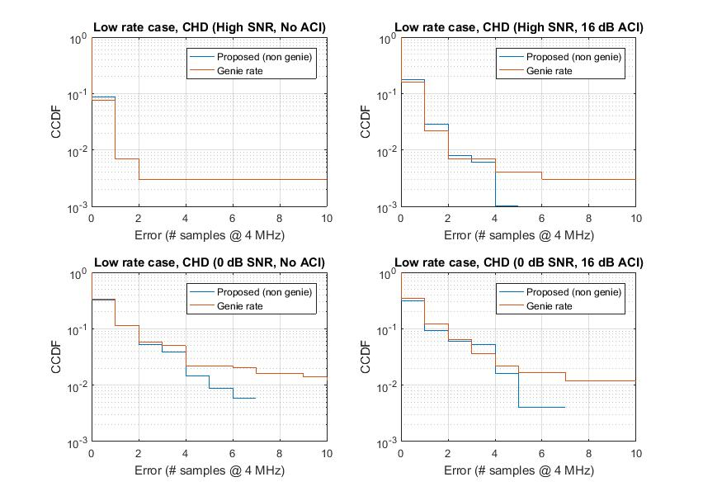
Timing Error for Low Rate (S, S) Transmission– Channel D
SNR
Genie rate has better timing
Timing error less than 8 samples (2 us), > 98% of times
ACI

Slide 32
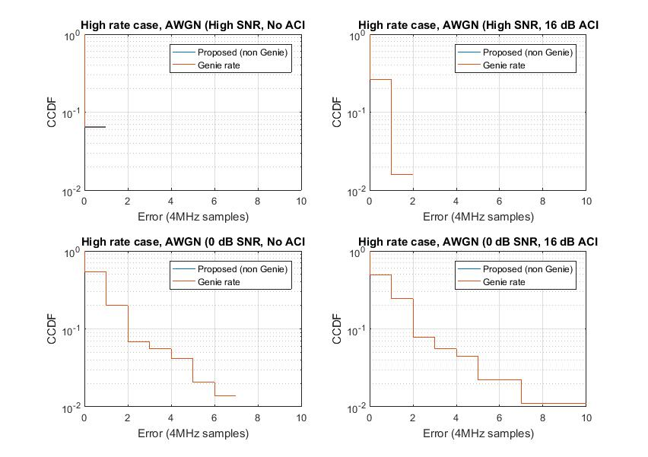
Proposal 1: Timing Error for High Rate S – AWGN
Genie and 16-bit correlator has similar timing
Timing error less than 8 samples (2 us), > 98% of times

Slide 33
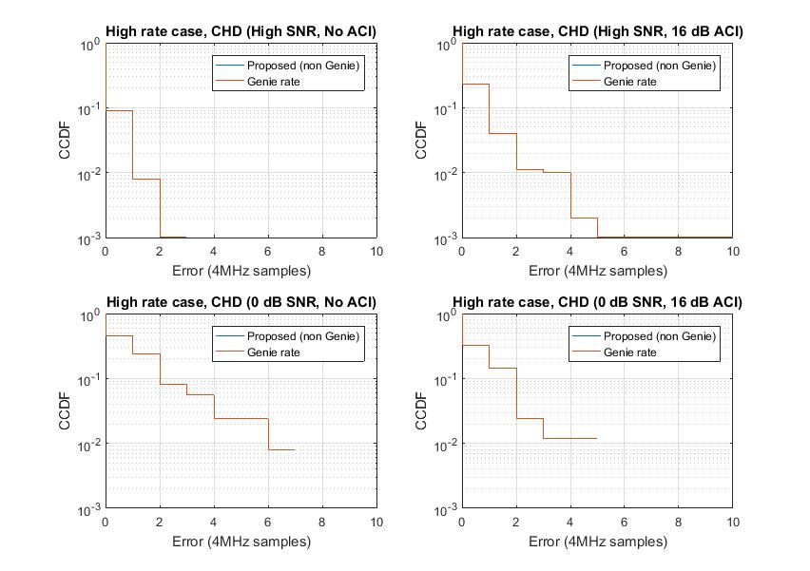
Proposal 1: Timing Error for High Rate S – Channel D
Genie and 16-bit correlator has similar timing
Timing error less than 8 samples (2 us), > 98% of times

Slide 34
Option 5: Preamble Sequence with Shorter OOK Symbol Duration
Use the same sequence, signal the lower rate by including two repetitions
20 µs
Legacy
Wake-up preamble
MAC header
Payload
FCS
Low Rate: 128 usec Preamble
0
15-bit PN seq.
0
15-bit PN seq.
4 us
4 us
High Rate: 64 usec Preamble
0
15-bit PN seq.
0
15-bit PN seq.
2 us
2 us

Slide 35
Rate and Timing estimate (Option 5)
Two correlators matched to two preamble sequences
  32 bit (128 us) correlator
  32 bit (64 us) correlator
Rate estimation
  Find the maximum correlation peak at the output of two correlators
  Whichever is higher, we declare it as corresponding rate
Timing estimation
  If max correlation > threshold
    Sync found
    Timing = idx corresponding to the max correlation

Slide 36
Simulation parameters (Option 5)
Transmitter
  Low rate transmissions
    Preamble
      Repetition of 15-bit PN seq
      Bit duration: 4 us
      Standard 4 MHz, 4 us OOK pulse
    Data
      Manchester [1 0 1 0], Bit duration: 4 us
      Standard 4 MHz, 4 us OOK pulse
  High rate transmissions
    Preamble
      Repetition of 15-bit PN seq
      Bit duration: 2 us
      4 MHz, 2 us OOK pulse generated using 32 pt FFT in 20 MHz
    Data
      Manchester [1 0], Bit duration: 2 us
      4 MHz, 2 us OOK pulse generated using 32 pt FFT in 20 MHz
Receiver
  First order analog 4 MHz LPF
  ACI (pre-filter): 16 dB at 25 MHz spacing
  SNR measured at 20 MHz Bandwidth

Slide 37
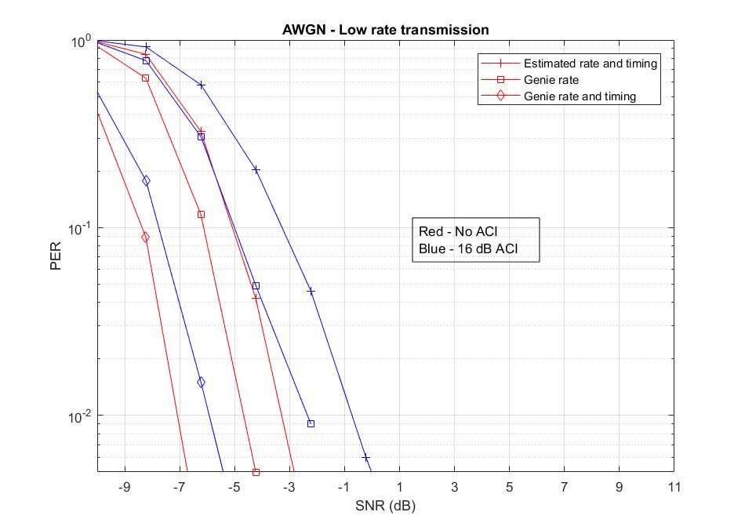
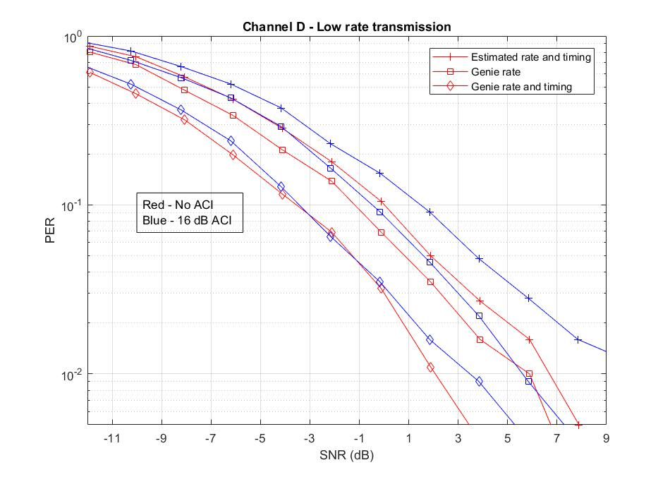
PER (Low rate transmissions)
3-4 dB performance gap from the genie rate and timing
  2 us bit duration for preamble did not work well

