Slide 1
WUR Synchronization
Date: 2017-11-05
Authors:
Name | Company | Address | Phone | Email
Lei Huang | Panasonic Corporation |  |  | lei.huang@sg.panasonic.com
Rojan Chitrakar
Yoshio Urabe

Slide 2
Background
WUR Beacon frame can be transmitted periodically to WURs for synchronization.
  WUR Beacon interval,T_{WBI}, is configurable (e.g., 1s, 2s, 4s, 6s, etc).
    T_{WBI} is included in WUR Mode element.
  WUR beacon frame comprises a Partial TSF field.
    The size of the Partial TSF field is fixed (e.g., 12 bits)
  WUR beacon frame may only use the low data rate 62.5 kbps.
The transmission time required for a WUR Beacon frame is about 1ms.
  Airtime occupied by WUR Beacon transmission is not trivial
  It is critical to minimize WUR Beacon transmission.
WUR PPDU containing WUR Beacon frame

Slide 3
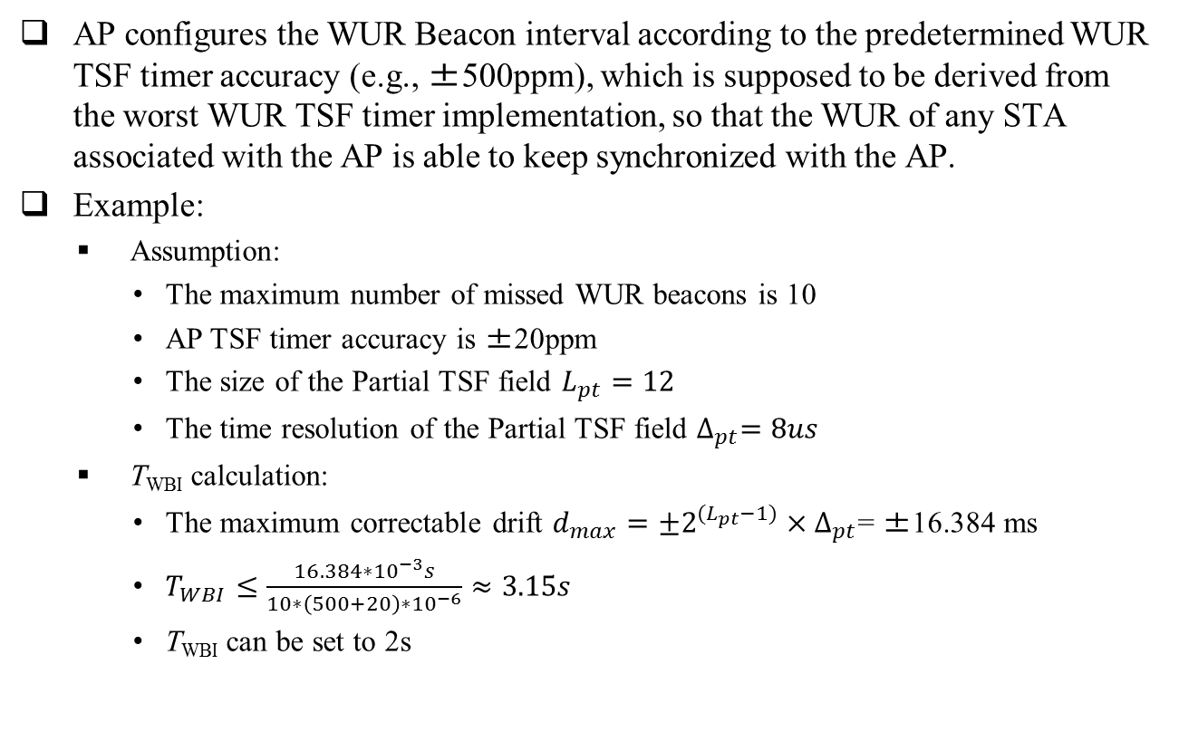
Approach for Configuring WUR Beacon interval
AP configures the WUR Beacon interval according to the predetermined WUR TSF timer accuracy (e.g., ±500ppm), which is supposed to be derived from the worst WUR TSF timer implementation, so that the WUR of any STA associated with the AP is able to keep synchronized with the AP.
Example:
  Assumption:
    The maximum number of missed WUR beacons is 10
    AP TSF timer accuracy is ±20ppm
    The size of the Partial TSF field $L_{pt}=12$
    The time resolution of the Partial TSF field $∆_{pt}=8us$
  T_{WBI} calculation:
    The maximum correctable drift $d_{max}={±2}^{{(L}_{pt}−1)}×∆_{pt}$= ±16.384 ms
    $T_{WBI}≤\frac{16.384∗{10}^{−3}s}{10∗\left(500+20\right)∗{10}^{−6}}≈3.15s$
    T_{WBI} can be set to 2s

Slide 4
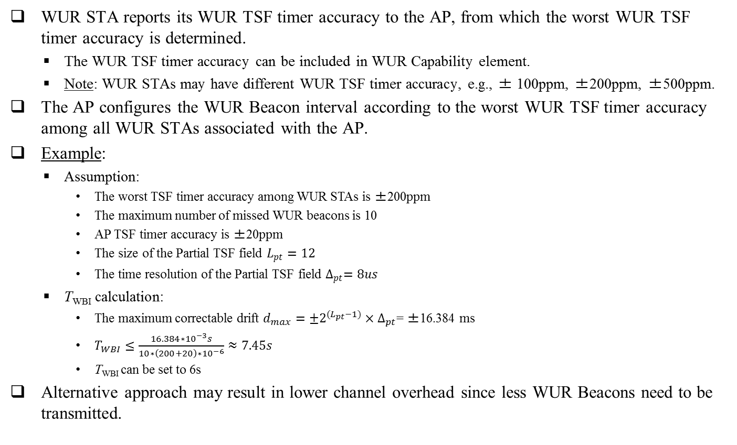
Alternative Approach for Configuring WUR Beacon interval
WUR STA reports its WUR TSF timer accuracy to the AP, from which the worst WUR TSF timer accuracy is determined.
  The WUR TSF timer accuracy can be included in WUR Capability element.
  Note: WUR STAs may have different WUR TSF timer accuracy, e.g., ± 100ppm, ±200ppm, ±500ppm.
  The AP configures the WUR Beacon interval according to the worst WUR TSF timer accuracy among all WUR STAs associated with the AP.
Example:
  Assumption:
    The worst TSF timer accuracy among WUR STAs is ±200ppm
    The maximum number of missed WUR beacons is 10
    AP TSF timer accuracy is ±20ppm
    The size of the Partial TSF field $L_{pt}=12$
    The time resolution of the Partial TSF field $∆_{pt}=8us$
  T_{WBI} calculation:
    The maximum correctable drift $d_{max}={±2}^{{(L}_{pt}−1)}×∆_{pt}$= ±16.384 ms
    $T_{WBI}≤\frac{16.384∗{10}^{−3}s}{10∗\left(200+20\right)∗{10}^{−6}}≈7.45s$
    T_{WBI} can be set to 6s
  Alternative approach may result in lower channel overhead since less WUR Beacons need to be transmitted.

Slide 5
Summary
Approaches for configuring the WUR Beacon interval by the AP are addressed.
It is recommended that the WUR Beacon interval is configured by the AP according to the reported WUR TSF timer accuracy among all WUR STAs associated with the AP.

Slide 6
Reference
11-17-0575-05-00ba-spec-framework

Slide 7
SP
Do you support adding the following to 11ba SFD?
  WUR STA shall report its WUR TSF timer accuracy to the AP.

