Slide 1
1st Vice Chair Report –
November 2017 – Orlando, Florida
Date: 2017-11-10
Authors:

Slide 2
Abstract
Agenda Items for 1st Vice Chair -
M3.3 II Other WG meeting plans
M3.4 II Meeting room locations
M3.5 II Next meeting reminder
M3.6 II Meeting registration
M3.7 II Recording attendance
M3.8 II File server
M3.9 II Breakfast, breaks, Social logistics
Friday:
  F3.1.1 II Straw Poll of membership regarding this meeting location
  F3.1.2 DT Future venues status and discussion

Slide 3
Monday–
802.11 Opening Plenary
802.11 First Vice Chair Report

Slide 4
M3.3 Other WG meeting plans
802.1 802.3
802.11 802.15 802.16 802.18 802.19 802.21 802.24
802.22
Treasurer Report: 11-17/1540r0
Patent policy (in IEEE-SA bylaws), patent policy (slide set), and antitrust guidelines

Slide 5
M3.4 Meeting room locations
Download the Combined Meeting Schedule
MEETING MAP (FLOOR PLAN)
Accessed online:
http://802world.org/plenary/files/2015/03/Caribe-Royale-Floor-Plan.pdf

Slide 6
Online Calendar Schedule
The WG meetings can also be added to your calendar.
Go to : http://schedule.802world.com
Select Calendar Integration:
http://schedule.802world.com/ics/directory
This application exports meetings in .ics format, which can be subscribed to from your favorite calendar application.
802.11 WG meeting calendar is here: http://schedule.802world.com/ics/show?group=11
Other WGs and the 802 EC calendar are also available.
Note: the schedule on this calendar will be updated as will IMAT.

Slide 7
M3.5 Next meeting reminder
802W Interim: January 14-19, 2018, Hotel Irvine, Irvine, CA, USA
Event Information
Registration
Hotel room reservation
REGISTRATION FEES & DEADLINES :
  Early Registration
    $US 650.00 for attendees staying three or more nights at the Hotel Irvine
    $US 950.00 for all others (including local attendees not staying at the group hotel)
  Deadline: 6:00 PM Pacific Time, Friday, December 8, 2017
  IEEE 802 GROUP HOTEL US$179.00 per Night (Single/Double)
  IEEE 802 GROUP RATE DEADLINE Friday December 15, 2017, 5:00 PM Pacific Time
802 Plenary: 4-9 March 2018 –
Hyatt Regency O'Hare, Rosemont, Illinois, USA
Notes:
Report version R0 and R1 had an error on the date of Early-Bird Registration Deadline – 19 May is correct.

Slide 8
M3.6 II Meeting registration
Total Registrations as of Monday AM: 706 Reported Primary WG:
802.1 | 69 | 10%
802.3 | 283 | 40%
802.11 | 272 | 39%
802.15 | 43 | 6%
802.16 | 1 | 0%
802.18 | 6 | 1%
802.19 | 4 | 1%
802.21 | 5 | 1%
802.22 | 6 | 1%
802.24 | 2 | 0%
Unknown | 15 | 2%

Slide 9
M3.7 Recording attendance
It is a requirement that attendees record their participation at an 802.11 session and declare their affiliation. This record is usually made using the IMAT attendance system.
  If you wish to participate without recording attendance, send an email per session to the WG 2nd vice chair declaring your participation and affiliation. You cannot gain or maintain 802.11 voting membership using this method.
You must record 75% attendance of required 802.11 slots in a session for that session to count towards gaining or maintaining 802.11 voting membership
  You need a single IEEE-SA web account
    The IEEE SA web account requires a working email address
    do not remove your email address from the account
  Use the email address associated with that web account when registering attendance
    If you change email addresses, update the web account, don’t create a new web account, or your membership status may not be calculated properly
  Record attendance using this URL: IMAT.IEEE.ORG/

Slide 10
M3.8 Local File Document Server information
Attendance Links 802.1 802.3 802.11 802.15 802.16 802.18 802.19 802.20 802.21 802.22 802.23 802.24 | Working Group Documents (Local Document Server) 802.11 802.15 802.16 802.18 802.19 802.21 802.22 802.23 802.24 Omniran 802 Whitespace SG 802 Executive Committee For FTP access, please use ftp://griffin.meeting.verilan.com Please DO NOT synchronize your documents directly with Mentor!

Slide 11
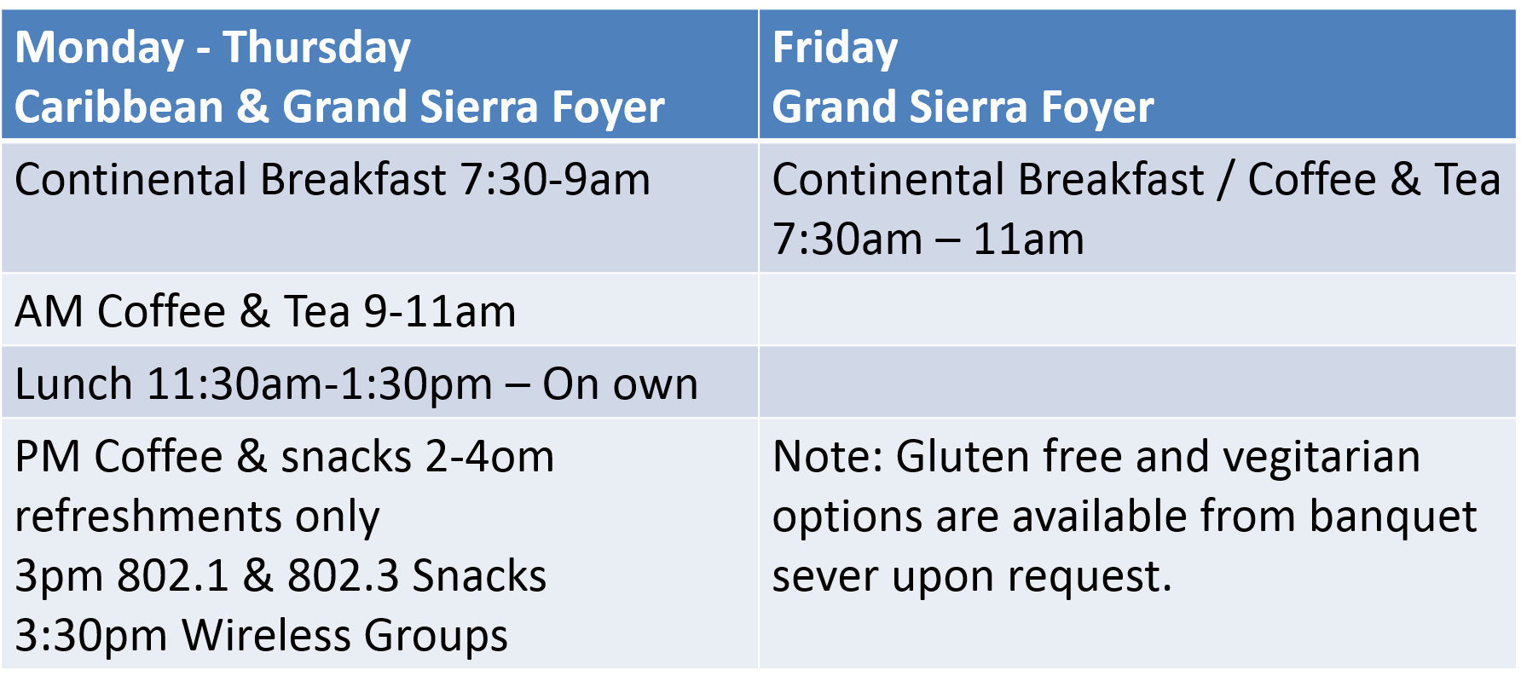
M3.09 FOOD & BEVERAGE

Slide 12
Network Assistance
WIRED CAFÉ
    Please report any disruption of service in the café to VeriLAN staff.
NETWORK HELP DESK
    Network Help is available for attendees experiencing difficulties accessing the meeting network.
Located in the near the Registration Desk

Slide 13

10.

Slide 14
802.11 Mid-Week Plenary
Agenda Items:
2.5 – Announcements
5.1 – Room Change Reports

Slide 15
W5.1 Room Change Requests
Delete:
  TGax - Wed PM2 and Thursday PM2
Add:
  TGba - Wed Pm2
  TGaq - Thurs AM1 15 people -- (if you cannot assign a room, we could use TGak if they finish early if no other option)
  TGaz - Thursday AM2 (45 people) ----- (if you cannot get a room we will try to share with PAR with a delayed start.)
Swap Room request: -- Change room assignments:
  Wed PM1 Coex <-> TGmd
  Wed PM2 TGaz<-> TGmd
  Thurs PM1 Coex <-> TGmd
  Thurs PM2 Move TGaz -> Seirra E

Slide 16
802.11 WG Closing Plenary
Agenda Items:
3.1.1 – Straw Poll
3.1.2 -- Future venues status and discussion

Slide 17
F3.1.1 -Straw Poll regarding this meeting location
Straw Poll:
How many people would like to come back to this venue?
Yes - 20
No – 12
Like the Social – 25
Disliked the Social – 2
Did not go to Social – 8

Slide 18
F3.1.2: Future Venue Insight
Future 802 Wireless Interims:
  Jan 2018 Hotel Irvine, Irvine, CA, USA
  May 2018 Marriott Warsaw, Poland
  Sept 2018 Hilton Waikoloa Village, Kona, HI, USA

Slide 19
F3.1.2: Future Venue Insight
Future 802 Plenary Sessions:
  March 4-9, 2018 Hyatt Regency O'Hare, Rosemont, Illinois, USA
  July 8-13, 2018 Manchester Grand Hyatt, San Diego, CA, USA
  November 11-16, 2018 Marriott Marquis Queen's Park, Bangkok, Thailand
  March 10-15, 2019 Hyatt Regency Vancouver and Fairmont Hotel Vancouver, Vancouver, Canada
  July 14-19,2019 Austria Congress Centre, Vienna, Austria
  November 10-15, 2019 Hilton Waikoloa Village, Kona, HI, USA

Slide 20
References
Plenary Meeting Status File: EC-16/66r1
https://mentor.ieee.org/802-ec/dcn/16/ec-16-0066-00-00EC-802-plenary-future-venue-contract-status.xlsx
802 Executive Secretary Report: EC-17/0198r4
https://mentor.ieee.org/802-ec/dcn/17/ec-17-0198-04-00EC-executive-secretary-agenda-items-nov-2017-plenary.pptx

