Slide 1
Discussion on detection schemes and thresholds
Date: 2017-09-12
Authors:
Name | Company | Phone | email
Shubhodeep Adhikari | Broadcom | +91 98805 42405 | shubhodeep.adhikari@broadcom.com
Sindhu Verma | Broadcom | +91 98809 91288 | sindhu.verma@broadcom.com
David Boldy | Broadcom |  | david.boldy@broadcom.com
Vinko Erceg | Broadcom | +1 858 208 6982 | vinko.erceg@broadcom.com

Slide 2
Abstract
This presentation was presented in ETSI: BRAN(17)000085
A comparison of the two detection schemes, ED-only @ -72dBm and ED @ -62dBm and PD @ -82dBm.
The adverse impact on 802.11ax if it were to use ED @ -72dBm.

Slide 3
Concerns regarding an ED-only detection threshold at -72dBm
ED = -72dBm is not an incidental value. It exists because it was shown by simulations, primarily in 3GPP, that by using ED = -72dBm LAA is fair to Wi-Fi which uses ED = -62 dBm and PD = -82dBm.
So, ED = -72dBm may not be fair if Wi-Fi uses lower thresholds. This is pertinent because many Wi-Fi deployments use PD below -82dBm in order to protect links below -82dBm.
ED = -72dBm has been evaluated only by simulations and not yet in field tests or deployments.
3GPP simulations on the fairness of ED = -72dBm did not adequately model Wi-Fi networks since they assumed very low % of links below -72dBm whereas Wi-Fi networks can have 20% to 80% links below -72dBm.
Even with a very low % of links below -72dBm, some simulations in 3GPP showed that ED = -72dBm is not sufficient to protect Wi-Fi voice and that ED = -77dBm is required instead.
However, due to the pressure to complete LAA standardization within deadline, ED = -72dBm was agreed as a compromise.

Slide 4
The adverse impact on 802.11ax with ED @ -72dBm
Let us consider the most probable network configuration after the introduction of 11ax. Such a network would contain legacy Wi-Fi, 11ax and LAA.
LAA will defer to all nodes whether LAA or Wi-Fi at -72dBm.
Legacy Wi-Fi will defer to Wi-Fi nodes mostly at -82dBm (or lower as discussed earlier) and LAA at -62dBm.
However, consider 11ax: In order to ensure backward compatibility and to also adhere to Wi-Fi standards, it has to defer to all own-BSS Wi-Fi (legacy or 11ax) at -82dBm or lower. Additionally, it has to obey an ED threshold at -72dBm. This means,
11ax will use the same PD threshold as legacy Wi-Fi but use a lower ED threshold than legacy Wi-Fi. Hence, in the presence of legacy Wi-Fi, 11ax will get a lower proportion of channel access.
11ax will use the same ED threshold as LAA, but additionally use a lower PD threshold to defer to at least own-BSS 11ax and legacy Wi-Fi. However, LAA will use the same higher ED threshold for all other nodes. Hence, in the presence of LAA, 11ax will get a lower proportion of channel access.

Slide 5
Advantages of the Wi-Fi scheme with a higher ED and a dynamically adjustable PD
The ED threshold @ -62dBm is a much higher value that is used as a fallback if a device is not able to detect preambles from another Wi-Fi device.
The PD threshold is varied dynamically based on policy:
Lower than -82dBm in order to protect weaker links, often below -92dBm till the point a device can decode another devices’ preamble.
Higher than -82dBm to enable spatial reuse if the corresponding increase in parallel transmission is estimated not to harm the network.
This dual threshold mechanism has been found to be efficient and fair in the numerous Wi-Fi deployments over many years.
On the contrary, the above dynamic behavior cannot be achieved by ED, since it is not feasible to set the ED threshold very low. This is also acknowledged by 3GPP in their LS to IEEE “RAN1 recognized the technical difficulties in operating at a very low energy threshold”.

Slide 6
Discussion and Proposal
The only substantial argument against an ED + PD scheme is that PD is not technology neutral and hence cannot be imposed on all access technologies.
Even from this perspective, considering the earlier points on the drawback of an ED-only scheme and the flexibility and proven effectiveness of the ED + PD scheme, it is appropriate to let Wi-Fi continue with the ED + PD scheme and let LAA employ an ED-only scheme once it has been proven to be fair in controlled tests and pilot deployments.
However, as a future long term solution, it is possible to explore a common detection-only preamble for all technologies.
Our proposal is that 802.11ax uses dual threshold mechanism (PD @ -82dBm and ED @ -62dBm), same as 802.11 legacy devices.

Slide 7
Appendix

Slide 8
Concerns regarding an ED-only detection threshold at -72dBm: Continued
ED = -72dBm has been evaluated only by simulations and not yet in field tests or deployments.
Further, simulation configurations in 3GPP did not adequately model Wi-Fi networks. 3GPP simulations used a miniscule % of links below -72dBm whereas a signification % of links in deployed Wi-Fi networks are below -72dBm.
The 3GPP Indoor model has 1% links < -72dBm and the Outdoor model has 7% links < -72dBm.
In such an “above -72dBm” configuration, it is natural that ED = -72dBm may be appropriate.
However:
Data presented by HPE (Appendix 1 and 2) show that even enterprise Wi-Fi networks (both Indoor and Stadium) that are administered and optimized by a single entity and relatively isolated from external interference have 20% - 60% of own-BSS links < -72dBm.
Data presented by CableLabs (Appendix 3) for uncoordinated multi-operator environments typical of many public Wi-Fi deployments show that 80% of links are < -72dBm.
Wi-Fi links < -72dBm are not “weak” and support meaningful data transfer. On an AWGN 20 MHz channel, 11ac with even a single spatial stream can support a data rate of 78Mbps @ -74dBm, 52Mbps @ -81dBm, 39Mbps @ -85dBm and 19.5Mbps at -92dBm.
These links are now protected at least till -82dBm and in many cases till -92dBm due to common Wi-Fi deployments using PD up to -92dBm.

Slide 9
Next steps: Continued
Note that it cannot be automatically inferred that different access technologies will be fair to each other as long as they use the same basic channel access scheme and detection threshold. For example, even if LAA and Wi-Fi were to use the same detection threshold, LAA will hold the channel longer and hence may be unfair to Wi-Fi due to the followings:
Wi-Fi relinquishes the channel if the first transmission in a COT is in error and may relinquish the channel if any intermediate transmission is in error. However, LAA continues transmissions within a COT irrespective of the error status of the transmissions. This is due the limitation that LAA isn’t aware of errors until at least after 4ms.
Errors even after proper channel sensing and link adaptation may indicate the presence of hidden nodes and so Wi-Fi relinquishes the channel to reduce the chance of subsequent collisions.
Once the transmission of permitted data is over Wi-Fi ends its transmission in the next 4us boundary irrespective of the duration of the MCOT. However, LAA transmits for a minimum of 1ms and in most cases more than 1ms irrespective of the amount of permitted data. For example, if both LAA and Wi-Fi were transmitting 1 voice flow each:
11ac will hold the channel for about 76us (assuming G.729 codec with 20 byte VoIP payload, 40 bytes IP/UDP/RTP header, 40 bytes MAC header, 4 bytes MPDU delimiter, 40us PHY preamble, 16us SIFS and 15us for ACK and an average MCS of 5).
LAA will hold the channel for an average 1.25ms which is ~20 times Wi-Fi.

Slide 10
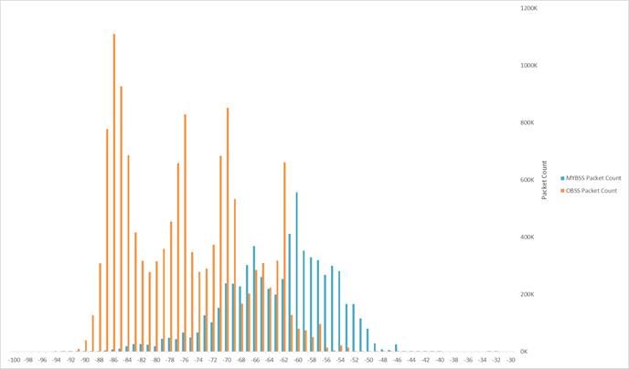
Appendix 1: Measurements of deployed Wi-Fi networks
Data presented by HPE/Aruba (3GPP R4-1701879) show that even in optimized enterprise-grade networks planned, deployed and administered by a single entity and relatively isolated from external interference a significant proportion of Wi-Fi links operate below -72dBm.
Indoor Single Operator Enterprise Network: The facility in San Francisco Bay Area covers 37,680 m² with 2,800 employees and 203 APs. Data captured from 802.11ac Wave 1 APs operating on 5GHz 40MHz channels 36+, 44+, 52+, 108+, and 157+. MyBSS packets correspond to transmissions in the own AP while OBSS packets correspond to transmissions from neighboring APs.
Observation: 20% of “MyBSS” Wi-Fi links are below -72dBm. Back

Slide 11
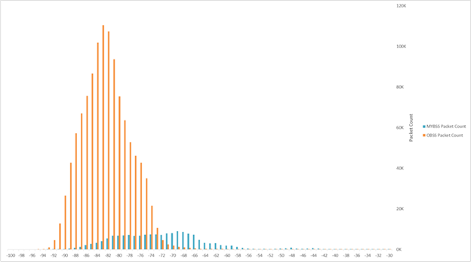
Appendix 2: Measurements of deployed Wi-Fi networks
Outdoor Single Operator Enterprise Network. Levi’s Stadium in Santa Clara, California during the USA vs. Colombia match of the Copa America Centenario soccer tournament on 3 June 2016. The stadium has a seating capacity of 68,500 and was 98.5% full. Data captured from 802.11ac Wave 1 APs operating on 5GHz 20MHz channels 157, 161, and 149. MyBSS packets correspond to transmissions in the own AP while OBSS packets correspond to transmissions from neighboring APs.
Observation: 60% of “MyBSS” Wi-Fi links are below -72dBm.

Slide 12
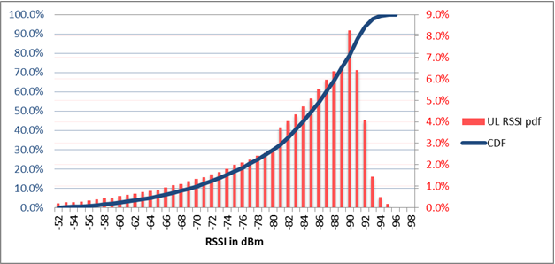
Appendix 3: Measurements of deployed Wi-Fi networks
In uncoordinated multi-operator environments typical of many public Wi-Fi deployments, a significantly higher p% of Wi-Fi links can be below -72dBm. This is borne out by the outdoor Wi-Fi network data presented by CableLabs (R4-164432) .This has much lower RSSI than the single operator enterprise data presented by HPE.
Outdoor RSSI of links from Wi-Fi networks used by multiple cable operators. The data consists of measurements at outdoor access points (APs) operating at 5GHz. It is a collection of over 1,000,000 individual measurement samples from 13,000 distinct outdoor APs for the duration of multiple days.
Observation: 80% of Wi-Fi links are below -72dBm for both DL and UL.

