Slide 1
MU Measurement and Feedback Scheduling
Date: 2017-09-12
Authors:
Chittabrata Ghosh, Intel

Slide 2
Abstract
September 2017
        doc.: IEEE 802.11-17/1455r0
In this presentation, we present the possible options of signaling single or multiple TXOPs/SPs for MU measurement and corresponding LMR feedback for power save STAs that intend to perform 11az-based measurement
Chittabrata Ghosh, Intel

Slide 3
Problem Statement
September 2017
        doc.: IEEE 802.11-17/1455r0
The STAs would like to spent minimum time on channel to minimize PWR and scheduling conflicts (e.g., range meas., traffic/association, co-ex.) occurrences over multiple channels
  This is possible when STAs are aware of the SP(s) scheduled for measurement and LMR feedback
The AP would like to minimize the memory footprint while avoiding completion of TOA measurement for all STAs that have participated in the measurement phase
Chittabrata Ghosh, Intel

Slide 4
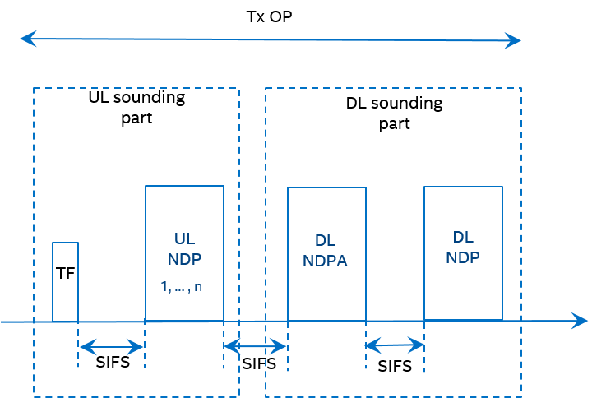
Introduction
September 2017
        doc.: IEEE 802.11-17/1455r0
    The 11az amendment has agreed on using NDP-based sounding mechanism for measurement in the measurement phase
      Within a single TXOP, the UL sounding is followed by the DL sounding
      In UL sounding, UL NDPs are solicited from STAs assigned resources identified in the Trigger frame
    However, for efficient resource allocation, the AP needs to identify the STAs that intend to perform measurements
    We have agreed to have a polling phase prior to the MU measurement phase
Chittabrata Ghosh, Intel

Slide 5
Illustration of a Single Polling Phase with Multiple NDP-based Measurement Phases
September 2017
        doc.: IEEE 802.11-17/1455r0
TXoP
Measurement Polling (e.g., BSRP)
UL Sounding and DL Sounding for first set of STAs
UL Sounding and DL Sounding for second set of STAs
MU LMR Feedback Sequence (TBD)
SIFS
SIFS
TBD
(Assume 10% polling success)
[14 STAs respond for
measurement request]
(8 STAs have resource allocation for measurement )
(6 STAs have resource allocation for measurement )
(14 STAs respond with LMR feedback)
(First wake-time for 14 STAs)
(Doze time for 8 STAs)
(Doze time for 6 other STAs)
(Wake-time for 6 other STAs)
(On-channel availability for 14 STAs)
For each measurement polling, a STA receives one allocation in a single Trigger frame of the MU measurement phase within a TXOP
Chittabrata Ghosh, Intel

Slide 6
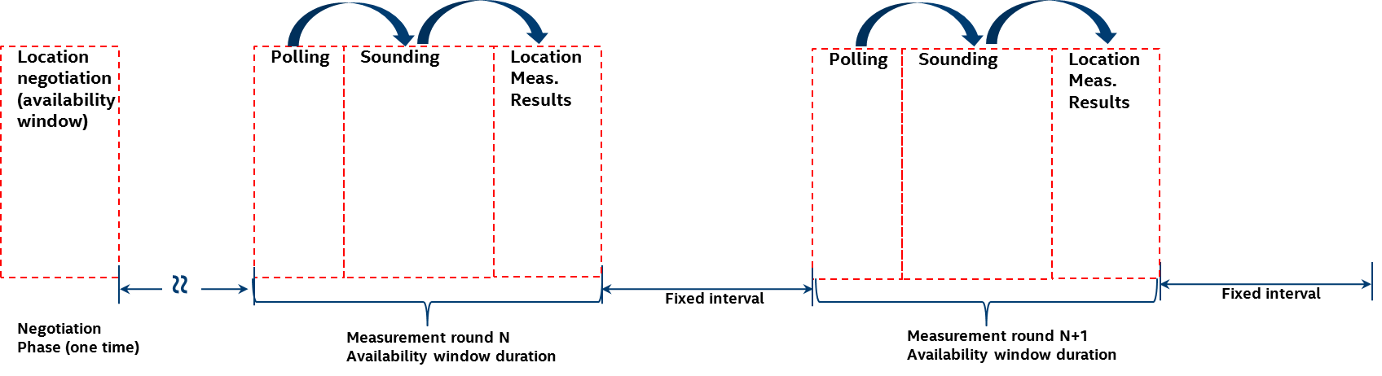
Discussion on Availability Window Scheduling
September 2017
        doc.: IEEE 802.11-17/1455r0
We understand that the following MU NDP Ranging measurement opportunities need to be signaled for power efficient MU ranging:
  Start time – the TSF value at the beginning of the first availability window
  Ranging interval – the time interval between two consecutive availability windows
  Measurement duration – the time duration of the availability window
Chittabrata Ghosh, Intel

Slide 7
Signaling of Availability Window Schedules
September 2017
        doc.: IEEE 802.11-17/1455r0
We propose to define the following MU availability windows scheduling where the rSTA shall perform MU measurements:
  Availability windows are scheduled to enable STAs to minimize on-channel availability
  Within an availability window, rSTAs shall perform ranging activities related to polling, measurement, and measurement results and group related scheduling
  Each availability window consists by default of a single TXOP and can be extended to multiple TxOPs by announcement if single TxOP is insufficient to accommodate all STAs responding to the polling phase
  Availability windows are negotiated/signaled between AP and a STA such that the STA knows when those availability windows occur
  A STA is not expected and does not perform MU ranging measurement and measurement results activities outside these windows
Chittabrata Ghosh, Intel

Slide 8
Signaling of LMR Feedback Scheduling
September 2017
        doc.: IEEE 802.11-17/1455r0
LMR feedback from the currently executed measurements or from the previous measurement are also sent to iSTAs in scheduled availability windows
We propose the following signaling behavior on LMR feedback scheduling:
  - Measurements and/or measurement results are provided for in the same availability window
  - Measurement results may be from this window’s measurement or the results of a measurement performed in a prior window
  - Protocol will support signaling for measurement results availability for current or next availability window within the measurement phase
  - The Trigger control frame or the NDPA control frame carries a dynamic signaling of measurement results availability in this or next availability window
Chittabrata Ghosh, Intel

Slide 9
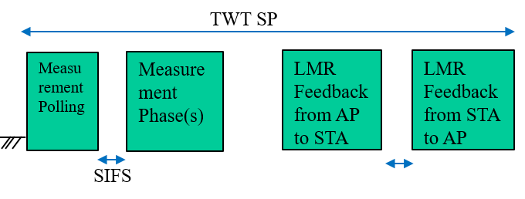
Illustration of Availability Windows for Measurement and LMR Feedback
September 2017
        doc.: IEEE 802.11-17/1455r0
Availability Window
Single availability window for MU measurement and LMR feedback
Availability Window
TWT SP
Availability Window
Availability Window negotiation
TWT SP
Measurement Polling
Measurement Phase(s)
LMR feedback from AP to STA
LMR feedback from STA to AP
ACK
ACK
FTM Request
FTM Response
SIFS
Availability Window Interval
Multiple availability windows for MU measurement and LMR feedback
Chittabrata Ghosh, Intel

Slide 10
Summary
September 2017
        doc.: IEEE 802.11-17/1455r0
In this presentation, we have proposed scheduled availability windows for MU measurements
We have also proposed availability window scheduling for LMR feedback either from the current MU measurements performed or from the immediately prior measurement phase
Finally, we have proposed the signaling of these availability windows either for MU measurements or for LMR feedback
Chittabrata Ghosh, Intel

Slide 11
Straw Poll 1
September 2017
        doc.: IEEE 802.11-17/1455r0
We propose to define availability windows where the rSTA shall perform MU measurements
  These availability windows are scheduled
  Within an availability window, rSTAs shall perform ranging activities related to polling, measurement, and measurement results and group related scheduling
  Each availability window consists by default of a single TXOP and can be extended to multiple TxOPs by announcement if single TxOP is insufficient to accommodate all STAs responding to the polling phase
  Availability windows are negotiated/signaled between AP and a STA such that the STA knows when those availability windows occur.
  A STA is not expected and does not perform MU ranging measurement and measurement results activities outside these windows.
Chittabrata Ghosh, Intel

Slide 12
Motion
September 2017
        doc.: IEEE 802.11-17/1455r0
Move to adopt the following text to the SFD and instruct the SFD editor to include it in section 3.2 and grant editorial license:
“availability windows where the rSTA shall perform MU measurements
are defined as folows:
  These availability windows are scheduled
  Within an availability window, rSTAs shall perform ranging activities related to polling, measurement, and measurement results and group related scheduling
  Each availability window consists by default of a single TXOP and can be extended to multiple TxOPs by announcement if single TxOP is insufficient to accommodate all STAs responding to the polling phase
  Availability windows are negotiated/signaled between AP and a STA such that the STA knows when those availability windows occur.
  A STA is not expected and does not perform MU ranging measurement and measurement results activities outside these windows.”
Chittabrata Ghosh, Intel

Slide 13
Straw Poll 2
September 2017
        doc.: IEEE 802.11-17/1455r0
We propose the following signaling behavior on LMR feedback scheduling:
  - Measurements and/or measurement results are provided for in the same availability window
  - Measurement results may be from this window’s measurement or the results of a measurement performed in a prior window
  - Protocol will support signaling for measurement results availability for current or next availability window within the measurement phase
  - The Trigger control frame or the NDPA control frame carries a dynamic signaling of measurement results availability in this or next availability window
Chittabrata Ghosh, Intel

Slide 14
Motion
September 2017
        doc.: IEEE 802.11-17/1455r0
Move to adopt the following text to the SFD and instruct the editor to include it in section 3.2 and grant editorial license:
“signaling behavior on LMR feedback scheduling is performed as follows:
  - Measurements and/or measurement results are provided for in the same availability window
  - Measurement results may be from this window’s measurement or the results of a measurement performed in a prior window
  - Protocol will support signaling for measurement results availability for current or next availability window within the measurement phase
  - The Trigger control frame or the NDPA control frame carries a dynamic signaling of measurement results availability in this or next availability window”
Chittabrata Ghosh, Intel

