Slide 1
WUR Preamble Performance Study with
Phase Noise and ACI
Date: 2017-9-11
Authors:

Slide 2
Introduction
In this presentation, wake-up receiver preamble performance is evaluated with
  Preamble option “repeated PN sequences” in [11-17/0997r0]
  The phase noise model proposed in [11-17/326r0] and ACI (adjacent channel interference)
Overall PER performance with the real preamble acquisition and timing detection is given

Slide 3
Tx Setup
The legacy Portion is inserted prior to the WUR packet for false alarm studies
Packet length: 32 bits (assumption: 16-bit ID, 8-bit payload, 8-bit CRC)
WUR signal OOK pulse:
  BW = 4.06 MHz (13 tones including DC)
  13 L-STF coefficients
  Symbol period = 4 µsec (including 0.8 µsec CP)
Manchester coding (MC)
  Code rate 1/4 (MC ¼): 62.5 kbps
    Bit 1 → [1 0 1 0], i.e. 4 µsec on, 4 µsec off, 4 µsec on, 4 µsec off
    Bit 0 → [0 1 0 1], i.e. 4 µsec off, 4 µsec on, 4 µsec off, 4 µsec on
802.11 preamble
WUR Mark
Wake-up preamble
Rate Field
MAC header
Payload
FCS
0
15-bit PN seq.
15-bit PN seq.
0

Slide 4
Rx Setup
The known preamble sequence is cross correlated (normalized output) with a sliding window of the received samples
  The first two peaks (using the repeated structure) are compared against two different fixed threshold and timing is obtained by examining the delta between two peaks
  False alarm is fixed at or about 1% (slight variations at different ACIs)
4 MHz LPF (IIR) – generated using MATLAB
  Numerator order=1, denominator order=1
  Passband freq. = 2MHz, Stopband freq.=6MHz, Sampling freq. =160MHz
WUR with in-phase only (single rx chain)
Channels: Channel D
Phase noise model [11-17/326r0]
  20 uW, 75 uW, 1mW, no phase noise
2.4 GHz band operation
25MHz away ACI: 16 dB & 20 dB higher than the received signal
SNR is measured after the 4 MHz LPF and 4 MHz sampling

Slide 5
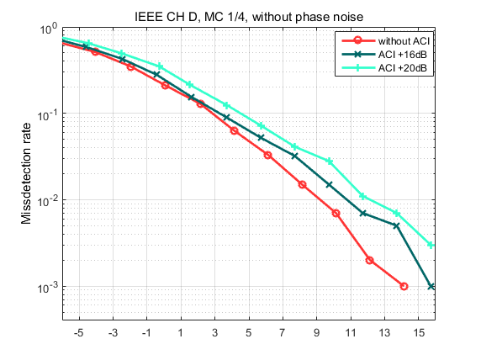
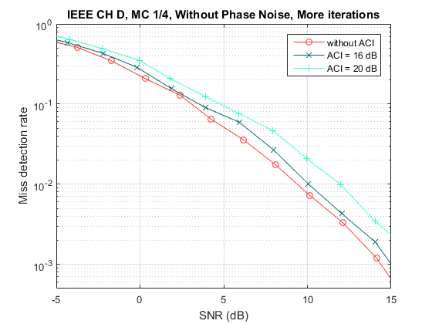
Miss Detection
Manchester Coding ¼ with ACI but without Phase Noise
Performance degradation is observed as ACIs increases

Slide 6
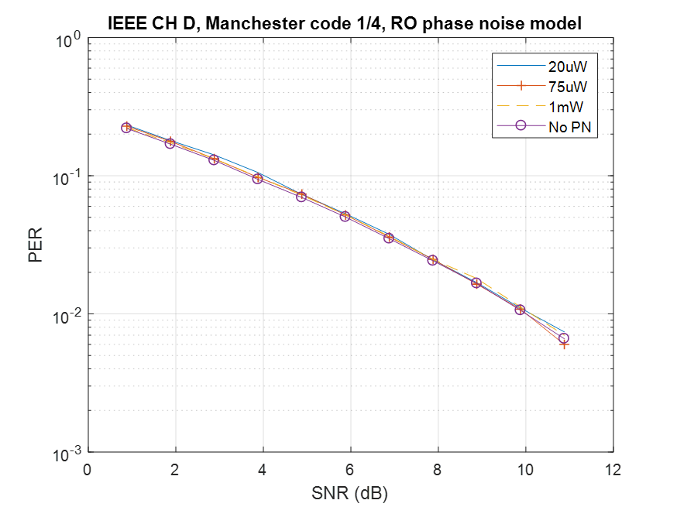
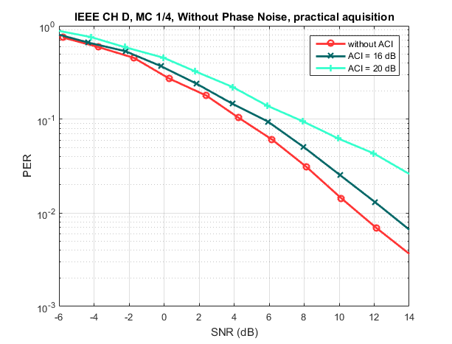
PER - Manchester Coding ¼ with ACI but without Phase Noise
Performance degradation with +16 dB of ACI meets the spec requirement of no more than 3dB degradation @ 10% PER
Perfect timing [11-17/0656r0]

Slide 7
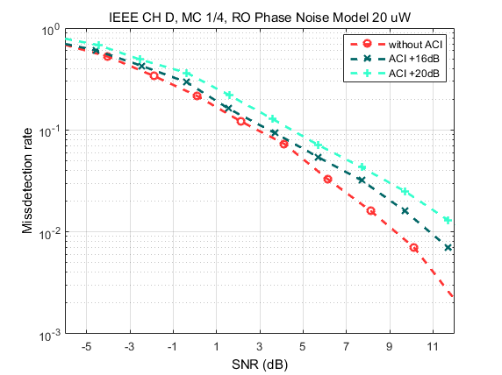
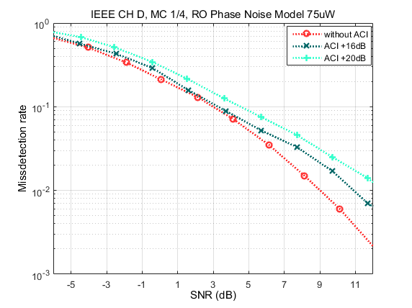
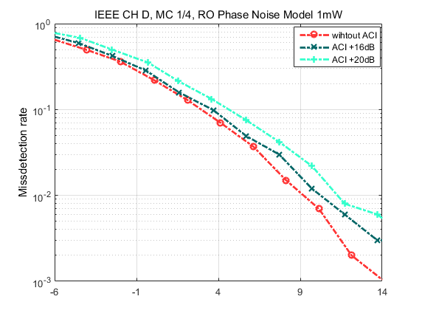
Miss Detection
Manchester Coding ¼ with Phase Noise
Performance degradation is observed as ACIs increases

Slide 8
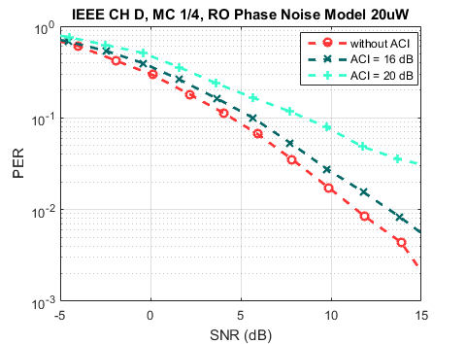
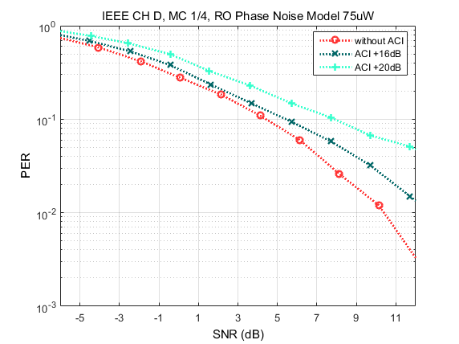
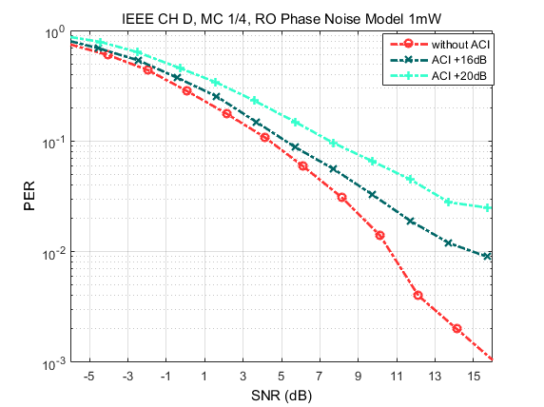
PER - Manchester Coding ¼ with
Phase Noise
Even in the presence of phase noise, the performance degradation with +16 dB of ACI meets the spec requirement of no more than 3dB degradation @ 10% PER

Slide 9
Summary and Conclusions
The preamble design with repetition of two 15-bit PN sequences with a simple 4 MHz LPF effectively mitigates effect of phase noise and ACI
  Phase noise (the 20 uW case) contributes <0.5 dB PER performance degradation
  ACI (+16dB, 25MHz) contributes 1 dB PER performance degradation

Slide 10
References
[1] Shahrnaz Azizi, et.al., “Preamble Options,” IEEE 802.11-17/0997r0
[2] Minyoung Park, et.al., “WUR PHY Performance Study with Phase Noise and ACI,” IEEE 802.11-17/0656r0
[3] Minyoung Park, et.al., “WUR phase noise model study,” IEEE 802.11-17/0026r0
[4] O. Khan; B. Wheeler; F. Maksimovic; D. Burnett; A. M. Niknejad; K. Pister, "Modeling the Impact of Phase Noise on the Performance of Crystal-Free Radios," in IEEE Transactions on Circuits and Systems II: Express Briefs , vol.PP, no.99, pp.1-1
[5] Navid, T. H. Lee, R. W. Dutton, “Minimum Achievable Phase Noise of RC Oscillators”, JSSC 2005
[6] A. Demir, A. Mehrotra, and J. Roychowdhury., "Phase noise in oscillators: a unifying theory and numerical methods for characterization," Transactions on Circuits and Systems I: Fundamental Theory and Applications, vol. 47, no. 5, pp. 655-674, May 2000.
[7] Osama Khan. Free Running Oscillator. [Online]. https://github.com/openwsn-berkeley/free-running-oscillator/blob/master/free-running-oscillator.m
[8] David C. Lee, "Modeling Timing Jitter in Oscillators," , 2001.

Slide 11
Backup

Slide 12
[11-17/0656r0]
Manchester Coding 1/4, Phase Noise,
ACI +16dB
AWGN, Channel D and B
ACI +16dB higher than the received signal, 25 MHz separation
Performance degradation ~ 0.5 dB compared to the no ACI cases

