Slide 1
OOK Waveform Coding Scheme for Frequency Domain Multiplexing
Date: 2017-09-11
Authors:

Slide 2
Introduction
During the last TGba F2F meeting, we had the following SP and result
  Do you agree that frequency domain multiplexing transmission of multiple WUSs should be one of 11ba system capabilities?
  Y:15, N:2, A: 6
Many use cases in the current 11ba usage models, such as Smart Home, Warehouse and Sensor Networks, can benefit from frequency domain multiplexing (FDM) capability
In this contribution, we compare transmitter structures that enable FDM using two different OOK waveform coding schemes, i.e., sequence-based and mask+filtering-based, and provide some simulation results based on 11n/ac numerologies
  Sequence-based scheme offers very simple Tx structure – the same as transmitting 11n/ac data
  Sequence-based scheme can offer slightly better performance

Slide 3
Recap: Sequence-based WFC OOK Symbols
In [1, 2], we proposed to generate the WFC OOK symbol(s) by using a set of carefully designed sequences
  Generated from DFT of time domain symbols (e.g. ZC sequences) with proper time domain allocation to represent logic 0 and 1
This method has three main benefits:
  Localizes energy in the spectrum to increase coverage range of 11ba
  Enables envelope detector based WURs and correlator-based WURs
  Easily supports frequency domain multiplexing
At the transmitter, these sequences can be kept in a look-up table (LUT), which maps the logic 0 and 1 to specific frequency domain sequences
Since the sequences are designed to shape the time domain waveform, they removes the need for masking operation and do not need additional filtering operation

Slide 4




Comparison of Tx Structures for Sequence-based and Mask-based Schemes (1/2)
Single user and single channel transmission
Sequence-based Scheme
Logic 1
Mapping
IDFT
(64)
Amplitude
Sequence1
Logic 0
+GI
$$0$$
$$T_{GI}$$
$$T_{OFDM}$$
time
Sequence2
$$T_{ook}$$
Data (0 or 1)
IDFT output
Mask-based Scheme
Mapping
IDFT
(64)
Masking for Logic 1
Sequence
+GI
Filtering
Masking for Logic 0
Data (0 or 1)

Slide 5
Comparison of Tx Structures for Sequence-based and Mask-based Schemes (2/2)
Multi-user and/or multi-channel transmission
Sequence-based Scheme
Sequence1
Sequence2
Mapping
IDFT
(64)
Sequence1
+GI
f
Sequence2
20 MHz
Sequence1
Sequence2
Mask-based Scheme
IDFT
(64)
Masking for Logic 1
Mapping
+GI
Filtering
0
Masking for Logic 0
Mapping
0
IDFT
(64)
Masking for Logic 1
Sequence
+GI
Filtering
0
Masking for Logic 0
Mapping
0
IDFT
(64)
Masking for Logic 1
Masking for Logic 0
+GI
Filtering

Slide 6
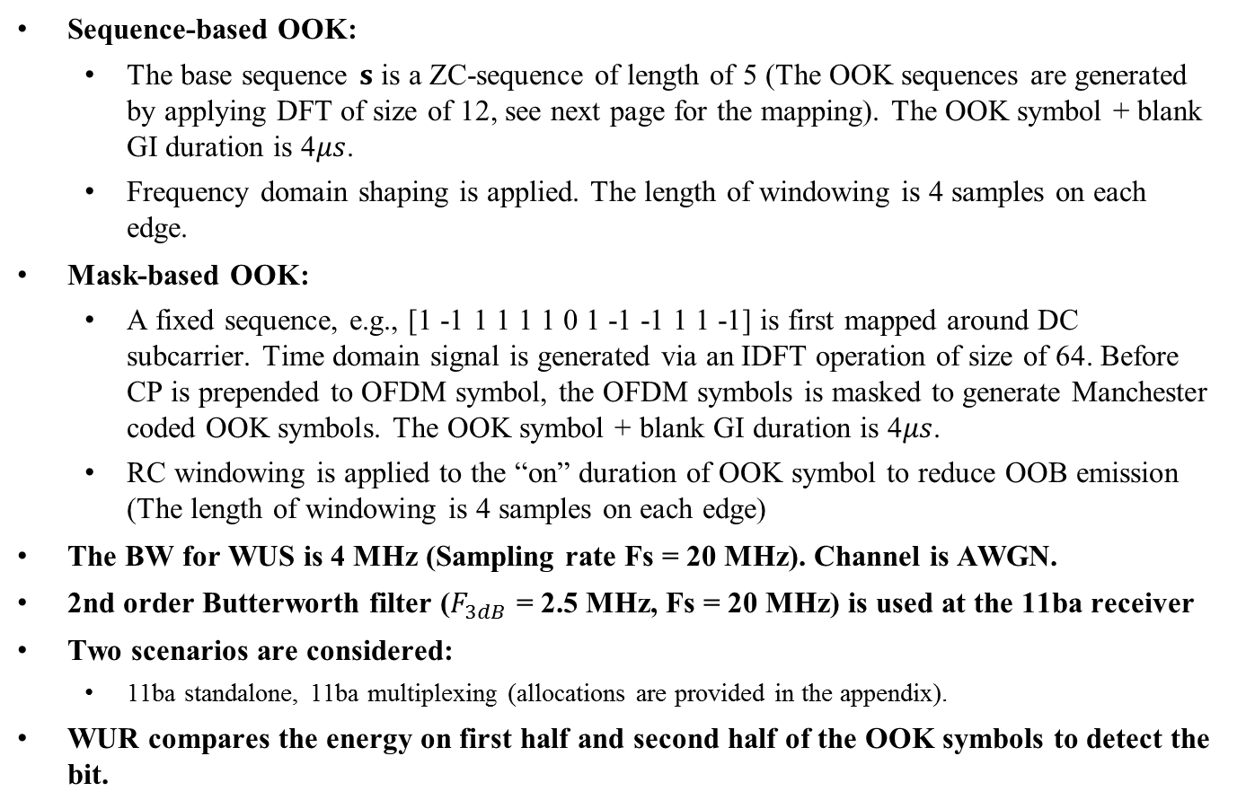
Simulation Assumptions
Sequence-based OOK:
  The base sequence $s$ is a ZC-sequence of length of 5 (The OOK sequences are generated by applying DFT of size of 12, see next page for the mapping). The OOK symbol + blank GI duration is 4$μs$.
  Frequency domain shaping is applied. The length of windowing is 4 samples on each edge.
Mask-based OOK:
  A fixed sequence, e.g., [1 -1 1 1 1 1 0 1 -1 -1 1 1 -1] is first mapped around DC subcarrier. Time domain signal is generated via an IDFT operation of size of 64. Before CP is prepended to OFDM symbol, the OFDM symbols is masked to generate Manchester coded OOK symbols. The OOK symbol + blank GI duration is 4$μs$.
  RC windowing is applied to the “on” duration of OOK symbol to reduce OOB emission (The length of windowing is 4 samples on each edge)
  The BW for WUS is 4 MHz (Sampling rate Fs = 20 MHz). Channel is AWGN.
2nd order Butterworth filter ($F_{3dB}$ = 2.5 MHz, Fs = 20 MHz) is used at the 11ba receiver
Two scenarios are considered:
  11ba standalone, 11ba multiplexing (allocations are provided in the appendix).
WUR compares the energy on first half and second half of the OOK symbols to detect the bit.

Slide 7
DFT Input Mapping for OOK Symbol with Manchester Coding
DFT Input Index
1
2
6
7
8
12
Symbol = 0
0
S
0
0
1
2
6
7
8
12
Symbol = 1
0
0
0
S
S is a sequence with the length of 5
Data-to-Sequence LUT
DFT-input (Time):
Logic 0:
Logic 1:
Logic 0:
Logic 1:
0.0437 + 0.0106i 0.0437 + 0.0106i
0.1116 + 0.0765i -0.1116 - 0.0765i
0.3611 - 0.2624i 0.3611 - 0.2624i
-0.2923 - 0.2003i 0.2923 + 0.2003i
0.4575 + 0.1108i 0.4575 + 0.1108i
-0.1793 - 0.8567i 0.1793 + 0.8567i
-0.6460 + 0.4693i -0.6460 + 0.4693i
0.6817 + 0.1050i -0.6817 - 0.1050i
-0.1747 - 0.7594i -0.1747 - 0.7594i
-0.6817 - 0.1050i 0.6817 + 0.1050i
-0.6460 + 0.4693i -0.6460 + 0.4693i
0.1793 + 0.8567i -0.1793 - 0.8567i
0.4138 + 0.1002i 0.4138 + 0.1002i
0.2115 + 0.1450i -0.2115 - 0.1450i
0.1906 - 0.1385i 0.1906 - 0.1385i
-0.0309 - 0.0212i 0.0309 + 0.0212i
0.0000 + 0.0000i 0.0000 + 0.0000i
1.0000 + 0.0000i 0.0000 + 0.0000i
0.3090 - 0.9511i 0.0000 + 0.0000i
-0.8090 + 0.5878i 0.0000 + 0.0000i
0.3090 - 0.9511i 0.0000 + 0.0000i
1.0000 + 0.0000i 0.0000 + 0.0000i
0.0000 + 0.0000i 0.0000 + 0.0000i
0.0000 + 0.0000i 1.0000 + 0.0000i
0.0000 + 0.0000i 0.3090 - 0.9511i
0.0000 + 0.0000i -0.8090 + 0.5878i
0.0000 + 0.0000i 0.3090 - 0.9511i
0.0000 + 0.0000i 1.0000 + 0.0000i
DFT+windowing
S
Windowing coefficients: [0.0955 0.3455 0.6545 0.9045]
Frequency
S
S: ZC sequence

Slide 8
Temporal Characteristics
(Sequence-based OOK)
Data
1
1
0
1
1
0
0
1
1
1
OOK
OOK
OOK
OOK
OOK
OOK
OOK
OOK
OOK
OOK
GI
GI
GI
GI
GI
GI
GI
GI
GI
GI

Slide 9
Spectral Characteristics
Standalone
Frequency multiplexing
While windowing helps to improve the spectral characteristics of mask-based OOK symbols, the sequence-based OOK symbols are confined without any extra operation

Slide 10
BER Performance
Standalone
Frequency Multiplexing
Since sequence-based OOK symbols yield better accumulation after WUR filter, it yields slightly superior performance as compared to mask-based OOK symbols in frequency multiplexing scenarios

Slide 11
Conclusions
In this contribution we compared the performance and the transmitter structure needed to support frequency domain multiplexing for sequence-based and mask-based waveform coding schemes
The transmitter structure for sequence-based waveform coding scheme is significantly simpler than that for mask-based waveform coding scheme
  For sequence-based waveform coding scheme, there is no need to change the existing 11n/ac hardware design; apply sequences as 11n/ac data based on a LUT is sufficient
Using 11n/ac numerology, the sequence based scheme can achieve slightly better performance than the mask-based scheme with windowing in FDM case

Slide 12
References
[1] Alphan Sahin, et. al., “On the Coexistence of 802.11ax and 802.11ba Signals,” IEEE 802.11-17/0659r3
[2] Alphan Sahin, et. al., “Performance Evaluation of OOK Waveform Coding Schemes with Impairments,” IEEE 802.11-17/1037r2

Slide 13
SP
Do you agree that sequenced-based OOK waveform coding scheme should be considered as one of the OOK waveform coding schemes for 11ba?
Y:
N:
A:

Slide 14
Appendix

Slide 15
Appendix - Allocation
3.75 MHz (12 tones)
Frequency domain windowing
(Implementation dependent)
-28
-17
-8
-6
5
7
18
27
Frequency

