Slide 1
MU-MIMO channel access flow for 11ay
Date: 2017-09-01
Authors:

Slide 2
Outline
Background and motivation
Scheme 1: DMG CTS-to-self
Scheme 2: Simultaneous DMG CTS
Conclusion

Slide 3
Background and motivation
This presentation proposes following schemes for MU-MIMO channel access flow, the goal is to set up a MU-MIMO TXOP and start MU-MIMO data transmission.
Scheme 1: DMG CTS-to-self
Scheme 2: Simultaneous DMG CTS
Assumption
Prior to the transmission of an EDMG MU PPDU to a set of responder STAs within an MU group, the initiator shall
Includes the MU group within the EDMG Group ID Set element and communicate the resulting element to the STAs in the BSS
Perform MU-MIMO beamforming with the responders of the MU group.

Slide 4
Scheme 1: DMG CTS-to-self
An EDMG STA establishes an MU-MIMO TXOP by transmitting a DMG CTS-to-self frame to the intended MU-MIMO group of responders.
The EDMG STA shall transmit the DMG CTS-to-self frame with a control trailer to the group of responders to indicate the intent to transmit an EDMG MU PPDU.
The EDMG Group ID is include in the control trailer
The MU-MIMO transmission begins SIFS interval following the end of the DMG CTS-to-self frame transmission by the initiator.

Slide 5
Scheme 2: Simultaneous DMG CTS
An EDMG STA establishes an MU-MIMO TXOP by transmitting an RTS frame to the intended MU-MIMO group of responders.
The EDMG STA shall transmit the RTS frame with a control trailer to the group of responders to indicate the intent to transmit an EDMG MU PPDU.
The EDMG Group ID is include in the control trailer
A STA that receives an RTS frame addressed to an MU group that the STA belongs to shall transmit a DMG CTS frame back to the initiator employing the most recent SISO antenna configuration used between the responder and the initiator. (More explanation in the next slide)
The MU-MIMO transmission begins SIFS interval following the reception or expected reception of the DMG CTS frame by the initiator.

Slide 6
Scheme 2: Simultaneous DMG CTS
For the simultaneous DMG CTS
The TA field of the DMG CTS shall be set to the broadcast MAC address and the Scrambler Initialization field in the PHY header shall be set to the same value as the Scrambler Initialization field of the PPDU that contained in the received RTS frame.
For the STA addressed by the DMG CTS frame to successfully receive the frame, the difference in time between all the DMG CTS transmissions as measured at the receiving STA should be no more than ±30 ns. A STA that transmits the DMG CTS should pre-compensate for carrier frequency offset (CFO) error. After compensation, the absolute value of residual CFO error with respect to the RTS should not exceed 12KHz. (The simulation and analysis for time delay and CFO error are shown in the following slides.)

Slide 7
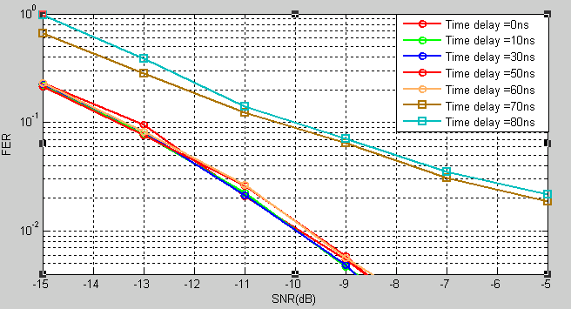
Scheme 2: Simultaneous DMG CTS (Simulation and analysis for time delay)
Simulation setting:
Control PHY (MCS0)
Conference room, NLOS Channel
STA to AP Scenario
Time delay: 0~80ns
Rake Equalization
Simulation packets number = 3000
Frame length = 20 Bytes (Length of DMG CTS)
Result:
when the time delay is less than or equal to 60ns, the performance is very close
When the time delay is greater than 60ns, the performance significantly degrades.
Time delay: is the difference in time between the DMG CTS responses from the STAs as measured at the AP.

Slide 8
Scheme 2: Simultaneous DMG CTS (Simulation and analysis for time delay)
Analysis fundamentally :
The structure of CEF is shown as the following figure
Channel estimation can be conducted at the receiver by performing cross-correlation between received signal and the stored local Golay sequences.
Assuming the received signal R = [-Ga128 Gu512 Gv512 Gv128], the local Golay sequences ref = [Gu512 Gv512]
The result of cross-correlation between R and ref is showed as the following figure, which is a delta function in the zone circled in red.
The max delay spread (time delay) should not exceed 128 samples, which is 128*1/1.76GHz=72 ns. The 72 ns need to cover, e.g., STA TX chain jitter and DL timing bias.
Conclusion:
Based on the simulation results and analysis, ±30 ns could be considered as the requirement of time delay. Hence, the absolute time delay is less than or equal to 60ns, with 12ns margin to cover the delay spread of single PPDU.

Slide 9
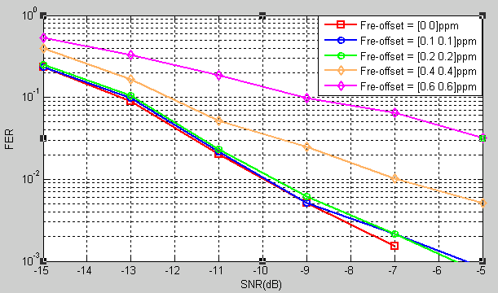
Scheme 2: Simultaneous DMG CTS (Simulation and analysis for carrier frequency offset (CFO) error)
Simulation setting:
Control PHY (MCS0)
Conference room, NLOS Channel
STA to AP Scenario
AP Antenna pattern: Isotropic radiator
STA Antenna pattern: basic steerable direction antenna
Rake Equalization
Simulation packets number = 3000
Frame length = 20 Bytes
Different CFO error after pre-compensation
Result:
When the frequency error is below 12KHz(0.2ppm), the performance is very close.
When the frequency error is greater than 12KHz(0.2ppm), the performance significantly degrades.
Hence, A STA that transmits the DMG CTS should pre-compensate for carrier frequency offset (CFO) error. After compensation, the absolute value of residual CFO error with respect to the RTS should not exceed 12KHz(0.2ppm).
Note:

Slide 10
Conclusion
Two MU-MIMO channel access schemes are proposed and compared.
Scheme 1: DMG CTS-to-self
Scheme 2: Simultaneous DMG CTS

Slide 11
Straw Poll/Motion
Do you agree to include the text for MU-MIMO Channel access flow proposed in “11-17-1409-00-00ay-Draft text for MU-MIMO channel access flow for 11ay.docx” to the spec draft?
Voting
Yes/No/Abstain

