Slide 1
Simple multiplexing of Wake-Up Signals
Date: 2017-09-11
Authors:

Slide 2
Abstract
In e.g. [1] it has been suggested to multiplex wake-up signals (WUS) in frequency
Multiplexing in frequency within a 20 MHz channel leads to harder requirement on the channel selective filter (CSF) as the distance to the adjacent channel by necessity is decreased for one or more WUS
Multiplexing over multiple 20 MHz obviously does not apply to 20 MHz operation, and may be less interesting for 2.4 GHz
In [3], it is agreed that the Manchester coded symbol rate could vary. With this feature, it is in this presentation shown that several WUSs can easily be multiplexed in a way transparent for the WUR with no need to increase the complexity of the CSF

Slide 3
Outline
Motivation
Illustration of the idea
Simulation results taking non-linearities into account (new since r0)
Modifications to the packet structure (new since r1)
Conclusions
Straw polls

Slide 4
Motivation
Addressing more than one WUR with a WUS may be done on the MAC layer using group addresses or on the PHY layer by multiplexing WUSs
It has been discussed to multiplex WUSs on the PHY layer by means of FDM, but this comes at an implementation cost in terms of e.g. more complex CSF
In this contribution we propose to instead perform the multiplexing in the code domain, which is in particularly simple as it has been agreed that Manchester coding should be used

Slide 5
Illustration of the idea
8us
62.5 kb/s
time
0
0
1
1
0
0
1
1
250 kb/s
time
0
1
1
0
1
0
0
1
1
0
By selecting Manchester coded signal that differ a factor of 2 (4,8,…) the signals will be “orthogonal” as long as the signals are properly aligned at the transmitter, illustrated in some detail on next page
This means that the only cost associated with multiplexing is that the transmitted energy is shared between WUS. Multiplexing is only used when the link budget admits it, just as the highest data rate only is used when the link budget allows for it…

Slide 6
Illustration of the idea
$$r_{0}$$
$$r_{1}$$
8us
62.5 kb/s
time
0
0
1
1
0
0
1
1
Manchester metric:
$$m=r_{0}−r_{1}$$
250 kb/s
time
0
1
1
0
1
0
0
1
1
0
Decoding of the higher rate (250 kb/s): It is clear that for any Manchester coded symbol, the low rate signal will be the same for $r_{0}$and $r_{1}$and thus will not impact the decision variable $m$ for a linear RX. For an envelope detector an “ON” signal will result in (a slightly) reduced noise margin
Decoding of the lower rate (62.5kb/s): It is clear that both $r_{0}$ and $r_{1}$will contain exactly the same number of ON and OFF periods and thus the impact on $r_{0}−r_{1}$ = 0 for a linear RX. For a non-linear RX, the “ON” part will suffer (slightly) more from the multiplexed signal

Slide 7
Simulation Results
Perfect orthogonality assumes linear processing. However both TX and RX processing are non-linear
To evaluate the feasibility of the idea, the BER for both the low rate and the high rate were simulated
Comparing it with non-multiplexed data
Considering the impact of the pulse form
Considering the impact of varying OBO for the PA
Considering the impact of power offset between the low rate and the high rate

Slide 8
Simulation Results, cont’d
Three different sequences are considered for the symbol design
Random data on the 13 sub-carriers, DC sub-carrier not used
Ideal OOK, i.e., only DC sub-carrier used
Optimum symbol design for low rate (4us), as defined below
[-0.5369 - 1.1504i,-1.1504 - 1.1504i,1.1504 + 0.5369i,-0.0767 + 0.0767i,0.6903 - 0.3835i,-0.5369 + 0.5369i,0,-0.0767 - 0.0767i,0.0767 + 0.0767i,0.0767 + 0.0767i,-0.0767 + 0.0767i,0.3835 - 0.3835i,0.3835 - 0.6903i];

Slide 9
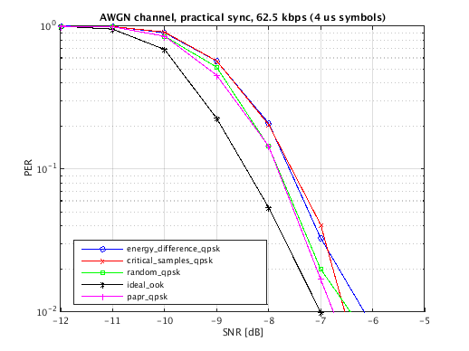
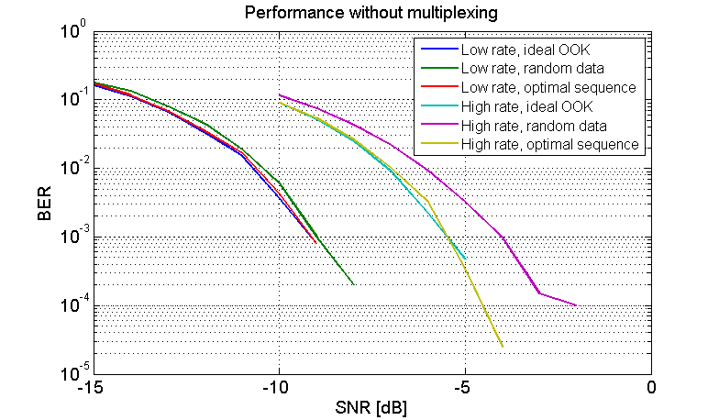
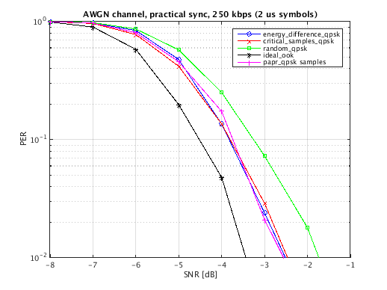
Simulation Results, Cont’d
For comparison, the performance for the low rate and the high rate are simulated without any multiplexing
Ideal time synchronization

Slide 10
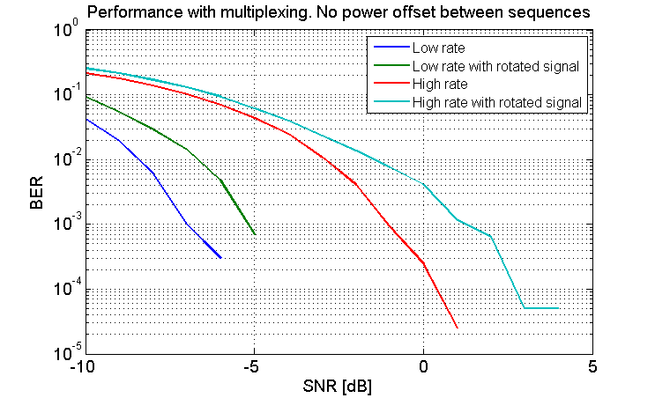
Simulation Results, Cont’d
Two ways of combine the high rate and low rate sequences are tested
Either with the sequence aligned in phase, or rotated 90 degrees
It is beneficial to phase-align the sequences for both low rate and high rate

Slide 11
Simulation Results, Cont’d
In what follows phase aligned sequences will be assumed
With the total power split between the low rate and the high rate, the loss in performance is about 3 dB with linear PA.

Slide 12
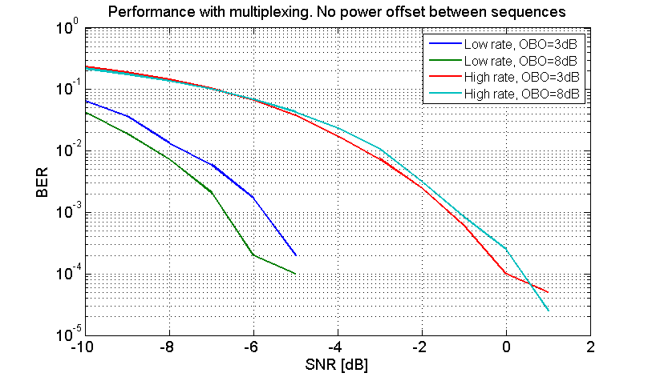
Simulation Results, Cont’d
The basic assumption of orthogonality assumes a linear transmitter, what when the PA is driven into the non-linear region?
There is a loss, but even at only 3 dB OBO the loss is acceptable.
Driving it much harder then 3 dB, it will start to degrade severely

Slide 13
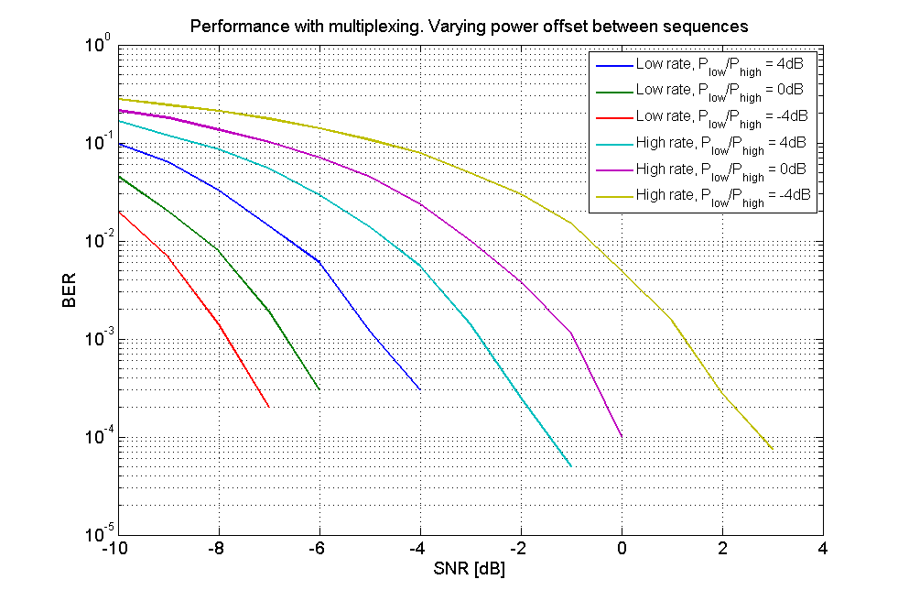
Simulation Results, Cont’d
By changing the power offset between the low rate and high rate sequences it is possible to improve the performance for one at the expense to the performance for the other

Slide 14
Modifications to the packet structure
To benefit from being able to multiplex two data streams, we need to
ensure the overhead e.g. in terms of synchronization is not increased
the two intended receivers can be addressed in a simple way without increasing overhead
In addition, it is desirable to
introduce multiplexing as a optional feature in such a way that it will be transparent for receivers not supporting the feature
keep the feature that no explicit signaling of the data rate is needed (it can be determined based on the used syncword)

Slide 15
Modifications to the packet structure
 | Syncword | MAC Header | Frame Body | FCS
 | Frame Control | Address | TD Control
Bits | 8 | 12 | 12
CRC/MIC
It is suggested that multiplexing of the two data rates is viewed as a low rate packet transmission (with an additional orthogonal high rate packet multiplexed)
The syncword for the low data rate is thus (re-)used, and the overall time for synchronization is not increased compared the low rate mode
A receiver not supporting multiplexing only processes the packet using the low rate

Slide 16
Modifications to the packet structure
 | Frame Control | Address | TD Control
Bits | 8 | 12 | 12
Low rate
Address
TD control
12
High rate
Ctrl
Address
TD Ctrl
8
12
12
It is proposed to multiplex the high rate in a staggered fashion such that a receiver switch to the high rate mode only if it has not been addressed using the low data rate
It is proposed to use the very same MAC header structure
Since higher data rate is 4x higher than the lower, the high rate control field can still be processed ahead of the control field for the lower rate

Slide 17
Modifications to the packet structure
The presence of a high rate packet may be signaled using the reserved bit, so a receiver capable of multiplexing can determine whether it should also look for the high rate
It can also be signaled using the PCR, basically saying that every low rate packet may potentially also contain multiplexed high rate data. A receiver capable of multiplexing then always switch to high rate reception if not addressed using the low rate
Alternatives exist. One can also let one packet type denote multiplexing, and then process address fields in parallel. It seems this comes with some drawbacks
Parallel processing
Not entirely transparent for receivers not supporting multiplexing

Slide 18
Conclusions
A simple means to multiplex WUSs on the PHY was presented
The multiplexing is done in the “code domain”, exploring that Manchester coded symbols of different rates easily can be made orthogonal
Compared to multiplexing using FDM, the proposed approach has no impact on the radio implementation e.g. in terms of filter requirements
Although the receiver processing is non-linear, the idea still works
The multiplexing may be made transparent for the different WURs, and can thus be an optional feature by
Using the syncword for the lower rate
Staggering the packets in time and only allow one rate to be used to address a WUR

Slide 19
Straw Poll
Do you believe multiplexing of WUSs is something that should be considered as, a potentially optional, feature in 802.11ba?
Y/N/A:

Slide 20
Straw Poll
Do you believe multiplexing of WUSs as described in this presentation is a good alternative or complement to multiplexing using FDM?
Y/N/A:

Slide 21
References
11-17/0028r0 “On waking-up multiple WUR stations”, Jianhan Liu et al.
11-17/0188r9 “TGba Simulation scenarios and evaluation methodology document”, Shahrnaz Azizi et al.
11-17/0575r3 “Specification Framework for TGba”, Po-Kai Huang

