Slide 1
On AP Power Saving Usage Model
Date: 2017-09-10
Authors:

Slide 2
Authors (cont’d) :

Slide 3
Abstract
In this contribution, we discuss the benefits of AP power saving for certain IoT usage scenarios based on simulation results and propose a modified AP power saving usage model.

Slide 4
Overview
Introduction
Benefit of AP power saving
  Simulation results comparing a number of AP power saving scenarios
Desirable scenarios for AP power saving
Cost to conduct AP power saving in 11ba
PAR coverage discussion for AP Power saving
Proposed AP power saving usage model
Conclusions

Slide 5
Introduction
Usage Model 8 (Wake Up AP) has been discussed elaborately in the past a few meetings [1]
  Straw poll results from [5] shows that wake up AP usage model needs revision
There are also concerns regarding AP power saving
  Scope/Impact on 11ba schedule
In this contribution, we propose a modified usage model of mobile AP power saving as Usage Model 3b (Cattle farm with AP power saving) to provide revisions and to address the concerns raised
  Discuss benefits of AP power saving for certain IoT scenarios based on simulations results
  Address some of the concerns raised about AP power saving
  Discuss and propose to limit the scope of AP power saving

Slide 6
Benefit of AP Power Saving
Multiple usage scenarios have been proposed that involve mobile APs[1]
  UM 3: Cattle farm
  UM 5 & 6: Wearable devices
Power consumption is a very important issue for mobile AP, especially for some class of IoT devices
  Mobile APs could be cell phones or ad hoc deployed devices operating on batteries without power plugs
  Power saving prolongs network lifetime; improves user experience
  Other benefits: regulatory, interference, security, etc.
We provide simulation results on power savings for AP based on a number of scenarios shown on the following slides
  AP power saving with varying duty cycles for AP’s PCR

Slide 7
AP Power Saving Scenarios (1)
Scenario 1: AP’s PCR is always on, i.e., duty cycle 1
  PCR beacons: BI: 100 ms Size: 100 bytes TX MCS: 1 Mbps/6.5 Mbps
  WUR beacons: BI: 10s TX duration: 144 us [2]
  UL data only;
  STA behavior: transmit data to AP directly when data arrives; No need for UL WUR packet from STA to AP
  AP power consumption is simulated
Legend:

Slide 8
AP Power Saving Scenarios (2)
Scenario 2: AP’s PCR is on duty cycle 1/2
  PCR beacons: BI: 100 ms Size: 100 bytes TX MCS: 1 Mbps/6.5 Mbps
  WUR beacons: BI: 10s TX duration: 144 us [2]
  AP’s PCR duty cycle: of ½; UL data only;
  STA behavior: STA transmits PCR packet directly when AP is awake. Otherwise STA sends WUP to AP followed by PCR packet exch.
  AP’s WUR is always on except when PCR is on
  AP power consumption is simulated
Legend:

Slide 9
AP Power Saving Scenarios (3)
Scenario 3: AP’s PCR is on duty cycle 1/4
  PCR beacons: BI: 100 ms Size: 100 bytes TX MCS: 1 Mbps/6.5 Mbps
  WUR beacons: BI: 10s TX duration: 144 us [2]
  AP’s PCR duty cycle: of 1/4; UL data only;
  STA behavior: STA transmits PCR packet directly when AP is awake. Otherwise STA sends WUP to AP followed by PCR packet exch.
  AP’s WUR is always on except when PCR is on
  AP power consumption is simulated
Legend:

Slide 10
AP Power Saving Scenarios (4)
Scenario 4: AP’s PCR is always off except when being woken up or sending beacons
  PCR beacons: BI: 100 ms Size: 100 bytes TX MCS: 1 Mbps/6.5 Mbps
  WUR beacons: BI: 10s TX duration: 144 us [2]
  AP’s PCR is off except when: 1)Transmitting beacon; 2)When woken up by a STA; AP’s WUR is always on except when PCR is on
  STA behavior: When having data, always send a WUP to wake up AP before continuing on with PCR packet exchanges

Slide 11
Simulation Assumptions (1/2)
Matlab Simulations
  Simulation time: 100s
Usage Model 3: Cattle farm:
  1 farmer (Mobile AP)
  30/50 cows (STAs)
Traffic Assumptions:
  UL data only
  Packet arrival interval per STA: [5:5:50] s
  Packet size: 32 bytes
AP PCR Duty cycle:
  [1, ½, 1/4, 0]
AP Power Consumptions simulated

Slide 12
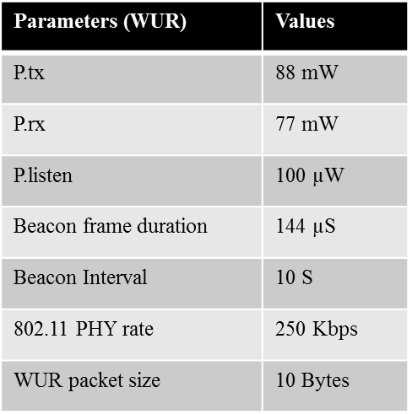
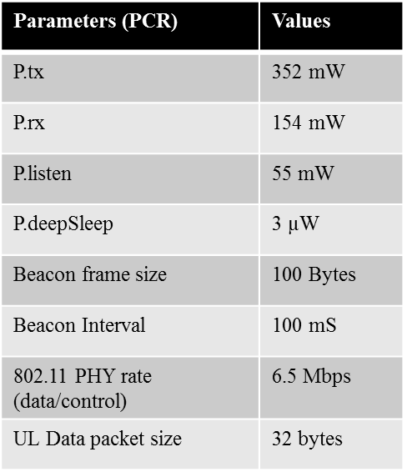
Simulation Assumptions (2/2)

Slide 13
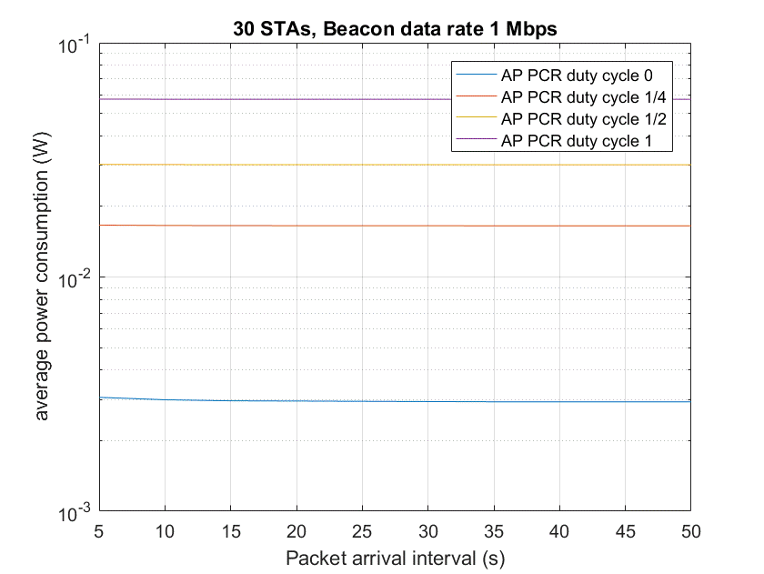
Simulation Results (1/4)

Slide 14
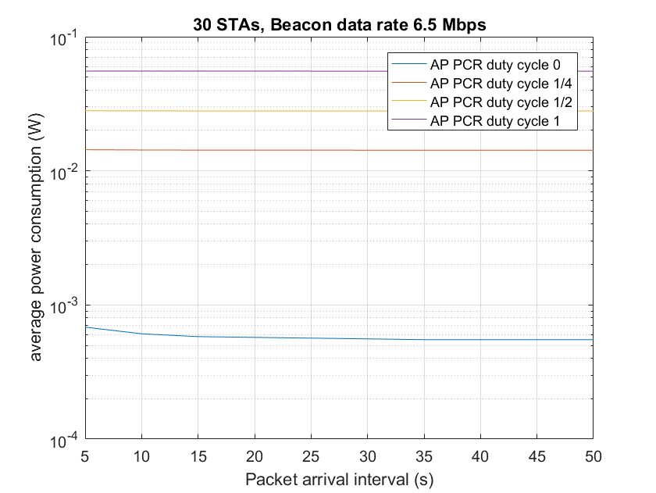
Simulation Results (2/4)

Slide 15
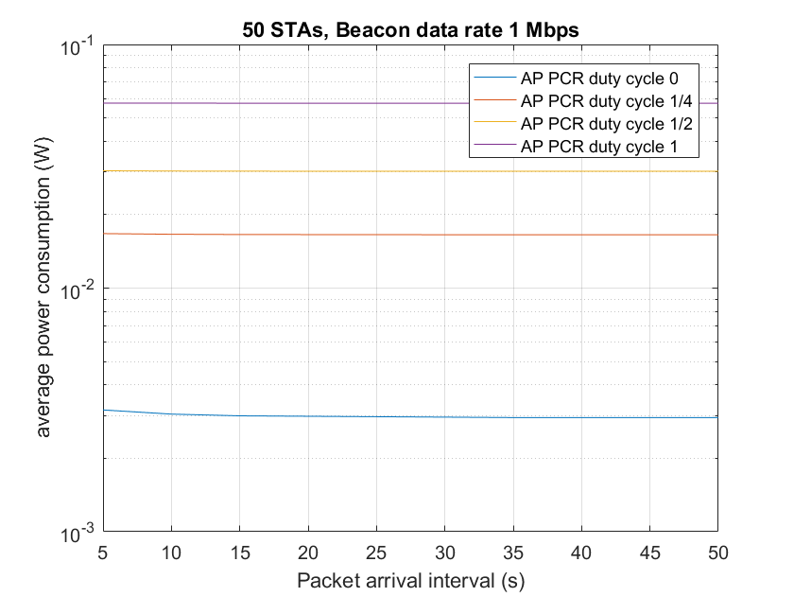
Simulation Results (3/4)

Slide 16
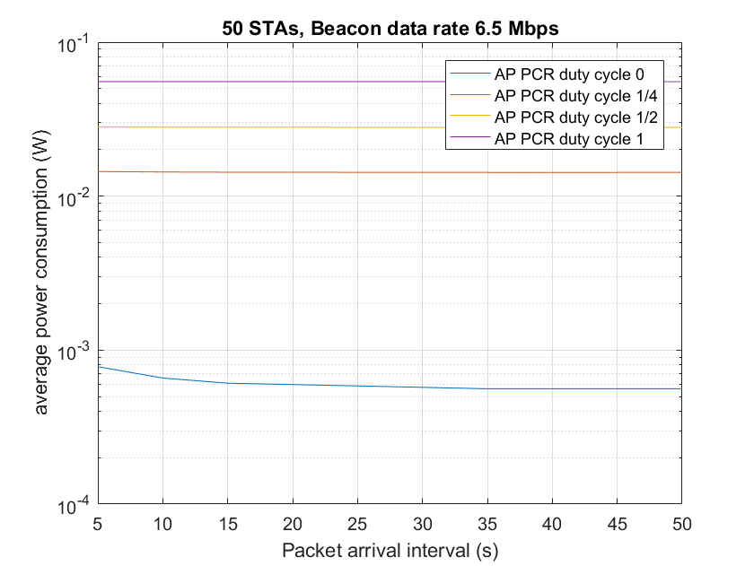
Simulation Results (4/4)

Slide 17
Observations
Impact by AP’s PCR Duty Cycle
  In all scenarios with DC < 1, significant power saving is achieved
    When AP’s PCR’s DC = ½, AP’s power consumption is slightly higher than 50% of that when AP’s PCR’s DC = 1
    When AP’s PCR’s DC = 1/4, AP’s power consumption is slightly higher than 25% of that when AP’s PCR’s DC = 1
    When AP’s PCR’s DC = 0, AP’s power consumption is around 1.2% - 5.2% (depending on PCR beacon rate) of that when AP’s PCR’s DC = 1
Impact by Packet Arrival Rate
  Small impact when packet arrival interval increase 5 -> 50s except when DC = 0
Impact by Number of STAs
  No significant impact when the number of STAs is increased from 30 to 50
Impact by PCR Beacon Tx Rate
  Only significant when AP PCR DC = 0

Slide 18
When is AP Power Saving Desirable
When aggregated traffic in the entire network is low
  It is suitable for some number of IoT usage models and scenarios
    However, power saving and network lifetime may be critical in these scenarios
Wake up AP procedure may enable low latency while maintaining low power consumptions
  Latency can also be critical for some of the IoT scenarios where power saving is critical as well
It may not be appropriate if:
  A large number of active STAs present in the BSS
  Traffic load is heavy in the BSS

Slide 19
Technical changes needed for AP Power Saving
An AP power saving mode:
  Only when scenario is appropriate
    E.g., AP delivered together with a cattle monitoring sensor network
  Only when all STAs associated with it are capable of handling AP power saving
    Indicated by capability
An AP power saving mode with these restrictions should not violate the PAR
Cost, e.g.:
  A low-cost WUR receiver at AP
  Procedure for going into power saving for APs of which all associated STAs have indicated of capable of handling AP Power Saving
  A wake up procedure for AP
  Possibly AP Discovery process

Slide 20
11ba PAR Discussion Regarding AP Power Saving
802.11ba PAR states [6]:
  “The WUR is a companion radio to the primary connectivity radio and meets the same range requirement as the primary connectivity radio. The WUR devices coexist with legacy IEEE 802.11 devices in the same band. The WUR has an expected active receiver power consumption of less than one milliwatt.”
  “Power efficient mechanisms need to be used with battery-operated devices while maintaining low latency where it is required.”
An mobile AP is a battery operated device and power saving mechanisms for mobile AP seems to be within the scope of the 802.11ba PAR.

Slide 21
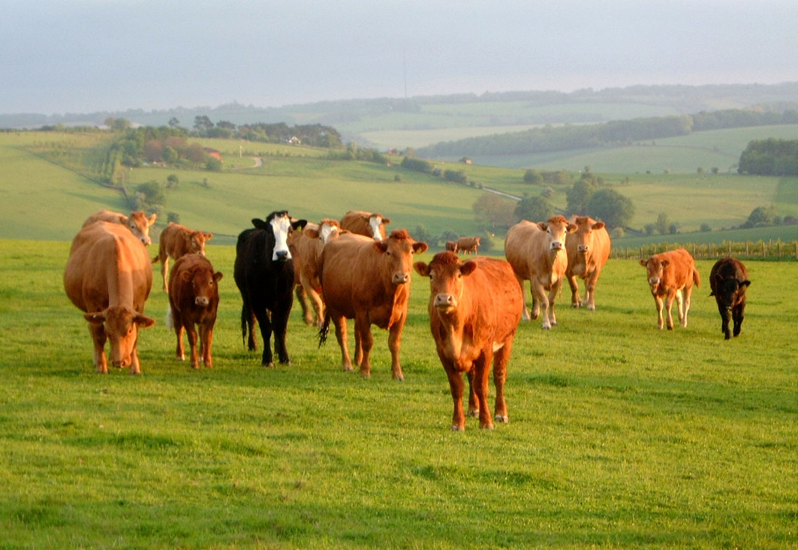
Proposed Usage Model 3b : Outdoor Cattle Farms with AP Power Saving
September 2017
Environment
In an outdoor cattle farms, 2 or 3 cattle farmers use their mobile phones as mobile APs. Every cow is equipped with a sensor. To insure that mobile APs do not needlessly waste battery power, the mobile APs may go to sleep when all sensors associated with it support AP power saving. The cattle farmers can use their mobile phones to frequently collect the temperatures/locations of the cows within the range of each mobile phone. The sensors may also wake the mobile APs to allow transmission of emergency report to the mobile AP. The number of cows is around 50 ~ 100.
Applications
Temperature/location request/report
Emergency report
Traffic Conditions
Interference with low volume wake up packet transmission

Slide 22


Proposed Usage Model 3b: Outdoor Cattle Farms with AP Power Saving
September 2017
Use Case
When an emergency/critical event happens, a sensor will transmit a WUP to the mobile AP when the MR of the mobile AP is off. When the MR of the mobile AP is awake, the sensors will send the emergency report to the mobile AP.
When an emergency/critical event happens, a sensor needs to discover new APs by waking up one or more APs that are known to support its association if its previous AP is out of range. When the MR of the new mobile AP is awake, the sensor conducts Association and sends the emergency report to the mobile AP.
Challenge and Requirements
The WUP transmission should enable coexistence with legacy IEEE 802.11 devices operating in the same band.
The supported range of the wake-up signal will be no less than the supported range of the primary IEEE 802.11 signal of at least 20MHz payload bandwidth.
It is critical that the mobile AP be allowed to sleep or its usable battery life may not be long enough to ensure it is available when an emergency arises.
Needs AP power saving mechanism and AP discovery mechanisms.
WUP to WUR, then emergency report to MR
Use case 1
Cattle with sensor
Previous AP out of range
WUP to WUR, Association, and then emergency report to MR
Cattle with sensor
Use case 2

Slide 23
Conclusions
An AP Power Save feature may enable critical functionalities for some IoT scenarios
  Allow long period of low power operation of its BSS while maintaining low latency for APs that are operated on battery power
Simulation shows that AP power save provides significant energy saving benefits even with PCR DC = ½. With DC = 0, AP’s consumption could be as low as 1.2% of that when DC = 1
We have proposed an alternative AP power saving Usage Model which is limited in scope while trying to addressing concerns raised on AP power saving

Slide 24
References
[1] 11-17/0029r8, WUR Usage Model Document, July 2017
[2] 11-17/0343r3, WUR Beacon, Mar. 2017
[3] 11-17/0124r1, WUR MAC and Wakeup Frame, Jan. 2017
[4] 11-16/1400r0, Power Efficient WUR AP Discovery, Nov. 2016
[5] 11-17/982r2, More on Wake-up AP Usage Model, July 2017
[6] 11-16/1045r9, A PAR Proposal WUR SG, Nov. 2016

Slide 25
Straw Poll 1
Do you agree to insert the usage model described on slide 21-22 into the 802.11ba Usage Model document as Usage Model 3b?

Slide 26
Straw Poll 2
Do you agree to add to the 802.11ba SFD
  “802.11ba shall consider an option for AP to go into power saving mode by turning off its PCR when TBD criteria are met:
    -e.g., when all STAs associated with the AP support AP power saving”

