Slide 1
WUR Preamble Evaluation
Date: 2017-MM-DD
Authors:

Slide 2
Evaluation
Evaluate three different “Preamble Bit Sequences” of equal length (32 bits)
  Alternating Ones and Zeros [1]
  Maximal Length Sequence [2]
  Pair of Maximal Length Sequences [3]
Begin by evaluating the correlation properties of each sequence
  Preamble required to support both Packet Detection and Symbol Timing Recovery

Slide 3
Preamble Bit Sequences
Alternating Ones and Zeros
  [1,0,1,0,1,0,1,0,1,0,1,0,1,0,1,0,1,0,1,0,1,0,1,0,1,0,1,0,1,0,1,0]
Maximal Length Sequence
  [0,1,0,0,0,0,1,0,1,0,1,1,1,0,1,1,0,0,0,1,1,1,1,1,0,0,1,1,0,1,0,0]
Pair of Maximal Length Sequences
  [0,1,0,0,0,1,1,1,1,0,1,0,1,1,0,0,0,1,0,0,0,1,1,1,1,0,1,0,1,1,0,0]

Slide 4

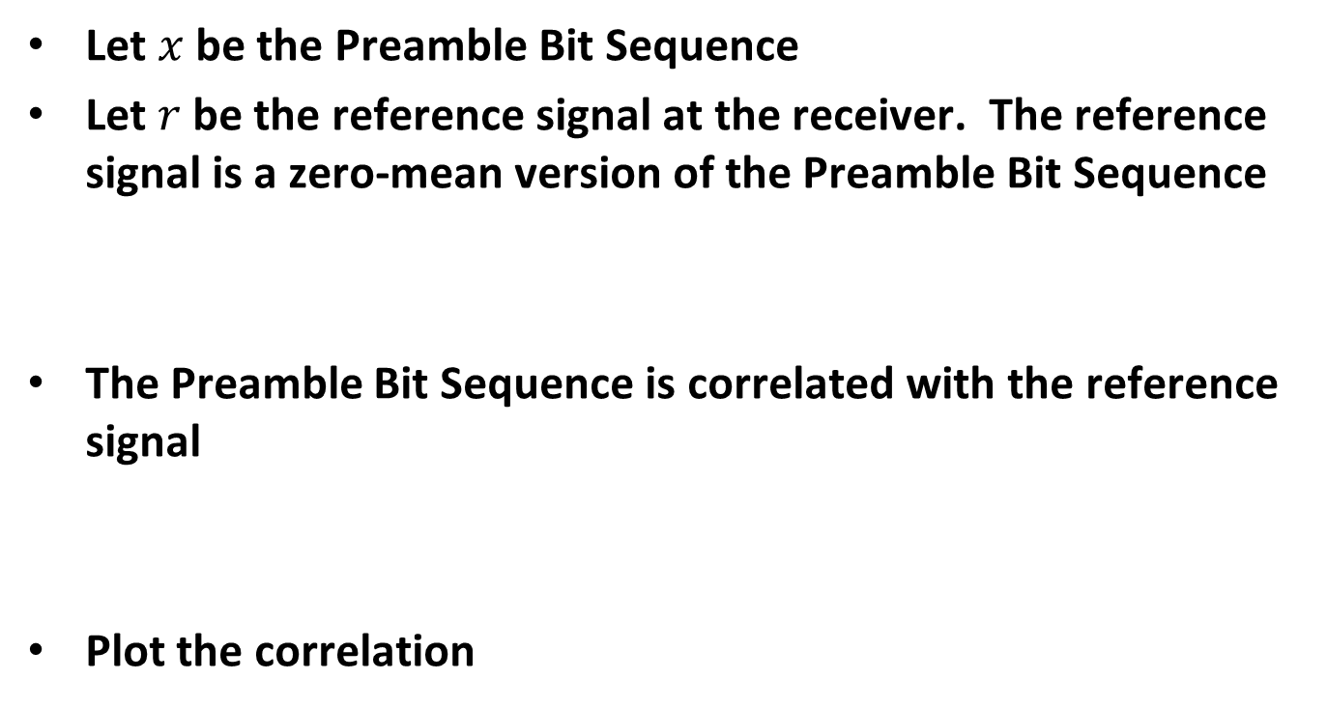

Correlation
Let $x$ be the Preamble Bit Sequence
Let $r$ be the reference signal at the receiver. The reference signal is a zero-mean version of the Preamble Bit Sequence
The Preamble Bit Sequence is correlated with the reference signal
Plot the correlation
$$r=2 x −1$$
$$y=corr(x, r)$$

Slide 5
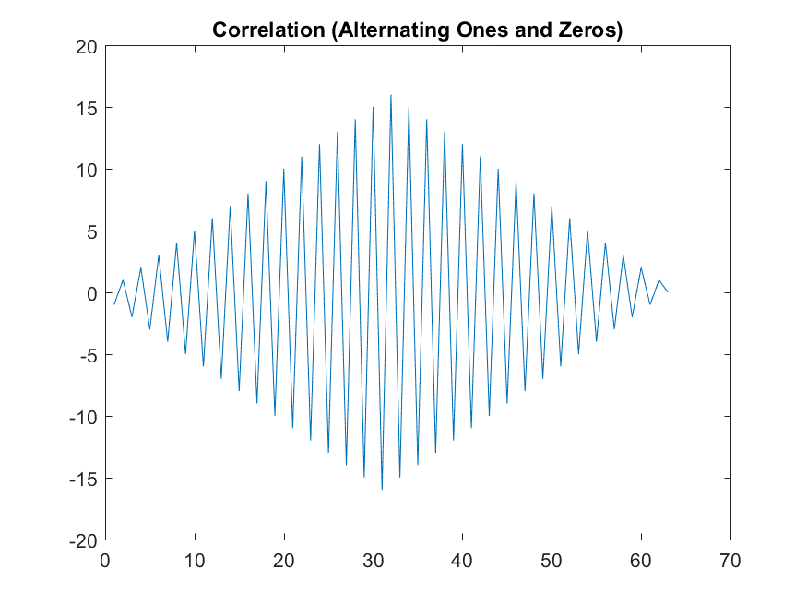
Correlation – Alternating Ones and Zeros

Slide 6
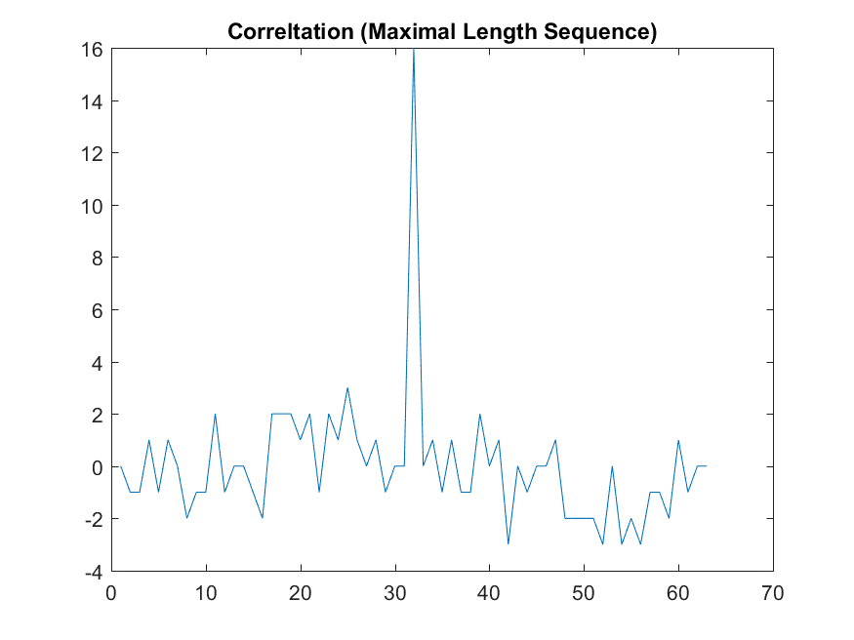
Correlation – Maximal Length Sequence

Slide 7
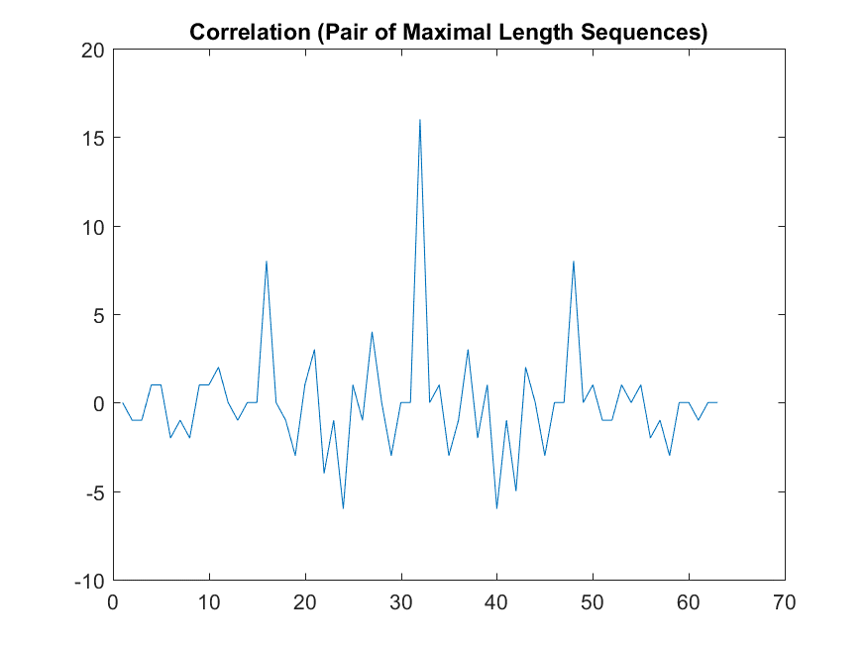
Correlation – Pair of Maximal Length Sequences

Slide 8
Observations
When fully aligned all three sequences have the same value
When not aligned the MLS has the lowest correlation values, followed by the Pair of MLS and then the Alternating Ones and Zeros

Slide 9
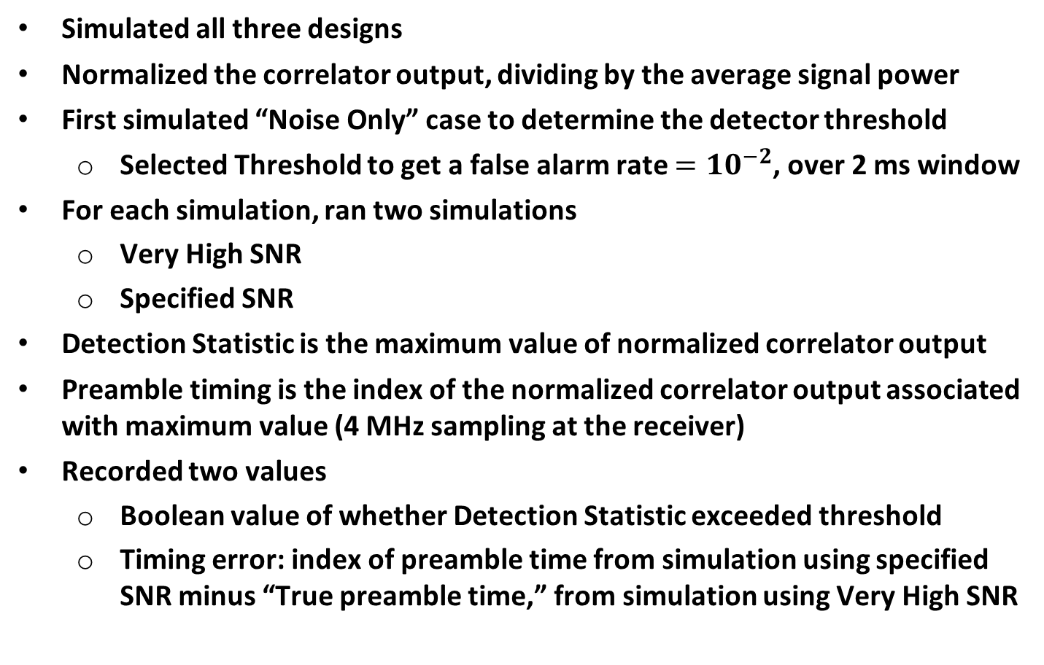
Simulation
Simulated all three designs
Normalized the correlator output, dividing by the average signal power
First simulated “Noise Only” case to determine the detector threshold
  Selected Threshold to get a false alarm rate $=10^{−2}$, over 2 ms window
For each simulation, ran two simulations
  Very High SNR
  Specified SNR
Detection Statistic is the maximum value of normalized correlator output
Preamble timing is the index of the normalized correlator output associated with maximum value (4 MHz sampling at the receiver)
Recorded two values
  Boolean value of whether Detection Statistic exceeded threshold
  Timing error: index of preamble time from simulation using specified SNR minus “True preamble time,” from simulation using Very High SNR

Slide 10
Simulation – Post Processing
Probability of Detection
  (1 - Probability of Detection) versus SNR
Timing Error
  Selected only the cases where the preamble was detected. In cases where the preamble was not detected the timing value is meaningless
  Plotted Four Different Timing Error Metrics, versus SNR
    95th Percentile of the Timing Error
    Fraction of Timing Errors > 1 µs

Slide 11
Probability of Detection – AWGN
In the “Alternating One and Zeros” design, sometime the “side peaks” exceed the main peak, so its probability of detection is better than the other designs

Slide 12
Timing Error Metric #1 – AWGN
In the “Alternating One and Zeros” design is much worse than the other two designs

Slide 13
Timing Error Metric #2 – AWGN
In the “Alternating One and Zeros” design is much worse than the other two designs

Slide 14
Probability of Detection – Model D

Slide 15
Timing Error Metric #1 – Model D
In the “Alternating One and Zeros” design is much worse than the other two designs

Slide 16
Timing Error Metric #2 – Model D
In the “Alternating One and Zeros” design is much worse than the other two designs

Slide 17
Target SNR Levels
Earlier Data Field simulations [4] for 62.5 kb/s data rate
Design | Data Rate (kb/s) | 10%-PER SNR (dB) AWGN | 10%-PER SNR (dB) Model D
Repetition Code & Manchester Code | 62.5 | -9.3 | -2.9
BCC & Manchester Code | 62.5 | -12.3 | -5.3
SNR measured with 20 MHz bandwidth

Slide 18
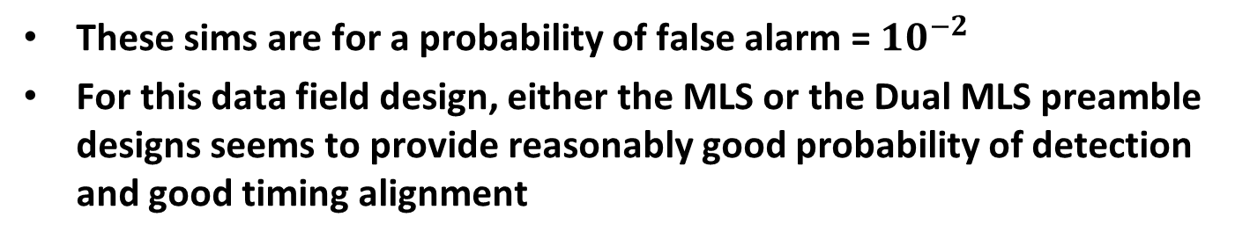
62.5 kb/s – Repetition Code & Manchester Code
 | AWGN @ -9 dB SNR |  |  | Model D @ -3 dB SNR
 | P(Miss Detection) | Timing Error 95 Percentile | Timing Error Percent > 1 µs | P(Miss Detection) | Timing Error 95 Percentile | Timing Error Percent > 1 µs
Alternating Ones and Zeros | 0.006 | 16 µs | 24% | 0.066 | 8 µs | 6.3%
MLS | 0.009 | 0.5 µs | 0.72% | 0.071 | 0.25 µs | 0.63%
Dual MLS | 0.009 | 0.5 µs | 0.79% | 0.070 | 0.25 µs | 0.68%
These sims are for a probability of false alarm = $10^{−2}$
For this data field design, either the MLS or the Dual MLS preamble designs seems to provide reasonably good probability of detection and good timing alignment

Slide 19
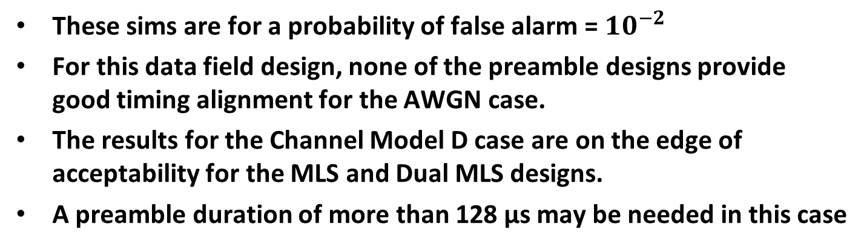
62.5 kb/s – BCC & Manchester Code
 | AWGN @ -12 dB SNR |  |  | Model D @ -5 dB SNR
 | P(Miss Detection) | Timing Error 95 Percentile | Timing Error Percent > 1 µs | P(Miss Detection) | Timing Error 95 Percentile | Timing Error Percent > 1 µs
Alternating Ones and Zeros | 0.64 | 40 µs | 53% | 0.13 | 8 µs | 10.6%
MLS | 0.71 | 1.75 µs | 8.5% | 0.14 | 0.5 µs | 1.0%
Dual MLS | 0.70 | 2 µs | 9.7% | 0.14 | 0.5 µs | 1.2%
These sims are for a probability of false alarm = $10^{−2}$
For this data field design, none of the preamble designs provide good timing alignment for the AWGN case.
The results for the Channel Model D case are on the edge of acceptability for the MLS and Dual MLS designs.
A preamble duration of more than 128 µs may be needed in this case

Slide 20
Conclusions
It is important to look at multiple factors in evaluating the preamble design
  Probability of False Alarm
  Probability of Miss Detection
  Timing Error Statistics
For the 62.5 kb/s design using Repetition Code and Manchester code, the 32-bit (128 µs) preamble of either the MLS or Dual MLS seem to be potential candidates for the preamble
For the 62.5 kb/s design using BCC and Manchester code, the 32-bit (128 µs) preamble may not be long enough to work at the lower SNR of this design

Slide 21
References
Jianhan Liu, Tianyu Wu, Thomas Pare, and Frank Hsu, “Follow up on Preamble Design for WUR,” IEEE 802.11-17/1020r0, July 2017
Steve Shellhammer, Bin Tian and Lochan Verma, “Preamble Design and Simulations,” IEEE 802.11-17/991r0, July 2017
Shahrnaz Azizi, Thomas Kenney and Juan Fang, “Preamble Options,” IEEE 802.11-17/997r0, July 2017
Steve Shellhammer and Bin Tian, “Data Rates and Coding,” IEEE 802.11-17/670r0, May 2017

