Slide 1
Strategies to Maximize Adoption of
802.11 in 5G Networks
Date: 2017-08-13
Authors:

Slide 2
Abstract
Reframe the LTE vs. Wi-Fi debate
  Consider 5G at a system & business model level
  Put 5G RATs including Wi-Fi into a broader context
  Explain the emergence of unlicensed LTE in evolutionary terms
Explain the huge “better together” opportunity
Offer a viewpoint on technical, organizational & procedural challenges
Propose specific actions to take as a community

Slide 3
Presenter’s Note
This presentation represents a personal viewpoint regarding systemic issues faced across the Wi-Fi ecosystem to hold and grow market share in “operator” networks.
Its scope intentionally goes beyond IEEE 802, and certain IEEE presentation conventions are not followed. The terms “802.11” and “Wi-Fi” are intentionally used interchangeably to draw a wider point. A variety of WFA programs are deliberately mentioned by name.
A form of this presentation was delivered as a keynote address to the Wi-Fi Alliance in June, 2017. It is being delivered to AANI SC at the request of the Chair.

Slide 4
5G cannot succeed without Wi-Fi
We need to look past LAA / LTE-U
Operators ultimately don’t care what RAT wins – just cost and efficacy
In 4G, a key driver of unlicensed LTE development is failure of Wi-Fi to address charging/PCRF, discovery & mobility requirements in a manner acceptable to operators
5G radio aggregation techniques natively incorporate 802.11 as a peer 5G RAT Family (5GRF) member, and effectively render Hotspot 2.0 unnecessary for SIM-based devices
This unlocks cooperative win/win outcomes that were not feasible in 4G

Slide 5
Wi-Fi Does Not Compete Directly With 5G
The parent SDOs have radically different scopes & approaches
  802.11 & WFA thinking is “atomic” - it starts at the AP/STA and stops at BSS
  By contrast, 3GPP starts from the subscription, works backwards to a system, and finally on to all of the constituent elements.
  Even WFA certifications like HotSpot 2.0 are not “operator-ready”; hence need for Wireless Broadband Alliance
At the end of the day, 802.11 is simply a layer-2 bridging technology
  In most deployments, 802.11 radios are small parts of a larger system
Wi-Fi is a component; 5G is a system of vastly higher complexity
  If 802.11 is a type of engine, “5G” would be the cars plus the road network.
At most we can say that Wi-Fi competes with specific 3GPP RATs in specific frequency bands

Slide 6
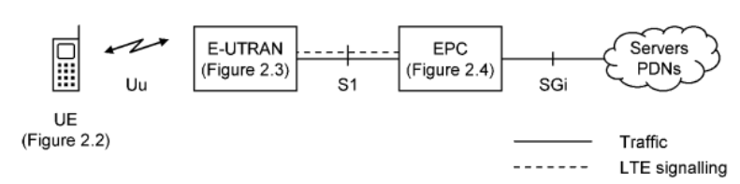
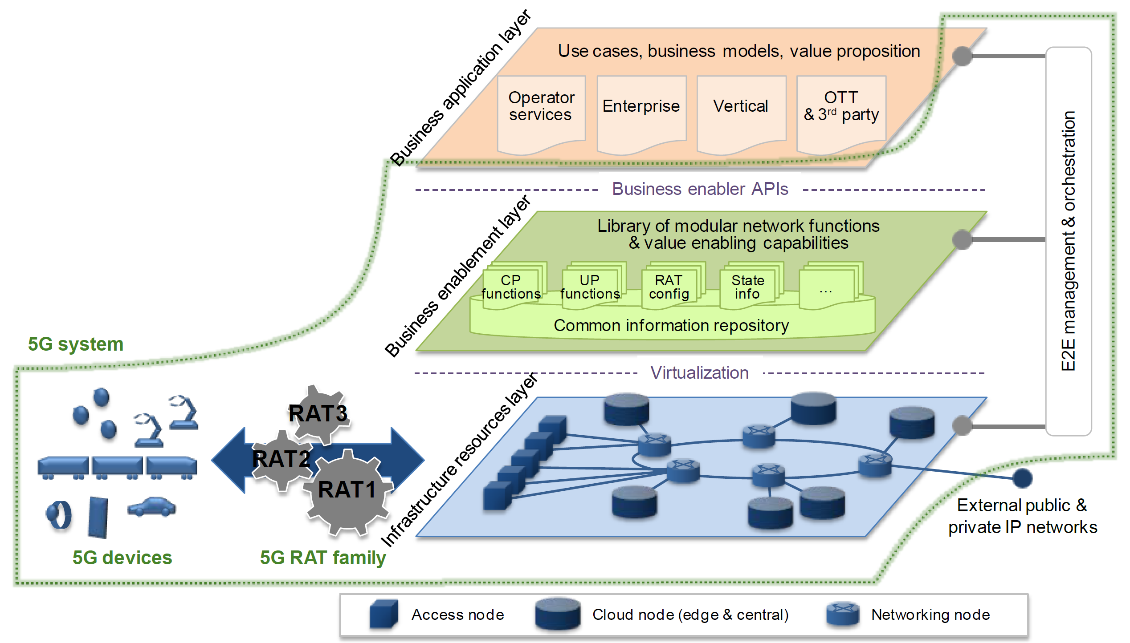
What Is “5G”?
5G is a strategy
5G is an eight layer architecture
It is a massive shift in how mobile operators provision services, forward traffic, manage competition, reduce costs and monetize subscribers
Main focus is on composability, modularity, service agility, virtualization, and datapath flexibility
5G is RAT agnostic and is building around Wi-Fi
5G is decentralized
4G Evolved Packet System (EPS)
5G Next Generation Mobile Network
Source: “5G White Paper”, Next Generation Mobile Networks Alliance, V1.0, 2015-02

Slide 7
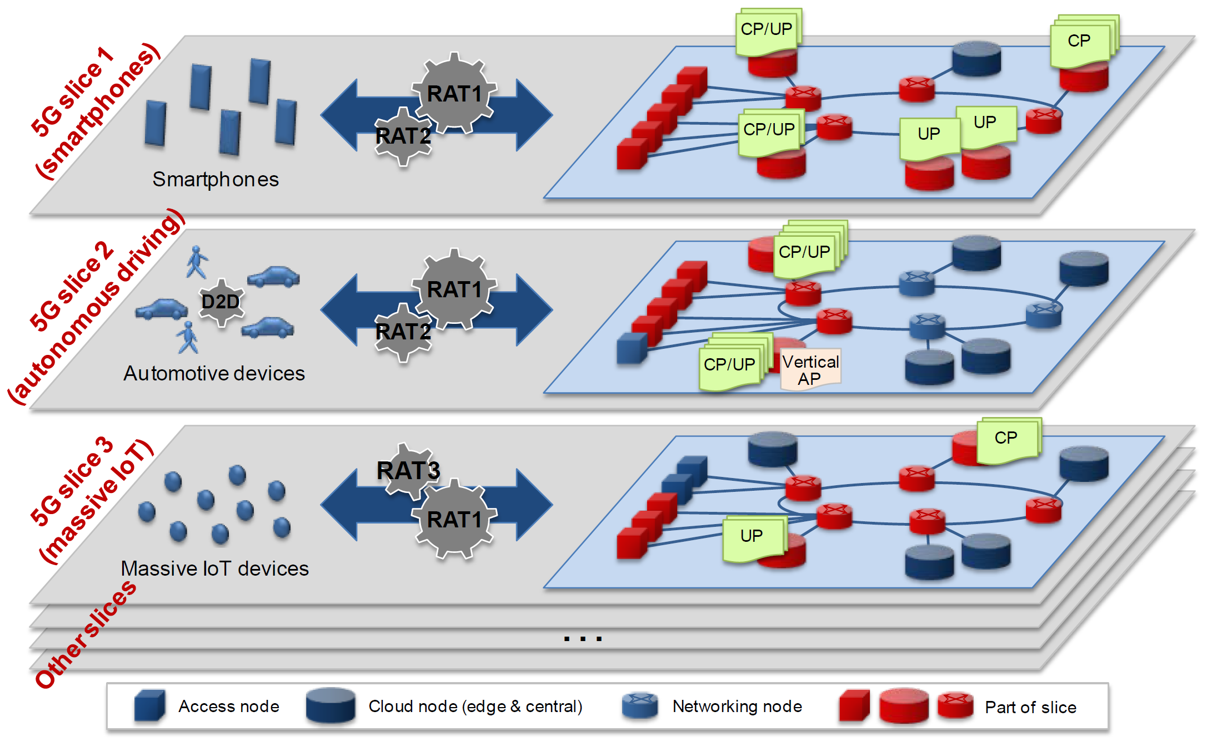
5G Strategy Example – Network Slicing
5G “network slicing” enables subscriber-specific custom virtualized datapaths to be dynamically provisioned, even spanning multiple physical network owners
Source: “5G White Paper”, Next Generation Mobile Networks Alliance, V1.0, 2015-02

Slide 8
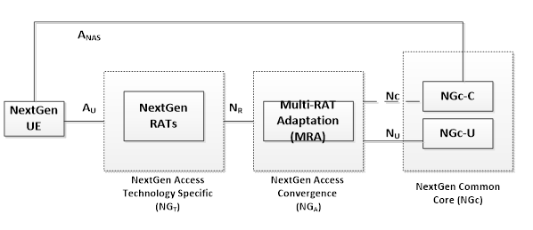
Decoupling the RAN with Multi-Connectivity
TR 23.799 introduces a network convergence sublayer (NCS) to explicitly enable independent evolution of RAN and core
Explicit mechanisms for managing Wi-Fi STA attach and mobility (including EAP-AKA’ key material exchange based on LWA) are being designed
UEs may have multiple, active RATs with varying capabilities anchored on different eNB / gNB / Wi-Fi / mmW or other serving radios
Source: 3GPP TR 23.799, “Study on Architecture for Next Generation System,” V14.0.0, 2016-12

Slide 9


5G Enables Radically New Operator Landscape
Next-Gen
Virtual NO
Wholesale
NO
Next-Gen
Neutral Host
Legacy MSO
Legacy MNO
5G-NGC
5G-NGC
5G-NGC
5G-NGC
5G-MRA
5G-MRA
5G-MRA
5G-MRA
Wi-Fi
CBRS
SCell
Wi-Fi
CBRS
Macro
SCell
Wi-Fi
DAS
SCell
CPE
CPE
CPE
CPE
CPE
CPE
CPE
CPE
Roaming
UEs
Own
UEs
Roaming
UEs
Own
UEs
Roaming
UEs
Own
UEs
Roaming
UEs

Slide 10
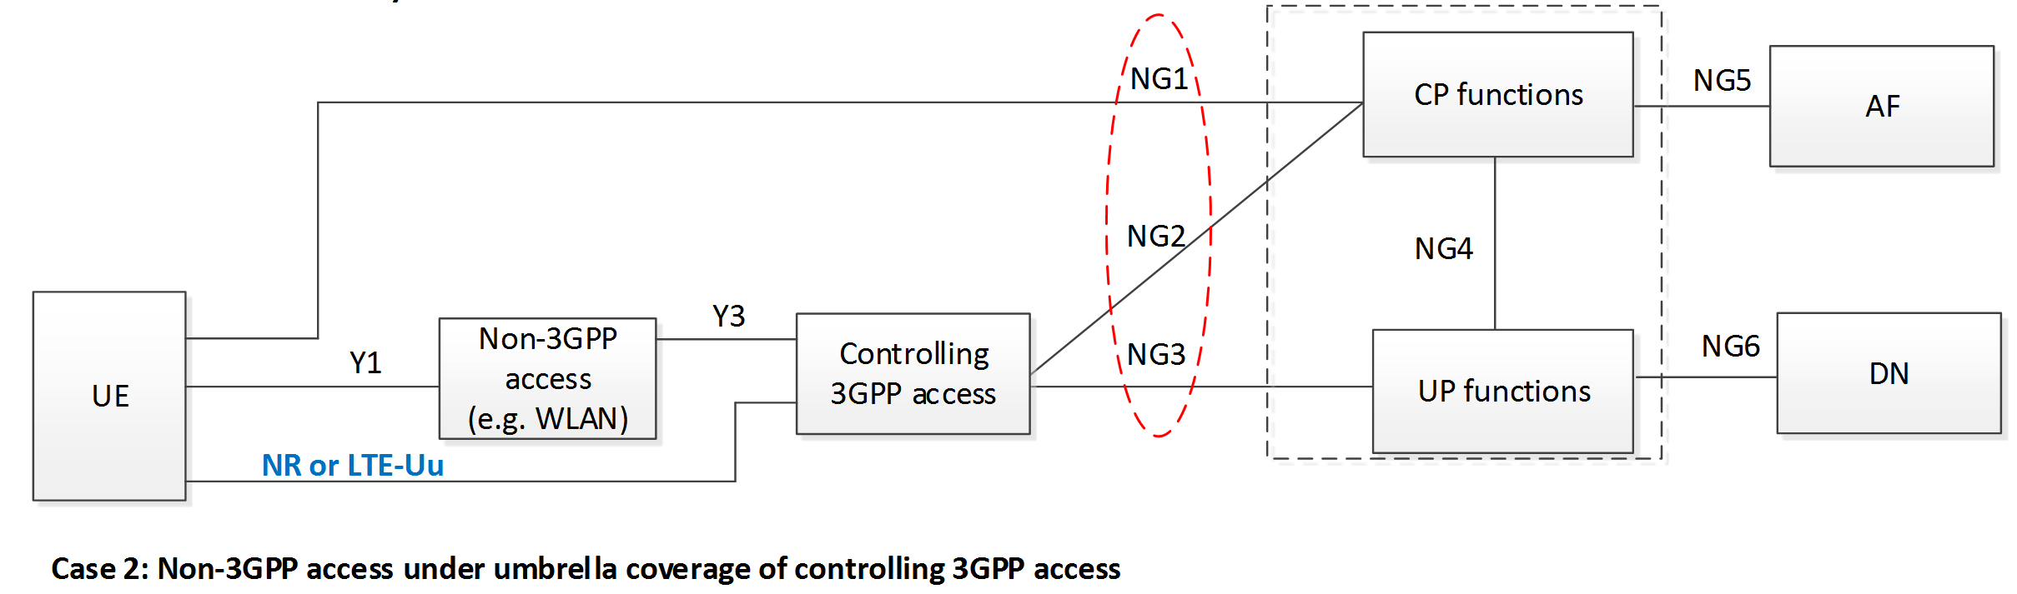
5G Combines Best of LWA & LWIP
Similar to R13/14 LWA, the 5G control plane allows programming UE with WLAN profiles, attachment policies, and keying material.
Hotspot 2.0 is no longer necessary. PCRF accounting is fully integrated.
Both trusted & untrusted modes are supported, effectively merging LWA & LWIP
Allows Wi-Fi to compete on equal footing with 3GPP RATs
Source: 3GPP TR 23.799, “Study on Architecture for Next Generation System,” V14.0.0, 2016-12

Slide 11
There’s Just One Small (Cell) Problem…
“Gigabit LTE” requires pervasive indoor small cells in places people work, shop, travel and relax.
This problem is also RAT agnostic:
  L/S bands: 4SS MIMO + 3 Carrier Agg + HO modulations
  C band: Bonding (unlicensed or LSA)
  Ka/V bands: Bonding (licensed or unlicensed)
Only 1.5 million indoor enterprise small cells were installed by YE16
Small Cell Forum forecasts show Wi-Fi lead growing from 14M in 2016 to 20+M in 2020.
Sources: Dell’Oro Group, Small Cell Forum Market Status Reports

Slide 12
Current Small Cell Models Are Flawed
Small cells have failed due to a structural funding model problem
  Enterprises are almost completely resistant to purchasing small cells for coverage
  Operators could easily fund a global indoor small cell buildout for < $60B
    But such an investment produces no incremental revenue!
Multiple, separate physical small cell layers are required to aggregate
  5 GHz S-Cells must be deployed 2-4X more densely than <2 GHz P-Cell
  mmW S-Cells must be deployed 8-20X more densely than <2 GHz P-Cell
  Indoor non-residential small cells are failing at licensed wavelengths
Wi-Fi is inherently neutral host, and “cost per bit” easily beats LTE
  Like any for-profit business, operators must carry bulk of their cost by cheapest means

Slide 13
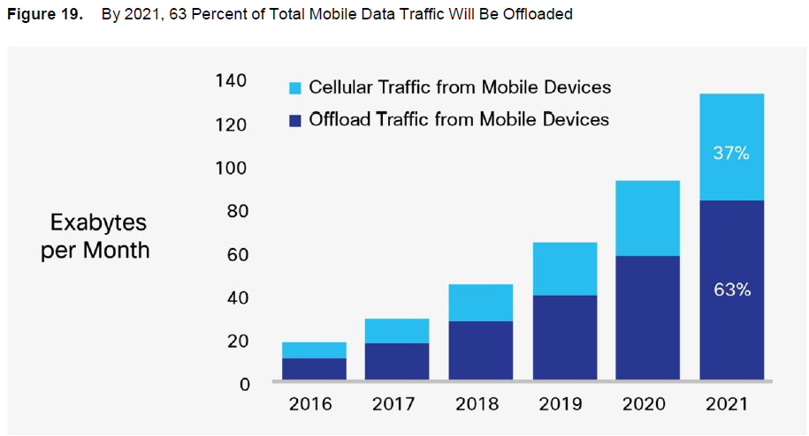
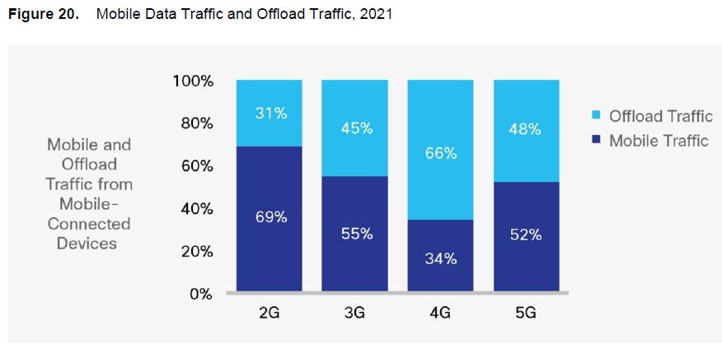
Understanding the Better Together Opportunity
In 2021…
Wi-Fi will be the dominant indoor aggregation technology
  Universal connectivity layer for both SIM and non-SIM based devices
  Capex & opex are already baked into end-user IT budgets
  Wi-Fi will keep lowest cost/bit (barring radical operator/silicon business model change)
11ax and 5G are naturally complementary.
  3GPP is designing user & control plane for Wi-Fi from ground up on both ends of link
  11ax is capable of being an operator grade air interface
Source: Cisco VNI Global Mobile Data Traffic Forecast Update, 2016-2021, February, 2017

Slide 14
What Does “Success” Look Like?
802.11 is the predominant indoor mid-band RAT, carrying vast majority of operator bulk traffic (regardless of spectrum holdings)
  Unlicensed LTE / NR is deployed selectively by MNO/MSO to address specific scenarios
Managed Wi-Fi systems are transparently integrated as trusted WTs in 5G networks, including network discovery, key exchange, and mobility
  Including MSO-managed residential & SMB systems with Wi-Fi CPE
  Only standalone home wireless routers/clusters would operate untrusted
  Requires significant Wi-Fi engagement with 3GPP SA to help define interfaces
Wi-Fi continues to be prominently visible user choice on SIM-based UEs
We still need to improve HS2.0 for non-SIM devices and enterprise use cases

Slide 15
What Must We Do to Achieve This Vision?
Meet or Exceed 3GPP RAT Minimums
Close Operator Technology Gaps
Improve Our Processes
100% bearer encryption with pairwise keys
Ultra-high QoS/GBR
Deterministic mobility
Ensure wide & timely deployment
Complete MBO, OCE expeditiously
Native support for 5G signaling (next-gen Xw and N3IWF) in Wi-Fi ESS/BSS
Radically accelerate 802.11 innovation
Improve member participation on critical programs
Engage at 3GPP
Tell our story better, especially mission criticality of Wi-Fi to global economy

Slide 16
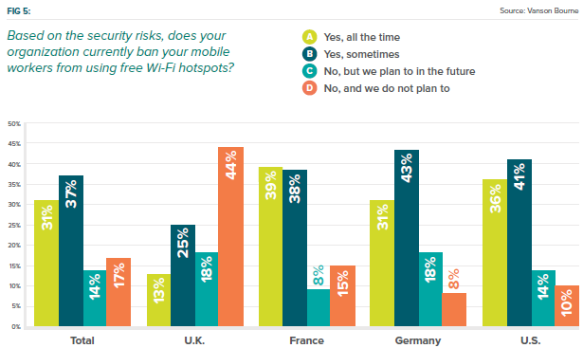
We Have to Modernize Security
“Open” ➔ Unencrypted radio bearers have been gone from 3GPP since 2008
“PSK” ➔ LTE has never used shared keying material.
“802.1X” ➔ Too complex to configure, leading to bad behavior.
iPass 2017 Mobile Security Report (Survey of 500+ CIOs), May, 2017
Notes:
This report has lots of scary statistics including (1) CEOs are the biggest threat to enterprise; (2) MiTM and unencrypted hotspots are top concern 69% and 63% respectively

Slide 17
We Have Solutions… It’s Time to Admit Problem
Open
Preshared Key
Enterprise 802.1X
Opportunistic Wireless Encryption (OWE)
  RFC 8110
Provides encryption of the wireless medium but no authentication
Based on ephemeral pairwise keys negotiated via Diffie-Hellman exchange on association
Simultaneous Authentication of Equals (SAE)
  Defined in 802.11s
  RFC 6617 (IKEv2)
Password authenticated key exchange with commit / confirm methodology
Resistant to dictionary attack
EAP-PWD
  RFC 8146 & 5931
  Simple EAP exchange with full mutual authentication using shared secret, and no certificate
  Existing support in Android, Windows
802.11ai FILS provides public key authentication without certificates
Allows fully encrypted Open mode with no user workflow change!
Pairwise encryption, mutual auth & forward secrecy!
Solves numerous well known 802.1X usability problems

Slide 18
3GPP Feature Velocity Is Accelerating…
UMTS
IMS, HSDPA
WLAN, HSUPA
LTE, OFDMA, 3G SC, UL-MU-MIMO
3G 2C Agg, 4G SC
LTE-A, 3G 4CA, DL-MU-MIMO
CoMP, SaMOG
Dual Connectivity, SIPTO, HSPA+
LAA, LWA, LWIP, NB-IOT, LTEm
eLAA, eLWA 60GHz , eLWIP
5G
Source: http://www.3gpp.org/specifications/67-releases

Slide 19
…While 802.11 is Decelerating
3GPP Median
3GPP Median
Sources: http://www.ieee802.org/11/Reports/802.11_Timelines.htm

Slide 20
Summary
Good News
Bad News
Wi-Fi and 5G do not compete directly.
Spectrum is more important to 3GPP than any specific RAT
Wi-Fi is a small component in a vastly larger end-to-end system
The pressures driving 3GPP to unlicensed have nothing to do with Wi-Fi
  PHY/MAC competition in 5 GHz is a byproduct of an inevitable 3GPP trajectory
  Dual connectivity, carrier agg, convergence layers are long term secular trends
5G is ironically solving many of the longstanding Wi-Fi integration problems and removing incentive to use LAA
Unlicensed LTE is above all the 3GPP verdict on Wi-Fi community’s failed attempts to integrate with cellular networks
  Arguably, success of S2b and total failure of S2a renders the same verdict.
WFA and WBA are hard to do business with (from a 3GPP perspective). They are engineering us out of the equation.
  HS2.0 & WBA inter-operator roaming are obsolete for 5G SIM-enabled UEs
The 3GPP community has made a huge bet on unlicensed LTE. It will be deployed, and it will be a serious competitive issue for Wi-Fi.
R15 unlicensed NR will work. The clock is ticking.

Slide 21
Call to Action
We can maximize role of 802.11 in 5G networks by driving towards a cooperative outcome in which Wi-Fi is transparently integrated and lowest cost per bit
  Market forces will drive operators to prefer Wi-Fi over alternatives for bulk transport
We cannot lose time – we have to speed up those items of concern to 3GPP
  Release 15 will deliver 3rd generation of unlicensed LTE. It will work.
  Wi-Fi ASPs and CAGRs are flattening quickly. This will limit our ability to invest.
  802.11ax timeframes are lengthening!
We are vulnerable to radical business model shifts
  Cable MSOs have already converted over 65% of residential users to subscription model for Wi-Fi AP hardware.
  Operators and/or silicon providers could adopt a Netscape/Google strategy
We must fight to ensure consumers retain RAT choice in UEs
  Wi-Fi could win but consumers could still lose.
  Consumers must be able to choose their RAT and cost model.

