Slide 1
September 2017 802.11ak Agenda
Date: 2016-09-02
Authors:
Name | Affiliations | Address | Phone | Email
Donald Eastlake | Huawei Technologies | 155 Beaver Street, Milford, MA 01757 USA | +1-508-333-2270 | d3e3e3@gmail.com

Slide 2
IEEE 802.11ak/GLK: Enhancements For Transit Links Within Bridged Networks
Waikoloa, Hawai‘i
11-14 September 2017
Chair & Editor: Donald E. Eastlake 3rd (Huawei)
d3e3e3@gmail.com +1-508-333-2270
Vice Chair: Mark Hamilton (Ruckus Wireless)
Vice Editor: Norm Finn (Huawei)
Secretary: Vacant
Mailing list: STDS-802-11-TGAK@listserv.ieee.org

Slide 3
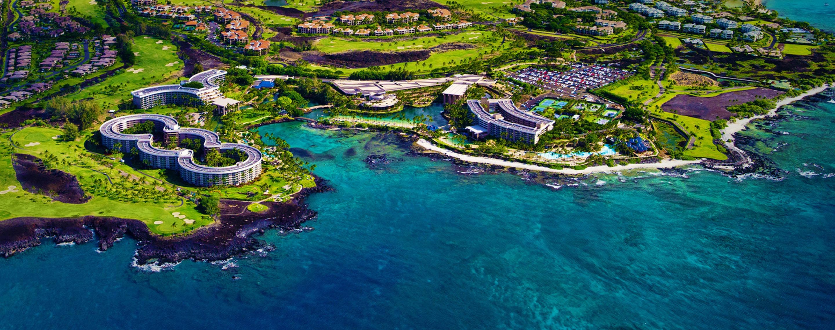
Venue
Hilton Waikoloa Village, Waikoloa, Hawai‘i

Slide 4
TGak Timeline
March 2015 – Initial WG Letter Ballot
February 2016 – WG Recirculation
January 2017 – Sponsor Ballot Pool Formation Start
January 2017 – MEC/MDR Initiated
(March 2017 – Sponsor Ballot Pool Formation and MEC/MDR Completed)
May 2017 – Initial Sponsor Ballot
September 2017 – Sponsor Recirculation
December 2017 – Final WG & ExecComm
March 2018 – RevCom Approval

Slide 5
Sessions
Day | Time | Room
Monday | AM2 | TBD
Monday | PM1 | TBD
Tuesday | AM1 | TBD
Tuesday | EVE | TBD
Thursday | AM1 | TBD
Thursday | PM1 | TBD

Slide 6
Monday, 11 September 2017 10:30-12:30
Call TGak meeting to order
Appointment of Secretary
Review of IEEE 802 and 802.11 Policies and Procedures on Intellectual Property, Inappropriate Topics, Etc. Call for essential patents
Attendance Recording Reminder
Approval of Agenda

Slide 7
Monday, 11 September 2017 10:30-12:30
Moved, to approve 11-17/1106r3 as the minutes of the Berlin TGak meeting in July.
Yes: No: Abstain:
Moved, to approve 11-17/1249rTBD as the minutes of the following TGak teleconferences held since the May TGak meeting:
31 July 2017
7 August 2017
28 August 2017
Yes: No: Abstain:

Slide 8
Monday, 11 September 2017 10:30-12:30
Presentations, motions, and discussion to resolve comments and improve the TGak Draft
Recess until 13:30 Monday afternoon.

Slide 9
Participants, Patents, and Duty to Inform
All participants in this meeting have certain obligations under the IEEE-SA Patent Policy.
Participants [Note: Quoted text excerpted from IEEE-SA Standards Board Bylaws subclause 6.2]:
“Shall inform the IEEE (or cause the IEEE to be informed)” of the identity of each “holder of any potential Essential Patent Claims of which they are personally aware” if the claims are owned or controlled by the participant or the entity the participant is from, employed by, or otherwise represent.
“Should inform the IEEE (or cause the IEEE to be informed)” of the identity of “any other holders of potential Essential Patent Claims” (that is, third parties that are not affiliated with the participant, with the participant’s employer, or with anyone else that the participant is from or otherwise represents)
The above does not apply if the patent claim is already the subject of an Accepted Letter of Assurance that applies to the proposed standard(s) under consideration by this group
Early identification of holders of potential Essential Patent Claims is strongly encouraged
No duty to perform a patent search

Slide 10
Patent Related Links
All participants should be familiar with their obligations under the IEEE-SA Policies & Procedures for standards development.
Patent Policy is stated in these sources:
IEEE-SA Standards Boards Bylaws
http://standards.ieee.org/develop/policies/bylaws/sect6-7.html#6
IEEE-SA Standards Board Operations Manual
http://standards.ieee.org/develop/policies/opman/sect6.html#6.3
Material about the patent policy is available at
http://standards.ieee.org/about/sasb/patcom/materials.html
If you have questions, contact the IEEE-SA Standards Board Patent Committee Administrator at patcom@ieee.org or visit http://standards.ieee.org/about/sasb/patcom/index.html
This slide set is available at https://development.standards.ieee.org/myproject/Public/mytools/mob/slideset.ppt

Slide 11
Call for Potentially Essential Patents
If anyone in this meeting is personally aware of the holder of any patent claims that are potentially essential to implementation of the proposed standard(s) under consideration by this group and that are not already the subject of an Accepted Letter of Assurance:
Either speak up now or
Provide the chair of this group with the identity of the holder(s) of any and all such claims as soon as possible or
Cause an LOA to be submitted

Slide 12
Participation in IEEE 802 Meetings
All participation in IEEE 802 Working Group meeting (Sponsor, Sponsor subgroup, Working Group, Working Group subgroup, etc.) is on an individual basis
• Participants in the IEEE standards development individual process shall act based on their qualifications and experience. (https://standards.ieee.org/develop/policies/bylaws/sb_bylaws.pdf section 5.2.1)
• IEEE 802 Working Group membership is by individual; “Working Group members shall participate in the consensus process in a manner consistent with their professional expert opinion as individuals, and not as organizational representatives”. (subclause 4.2.1 “Establishment”, of the IEEE 802 LMSC Working Group Policies and Procedures)
Participants have an obligation to act and vote as an individual and not under the direction of any other individual or group. A Participant’s obligation to act and vote as an individual applies in all cases, regardless of any external commitments, agreements, contracts, or orders.
Participants shall not direct the actions or votes of any other member of an IEEE 802 Working Group or retaliate against any other member for their actions or votes within IEEE 802 Working Group meetings, see https://standards.ieee.org/develop/policies/bylaws/sb_bylaws.pdf section 5.2.1.3 and the IEEE 802 LMSC Working Group Policies and Procedures, subclause 3.4.1 “Chair”, list item x.
By participating in IEEE 802 meetings, you accept these requirements. If you do not agree to these policies then you shall not participate.
(Latest revision of IEEE 802 LMSC Working Group Policies and Procedures: http://www.ieee802.org/devdocs.shtml)

Slide 13
Other Guidelines for IEEE WG Meetings
All IEEE-SA standards meetings shall be conducted in compliance with all applicable laws, including antitrust and competition laws.
Don’t discuss the interpretation, validity, or essentiality of patents/patent claims.
Don’t discuss specific license rates, terms, or conditions.
Relative costs, including licensing costs of essential patent claims, of different technical approaches may be discussed in standards development meetings.
Technical considerations remain primary focus
Don’t discuss or engage in the fixing of product prices, allocation of customers, or division of sales markets.
Don’t discuss the status or substance of ongoing or threatened litigation.
Don’t be silent if inappropriate topics are discussed … do formally object.
---------------------------------------------------------------
See IEEE-SA Standards Board Operations Manual, clause 5.3.10 and “Promoting Competition and Innovation: What You Need to Know about the IEEE Standards Association's Antitrust and Competition Policy” for more details.

Slide 14
Monday, 11 September 2017 13:30-15:30
Call meeting to order
Appointment of Secretary
Call for essential patents
Attendance Recording Reminder
Approval of Agenda

Slide 15
Monday, 11 September 2017 13:30-15:30
Moved, to adopted the Figures in 11-17/0932r6 and direct the Editor to insert them into the 11ak draft.
Moved: Seconded:
Yes: No: Abstain:

Slide 16
Monday, 11 September 2017 13:30-15:30
Presentations, motions, and discussion to resolve comments and improve the TGak Draft
Recess until 8:00 Tuesday evening.

Slide 17
Tuesday, 12 September 2017 08:00–10:00
Call meeting to order
Appointment of Secretary
Call for essential patents
Attendance Recording Reminder
Approval of Agenda
Presentations, motions, and discussion to resolve comments and improve the TGak Draft
Recess until 21:30 Tuesday evening

Slide 18
Tuesday, 12 September 2017 19:30–21:30
Call meeting to order
Appointment of Secretary
Call for essential patents
Attendance Recording Reminder
Approval of Agenda
Presentations, motions, and discussion to resolve comments and improve the TGak Draft
Recess until 08:00 Thursday

Slide 19
Thursday, 14 September 2017 08:00–10:00
Call meeting to order 08:00
Appointment of Secretary
Call for essential patents
Attendance Recording Reminder
Approval of Agenda
Presentations, motions, and discussion to resolve comments and improve the TGak Draft
Recess until 13:30 Thursday afternoon

Slide 20
Thursday, 14 September 2017 13:30–15:30
Call meeting to order 08:00
Appointment of Secretary
Call for essential patents
Attendance Recording Reminder
Approval of Agenda
Presentations, motions, and discussion to resolve comments and improve the TGak Draft

Slide 21
Thursday, 14 September 2017 13:30–15:30
Teleconferences discussion
Moved, to hold 802.11ak Teleconferences:
1 hour teleconferences through the November 2017 802.11 meeting on Monday TBD at 9am Eastern US Time.
Yes: No: Abstain:
Adjourn TGak

Slide 22
[Reference Information]
802.11ak PAR and Five Criterion
https://development.standards.ieee.org/get-file/P802.11ak.pdf?t=77398400003
11-12/1207r1, “802.11 GLK Draft PAR”
11-12/1208r0, “802.11 GLK Draft 5C”
Draft 4.0 of 802.11ak (now in Sponsor Ballot):
http://www.ieee802.org/11/private/Draft_Standards/11ak/Draft P802.11ak_D4.0.pdf
802.1Qbz and 802.1AC-REV are published as IEEE Std 802.1Qbz-2016 and IEEE Std 802.1AC-2016
Last Drafts:
http://www.ieee802.org/1/files/private/bz-drafts/d2/802-1Qbz-d2-4.pdf
http://www.ieee802.org/1/files/private/ac-rev-drafts/d4/802-1ac-rev-d4-0.pdf
(Note: you can use 802.1 or 802.11 credential to access either members site.)

