Slide 1
802.11 September 2017 Closing Reports
Date: 2017-09-14
Authors:

Slide 2
Abstract
This document is a digest of the closing reports of all 802.11 sub-groups for presentation at the September 2017 closing plenary meeting. Attendance information and liaison reports (including liaison reports from the mid-week plenary) are also included.

Slide 3
Attendance
Data as of 2017-09-14
19:00

Slide 4
Attendance Total

Slide 5
Attendance Histogram

Slide 6
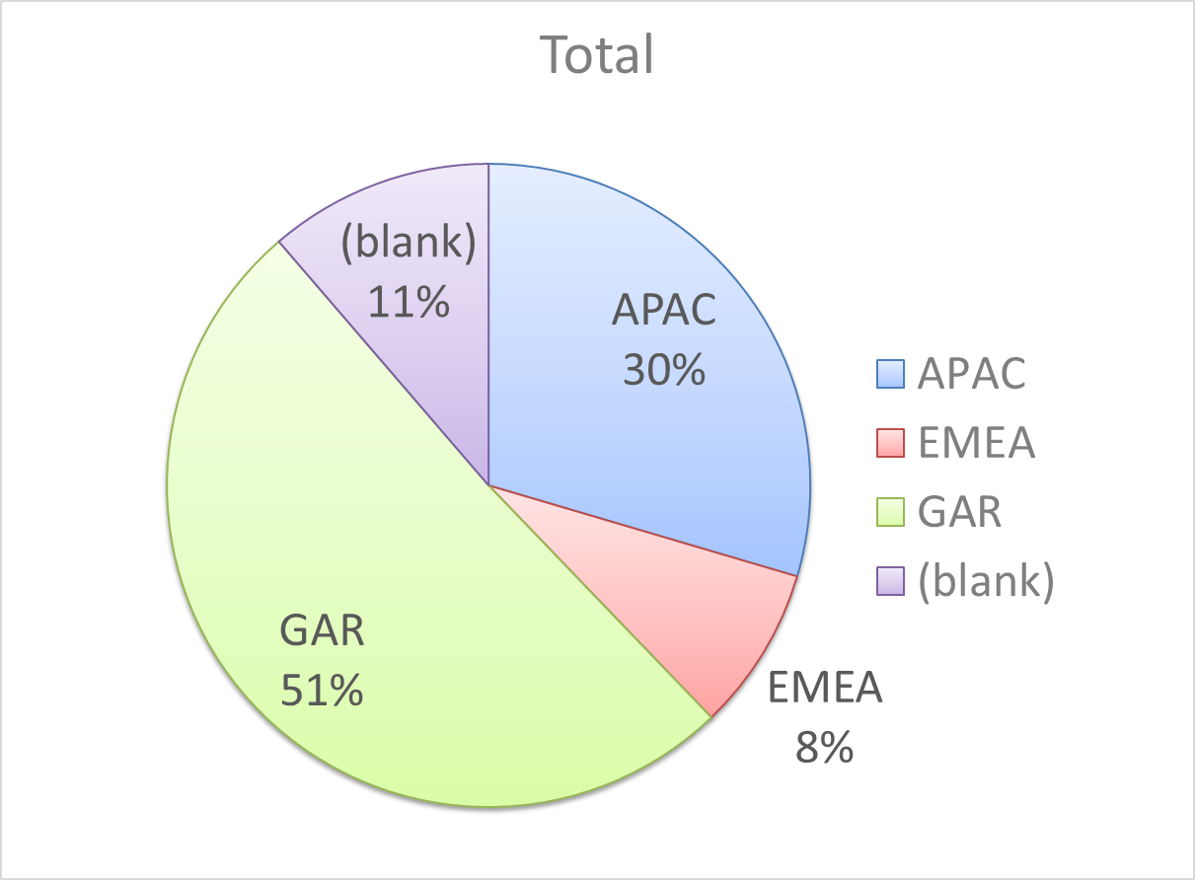
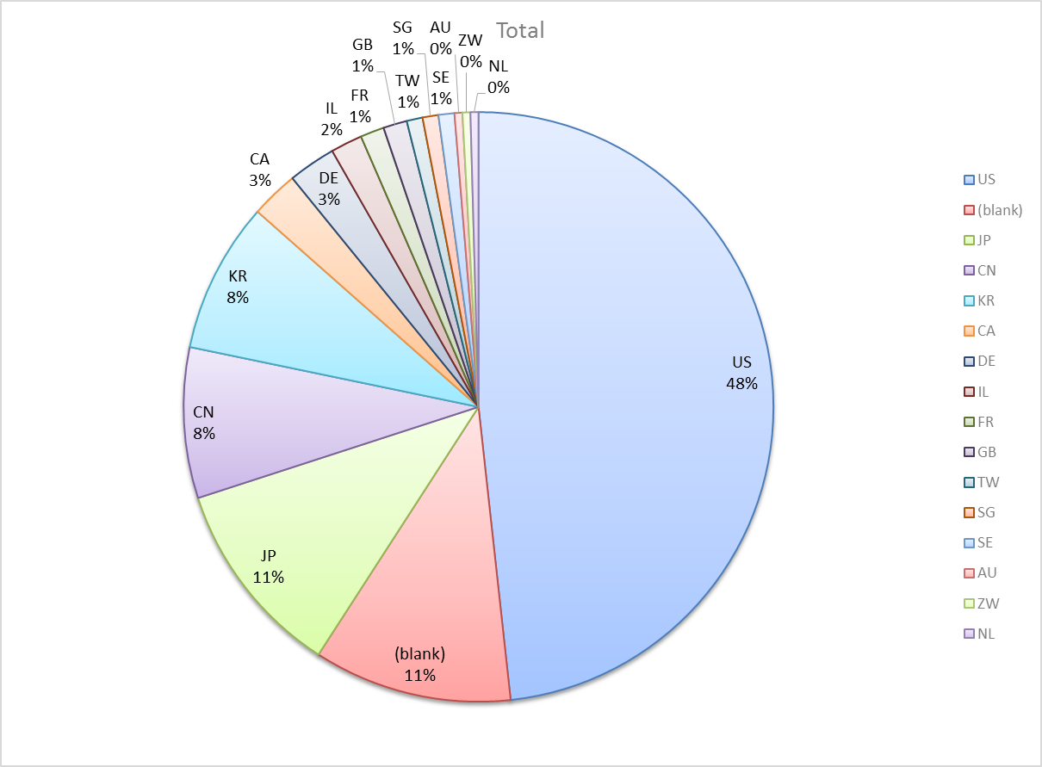
Attendance by Country

Slide 7
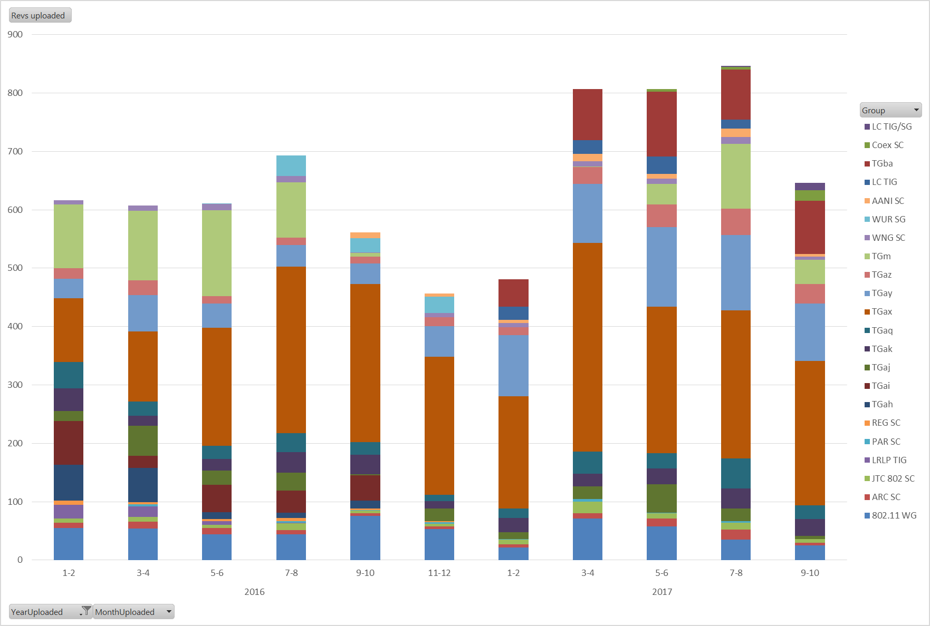
Doc Revision uploads by meeting (month #)

Slide 8
802.11 WG Editor’s Closing Report
(Sept 2017)
Date: 2017-09-12
Authors:
from slide 1/5 of 11-17-1206 by Robert Stacey, Intel Corporation
Notes:
July 2007

Slide 9
Volunteer Editor Contacts
TGaj – Jiamin CHEN – jiamin.chen@mail01.huawei.com, Shiwen He – shiwenhe@seu.edu.cn
TGak – Donald Eastlake – d3e3e3@gmail.com
TGaq – Lee Armstrong – LRA@tiac.net
  TGax – Robert Stacey – robert.stacey@intel.com
  TGay – Carlos Cordeiro – carlos.cordeiro@intel.com
  TGaz – Chao Chun Wang – chaochun.wang@mediatek.com
  TGba – Po-kai Huang – po-kai.huang@intel.com
REVmd –Emily Qi – emily.h.qi@intel.com, Edward Au – edward.ks.au@huawei.com,
  Editors Emeritus:
  TGaa – Alex Ashley – alex.ashley@hotmail.co.uk
  TGac – Robert Stacey – robert.stacey@intel.com
  TGad – Carlos Cordeiro – carlos.cordeiro@intel.com
  TGae – Henry Ptasinski – henry@LOGOUT.COM
  TGaf – Peter Ecclesine – petere@ieee.org
  REVmc – Adrian Stephens – adrian.p.stephens@ieee.org , Edward Au – edward.ks.au@huawei.com, Emily Qi – emily.h.qi@intel.com
  TGai - LRA@tiac.net, Ping FANG Ping.FANG@huawei.com
  TGah – Yongho Seok yongho.seok@gmail.com, Alfred Asterjadhi – aasterja@qti.qualcomm.com
  TGaq – Dan Gal – ddrgal@gmail.com
from slide 2/5 of 11-17-1206 by Robert Stacey, Intel Corporation
Notes:
July 2007

Slide 10
Sept 12th round table status report
11aq – Just completed ballot, 16 comments. Most likely will need to address compliance with 802c.
11ak – Resolving comments. Expect to recirc out of September meeting.
11aj – D8.0 received no additional comments. Request WG approval to forward to EC and REVCOM
11ax – Expect to complete comment resolution and go to WG letter ballot coming out of September meeting.
11ay – No update available
11az – Approved SFD D0.4. Release D0.5 coming out of September. May revise PAR – some time until draft available.
11ba – Approve SFD 0.3. Release 0.4 coming out of September.
REVmd – Have D0.3 with 11ai and 11ah. Halfway through 368 comments. Hit 4000 pages.
from slide 3/5 of 11-17-1206 by Robert Stacey, Intel Corporation

Slide 11
Editor Amendment Ordering
Amendment numbering is editorial! No need to make ballot comments on these dynamic numbers!
Data as of September 2017
See http://grouper.ieee.org/groups/802/11/Reports/802.11_Timelines.htm
In July 2017, Editors discussed REVmd schedule and possible completion in 2020, and expect only amendments 1 to 5 in REVmd. We will revisit the running order in November.
Amendment Number | Task Group | Projected REVCOM Date
802.11-2016 Amendment 1 | TGai | Dec 2016
802.11-2016 Amendment 2 | TGah | Dec 2016
802.11-2016 Amendment 3 | TGaq - 81 | Dec 2017
802.11-2016 Amendment 4 | TGak - 95 | March 2018
802.11-2016 Amendment 5 | TGaj - 320 | March 2018
802.11-2016 Amendment 6 | TGax – 534 | Dec 2019
802.11-2016 Amendment 7 | TGay - 242 | Nov 2019
802.11-2016 Amendment 8 | TGaz | Mar 2021
802.11-2016 Amendment 9 | TGba | Jul 2020
from slide 4/5 of 11-17-1206 by Robert Stacey, Intel Corporation
Notes:
July 2007

Slide 12
Draft Development Snapshot
Sept 2017
Changes from last report shown in red.
Most current doc shaded green.
TG | Published or Draft Baseline Documents |  |  |  |  |  |  |  |  |  | Source | MDR | Style Guide | Editor | Snapshot Date
 | Published | mc | aq | ak | aj | md | ax | ay | az | ba
mc | Y | Y |  |  |  |  |  |  |  |  | Frame 12.0 | Yes | 2012 | Adrian Stephens Edward Au, Emily Qi | 17-Jan
aq | Y | Y | 11.0 |  |  |  |  |  |  |  | Frame 12.0 | Yes | 2012 | Lee Armstrong | 12-Sep
ak | Y | Y | 9.0 | 4.3 |  |  |  |  |  |  | Word | Yes | 2012 | Donald Eastlake Norm Finn | 12-Sep
aj | Y | Y | 7.2 | 3.0 | 8.0 |  |  |  |  |  | Frame 10.0 | Yes | 2012 | Jiamin Chen Shiwen He | 12-Sep
md |  |  |  |  |  | 0.3 |  |  |  |  |  |  |  | Emily Qi Edward Au | 12-Sep
ax | Y | Y | 10.0 | 4.0 | 6.0 |  | 1.4 |  |  |  | Frame 12.0 | No | 2012 | Robert Stacey | 12-Sep
ay | Y | Y | 3.0 | 2.0 | 3.0 |  | 1.2 | 6.0 |  |  | Word | No | 2012 | Carlos Cordeiro | 9-Jul
az |  |  |  |  |  |  |  |  |  |  |  |  |  | Chao Chun Wang | 11-Jul
ba |  |  |  |  |  |  |  |  |  |  |  |  |  | Po-Kai Huang | 11-Jul
from slide 5/5 of 11-17-1206 by Robert Stacey, Intel Corporation
Notes:
July 2009
July 2007
Peter Ecclesine (Cisco Systems)
Page 12

Slide 13
AANI SC Closing Report September 2017
Date: 2017-09-14
Authors:
from slide 1/6 of 11-17-1510 by Joseph Levy (Interdigital)

Slide 14
Abstract
Abstract
This Document is the closing report for AANI SC,
November 2016 Meeting in San Antonio, TX
This Document is the closing report for AANI SC,
September 2017 Meeting in Waikoloa, Hawaii, USA
from slide 2/6 of 11-17-1510 by Joseph Levy (Interdigital)

Slide 15
802.11 AANI SC – September 2017
Meeting Goals:
  Discuss contributions on SA/802.11 interworking and related topics
  Discuss 802.11 support of 802.1 NEND IC activity and actions
  Increase member participation
Agenda: See 11-17/1222r2 , met for 3 hours (2 on Monday, 1 on Thursday)
Meeting Activity:
  Reviewed AANI SC Status
  Continued discussion teleconference activity – 11-17/1242r0 – “Strategies to Maximize Adoption of 802.11 in 5G Networks”
  Discussed 802.1 NEND ICA and future ICA possible actions
from slide 3/6 of 11-17-1510 by Joseph Levy (Interdigital)

Slide 16
Call for Contributions
To progress the work in AANI SC contributions are requested:
Related to 3GPP SA TSG
  Reviews/tutorials on 3GPP SA solutions related to 3GPP core network and 802.11 interworking
  Reviews/tutorials on the completed 3GPP SA studies for 5G:
  SA2 “Study on Architecture for Next Generation System” TR 23.799
  SA3 “Study on the Security Aspects of the Next Generation System” TR 33.899
  Reviews/Tutorials on 3GPP SA R15 (5G) Activity:
  SA2: TS 23.501 System Architecture for the 5G System (Stage 2), planned 9/17
  SA2: TS 23.502 Procedures for the 5G System (Stage 2), planned 12/17
  SA3: TS 33.501 Security Architecture and Procedure for the 5G System, planned 3/18
  Any other 3GPP nextGen Core network and 802.11 interworking
Related to NEND IC – next
from slide 4/6 of 11-17-1510 by Joseph Levy (InterDigital)

Slide 17
Future Session Planning
Teleconference: None Scheduled
  Will schedule with 10 day notice if required.
5-10 November 2017 F2F, Orlando, FL, USA:
Goals:
  Contributions on SA/802.11 interworking: 2G/3G/4G
  Contributions on SA/802.11 or RAN/802.11 interworking or related 5G/nextGen
  Continue discussions on NEND IC and report NEND IC activity.
  Generate a 802.11 contribution(s) for NEND IC activity
Meeting time: 2 sessions - Monday PM1 and Thursday AM2 - TBC
from slide 5/6 of 11-17-1510 by Joseph Levy (Interdigital)

Slide 18
Long Range Planning
The number of contributions and level of activity for the AANI SC is not currently at a level where the goals of the group can be met.
AANI Goals:
To generate 802.11 Liaisons to 3GPP RAN and/or SA to allow for one or more 802.11 RAT(s) to be included in the 3GPP IMT-2020 proposal
Coordinate 802.11 activity to enable and support a 3GPP IMT-2020 proposal and specification.
Coordinate with and support NEND IC activity to define requirements for 802.11 network enhancement, for next decade
To regularly report status to 802.11
If participation does not improve consider:
Hibernating the AANI SC
Making the AANI SC Inactive
from slide 6/6 of 11-17-1510 by Joseph Levy (Interdigital)

Slide 19
ARC Closing Report
Date: 2017-09-13
Authors:
from slide 1/7 of 11-17-1507 by Mark Hamilton, Ruckus/Brocade

Slide 20
Abstract
This document is the closing report for ARC SC,
September 2017 Meeting in Waikoloa, Hawaii, USA
from slide 2/7 of 11-17-1507 by Mark Hamilton, Ruckus/Brocade

Slide 21
Work Completed
Agenda is here: 11-17/1225r2
  Consideration of 11ax architecture topics: 11-17/1220r0, 11-17/1396r0
      Reviewed 11-17/1396r0, agreed to changes, and 11-17/1396r1 was uploaded after the meeting slot, for forwarding to TGax for their consideration as resolutions to MAC Architecture (10.1 and 10.2) comments
MIB Design Pattern work item
  Completed review of all MIB TruthValue attributes (11-17-0475r8), scan only
  Added one new Pattern, “Pattern E” as another flavor of master/slave
  Reviewed document capturing patterns envisioned, halfway through: 11-15/0355r07. Intend to complete (finally!) in November.
from slide 3/7 of 11-17-1507 by Mark Hamilton, Ruckus/Brocade

Slide 22
Work Completed (cont)
“What is an ESS?”
  What is an HESS (from the term “HESSID”)?
  Is an HESS a type of ESS, or a separate (perhaps similar) concept?
  MSGCF has an “ESSIdentifier”, which is the concatenation of SSID and HESSID. Why/when do we need both?
11ba architecture implications
  Agreed to defer, until TGba has some more stability, and experts there have more time to consider architecture concepts – maybe November?
YANG/NETCONF
  No progress this session.
  Hope to consider input received and review reference materials in preparation, and make a recommendation in July.
  Anybody with experience on these, please come help us out!
from slide 4/7 of 11-17-1507 by Mark Hamilton, Ruckus/Brocade

Slide 23
Work Completed
802.1AS-rev use of Fine Timing Measurement
  Being worked directly by 802.11 experts, with 802.1AS
AP/DS/Portal architecture, 802/802.1 mappings
  No progress this session.
  Need to consolidate agreements, and provide input to REVmd.
Noted status of IEEE 1588 mapping to IEEE 802.11
  No changes. Ongoing balloting. No action needed.
  Related activity: 802.1AS REVision use of FTM (next slide)
Noted IEEE 802 activities relevant to 802.11/ARC
  No change: 802.1AC is now published, 802.1Q revision underway.
IETF/802 coordination
  No actions
from slide 5/7 of 11-17-1507 by Mark Hamilton, Ruckus/Brocade

Slide 24
Teleconference(s)
None planned
from slide 6/7 of 11-17-1507 by Mark Hamilton, Ruckus/Brocade

Slide 25
November 2017 Plans
Three standalone meeting slots planned:
If ready, resume discussion of 11ba architecture implications, prepare proposal to TGba
Consider other “split” PHYs (?) – perhaps LC, 28 GHz
Finish Design Patterns for MIB attribute use
Recommendation on 802.11’s use of YANG/NETCONF
DS/AP/Portal architecture discussions, and “what is an ESS?”
Status updates on IETF work, IEEE 1588 work
Discussion of 802.1ASrev use of FTM, if needed
from slide 7/7 of 11-17-1507by Mark Hamilton, Ruckus/Brocade

Slide 26
IEEE 802.11 Coexistence SC closing report in Hawaii in Sept 2017
15 Sept 2017
Authors:
Name | Company | Phone | email
Andrew Myles | Cisco | +61 2 84461010 +61 418 656587 | amyles@cisco.com
from slide 1/3 of 11-17-1516 by Andrew Myles, Cisco

Slide 27
IEEE 802.11 Coexistence SC achieved most of its goals in Hawaii in Sept 2017
IEEE 802.11 Coex SC achievements in Hawaii in Sept 2017 (agenda)
  Discussed liaison issues related to
    ETSI BRAN (see agenda)
    3GPP RAN (11-17-1498-00),
    MulteFire Alliance (see agenda)
    Wi-Fi Alliance (see agenda)
  Developed a presentation for TGax that highlighted the importance of ETSI BRAN revision of EN 301 893 (11-17-1469-043)
  Discussed various technical issues
    Detection schemes and thresholds (11-17-1478-00)
    Deterministic backoff (11-17-1428-01)
    PD & ED history (11-17-1444-00)
    Spatial reuse (see agenda)
    Neutral preambles (see agenda)
from slide 2/3 of 11-17-1516 by Andrew Myles, Cisco

Slide 28
IEEE 802.11 Coexistence SC will continue its work in between now and Orlando in November 2017
Possible teleconferences before Orlando
  Possible topics
    Neutral preamble
    Spatial reuse
    Blocking energy (not covered in Hawaii due to lack of time)
  Teleconferences will be called with 10 days notice based on material being available for discussion
Tentative tasks for Orlando
  Continue technical discussion
  Consider possible LS’s to ETSI BRAN for their December meeting
  Review any relevant 3GPP activities
from slide 3/3 of 11-17-1516 by Andrew Myles, Cisco

Slide 29
WNG SC Closing Report
Date: 2017-09-15
Authors:
from slide 1/3 of 11-17-1496 by Jim Lansford (Qualcomm)

Slide 30
Abstract
Closing report for WNG SC for September 2017 in Waikoloa (Hawaii, USA)
from slide 2/3 of 11-17-1496 by Jim Lansford (Qualcomm)

Slide 31
Final Agenda
https://mentor.ieee.org/802.11/dcn/17/11-17-1211-02-0wng-agenda-for-wng-2017-september.ppt
Presentations at September 2017 meeting
  “Orchestrator pilot signal” – Hiroshi Mano (Koden Techno Info, K.K.)
    https://mentor.ieee.org/802.11/dcn/17/11-17-1110-03-0wng-orchestrator-pilot-signal.pptx
    Two straw polls, no motions
  “Broadcasting on WLAN” - Hitoshi Morioka (SRC Software)
    https://mentor.ieee.org/802.11/dcn/17/11-17-0999-02-0wng-broadcasting-on-wlan.pptx
    One straw poll, no motions
Minutes
  https://mentor.ieee.org/802.11/dcn/17/11-17-1482-00-0wng-wng-meeting-minutes-of-2017-september-waikoloa-meeting.docx
Plans for November 2017
  TBD
No motions, no conference calls
from slide 3/3 of 11-17-1496 by Jim Lansford (Qualcomm)

Slide 32
IEEE 802 JTC1 Standing Committee
September 2017 (Hawaii) closing report
14 September 2017
Authors:
Name | Company | Phone | email
Andrew Myles (Chair) | Cisco | +61 2 84461010 +61 418 656587 | amyles@cisco.com
Peter Yee (Vice Chair) | AKAYLA | +1 415 215 7733 | peter@akayla.com
from slide 1/3 of 11-17-1514 by Andrew Myles, Cisco

Slide 33
IEEE 802 JTC1 SC focused on executing PSDO process & reviewing SC6 work in Hawaii in July 2017
IEEE 802 JTC1 SC achievements in Hawaii in Sept 2017
  Processed PSDO submissions
    Noted status of 46 standards in the PSDO pipeline
    Response to comment on 2nd 802.11ai 60-day ballot was approved
    The main issue addressed in this response is based on the allegation by China NB that 802.1X based security is flawed
  Reviewed past and upcoming activities in SC6
    SC6 is meeting in Korea in late Oct 2017
    WG1 will be getting a new Convenor from China NB
    The proposal for a Security ad hoc in SC6 passed, but with 4 negative votes
      The negative comments will considered by a CRM in Korea
      IEEE 802 is arguing that the ad hoc should not consider IEEE 802 issues
    Andrew Myles will attend SC6 as IEEE 802 HoD by teleconference
      Subject to IEEE 802 approval
      Please contact Andrew if you want to join the delegation
from slide 2/3 of 11-17-1514 by Andrew Myles, Cisco

Slide 34
The IEEE 802 JTC1 SC will execute the PSDO process & review SC6 meeting in Nov 2017
September 2017
IEEE 802 JTC1 plans for Orlando in Nov 2017
  Execute PSDO process
  Review results of SC6 meeting in Korea in Oct 2017
from slide 3/3 of 11-17-1514 by Andrew Myles, Cisco

Slide 35
TGmd September 2017 Closing Report
Date: 2017-09-14
Authors:
from slide 1/6 of 11-17-1517 by Dorothy Stanley, HP Enterprise

Slide 36
Abstract
This presentation contains the IEEE 802.11 TGmd closing report for the September 2017 session.
from slide 2/6 of 11-17-1517 by Dorothy Stanley, HP Enterprise

Slide 37
Work completed this week
Continued Comment resolution (368 total)
  Approximately 50 CIDs resolved this week; another 30 discussed
Approved an ad-hoc meeting December 7-8, 2017 in Piscataway NJ for the purposes of comment resolution
Agenda, includes motions
  https://mentor.ieee.org/802.11/dcn/17/11-17-1199-05-000m-september-2017-tgmd-agenda.pptx
Reminder: Call for contributions response to 3GPP Liaison 11-17-0315
  Call will be open through November 2017
  Approved contribution criteria in 11-17-806r1
from slide 3/6 of 11-17-1517 by Dorothy Stanley, HP Enterprise

Slide 38
TGmd schedule - unchanged
January 2018 – Initial WGLB
September 2018 –D2.0 WGLB Recirculation LB
February 2019 – Form SB Pool
March 2019 – MEC/MDR done
April 2019 – Initial SB
October 2019 – Recirculation SB
July 2020 – Final WG/EC approval
September 2020 – Revcom/SASB approval
from slide 4/6 of 11-17-1517 by Dorothy Stanley, HP Enterprise

Slide 39
Plans for Sept - Nov
Teleconferences planned for Friday September 29, October 6, 13, Nov 3 10am Eastern 2 hour
  Continued comment resolution
TGai and TGah roll-in completed
  Request TGai and TGah participant volunteers to help address roll-in issues (teleconference)
from slide 5/6 of 11-17-1517 by Dorothy Stanley, HP Enterprise

Slide 40
References
https://mentor.ieee.org/802.11/dcn/17/11-17-0004-03-0000-revision-par-proposal-tgmd.doc
Approved PARs: https://standards.ieee.org/about/sba/index.html
from slide 6/6 of 11-17-1517 by Dorothy Stanley, HP Enterprise

Slide 41
IEEE 802.11aj September Closing Report
Date: 2017-09-15
Author:
from slide 1/8 of 11-17-1495 by Jiamin Chen (Huawei)

Slide 42
Abstract
This document is the TGaj closing report for the September 2017 session.
from slide 2/8 of 11-17-1495 by Jiamin Chen (Huawei)

Slide 43
Work Completed
Approved meeting minutes:
  July 2017 Meeting Minutes (11-17/1145r0)
  August 10, 2017 Conference Call Meeting Minutes (11-17/1245r0)
Authorized a 10-day recirculation ballot on D9.0 with editorial changes
Approved the report to EC for RevCom in TG
Updated TG timeline
from slide 3/8 of 11-17-1495 by Jiamin Chen (Huawei)

Slide 44
Motion
Instruct the chair to consult with the TGaq and TGak chairs to determine their final revision numbers
Instruct the editor to update the cited revisions of 802.11aq and 802.11ak in the 802.11aj draft
And authorize a 10-day recirculation ballot of the resulting draft
Moved: Dejian Li
Seconded: Jon Rosdahl
Result: Y-5 N- 0 A-0
from slide 4/8 of 11-17-1495 by Jiamin Chen (Huawei)

Slide 45
Approve TGaj Report for EC
Motion:
  Approve document 11-17/1467r1, https://mentor.ieee.org/802.11/dcn/17/11-17-1467-01-00aj-p802-11aj-report-to-ec-on-approval-to-forward-draft-to-revcom.pptx as the report to the IEEE 802 Executive Committee on the requirements for approval to forward P802.11aj D9.0 to RevCom, granting the chair editorial license.
Moved: Haiming Wang
Seconded: Dejian Li
Result: Y-5 N-0 A-0
from slide 5/8 of 11-17-1495 by Jiamin Chen (Huawei)

Slide 46
Plan for November meeting
TGaj will not meet in November session
from slide 6/8 of 11-17-1495 by Jiamin Chen (Huawei)

Slide 47
Conference Call Time
  Will schedule with 10-day notice
from slide 7/8 of 11-17-1495 by Jiamin Chen (Huawei)

Slide 48
September 2017
Thank you！
from slide 8/8 of 11-17-1495 by Jiamin Chen (Huawei)

Slide 49
TGak September Closing Report
Date: 2017-09-14
Authors:
Abstract
Closing Report of the 802.11 TGak meeting September 2017 in Waikoloa, Hawai‘i.
from slide 1/3 of 11-17-1508 by Donald Eastlake, Huawei Technologies

Slide 50
TGak Closing Report
Accomplishments
  Resolved all remaining comments from the initial P802.11ak Sponsor Ballot.
  Voted to authorize a P802.11ak Sponsor Ballot recirculation on a Draft D5.0.
  TGak annotated agenda is in 11-17/1210.
  TGak minutes are in 11-17/1457.
from slide 2/3 of 11-17-1508 by Donald Eastlake, Huawei Technologies

Slide 51
TGak Closing Report
Teleconferences
  Scheduled 1 hour teleconferences until the November 2017 802.11 meeting on Mondays September 25th, October 2nd, October 16th, and October 30th at 9am Eastern US Time.
November 2017 Plans
  Resolve comments from Sponsor Ballot recirculation.
  Go to Sponsor Ballot recirculation.
from slide 3/3 of 11-17-1508 by Donald Eastlake, Huawei Technologies

Slide 52
TGaq Closing Report
Date: 2017-09-14
Authors:
from slide 1/3 of 11-17-1509 by Stephen McCann, BlackBerry

Slide 53
Abstract
Closing report for TGaq (Pre-Association Discovery) for September 2017, Waikoloa, Hawaii, USA.
from slide 2/3 of 11-17-1509 by Stephen McCann, BlackBerry

Slide 54
Summary
  4 meeting slots this week
  4th re-circulation sponsor ballot comment resolution
    16 comments, 10T, 6E
    All comments resolved
  Will start 5th re-circulation sponsor ballot with D12.0 when it has been prepared by the technical editor
  Small change to the timeline (RevCom date)
Plans for November 2017
  5th re-circulation sponsor ballot comment resolution
  Conditional/unconditional request to forward draft to RevCom.
from slide 3/3 of 11-17-1509 by Stephen McCann, BlackBerry

Slide 55
TGax September 2017 Closing Report
Date: 2017-09-14
Authors:
from slide 1/5 of 11-17-1515 by Osama Aboul-Magd (Huawei Technologies)

Slide 56
Abstract
This document is the closing report for the TGax for the September 2017 session.
from slide 2/5 of 11-17-1515 by Osama Aboul-Magd (Huawei Technologies)

Slide 57
Work Completed
The TG completed the comment resolution on comments received during WG LB225 on draft D1.0.
The TG approved a motion to prepare draft D2.0 and start a WG LB.
Motion passed to affirm the applicability of the IEEE P802.11ax CSD to the modified PAR.
The agenda is available at: https://mentor.ieee.org/802.11/dcn/17/11-17-1219-06-00ax-tgax-september-2017-meeting-agenda.pptx
from slide 3/5 of 11-17-1515 by Osama Aboul-Magd (Huawei Technologies)

Slide 58
November 2017 Goals
Start and complete comment assignment.
Start comment resolution on draft D2.0
from slide 4/5 of 11-17-1515 by Osama Aboul-Magd (Huawei Technologies)

Slide 59
Conference Call Times
Approved in July
  September 28 10:00 – 12:00 ET
  September 21 20:00 – 22:00 ET
New Set of Telecons
  Thursday November 02 10:00 – 12:00 ET
from slide 5/5 of 11-17-1515 by Osama Aboul-Magd (Huawei Technologies)

Slide 60
Task Group AY
September 2017 Closing Report
Date: 2017-09-14
Authors:
from slide 1/5 of 11-17-1497 by Edward Au (Huawei Technologies)

Slide 61
Abstract
This document is the closing report for Task Group AY for the September 2017 session.
from slide 2/5 of 11-17-1497 by Edward Au (Huawei Technologies)

Slide 62
Work Completed
46 submissions were covered during the meeting covering areas related to:
  Draft amendment
  Comment resolution for CC24
  Coexistence assurance document
  Usage model
Comment resolution started
  112 CIDs are resolved this week
  There are 98 remaining CIDs to resolve
from slide 3/5 of 11-17-1497 by Edward Au (Huawei Technologies)

Slide 63
Goals for November 2017 plenary
Draft development
  Comment resolution from D0.3 comment collection ballot
  Technical presentation
Review and approval of the Coexistence assurance document
Consider approval of a 30 day Working Group Technical Letter Ballot
from slide 4/5 of 11-17-1497 by Edward Au (Huawei Technologies)

Slide 64
Teleconference Schedule
90-minutes calls:
  September 27 (Wednesday), 10:00am ET – 11:30am ET
  October 11 (Wednesday), 10:00am ET – 11:30am ET
  October 18 (Wednesday), 10:00am ET – 11:30am ET
  November 1 (Wednesday), 10:00am ET – 11:30am ET
60-minutes call:
  October 25 (Wednesday), 10:00am ET – 11:00am ET
from slide 5/5 of 11-17-1497 by Edward Au (Huawei Technologies)

Slide 65
TGaz Next Generation Positioning
Sep. Closing Report
Date: 2017-09-14
Authors:
from slide 1/6 of 11-17-0863 by Jonathan Segev, Intel corporation

Slide 66
Abstract
This document is the TGaz Next Generation Positioning closing report for the Waikoloa meeting, Sep. 2017.
from slide 2/6 of 11-17-0863 by Jonathan Segev, Intel corporation

Slide 67
TG Status And Work Completed
Group met for 5 time slots during this week.
FRD (Functional Requirement Document):
  Reviewed remaining outstanding FRD comments, and approved resolution.
  Approved and freeze FRD.
SFD (Spec Framework Document):
  Approved 21 new SFD requirements with most focus on MU (Multi User) and SU (Single User) ranging.
Group approved going to amendment text past the Sep. for sections which are of sufficient maturity in SFD.
from slide 3/6 of 11-17-0863 by Jonathan Segev, Intel corporation

Slide 68
TG Status And Work Completed
PAR Changes:
  TG considered increased scope and approved PAR and CSD changes to include security related operation. PAR changes
In total 18 submissions reviewed.
from slide 4/6 of 11-17-0863 by Jonathan Segev, Intel corporation

Slide 69
Goals For Nov. Meeting
Continue SFD development.
Review and address PAR and CSD comments from other WGs and possibly from EC members.
Consider technical proposals.
And consider proposed Amendment text draft.
from slide 5/6 of 11-17-0863 by Jonathan Segev, Intel corporation

Slide 70
Teleconference Schedule
Oct. 25th (Wed.) 11:00AM ET, 1hr.
from slide 6/6 of 11-17-0863 by Jonathan Segev, Intel corporation

Slide 71
TGba
September 2017 Closing Report
Date: 2017-09-14
Authors:
from slide 1/5 of 11-17-1502 by Minyoung Park (Samsung)

Slide 72
Abstract
This document is the TGba closing report for September 2017
from slide 2/5 of 11-17-1502 by Minyoung Park (Samsung)

Slide 73
Work Completed
Reviewed technical presentations
Approved TGba Spec Framework Document (SFD)
  IEEE 802.11-17/575r3
Reviewed and approved TGba task group documents
  Usage model document
  Simulation Scenarios and Evaluation Methodology Document
Reviewed and revised the TG timeline
  Draft 0.1 in January 2018, Draft 1.0 in May 2018
Set goals for the November 2017 meeting and teleconference schedule
Agenda: see doc.: IEEE 802.11-17/1223r9
from slide 3/5 of 11-17-1502 by Minyoung Park (Samsung)

Slide 74
Goal for November 2017
Review technical presentations
Prepare for TGba Draft 0.1 based on the TGba SFD
  Appoint and confirm TGba technical editor
Work on TGba task group documents
Review TG timeline
from slide 4/5 of 11-17-1502 by Minyoung Park (Samsung)

Slide 75
Teleconference Call Schedule
  Three teleconference calls (each 1 hour)
    October 9 (Monday), 10:00 ET
    October 23 (Monday), 17:00 ET
    October 30 (Monday), 23:00 ET
from slide 5/5 of 11-17-1502 by Minyoung Park (Samsung)

Slide 76
Light Communications Study Group
September 2017 Closing Report
Date: 2017-09-14
Author:
from slide 1/5 of 11-17-1511 by Nikola Serafimovski (pureLiFi)

Slide 77
Abstract
This presentation contains the IEEE 802.11 Light Communications Study Group closing report for the September 2017 session.
from slide 2/5 of 11-17-1511 by Nikola Serafimovski (pureLiFi)

Slide 78
The LC SG achieved its objective for the Kona Meeting
  Content
  Agreed timeline for the Study Group (doc. 11-17/1477r2) with the aim of submitting a PAR/CSD to the EC at the end of the Jan. 2018 meeting.
  Proposals for the scope of the PAR were discussed (doc. 11-17/1470r0 and doc. 11-17/1500r1)
  The issue of the applicability of the Letters of Assurance were discussed and motions were passed to ask for clarification.
  Nikola Serafimovski (pureLiFi) was confirmed as the Chair of the LC SG
  Li Qiang (Huawei) was confirmed as the Vice-Chair of the LC SG
  Motions
  Move to approve Nikola Serafimovski for the Chair of the LC SG, Li Qiang (John) as Vice-Chair of the LC SG and Volker Jungnickel as Secretary. (Unanimous consent).
  Two other motions asking for clarification on the applicability of the LoAs to a possible standalone standard (next slides)
  Minutes of the meeting are available as doc. 11-17/1513r0.
from slide 3/5 of 11-17-1511 by Nikola Serafimovski (pureLiFi)

Slide 79
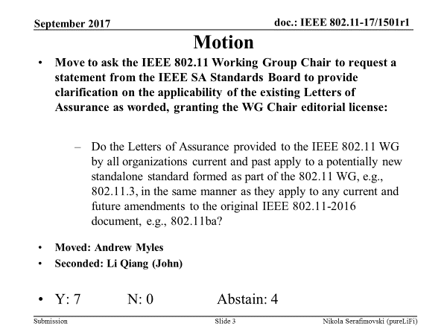
from slide 4/5 of 11-17-1511 by Nikola Serafimovski (pureLiFi)

Slide 80
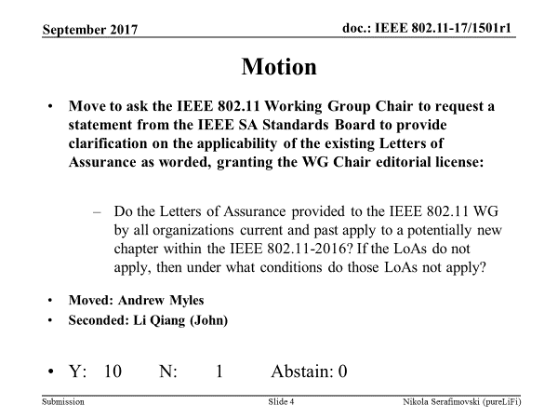
from slide 5/5 of 11-17-1511 by Nikola Serafimovski (pureLiFi)

Slide 81
RR-TAG (802.18) Liaison
Date: 2017-09-15
Authors:
from slide 1/4 of 11-17-1503 by Rich Kennedy, HP Enterprise

Slide 82
Overview
This document presents an IEEE 802.18 Radio Regulatory Technical Advisory Group (RR-TAG) liaison to the 802.11 WG.
from slide 2/4 of 11-17-1503 by Rich Kennedy, HP Enterprise

Slide 83
Discussion Items
Americas updates
  FCC 17-104 Mid-band Notice of Inquiry
  More legislation to limit Wi-Fi in schools
  FCC Technical Advisory Council inquiry into the removal of regulations
EMEA updates
  6 GHz Band opening study in “process”
  60 GHz proceeding(s)
APAC updates
  ACMA consultations
from slide 3/4 of 11-17-1503 by Rich Kennedy, HP Enterprise

Slide 84
Actions
Completed and approved response to the FCC Mid-band Spectrum NOI
  https://mentor.ieee.org/802.18/dcn/17/18-17-0114-06-0000-ieee-802-response-to-fcc-17-104.docx
  Vote: 15/0/0
from slide 4/4 of 11-17-1503 by Rich Kennedy, HP Enterprise

Slide 85
IEEE 802.11-IETF Liaison Report
Date: 2017-09-13
Authors:
from slide 1/15 of 11-17-1204 by Dorothy Stanley, HPE

Slide 86
Abstract
This presentation contains the IEEE 802.11 – IETF liaison report for September 2017.
from slide 2/15 of 11-17-1204 by Dorothy Stanley, HPE

Slide 87
IETF Meetings
Upcoming Meetings:
  November 12-17, 2017 – Singapore
  March 18-23, 2018 – London
  July 14-20, 2018 – Montreal
  November 3-9, 2018 - TBD
http://www.ietf.org
  Newcomer training: https://www.ietf.org/edu/process-oriented-tutorials.html#newcomers
  April 2016: Wireless Tutorial (Donald Eastlake), 802.11 & 802.15 tutorials (Dorothy Stanley, Charlie Perkins), see 11-16/500, July 2016: Pat Thaler & Juan Carlos – 802.1E (Privacy Considerations) and 802.c (Local MAC address usage) https://www.ietf.org/edu/tutorials.html
  http://tools.ietf.org/dailydose/
from slide 3/15 of 11-17-1204 by Dorothy Stanley, HPE

Slide 88
IETF- IEEE 802 Liaison Activity
Joint meetings, agenda and presentations
  http://www.iab.org/activities/joint-activities/iab-ieee-coordination/
  Recent July 2017 Agenda topics included: YANG Models, Low Latency, Time Sensitive Networking/DETNET, FlexE, Networking Slicing, 48-bit and 64-bit MAC addresses interworking, 5G
802.11 related items being discussion/tracked
  CAPWAP, one remaining draft: https://datatracker.ietf.org/doc/draft-ietf-opsawg-capwap-alt-tunnel/
  Intelligent Transportation Systems (ITS)- IETF IP Wireless Access in Vehicular Environments ipwave
Also note
  March 2017 IETF presentation on 5G Security, see https://www.youtube.com/watch?v=SMh_vggVgrg&index=43&list=PLC86T-6ZTP5jo6kIuqdyeYYhsKv9sUwG1
from slide 4/15 of 11-17-1204 by Dorothy Stanley, HPE

Slide 89
IoT related work – feedback requested
IETF last call ongoing for IPv6 over Networks of Resource-constrained Nodes (6LO) draft: “An update to 6LO ND”, see https://tools.ietf.org/html/draft-ietf-6lo-rfc6775-update-06
  6LoWPAN Neighbor Discovery for LoWPANs was initially used only for duplicate address detection.
  Now being extended as a Layer-3 association process that enables IPv6 ND proxy operations.
  Nothing prevents its use in higher power environments such as 802.11
Invitation/request for review and feedback from 802.11 members, send to any comments to 6lo@ietf.org
from slide 5/15 of 11-17-1204 by Dorothy Stanley, HPE

Slide 90
IETF BOFs IETF July 16-21, 2017
See https://datatracker.ietf.org/wg/bofs/ and new work summary
netslicing | Network Slicing
banana | BANdwidth Aggregation for interNet Access: bandwidth aggregation across multiple Internet access links in single-provider and multi-provider scenarios
Iasa2.0 | IETF Administrative Support Activity 2.0 (IASA 2.0) Virtual Workshops; The IASA 2.0 process seeks to address which administrative arrangements will best support the IETF going forward.
ideas | Identity Enabled Networks
from slide 6/15 of 11-17-1204 by Dorothy Stanley, HPE

Slide 91
YANG Model Catalog
YANG catalog development
  A YANG model catalog and registry that allows users to find models relevant to their use cases from the large and growing number of YANG modules being published.
  YANG Catalog was developed through a collaboration between the IETF and the Broadband Forum, and contains many data models, including from other Standards Development Organizations (SDOs) such as the IEEE, as well as some vendor-specific data models. Interest and participation from other SDOs, equipment vendors, open source projects and network operators is encouraged.
See https://www.ietf.org/blog/2017/04/yang-catalog-latest-development-ietf-98-hackathon/Insights
See https://yangcatalog.org/
from slide 7/15 of 11-17-1204 by Dorothy Stanley, HPE

Slide 92
Multicast Topics
Multicast issues were discussed at the IETF-IEEE 802 meeting Sept 29th 2015 and a presentation given at the November 2015 IETF meeting
  See https://mentor.ieee.org/802.11/dcn/15/11-15-1261-02-0arc-mulicast-performance-optimization-features-overview-for-ietf-nov-2015.ppt
  Further actions: ietf mailing list has been established for ongoing discussion, will include additional 802. wireless groups, see http://www.ieee802.org/11/email/stds-802-11/msg01838.html
  Multicast considerations Internet draft describing use cases, issues, etc. under development, see https://tools.ietf.org/html/draft-perkins-intarea-multicast-ieee802-02
See https://www.ietf.org/proceedings/98/slides/slides-98-intarea-80211-multicast-testbed-and-results-00.pdf ;
  TGmd teleconference held with the authors 2017-05-30
from slide 8/15 of 11-17-1204 by Dorothy Stanley, HPE

Slide 93
Of Interest to Smart Grid
6LO
  Working Group website: http://datatracker.ietf.org/wg/6lo/charter/
  Focus: IPv6 over Networks of Resource-constrained Nodes
  See WNG presentation: https://mentor.ieee.org/802.11/dcn/15/11-15-1085-00-0wng-6lowpan-over-802-11.pptx and
  http://datatracker.ietf.org/doc/draft-delcarpio-6lo-wlanah/
  https://tools.ietf.org/html/draft-thubert-6lo-routing-dispatch-06
  https://tools.ietf.org/html/draft-thubert-6lo-backbone-router-02
  Unique IPv6 Prefix Per Host, https://tools.ietf.org/html/draft-jjmb-v6ops-unique-ipv6-prefix-per-host-00
    The concepts in this document were originally developed as part of a large scale, production deployment of IPv6 support for a community Wi-Fi service.
ROLL: Working Group website: http://datatracker.ietf.org/wg/roll/
  Focus: Routing over Low Power and Lossy Networks
  Of interest: https://tools.ietf.org/html/draft-ietf-6lo-ethertype-request-01
CORE : (Constrained RESTful Environments) Working Group website: http://datatracker.ietf.org/wg/core/
  Focus: framework for resource-oriented applications intended to run on constrained IP networks.
from slide 9/15 of 11-17-1204 by Dorothy Stanley, HPE

Slide 94
CAPPORT WG
CAPtive PORTal: https://datatracker.ietf.org/wg/capport/charter/
The CAPPORT Working Group will define secure mechanisms and protocols to
  allow endpoints to discover that they are in this sort of limited environment,
  provide a URL to interact with the Captive Portal, - allow endpoints to learn about the parameters of their confinement,
  interact with the Captive Portal to obtain information such as status and remaining access time, and
  optionally, advertise a service whereby devices can enable or disable access to the Internet without human interaction. (RFC 7710 may be a full or partial solution to the first two bullets)
Updates [Sept 2017]
  Of interest: CAPPORT architecture: https://datatracker.ietf.org/doc/draft-larose-capport-architecture/
  Of interest: Captive Portal API: https://datatracker.ietf.org/doc/draft-donnelly-capport-detection/
from slide 10/15 of 11-17-1204 by Dorothy Stanley, HPE

Slide 95
RADEXT WG
See http://datatracker.ietf.org/wg/radext/
RADIUS Extensions
  The RADIUS Extensions Working Group will focus on extensions to the
  RADIUS protocol required to define extensions to the standard attribute space as well as to address cryptographic algorithm agility and use over new transports.
  In addition, RADEXT will work on RADIUS Design Guidelines and define new attributes for particular applications of authentication, authorization and
  accounting such as NAS management and local area network (LAN) usage.
Updates [Sept 2017]
  New: RADIUS End-to-end Attribute Security, see https://datatracker.ietf.org/doc/draft-aravind-radext-endtoend-attribute-security/
  Of interest: LoRaWAN Authentication in RADIUS, see https://datatracker.ietf.org/doc/draft-garcia-radext-radius-lorawan/
  Published: RFC 8146: Adding Support for Salted Password Databases to EAP-pwd, see https://tools.ietf.org/html/rfc8146
from slide 11/15 of 11-17-1204 by Dorothy Stanley, HPE

Slide 96
Operations Area Working Group
http://datatracker.ietf.org/wg/opsawg/
Responded to requests from OPSAWG chairs for IEEE 802.11 review
  “Alternate Tunnel Encapsulation for Data Frames in CAPWAP” http://www.ietf.org/id/draft-zhang-opsawg-capwap-cds-02.txt , see Slide 5 in11-14-0368-01
  “IEEE 802.11 MAC Profile for CAPWAP” https://datatracker.ietf.org/doc/draft-ietf-opsawg-capwap-hybridmac/ , see 11-14-0684-01
  CAPWAP Hybrid MAC published as RFC7494, http://datatracker.ietf.org/doc/rfc7494/
  “CAPWAP extension for 802.11n and Power/channel Autoconfiguration” http://datatracker.ietf.org/doc/draft-ietf-opsawg-capwap-extension/ , see 11-14-0913-01
Updates [Sept 2017] Operations Area Working Group work group items
  Updated: Alternate Tunnel Encapsulation for Data Frames in CAPWAP, see https://datatracker.ietf.org/doc/draft-ietf-opsawg-capwap-alt-tunnel/
  Updated: The TACACS+ Protocol, see https://datatracker.ietf.org/doc/draft-ietf-opsawg-tacacs/
  Of interest: Requirements and Architecture of Carrier IP Service Models https://datatracker.ietf.org/doc/draft-li-opsawg-carrier-ip-service-model-req-arch/
  Carrier Wi-Fi Calling Deployment Considerations: https://datatracker.ietf.org/doc/draft-pularikkal-opsawg-wifi-calling/
  Of interest: RFC6632, An Overview of the IETF Network Management Protocols, see https://tools.ietf.org/html/rfc6632
  Of Interest: RFC7548, Management of Networks with Constrained Devices: Use Cases, see https://datatracker.ietf.org/doc/rfc7548/
from slide 12/15 of 11-17-1204 by Dorothy Stanley, HPE

Slide 97
Transport Layer Security (TLS)
Transport Layer Security Working Group website: http://datatracker.ietf.org/wg/tls/charter/
Work underway on a new version of TLS (used in EAP methods): Transport Layer Security Protocol Version 1.3
Updates [Sept 2017]
  Of interest: Datagram Transport Layer Security (DTLS) Protocol Version 1.3,see https://datatracker.ietf.org/doc/draft-ietf-tls-dtls13/
  Updated and in WG Last Call: TLS version 1.3 https://datatracker.ietf.org/doc/draft-ietf-tls-tls13/
  Of interest: Example Handshake Traces for TLS 1.3, see https://datatracker.ietf.org/doc/draft-ietf-tls-tls13-vectors/
  Submitted for publication: Elliptic Curve Cryptography (ECC) Cipher Suites for Transport Layer Security (TLS) Versions 1.2 and Earlier, see http://datatracker.ietf.org/doc/draft-ietf-tls-rfc4492bis/
from slide 13/15 of 11-17-1204 by Dorothy Stanley, HPE

Slide 98
Deterministic Networking (DETNET)
DETNET: https://datatracker.ietf.org/wg/detnet/charter/
  The Deterministic Networking (DetNet) Working Group focuses on deterministic data paths that operate over Layer 2 bridged and Layer 3 routed segments, where such paths can provide bounds on latency, loss, and packet delay variation (jitter), and high reliability.
  Addresses Layer 3 aspects in support of applications requiring deterministic networking.
  The Working Group collaborates with IEEE802.1 Time Sensitive Networking (TSN), which is responsible for Layer 2 operations, to define a common architecture for both Layer 2 and Layer 3.
  Example applications for deterministic networks include professional and home audio/video, multimedia in transportation, engine control systems, and other general industrial and vehicular applications being considered by the IEEE 802.1 TSN Task Group.
Of interest:
  DetNet Data Plane Protocol and Solution Alternatives, see https://datatracker.ietf.org/doc/draft-ietf-detnet-dp-alt/
  Deterministic Networking Architecture, see https://datatracker.ietf.org/doc/draft-ietf-detnet-architecture/
  Deterministic Networking Use Cases, see https://datatracker.ietf.org/doc/draft-ietf-detnet-use-cases/ (note 5.1.1, reference to WiFi)
  Deterministic Networking Problem Statement, see https://datatracker.ietf.org/doc/draft-ietf-detnet-problem-statement/
  Integrated Mobile Fronthaul and Backhaul, see https://datatracker.ietf.org/doc/draft-huang-detnet-xhaul/
from slide 14/15 of 11-17-1204 by Dorothy Stanley, HPE

Slide 99
References
RFC 7241, “The IEEE 802/IETF Relationship” (RFC4441 update)
  https://datatracker.ietf.org/doc/rfc7241/
IEEE 802 Liaisons list is available
  http://ieee-sa.centraldesktop.com/802liaisondb/FrontPage
from slide 15/15 of 11-17-1204 by Dorothy Stanley, HPE

Slide 100
Wi-Fi Alliance Liaison Update
Date: 2017-09-13
Authors:
from slide 1/4 of 11-17-1486 by Ian Sherlock, Texas Instruments

Slide 101
The last WFA member meeting was held in the week of 5th Jun 2017 in Vancouver, Canada.
Recent Items of note
  14th Jun 2017 Wi-Fi Alliance® delivers Wi-Fi CERTIFIED™ home designs
    https://www.wi-fi.org/news-events/newsroom/wi-fi-alliance-delivers-wi-fi-certified-home-designs
  26th Jul 2017 Wi-Fi CERTIFIED Miracast™ delivers high-resolution multimedia experience
    https://www.wi-fi.org/news-events/newsroom/wi-fi-certified-miracast-delivers-high-resolution-multimedia-experience
  7th Sept 2017 New features in Wi-Fi CERTIFIED Vantage™ improve performance in managed networks
    https://www.wi-fi.org/news-events/newsroom/new-features-in-wi-fi-certified-vantage-improve-performance-in-managed-networks
Ongoing technical activity at WFA leading to certification, based on IEEE programs
  60GHz
  HaLow
  Timing Measurement (TimeSync )
  Pre Association Infrastructure Service Discovery
  Optimized Connectivity Experience
  Multiband Operations
  IoT Low Power
  DSRC
  ax
from slide 2/4 of 11-17-1486 by Ian Sherlock, Texas Instruments

Slide 102
Examples of other technical work ongoing in WFA
  Neighbor Awareness Networking – low power discovery, many-to-many data connectivity, and accurate ranging
  Display
  Security
  Device Provisioning Protocol
  Application Services
  Passpoint
  Home Experience
Examples of WFA Activity in other areas, potentially leading to technical work
  Automotive
  Healthcare
from slide 3/4 of 11-17-1486 by Ian Sherlock, Texas Instruments

Slide 103
For more information on current areas of work see
  http://www.wi-fi.org/who-we-are/current-work-areas
If those sound like interesting topics please plan to attend the next member meeting which is scheduled for the week of 23rd Oct 2017 in Bucharest, Romania.
Further general information at http://www.wi-fi.org/
from slide 4/4 of 11-17-1486 by Ian Sherlock, Texas Instruments

