Slide 1
Flow control for EDMG devices
Date: 2017-04-18
Authors:

Slide 2
Abstract
Flow control mechanism is presented. This mechanism is optimized for high utilization of responder buffer memory when MPDU’s are of different sizes. Presented solution allows flow control per TID as well flow control of aggregated load.

Slide 3
Agenda
Motivation and problem statement
Responder buffer memory models
Configurable parameters and new IE
Frame format changes BA (Control field)
RBUFCAP encoding
Responder and originator rules
Capabilities negotiation
Flow examples

Slide 4
Motivation and problem statement
Flow control is needed to align high link throughput with specific system limitations like low internal bus or/and CPU performance as well system power management mechanisms that may lead to delay in access to system internal bus and memory. The mentioned cases are about link throughput that is higher than system throughput.
Memory utilization becomes very important in all mentioned cases that arriving data should be accumulated in memory to uninterruptedly feed the applications.
MSDU/MTU are of different sizes that differs from about 64 byte to 8Kbyte. MSDU sizes variates inside flow and between flows.
BlockAck mechanism operates with buffer units of max MSDU size that does not reflect actual MSDU sizes variation. Memory control in granularity of buffer units does not allow efficient memory utilization.
Sharing common buffer pool among multiple flows/TID also improve memory utilization and should be supported by the Flow control mechanism.
Flow control mechanism should enable high link utilization and low overhead by stimulating transmission of big data bursts still keeping low delay.

Slide 5
Motivation and problem statement (cont.)
IEEE Std 802.11-2016 defines DMG block ack with flow control (10.24.11)
Existent solution is tightly coupled with per TID block ack agreement and operates with buffer units of max MSDU size.
The existent solution is not optimal for variable MSDU/MPDU sizes and for responder memory that is shared among multiple flows/TIDs.

Slide 6
Few observations about expected support of EDMG Flow control
Flow control is a service provided on top of Block Ack agreement
Flow control is the service provided by Originator to Recipient
The Originator advertises Flow control options it supports
The Recipient may confirm to use all or part of the options provided by the Originator
Even confirmed the Recipient may not consume the service the Originator is ready to provide

Slide 7
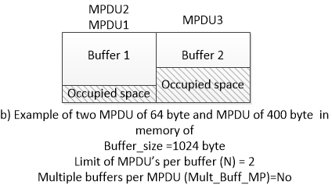
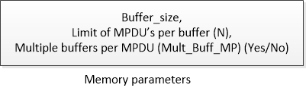
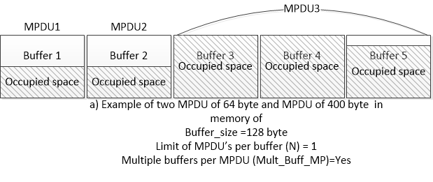
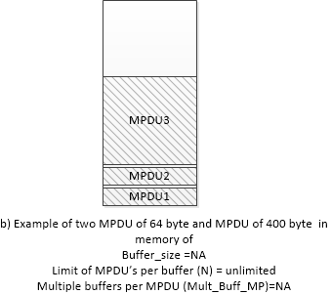
Responder buffer memory parametrization

Slide 8
Recipient memory configuration
 | Element ID | Length | Memory_config_tag | RBUF_ Unit_Size | Recipient Memory Multiple Buffer Units parameters |  |  | TID Grouping
 |  |  |  |  | Mem_ Unit_ Size | Max MPDU_ per_ MemUnit | Mult_ Buff_ MPDU
 |  |  |  |  |  |  |  | TID/TSID
 |  |  |  |  |  |  |  | 0 | 1 | 2 | 3 | 4 | 5 | 6 | 7 | 8 | 9 | 1 0 | 1 1 | 1 2 | 1 3 | 1 4 | 1 5
Octets 1 |  | 1 | 1 | 2 | 2 | 1 | 1 | 2
Figure 9-xyz3 Recipient memory configuration sub-element
The Memory_config_tag indicates one of two memory structures applicable for the TID/TSID indicated in ADDBA Response frame there the EDMG Flow control extension configuration element is presented. Allowed values are 0 and 1.
The RBUF_Unit_Size is used as a measure unit in RBUFCAP to deliver information of the Recipient free space available for Originator MPDU delivery. The recipient memory free space = RBUFCAP x RBUF_Unit_Size (byte)
The Mem_Unit_Size field (byte) indicates size of each buffer unit in the Responder memory. Minimal allowed value is 32.
The MaxMPDU_per_ MemUnit is a maximal number of MPDUs that can be collected in a single buffer. Valid values are 1-0xFE, value equal to 0xFF indicates unlimited number of MPDUs in the single buffer. This field is NA if the Mem_Unit_Size field = 0
The Mult_Buff_MPDU if set to 1 to indicate that single MPDU may be split between memory buffer units in Recipient memory, and is set to 0 otherwise. This field is NA if the Mem_Unit_Size field = 0
The TID grouping field indicates TID/TSIDs that correspond to a TID of a ADDBA Response frame a Recipient memory configuration subelement(s) is delivered with. The Recipient memory configuration becomes applicable to the corresponding TID/TSIDs.

Slide 9
Originator capabilities to support Recipient memory configuration
 |  | B0 | B1 | B2 | B3 | B4 | B5 B7
 |  | RBUFCAP quantity capable | Advanced Recipient Memory length capable | Recipient Memory Multiple Buffer Units capable | TID Grouping capable | Memory config tag capable | Reserved
Bits |  | 1 | 1 | 1 | 1 | 1 | 3
Figure 9-xyz2 Recipient memory capabilities field
The RBUFCAP quantity capable subfield is set to 1 to indicate support of RBUFCAP values in range 1-0xFE and set to 0 otherwise (Table 9-y1). The RBUF_Unit_Size field value is greater than 0 in the Recipient memory configuration sub element provided by the Recipient if it sets to 1 the RBUFCAP quantity capable subfield.
The Advanced Recipient Memory length capable subfield is set to 1 to indicate support of Advanced Recipient Memory length exponent and is set to 0 otherwise (Figure 9-xyz and Table 1 —A-MPDU Parameters field definition).
The Recipient Memory Multiple Buffer Units capable subfield is set to 1 to indicate support of Mem_Unit_Size, MaxMPDU_per_MemUnit, and Mult_Buff_MPDU values and is set to 0 otherwise
The TID Grouping capable subfield is set to 1 to indicate support of TID Grouping values and set to 0 otherwise
The Memory config tag capable subfield is set to 1 to indicate capability to support two Memory_Config_tag values and is set to 0 otherwise

Slide 10
RBUFCAP field encoding
Table 9-y1 RBUFCAP encoding for EDMG Compressed BlockAck variant
RBUFCAP Value | RBUFCAP Value name | Definition
0 | Unlimited_space | Space of the Recipient memory to receive A-MPDUs with length that is not less than indicated by Maximum A-MPDU Length Exponent (Table 1 —A-MPDU Parameters field definition)
0xFF | Zero_space | No place in the Recipient memory
1-0xFe | RBUFCAP (RBUF_Unit_Size) | Size of Recipient memory that Originator may use to transmit MPDUs to the Recipient is measured in RBUFCAP units of RBUF_Unit_Size

Slide 11
RBUFCAP field and BA control field encoding
 | B0 | B1 B4 | B5 B9 | B9 | B10 | B11 | B12 B15
 | BA Ack Policy | BA Type | Reserved | No_Mem Kept | Memory configuration tag | Management ACK | TID INFO
Bits: | 1 | 4 | 5 | 1 | 1 | 1 | 4
Figure 9-33 BA Control field
The No_Mem_kept field indicates that Free Memory space provided in last RBUFCAP delivery in frame exchange sequence is not kept at start of next sequence if the field is set to 1 and it is kept otherwise. Value of the No_Mem_kept is set to 0 at successive Block Ack agreement establishment.
The Memory_configuratiuon_tag field indicates one of two Recipient memory configurations as indicated in Memory config tag field in Recipient memory configuration sub-element (9.4.2.258)
Value of the Memory_configuratiuon_tag is set to 0 at successive Block Ack agreement establishment.

Slide 12
What is mandatory?
Existent rule – A DMG STA shall not transmit an A-MPDU that is longer than the value indicated by the Maximum A-MPDU Length Exponent field in the DMG Capabilities element received from the intended receiver
  In EDMG where BlockAck with RBUFCAP field is mandatory the rule is accompanied with RBUFCAP containing 0
New rules:
  The Originator shall not transmit QoS data to the Recipient if RBUFCAP indicates Zero_space (0xFF)
  The Originator shall not transmit QoS data at start of transmit sequence if No_Mem_kept subfield in the BA Control field is set to 1.
The rules are mandatory for the Originator, zero in both RBUFCAP field and No_Mem_kept subfield set by the Recipient disables the Flow control by default
Rules above are mandatory and are not part of any capability exchange
Only those rules are mandatory

Slide 13
Responder operation rules
In case of requesting flow control per TID the responder provides its capabilities by adding Flow control information element to ADDBA response,
At time of BA responding the responder provides indication amount of free memory in RBUFCAP field.
If the responder is able to keep free memory space and not to decrease it between frame exchange sequences it may set the Mem_kept filed to 1.
In case the Responder free memory space changes it can initiate TXOP and inform an Originator by sending unsolicited ADDBA Rsp with the dialog token set to 0.
The Responder may provide the unsolicited BA aggregated with Grant frame to switch the TXOP holder role to the Originator

Slide 14
Originator operation rules
At the time an Originator receives BA from the Responder it shall compute number of MPDU’s to be sent to the Responder in the next BA burst. This number is not greater than a minimum between number of MPDU’s allowed to send as per BlockAck rules including retries and number (K) of MPDU’s that is computed to not exceed amount of responder free buffer memory indicated in RBUFCAP of the BA.
An Originator while computing of the value K shall use the Responder memory parameters in Flow control IE and in the BA control field if latter is relevant.
At start of frame sequence exchange an Originator can utilize
  max (free_memory_space of last RBUFCAP, Advanced_Recipient_Memory_size) if mem_kept =1,
  otherwise it can utilize Advanced_Recipient_Memory_size if it is >0

Slide 15
References
1. IEEE Std 802.11-2016

Slide 16
SP
Do you support adding to the draft the text changes presented in document 11-17-1196-00-00ay EDMG Flow control extension text?

Slide 17
backup

Slide 18
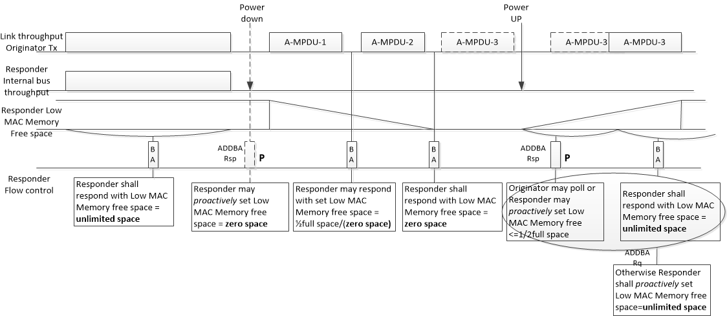
Exemplary flow of power management transition

Slide 19
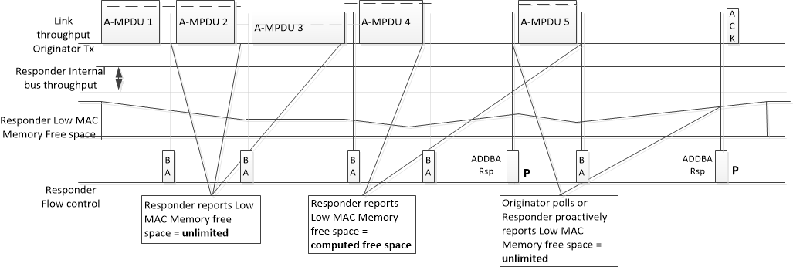
Exemplary flow of slow system

Slide 20
Power and throughput comparison depending on memory utilization
Power consumption is proportional to Rx/Tx time spent on link

