Slide 1
Target Wake Time for MU Measurement Scheduling
Date: 2017-07-12
Authors:
Chittabrata Ghosh, Intel

Slide 2
Abstract
July 2017
        doc.: IEEE 802.11-17/1128r0
In this presentation, we propose a power efficient scheduling mechanism for power save STAs that intend to perform 11az-based measurement
Chittabrata Ghosh, Intel

Slide 3
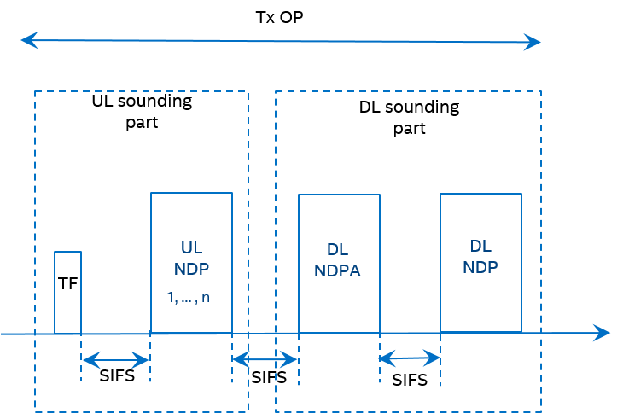
Introduction
July 2017
        doc.: IEEE 802.11-17/1128r0
    The 11az amendment has agreed on using NDP-based sounding mechanism for measurement in the measurement phase
      Within a single TXOP, the UL sounding is followed by the DL sounding
      In UL sounding, UL NDPs are solicited from STAs assigned resources identified in the Trigger frame
    However, for efficient resource allocation, the AP needs to identify the STAs that intend to perform measurements
    We have agreed to have a polling phase prior to the MU measurement phase
Chittabrata Ghosh, Intel

Slide 4
Illustration of a Single Polling Phase with Multiple NDP-based Measurement Phases
July 2017
        doc.: IEEE 802.11-17/1128r0
TXoP
Measurement Polling (e.g., BSRP)
UL Sounding and DL Sounding for first set of STAs
UL Sounding and DL Sounding for second set of STAs
MU LMR Feedback Sequence (TBD)
SIFS
SIFS
TBD
(Assume 10% polling success)
[14 STAs respond for
measurement request]
(8 STAs have resource allocation for measurement )
(6 STAs have resource allocation for measurement )
(14 STAs respond with LMR feedback)
(First wake-time for 14 STAs)
(Doze time for 8 STAs)
(Doze time for 6 other STAs)
(Wake-time for 6 other STAs)
(On-channel availability for 14 STAs)
For each measurement polling, a STA receives one allocation in a single Trigger frame of the MU measurement phase within a TXOP
Chittabrata Ghosh, Intel

Slide 5
Individual TWT-enabled Periodic Measurement Phase
July 2017
        doc.: IEEE 802.11-17/1128r0
TWT Negotiation
TWT SP
TWT SP
Measurement Polling
Measurement Phase(s)
Measurement Polling
Measurement Phase(s)
ACK
ACK
TWT Request
TWT Response
TWT Interval
SIFS
TWT Interval
Each STA negotiates TWT for ranging with the AP
  STAs need not wake up to receive Beacon frames
Number of measurement phases within a TWT SP is dependent on number of STAs responded to polling
Polling is always the first phase within a TWT SP
Chittabrata Ghosh, Intel

Slide 6
Broadcast TWT-enabled Dynamic Measurement Phases
July 2017
        doc.: IEEE 802.11-17/1128r0
TWT 2 indicated in TWT 2 within Beacon
TWT Negotiation
TWT SP 1
TWT SP 2
Measurement Polling
Measurement Phase(s)
LMR Feedback
ACK
ACK
TWT Request
TWT Response
Beacon
TWT 1indicated in TWT 1 within Beacon
Each STA participating in Broadcast TWT wakes up in pre-defined Beacon intervals to decode the TWT Element within the Beacon frame
  Each TWT Element contains the TWT of SP scheduled either for MU ranging or for measurement feedback report
Number of measurement phases within a TWT SP is dependent on number of STAs responded to polling
Polling is always the first phase within a TWT SP
Chittabrata Ghosh, Intel

Slide 7
TWT Element Format and Control Field defined in 11ah, Reused in 11ax
July 2017
        doc.: IEEE 802.11-17/1128r0
Chittabrata Ghosh, Intel

Slide 8
MU NDP Ranging Parameters
July 2017
        doc.: IEEE 802.11-17/1128r0
We agreed that the MU NDP Ranging measurement opportunities scheduling will be signaled by the following parameters:
  Start time – the TSF value at the beginning of the first Service Period.
  Ranging interval – the time interval between two consecutive Service Periods.
  Measurement duration – the time duration of the Service Period.
If using TWT element for signaling the above parameters for MU NDP ranging measurements:
  Start time: This value is indicated by the Target Wake Time field that indicates the TSF time for the STA to initiate MU ranging negotiation
  Ranging interval: The difference between 2 start times provides the ranging interval
  Measurement duration: This value is indicated by the TWT Wake Interval Mantissa field and TWT Wake Interval Exponent subfield in Request Type field
    Interval = TWT Wake Interval Mantissa x 2^(TWT Wake Interval Exponent)
Chittabrata Ghosh, Intel

Slide 9
Proposed TWT Element Format and Control Field for MU Ranging
July 2017
        doc.: IEEE 802.11-17/1128r0
Ranging
Reserved
Bits 1 3
  Ranging (B5) – This subfield indicates that the signaling using the following fields in the TWT element are used for 11az-based ranging
Chittabrata Ghosh, Intel

Slide 10
Summary
July 2017
        doc.: IEEE 802.11-17/1128r0
In this presentation, we have introduced the TWT element as defined in 802.11ax
We have proposed use of the TWT element for MU NDP measurement and in definition of the ranging start time, interval, and measurement duration
Finally, we have proposed a differentiation of the TWT element to be used for MU NDP ranging over that in 802.11ax by using the following signaling:
  Ranging subfield in Control field
Chittabrata Ghosh, Intel

Slide 11
Straw Poll
July 2017
        doc.: IEEE 802.11-17/1128r0
Do you agree that the periodic MU measurements shall be based on Individual Target Wake Time (TWT)
Y: N: A:
Chittabrata Ghosh, Intel

