Slide 1
Orchestrator pilot signal
Authors:
Date: 2017-09-13

Slide 2
Abstract
Proposal of a new Orchestrator pilot signal mechanism that improves the efficiency of spectrum sharing among 802.11 devices in unlicensed band.

Slide 3
Problem statement
Current sharing mechanism on un-licensed band not efficient
Energy detection
Different RAT use different approaches of energy detection to assess if the media is available
Consumes in-band capacity (i.e.: waiting time to detect & response time to react)
Common Data Base for (secondary) spectrum usage
11af provides access to data base (i.e.: grant access to a given band)
11af does not coordinate spectrum usage (per transmission) among secondary users
We will see a multiplicity of upcoming unlicensed shared spectrum (large amount of potential frequencies to operate on)

Slide 4
What we want
Reduce the consumption of in-band spectrum resources for arbitration.
Reduce the waiting and reaction times.
Reduce the time to find
potential communication partners on different channels
channels available to operate in
Escape the 5G prisoner’s dilemma
Provide a WiFi-specific, optional mechanism for improved and controlled channel usage
While not competing with 3GPP approaches
Autonomous operation is the still the key of IEEE 802.11

Slide 5
Potential solutions
Use existing mechanisms on “dedicated coordination channels” to optimize WiFi behavior
  Enhanced neighbor reports
  Optimized, dynamic adjustments of contention window or energy detection
Common pilot signal for arbitration
This proposal focuses on this aspect as one potential solution

Slide 6
Propose to create new arbitration mechanism
  Create new arbitration mechanism by using common pilot signal
    in dedicated spectrum or
    In a dedicated channel
  Dedicated frequency shall be allocated to every single system that is an entity of sharing spectrum.
  The pilot signal is transmitted by every single system by using common PHY modulation.
  The pilot signal contains the information improving the arbitration to avoid conflicts of the in-band signal such as,
    Geographical location of station
    Transmit power
    Required D/U
    Time interval of transmitting
    Etc,.
  Every single system controls their transmission timing and power by using information received by the pilot signal
  Try to be as much as possible technology-agnostic

Slide 7
Two potential approaches for Orchestration
Pilot Signal
Use in-band spectrum
Very narrow band signal
Transmitted in channel gaps
Avoiding interference with active channels
Use of dedicated channels
In-band channel
Out-of-band (new) channel
Pilot channel

Slide 8
In-band channel arbitration mechanism
Allocate pilot signal at the edge of existing channel
Allocate one or more pilot signal to each system.
Same system share the pilot signals
Using multiple pilot signal to send more information.
Specify a new RAT for pilot signal that can be transmit and receive the information by all of system.
Pilot1
Pilot2
Pilot1
Pilot2
Pilot3
Pilot3
Pilot1-1
Pilot2-1
Pilot301
Pilot1-2
Pilot2-2
Pilot3-2

Slide 9
Interference by narrow signal on the null point
Narrow signal can be share the null point of OFDM.
Interference impact is 20dB lower than wide band signal at the center null point of channel
Interference impact is 30dB lower than wide band signal at the channel edge.
Plot Desire/Un-desire power ratio @10% outage of through put.
iPerf
802.11AP
802.11STA
Desire : OFDM 6Mbps, f=2442MHz
Compare proposed Emulator and RF circuit
Interference
Un-desire: OFDM or CW, f=variable
20dB at the center null point
30dB at the channel edge

Slide 10
Out of band channel arbitration mechanism
Allocate a dedicated pilot channel
Allocate sub channel to each system
Same system share the sub channel
Specify a new RAT for pilot signal that can be transmit and receive the information by all of system
Pilot channel
SubCh1
]
SubCh2
SubCh1
SubCh2
SubCh2
SubCh1
SubCh3
SubCh3
SubCh3

Slide 11
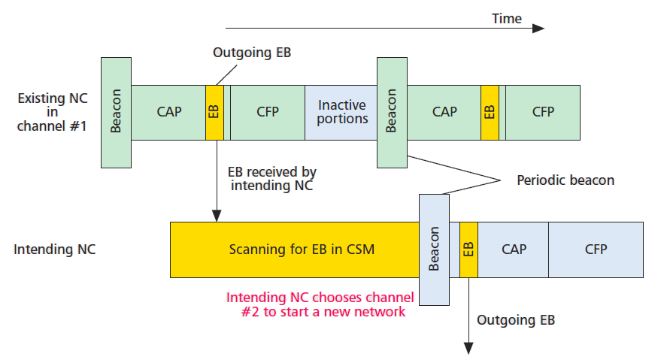
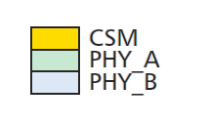
Previous Discussion in IEEE802.15
IEEE802.15.4g Multi-PHY Management (MPM)
The intending NC receives Enhanced Beacon (EB) from the existing NC using Common Signaling Mode (CSM).
The intending NC chooses operating channel based on EB information.

Slide 12
Discussion topics
What is the mean of “System” ?
  A Wireless system which use unlicensed spectrum shared with 802.11.
What system are targeted to arbitrated by this proposal?
  802.11 and 802.11
  802.11 and radar (reduce the undesired miss detection of DFS)
  802.11 and 802.xx

Slide 13
Q & A

Slide 14
Straw Poll(1)
Would you like to receive more information on use of Common Signaling Mode of IEEE802.15.4 EB mechanism in future WNG.
  Result:
  Yes:11
  No:4
  Abstain:28

Slide 15
Straw Poll

Slide 16
Straw Poll (2)
Which do you prefer to take further discussion of this topic occur in?
Within a (new) TIG
Within a (new) Study Group with the goal of creating a PAR
Continue within WNG
a: 5
b: 1
c: 32

